Slide 1
Running Neural Networks on the NIC
Siracusano, G., Galea, S., Sanvito, D., Malekzadeh, M., Haddadi, H., Antichi, G., & Bifulco, R. (2020). Running Neural Networks on the NIC. arXiv preprint arXiv:2009.02353.
FACULTY OF
COMPUTER SCIENCE

Slide 2
Presentation Outline
Introduction
Contribution
Motivation
Neural Networks on the NIC
Implementation
Use Cases
Evaluation
Discussion and Conclusion

Slide 3
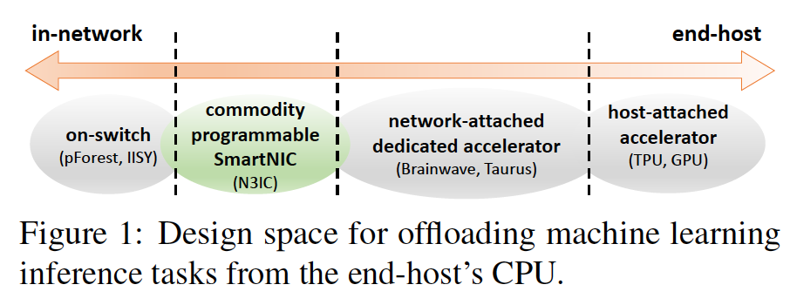
Introduction
NICs with integrated programmable components
Previous works:
Load balancing
Consensus Protocols
Key-Value stores
Challenges of Machine Learning applications in the NIC:
They need more resources
They need complex operations
PCIe data transfer overheads
N3IC relies on Quantization
3 network-based applications:
Traffic Classification
Anomaly Detection
Network tomography

Slide 4
Contribution
N3IC: an approach to accelerate NN inference
Implementing N3IC in three ways
A compiler that generates P4 code from a Neural Network
Checking three use cases

Slide 5
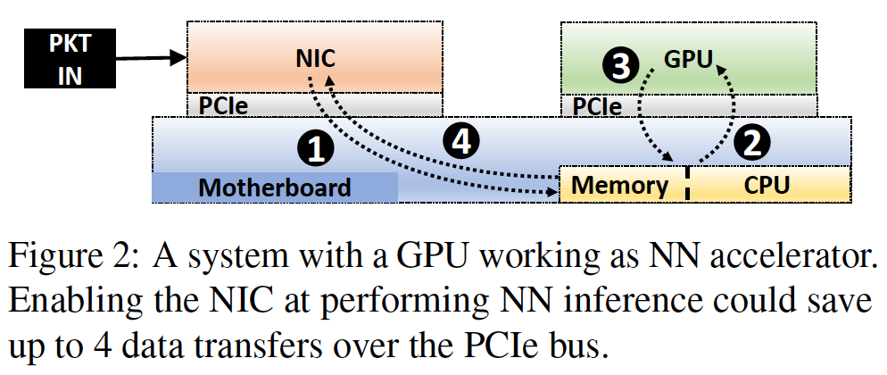
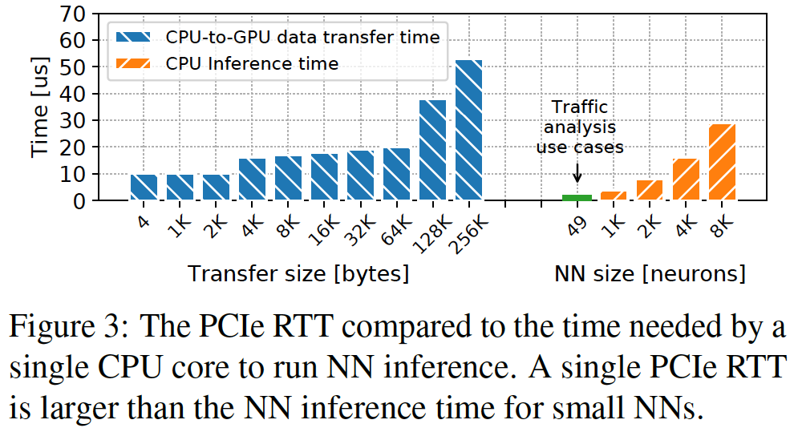
Motivation
I/O operations are expensive
Observation 1: Running NN inference on a NIC could completely avoid crossing the PCIe bus and help in the execution of time sensitive workloads.

Slide 6
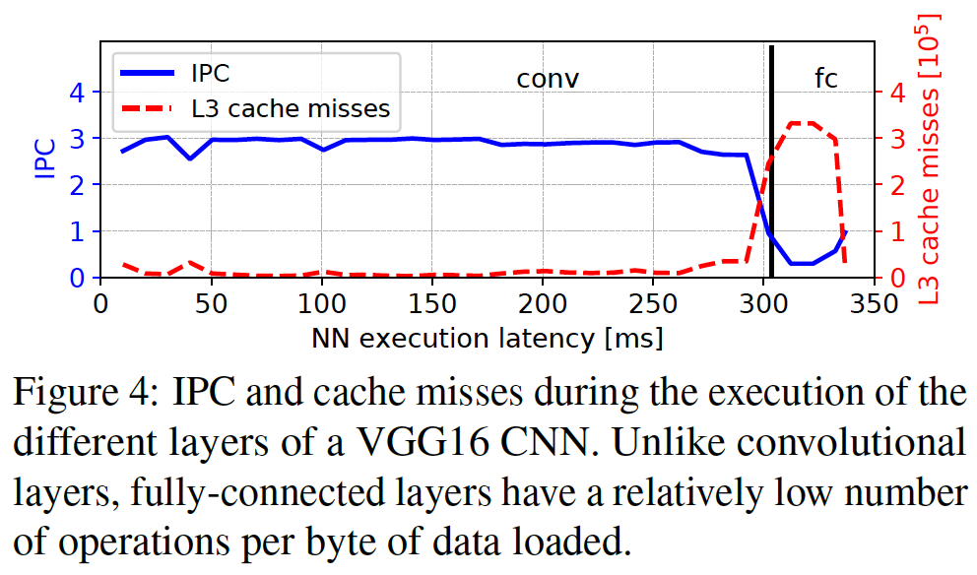
Motivation
NN processing is memory bounded
Observation 2: FC layers have relatively low arithmetic intensity. This makes hardware architectures optimized for fast memory accesses a good fit for their execution.

Slide 7
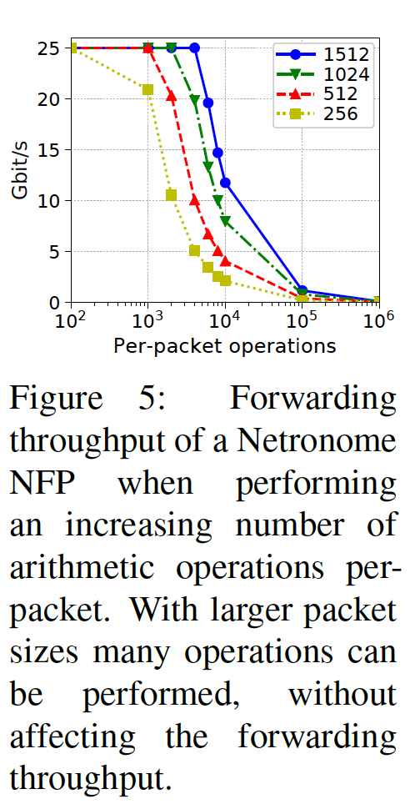
Motivation
NICs processing load depends on traffic patterns
Observation 3: The relatively small arithmetic intensity of MLPs aligns well with the potentially available processing power of a NIC.

Slide 8
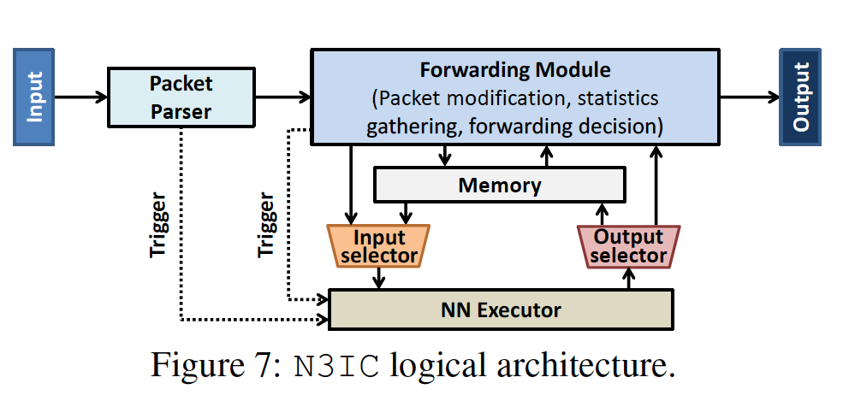
Neural Networks on the NIC
The need for small NN models
Quantization
The need for a low complexity algebra
Bitwise logic, shifts, and simple integer arithmetic operations
The need for hardware compatibility
The Solution: Binarization
Original NN → NN with 0 or 1 weights

Slide 9
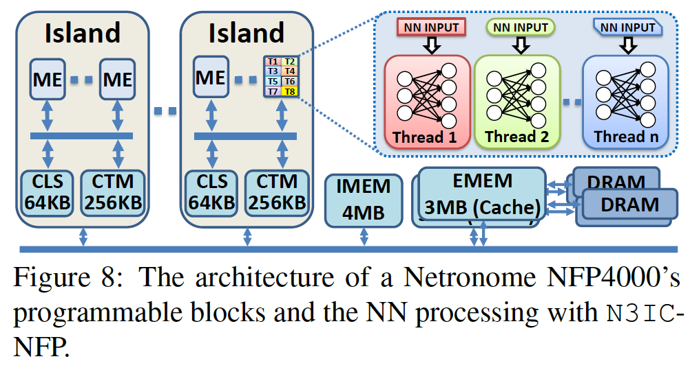
Implementation
SoC NIC: Netronome NFP4000:
Tens of Micro Engines (ME)
MEs are programmed using microC
CLS is used for N3IC (~100ns access time)
From NNs to P4:
NNtoP4
Porting P4 to NetFPGA
Translating P4 to HDL (Verilog)

Slide 10
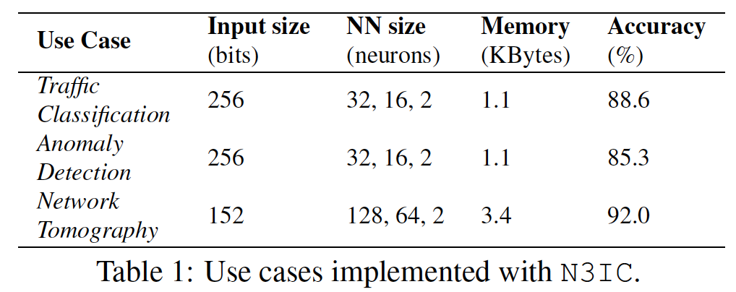
Use Cases
Traffic Classification: Dataset: UPC-AAU, 750K flows, P2P or not
Anomaly Detection: Dataset: UNSW-NB15, 170K flows, good or bad
Network Tomography: CLOS-like Fat Tree datacenter network in NS3

Slide 11
Evaluation
Testbed:
Host: Intel Haswell E5-1630 v3, 3.7GHz
NIC1: Netronome Agilio CX SmartNIC, with an NFP4000 processor, 800MHz
NIC2: NetFPGA-SUME, 200MHz
Under test NIC is connected to DPDK packet generator with 40Gbps cables

Slide 12
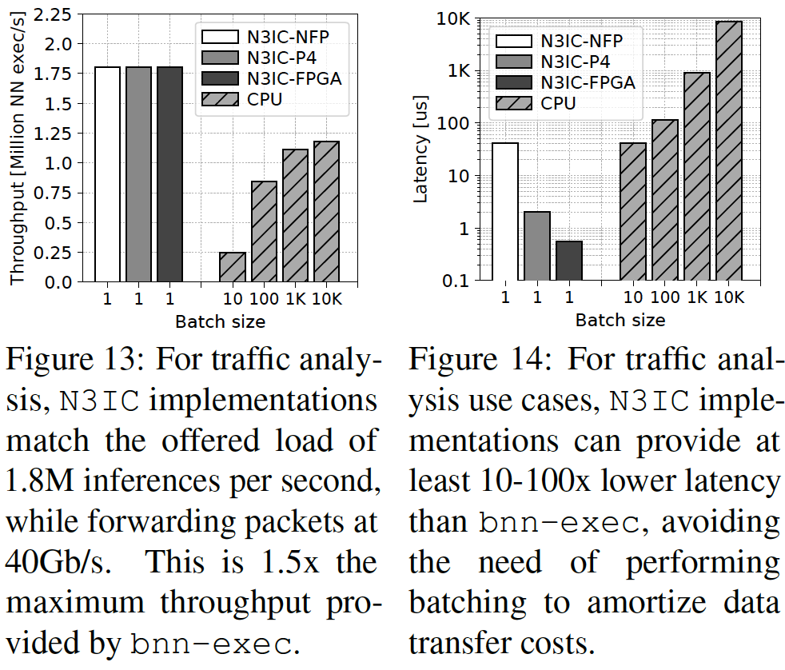
Evaluation
Traffic Analysis
Result 1: when performing traffic analysis, N3IC saves at least an entire CPU core, while providing a 1.5x higher throughput and 10-100x lower processing latency than a system running on the host’s CPU.

Slide 13
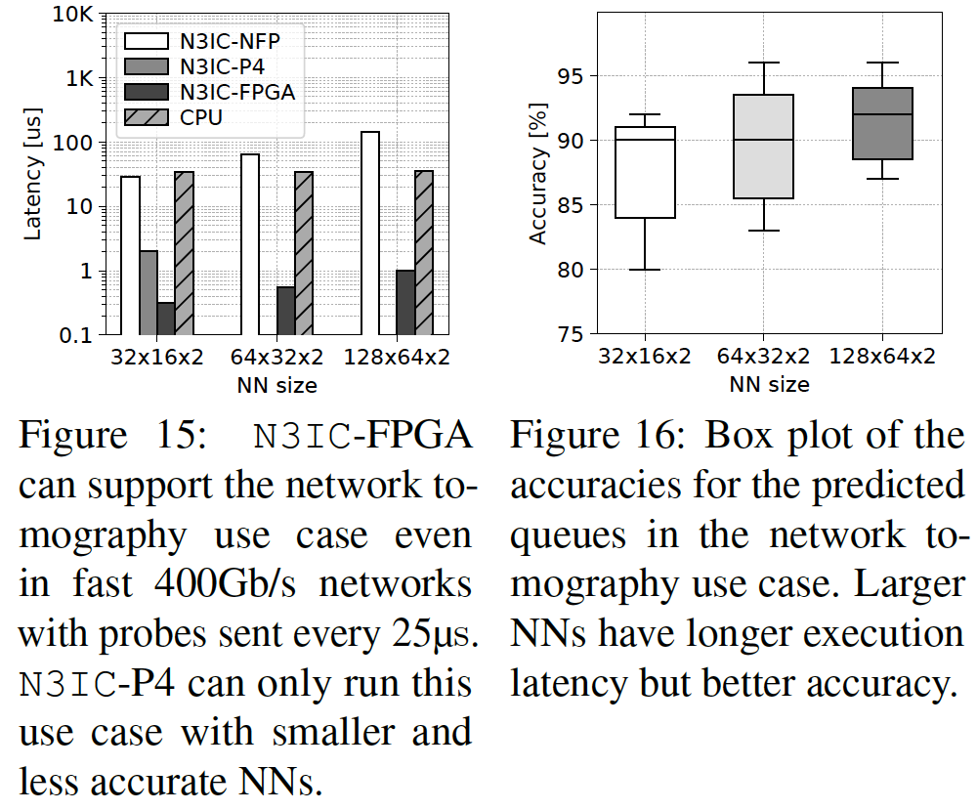
Evaluation
Network Tomography
Result 2: compared to a host-based system, for low throughput but latency-sensitive use cases N3IC-FPGA can reduce processing latency by 20x. This enables applications like SIMON to run in real time in networks running at 400Gb/s and beyond.

Slide 14
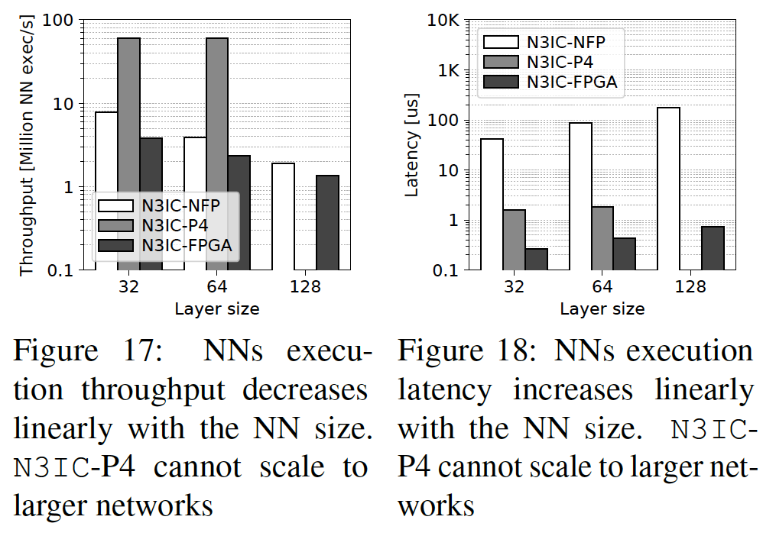
Evaluation
Neural Network Size
Result 3: N3IC-NFP’s and N3IC-FPGA’s processing throughput decreases linearly, while latency increases linearly, with the NN size. N3ICP4 does not scale to larger NNs.

Slide 15
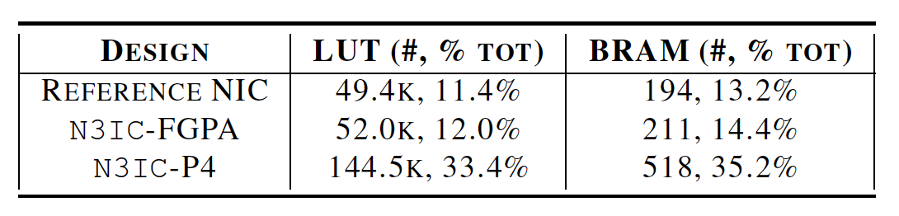
Evaluation
NIC Resource usage
Result 4: N3IC-FPGA consumes a very small fraction of the NetFPGA resources, and both N3IC-FPGA and N3IC-NFP can be configured to trade-off used NICs’ resources with provided performance.

Slide 16
Discussion
N3IC Costs:
Converting NN models with Binarization
Application should be split
N3IC-FPGA is more efficient.
Large NN cannot be implemented with N3IC

Slide 17
Conclusion
N3IC Features:
N3IC provides 1.5x higher throughput
100x lower latency
Uses only 2% of resources
N3IC-FPGA is more efficient.

Slide 18

Any Question?

