Slide 1
Running Neural Networks on on-path SoC SmartNICs
Project of SDN course Presented by Hesam Tajbakhsh
FACULTY OF
COMPUTER SCIENCE

Slide 2
Presentation Outline
Background
Motivation
Methodology
Testbed setup
Code
A few results

Slide 3
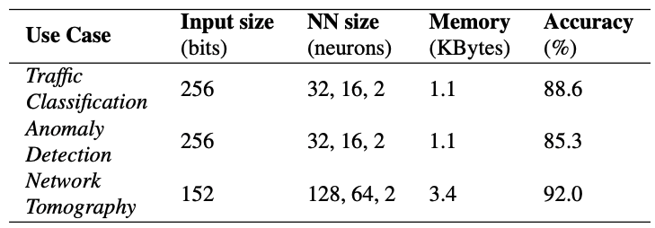
Background
N3IC paper:
Offloading binarized-NNs
Why?
Reducing model size
Simpler operations
Advantages:
Reduces latency
Increases throughput
PCIe data transfer overheads
Table source: Siracusano G, Galea S, Sanvito D, Malekzadeh M, Haddadi H, Antichi G, Bifulco R. Running Neural Networks on the NIC. arXiv preprint arXiv:2009.02353. 2020 Sep 4.

Slide 4
Background (II)
Using different kinds of SmartNIC
On-path SoC
On-path FPGA
Off-path SoC Mellanox BlueField

Slide 5
Motivation
Running different NN networks on an SoC SmartNIC (More specifically on-path)
Which ML/DL applications?
Our goal:
Not to drop the accuracy:
The same model
TensorFlow lite
Reduce the latency, due to faster PCIe access in ARMs

Slide 6
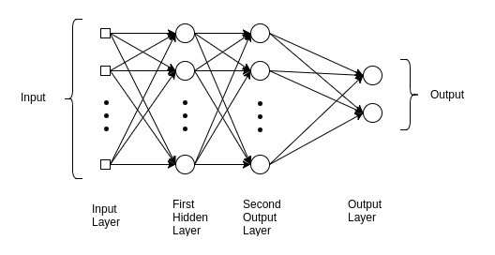
Methodology
Performance Evaluation of CPU
Neural Networks
VGG 16 (Image Classification)
Tensorflow lite on the SmartNIC
MLP (Anomaly Detection)
Performance metrics:
Latency
Accuracy
Image source:
Ferguson M, Ak R, Lee YT, Law KH. Automatic localization of casting defects with convolutional neural networks. In2017 IEEE international conference on big data (big data) 2017 Dec 11 (pp. 1726-1735). IEEE.
Image source: https://medium.com/@AI_with_Kain/understanding-of-multilayer-perceptron-mlp-8f179c4a135f

Slide 7
Testbed Setup

Slide 8
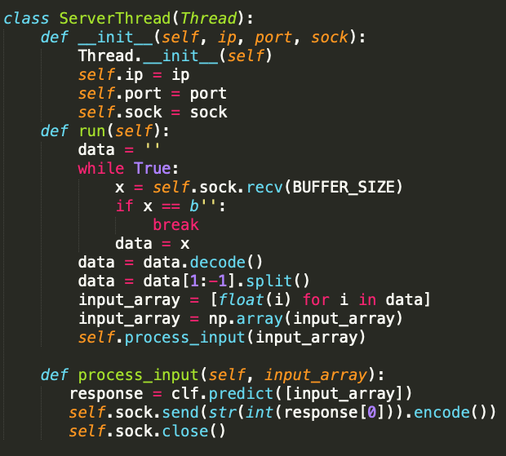
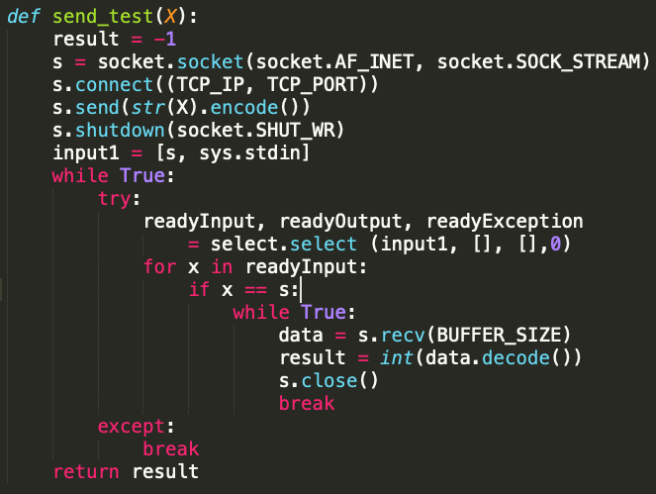
Code
Server Code
Client Code

Slide 9
VGG results
Framework: TensorFlow or TensorFlow lite (Accuracy is 91% for both cases)
It needs complex operations
Client sends an image and the server responds to the clients
ARM is a wimpy processor
(Units: ms) | Total | computation | Loading the image | Communication Time
ARM | 493.58 | 470.99 | 16.88 | 5.71
x86 | 107.05 | 97.98 | 5.21 | 3.86

Slide 10
Roofline Results
It shows the performance in different level of memory
 | x86 (10 cores) | SmartNIC (16 cores)
Max (computing power) | 91 GFLOPs/sec | 17.6 GFLOPs/sec
Max L1 speed | 1009.4 GB/s | 231.1 GB/s
Max L2 speed | 49.9 GB/s | 19.9 GB/s
Max L3 speed | 35.2 GB /s | 14.1 GB/s
Max DRAM speed | 26.8 GB/s | 10.6 GB/s

Slide 11
Anomaly Detection
Framework: scikit-learn
Dataset: UNSW-NB15
An MLP classifier is applied
The second use case in N3IP paper
Using the same model, accuracy: 96.02% (it was 85.3% in the paper)
(Units: ms) | Total(average/std) | Communication(average/std)
ARM | 3.89/2.99 | 1.14/0.18
x86 | 4.01/1.01 | 1.65/0.19

Slide 12
Conclusion
Using SoC SmartNICs can reduce the latency (Not too much)
SoC SmartNICs are not strong enough for resource hungry (e.g. VGG) applications.
ARM architecture is faster in communication. They are good for IO-intensive applications.
At least, we have offloaded an application to a SmartNIC without accuracy penalty; in other words, some resources have been released in the host.

Slide 13

Thanks for your attention

