Slide 2
Deconvolution of dna mixture in literature
Forensic
  Minor and major contributor to the sample are known
  Minor contributor is at higher level than the noise threshold
  Mostly concerned with qualitative result
  Concern: avoid false positive
Tumor purity
Complex method with many assumption
  Main source of information: structural variance
Donor-DerivedCell-Free DNA in organ transplantation
  New
  High coverage sequencing
  No mtDNA-based method
  No predictive value: Many reports: donor contributor is at or below the noise threshold (1%)

Slide 3
Deconvolution of donor-derived mtDNA in DNA mixture
Sources of noise
  Sequence reads
  Allele heteroplasmy (Individual level)
  NUMPs

Slide 4
Method 1: donor-derived variant as somatic variant
FastQ of recipient
FastQ of mixture
  Somatic pipeline
    SNV, INS, DEL
    VAF
Variant posterization:
Alleles with high population level frequency (20% - 80%)
Alleles with low heteroplasmy level (population level-gnomAD)

Slide 5
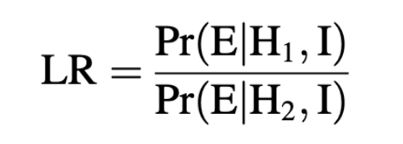
Bayesian method
Lets say we observe 10% VAF in an allele with population frequency of 1%
Bayesian method: start with prior estimate and update your estimate following each observation
likelihood ratio:
Pr(E = H, I) is the probability of the evidence (E) given each of two competing hypotheses:
H1: the sample contains the DNA of the donor) and
H2 : the sample contains the DNA of a random person), given the available information I (e.g., vaf>10% in allele with low expected vaf).
updated estimate = LR x prior estimate

Slide 6
Factors involved in calculation of each probability
Population level vaf
Sequencing accuracy (sensitivity and specificity)
Observed vaf
Coverage
If we observe 1% VAF in allele with 0.001% expected VAF that is more likely due to a sequencing error
If we observe 20% VAF in allele with 0.001% expected VAF that is un-likely due to a sequencing error

Slide 7
Deconvolution of donor-derive mtDNA:
Filter and prioritize (weight) variants based on the probabilty
Distribution of weighted variant’s VAFs across mt genome (remove 100% and 0%)
Best case scenario: two peaks: 95% and 5%

Slide 8
How to improve accuracy
performance of a test is related to :
number of SNPs x average coverage of each SNP

Slide 9
2:Phasing
Identify alleles that occur together on the same chromosome
Application: diploids
In the context mtDNA, donor and recipient can be considered as a parent and their combined DNA as the genotype.
Many available tools
methods are designed for (single-source) diploid data, and not suitable for mtDNA mixture deconvolution.
unlike diploid DNA, in haploid mixtures genetic material of each contributor can be present in varying proportions

Slide 10
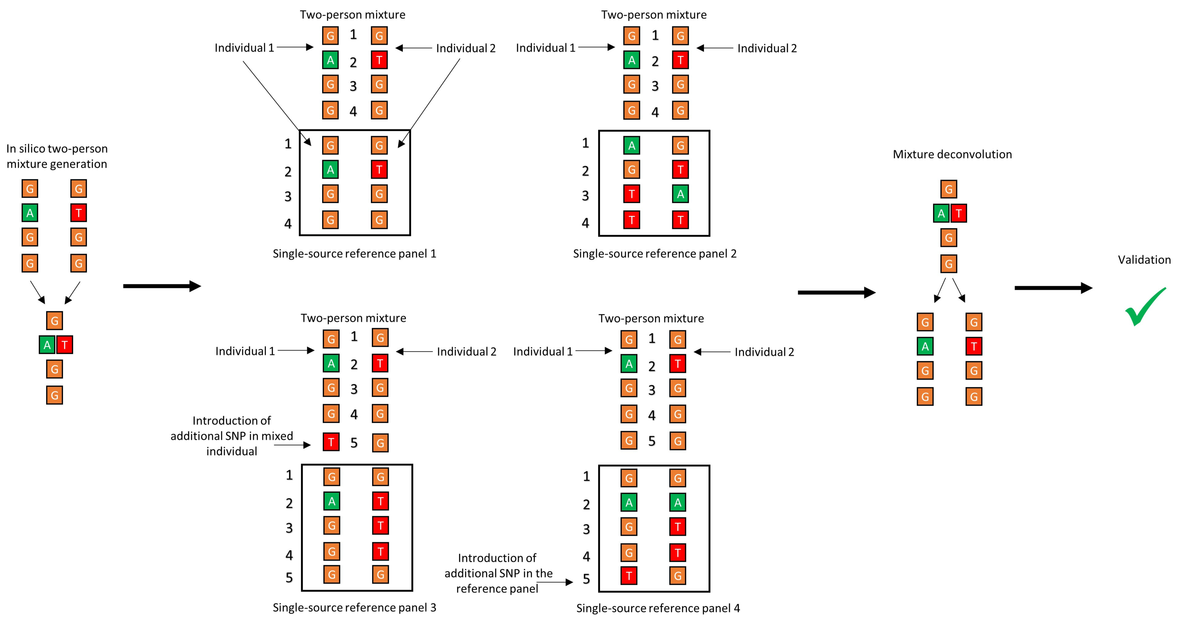
SIMULATION (MIXTURE OF REAL GENOMES)

Slide 11
3:Haplogroup
Start from well-annotated phylogeny of human mt Genomes
approximate the haplogroups of donors in a mixture.
searches each bam file for variants described in the public database
calculates the probability of the read originating from each haplogroup
Statistics: maximum likelihood function
Result: allocate the most likely haplogroup(s).
Weakness:
  if samples belong to considerably similar haplogroups
  comprise short DNA fragments.

