Slide 1
Bootstrapping a
Perl Development Environment
https://github.com/hesco/perl_toolchain
by: Hugh Esco
YAPC::NA::2014
Orlando Florida
Wednesday, June 25th, 2014

Slide 2
Configuration Management
* manage and document a node's configuration
* common options
** puppet
** chef
** ansible

Slide 3
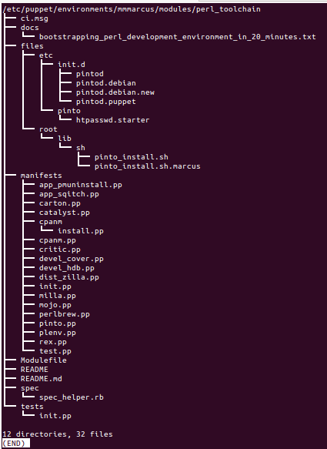
perl_toolchain puppet manifest

Slide 4
other development tools I use perhaps they belong here, not sure.
compass_sass
drush
fpm
libcloud
vagrant

Slide 5
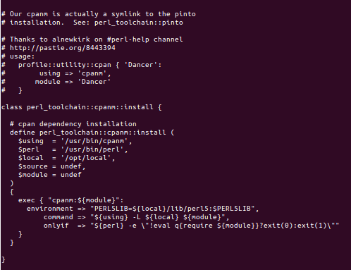
Thanks to alnewkirk

Slide 6
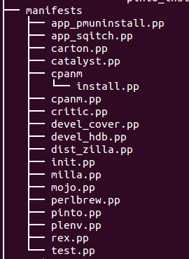
My Perl Development Environment

Slide 7
Puppet Development Workflow
I develop my puppet manifests here:
  /home/hesco/sandbox/marcus/puppet
a shell script provides static lint, syntax checks and pushes the clean results here:
/etc/puppet/modules/marcus/
Although this tree structure is now deprecated and the latest version of puppet suggests:
/etc/puppet/environments/marcus/modules/

Slide 8
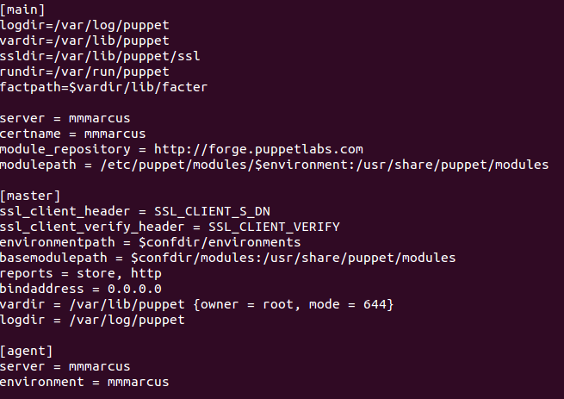
Poor Man's External Node Classifier

Slide 9
Puppet configuration
/etc/puppet/manifests/site.pp --
  import 'nodes.pp'
/etc/puppet/manifests/nodes.pp --
  node 'marcus10.yourmessagedelivered.com' { include marcus_init }
/etc/puppet/modules/marcus/marcus_init/manifests/init.pp

Slide 10
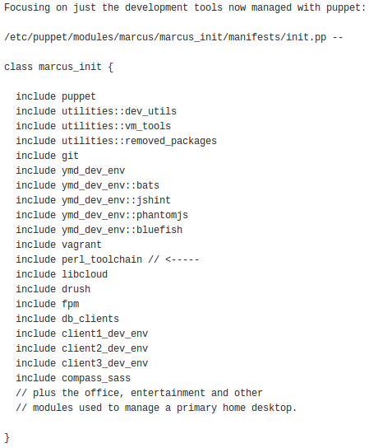
Poor Mans ENC Class List

Slide 11
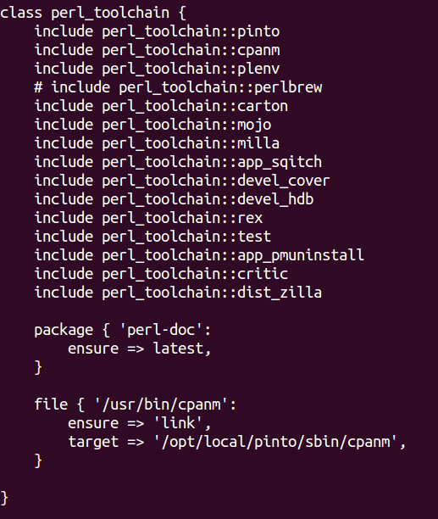
perl_toolchain/manifests/init.pp

Slide 12
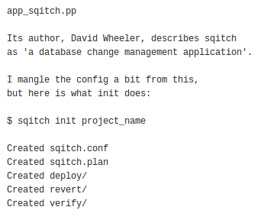
Sqitch – database change management application

Slide 13
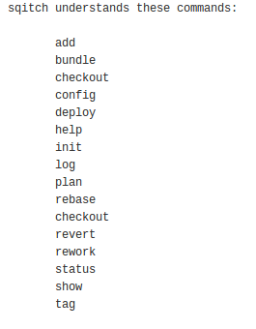
Sqitch command vocabulary

Slide 14
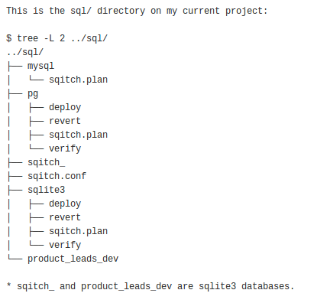
The sqitch directory

Slide 15
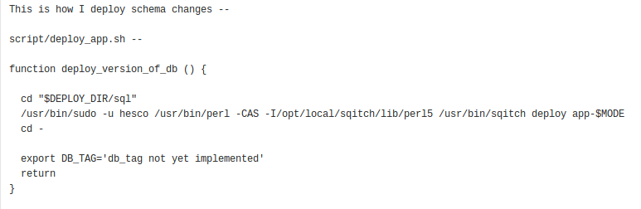
sqitch deploy

Slide 16
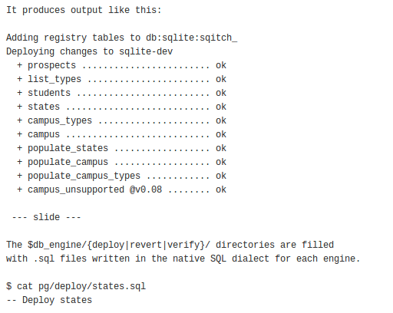
sqitch deploy output

Slide 17
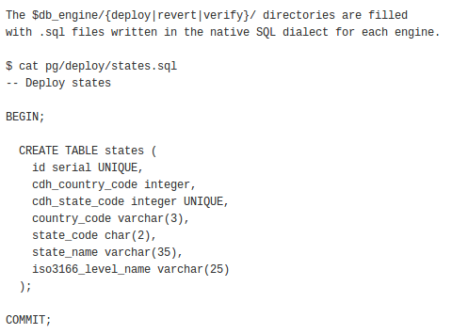
sqitch uses native SQL

Slide 18
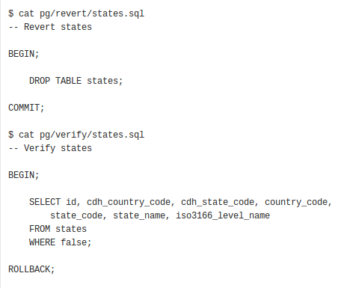
sqitch reverts and verifies too

Slide 19
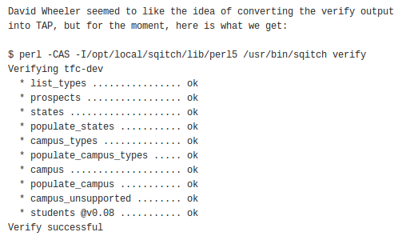
sqitch verify output

Slide 20
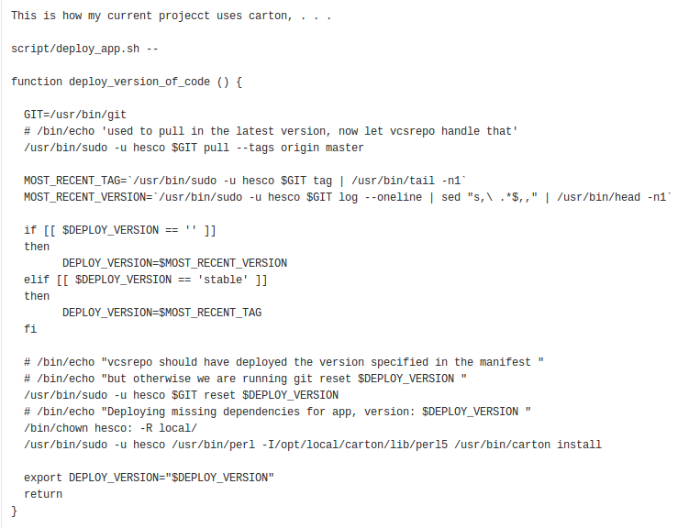
Tatsuhiko Miyagawa's carton manages perl dependencies

Slide 21
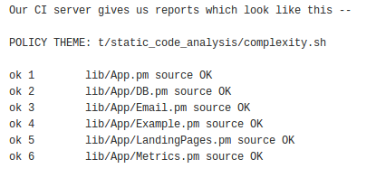
Jeffrey Ryan Thalhammer's
Perl Critic – static code analysis

Slide 22
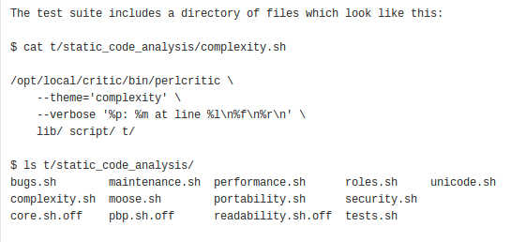
Adding static code analysis to your test suite

Slide 23
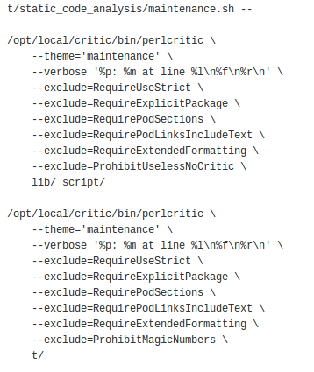
Deploy Perl Critic without immediately fixing your code

Slide 24
Pinto – curate a repository of Perl modules

Slide 25
Devel::Cover measuring test coverage

Slide 26
Devel::hdb – Perl debugger as a web page and REST service

Slide 27
Plenv – perl binary manager

Slide 28
Test.pp
Test::Most
  Test::More
  Test::Warn
  Test::Deep
  Test::Difference
  Test::Exception
Test::Perl::Critic
Test::Perl::Critic::Progressive
DB::Skip

Slide 29
Mojolicious –
Real-time web framework

Slide 30
Catalyst – Elegant MVC
Web Application Framework
Catalyst::Runtime
Catalyst::Devel

