Slide 1


Here's your outline to get started
Key facts about your topic
Amelia Mary Earhart was an American aviation pioneer and author. Earhart was the first female aviator to fly solo across the Atlantic Ocean. She set many other records, wrote best-selling books about her flying experiences, and was instrumental in the formation of The Ninety-Nines, an organization for female pilots.
Born: Jul 24, 1897
Died: Jul 2, 1937
Height: 5'7" (1.70 m)
Spouse: George P. Putnam (1931-1939)
Founded: Ninety-Nines
Education: Columbia University, Hyde Park Academy High School, Central Senior High School
Siblings: Grace Muriel Earhart (Sister)
See more: Open the Notes below for more information.
Notes:
QuickStarter has created an outline to help you get started on your presentation. Some slides include information here in the notes to provide additional topics for you to research.

Slide 2
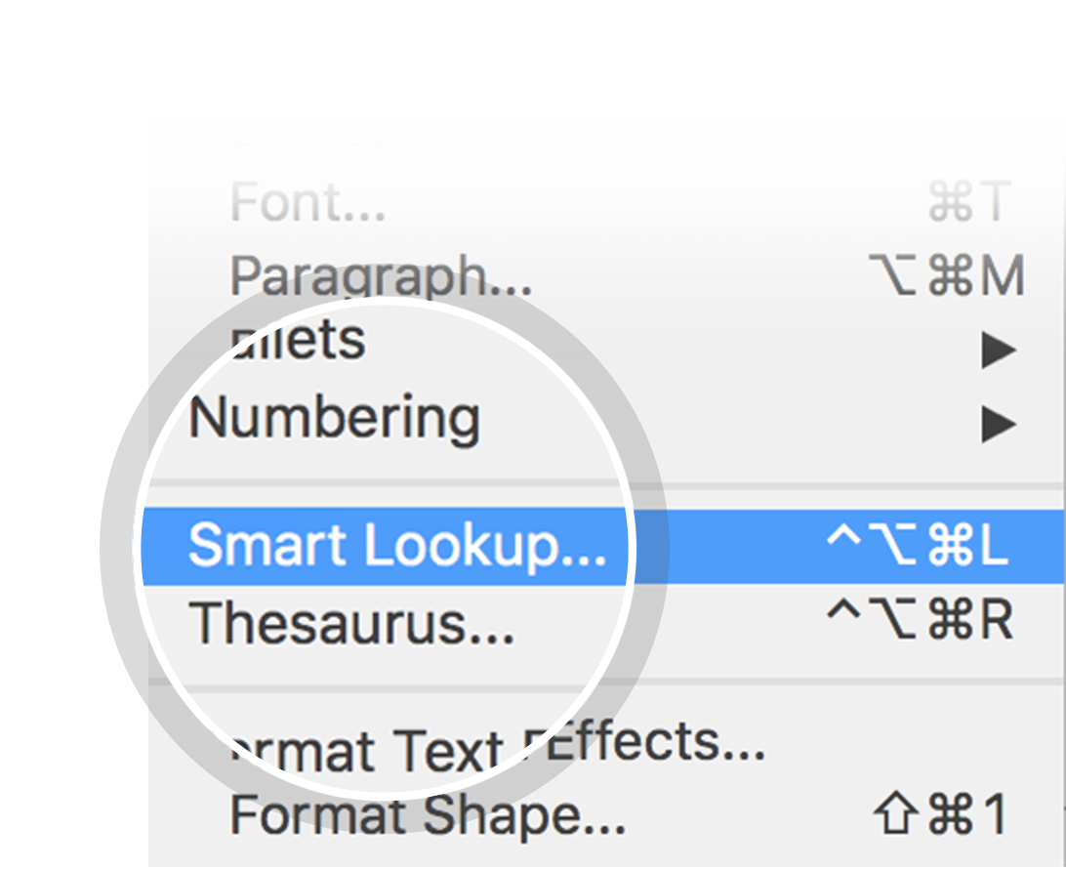
Related topics to research
Lockheed Model 10 Electra
Howland Island
Nikumaroro
Declared death in absentia
Wright brothers
Lockheed Vega
Unexplained disappearances
Women in aviation
Atchison
USCGC Itasca
Use Smart Lookup to learn more
1
Highlight one of the related topics
Right-click on the topic
Choose "Smart Lookup"
2
3

Slide 3
Amelia Earhart

Slide 4
Contents
Early life
Aviation career and marriage
Transatlantic solo flight in 1932
Move from New York to California
World flight in 1937
Speculation on disappearance
Legacy
In popular culture
Records and achievements
Books by Earhart
Quote

Slide 5
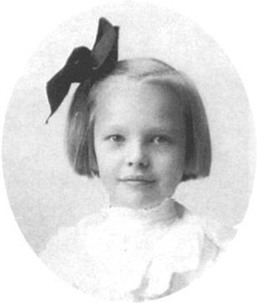
Early life
Look in the slide notes below for topics to consider talking about
Notes:
Consider talking about:
Childhood
Early influence
Education
Family fortunes
Spanish flu pandemic of 1918
Early flying experiences

Slide 6
Aviation career and marriage
Look in the slide notes below for topics to consider talking about
Notes:
Consider talking about:
Financial crisis
Boston
Transatlantic flight in 1928
Celebrity image
Promoting aviation
Competitive flying
Marriage to George Putnam

Slide 7
Transatlantic solo flight in 1932
Look in the slide notes below for topics to consider talking about
Notes:
Consider talking about:
Additional solo flights

Slide 8
Move from New York to California

Slide 9
World flight in 1937
Look in the slide notes below for topics to consider talking about
Notes:
Consider talking about:
Planning
First attempt
Second attempt
Departure from Lae
Radio equipment
Nearing Howland Island
Radio signals
Contemporary search efforts

Slide 10
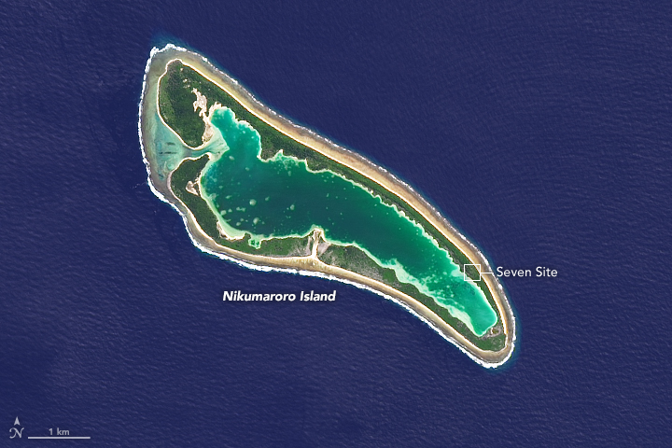
Speculation on disappearance
Look in the slide notes below for topics to consider talking about
Notes:
Consider talking about:
Crash and sink theory
Gardner Island hypothesis
Japanese capture theory
Myths, legends, and claims

Slide 11
Legacy
Look in the slide notes below for topics to consider talking about
Notes:
Consider talking about:
Memorial flights

Slide 12
In popular culture

Slide 13
Records and achievements

Slide 14
Books by Earhart

Slide 15
"Insert an interesting quote here from the notes below"
Amelia Earhart
Notes:
Quotes by Amelia Earhart:
"“Adventure is worthwhile in itself.”"
"“Never interrupt someone doing something you said couldn't be done.”"
"“Everyone has ocean's to fly, if they have the heart to do it. Is it reckless? Maybe. But what do dreams know of boundaries?”"
"“Courage is the price that life exacts for granting peace.”"
"“The most effective way to do it is to do it.”"
"“Being alone is scary, but not as scary as feeling alone in a relationship.”"
"“I did for the fun of it”"
"“...decide...whether or not the goal is worth the risks involved. If it is, stop worrying....”"
"“Never do things others can do and will do, if there are things others cannot do or will not do.”"
"“You haven't seen a tree until you've seen its shadow from the sky.”"

Slide 16
Works cited

