Slide 1




Utilizing Data Science and AI to Predict Patient Attendance in Hospital Appointments
T5 Bootcamp Project – 27/02/2024

Slide 2

ABOUT THE PROJECT
In recent years, hospitals have been grappling with the issue of an increasing number of patient no-shows for scheduled appointments. This phenomenon not only leads to inefficiencies in resource allocation but also affects the quality of care provided.

Slide 3
ABOUT THE PROJECT CONT.
As a proactive solution, this proposal aims to leverage the power of data science and artificial intelligence (AI) to develop a predictive model that can estimate the likelihood of patient attendance when booking an appointment

Slide 4
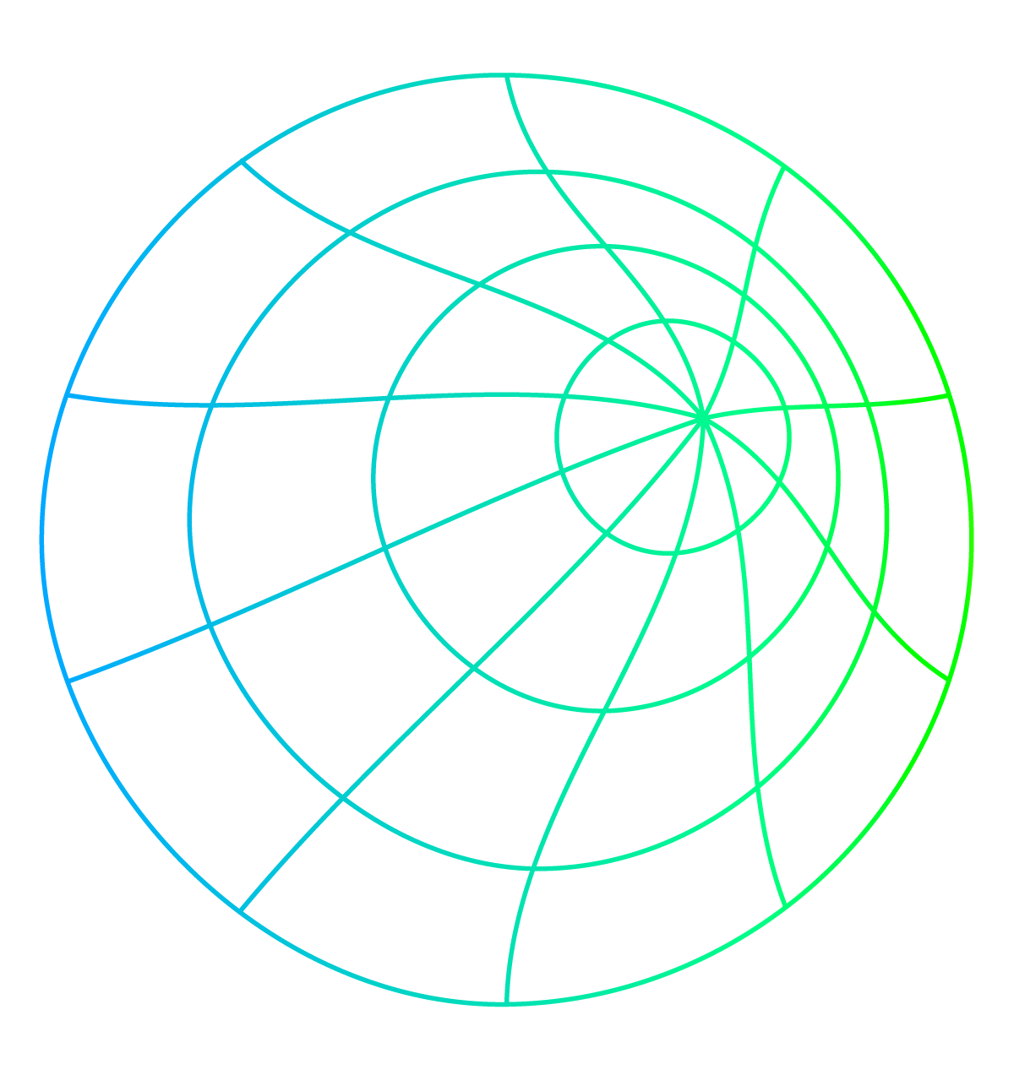
PROJECT ARCHITECTURE
Question/Problem
Data
EDA
Decision
Modeling
Interpretation
Communication

Slide 5
—Ronald Coase
“if you torture the data long enough it will confess to anything.”

Slide 6
Dataset
Through searching for data that aligns with the project idea, we explored several platforms providing open-source data and reviewed various datasets to assess their quality and suitability for the project's general concept. We found the suitable data for the project on Kaggle platform and worked on it during this project.
The data consists of patient appointment bookings for the year 2016 over a period of approximately 8 months in a hospital, which were prepared, cleaned, and analyzed to work on the algorithm idea aimed at developing an artificial intelligence model that predicts the probability of patient attendance for scheduled appointments.

Slide 7
Dataset Cont.
We will utilize advanced data science techniques to clean, preprocess, and extract relevant features from the data, and build a predictive model capable of accurately estimating attendance rates. This model will assist healthcare providers in optimizing appointment scheduling processes, reducing no-show rates, and improving resource allocation.

Slide 8

EDA, Exploration and Visualization
Through the upcoming slides, we will explore and analyze the data, identify relationships between them, and represent them in graphical forms.

Slide 9
01
Show/NoShow
EDA, Exploration and Visualization

Slide 10
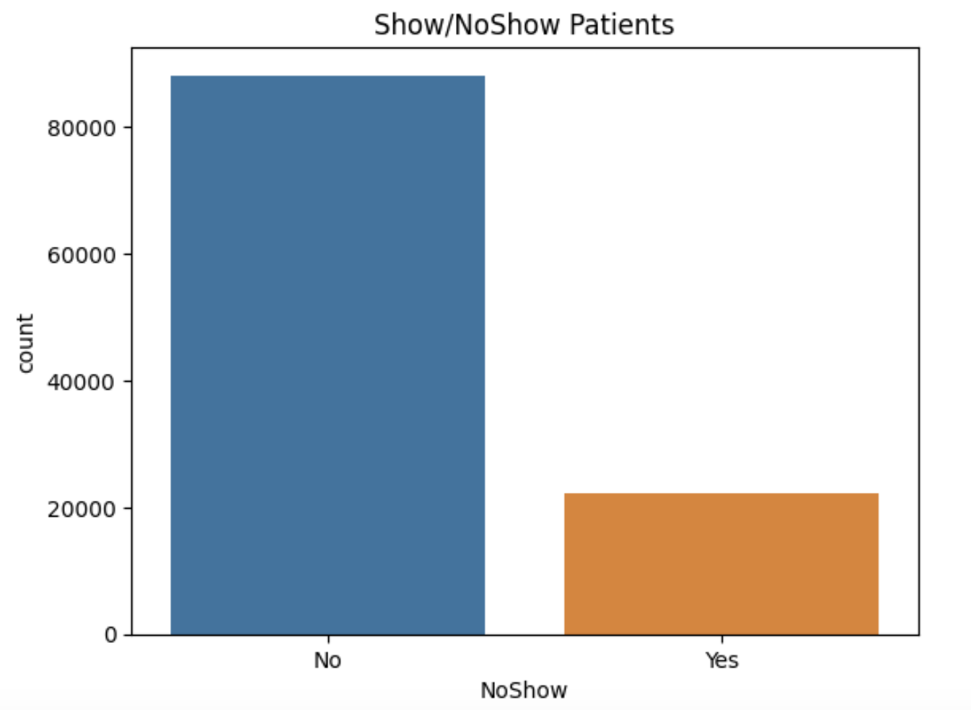
EDA, Exploration and Visualization
Show/NoShow: Below we can see that out of 110,500 patients around 88,000 of them have turned up and that's around 80%.

Slide 11
02
Gender
EDA, Exploration and Visualization

Slide 12
EDA, Exploration and Visualization
In the next slide we can see that out of the 88,000 patients that have turned up, around 57,000 of them are Females and 31,000 are Males.
Of the 22,500 patients that haven't come for the visit around 15,000 are Females and 7,500 are Males

Slide 13
EDA, Exploration and Visualization
From the visualization we can clearly see that 'Female' patients usually have more appointments that 'Male' patients. So, Gender might be an important factor. But if we closely look at the NoShow distribution across Male's and Female's it is almost the same. So, Gender may not play an important role in determining if a patient comes for a visit or not.

Slide 14
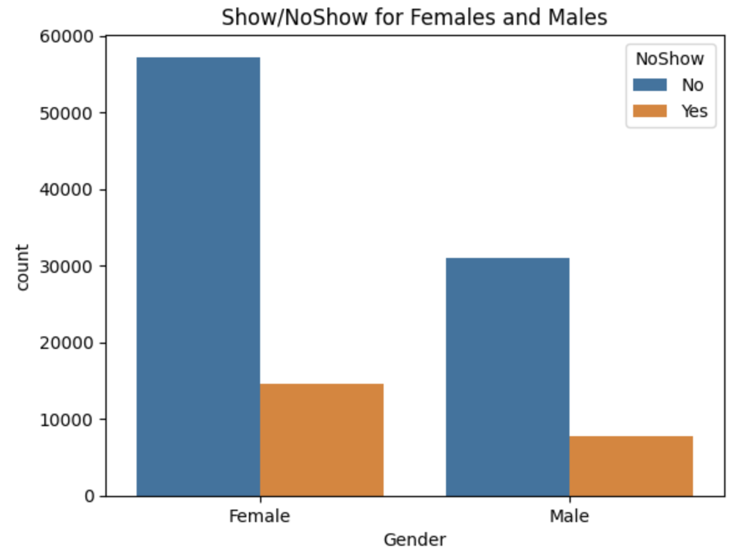
EDA, Exploration and Visualization

Slide 15
03
Hypertension
EDA, Exploration and Visualization

Slide 16
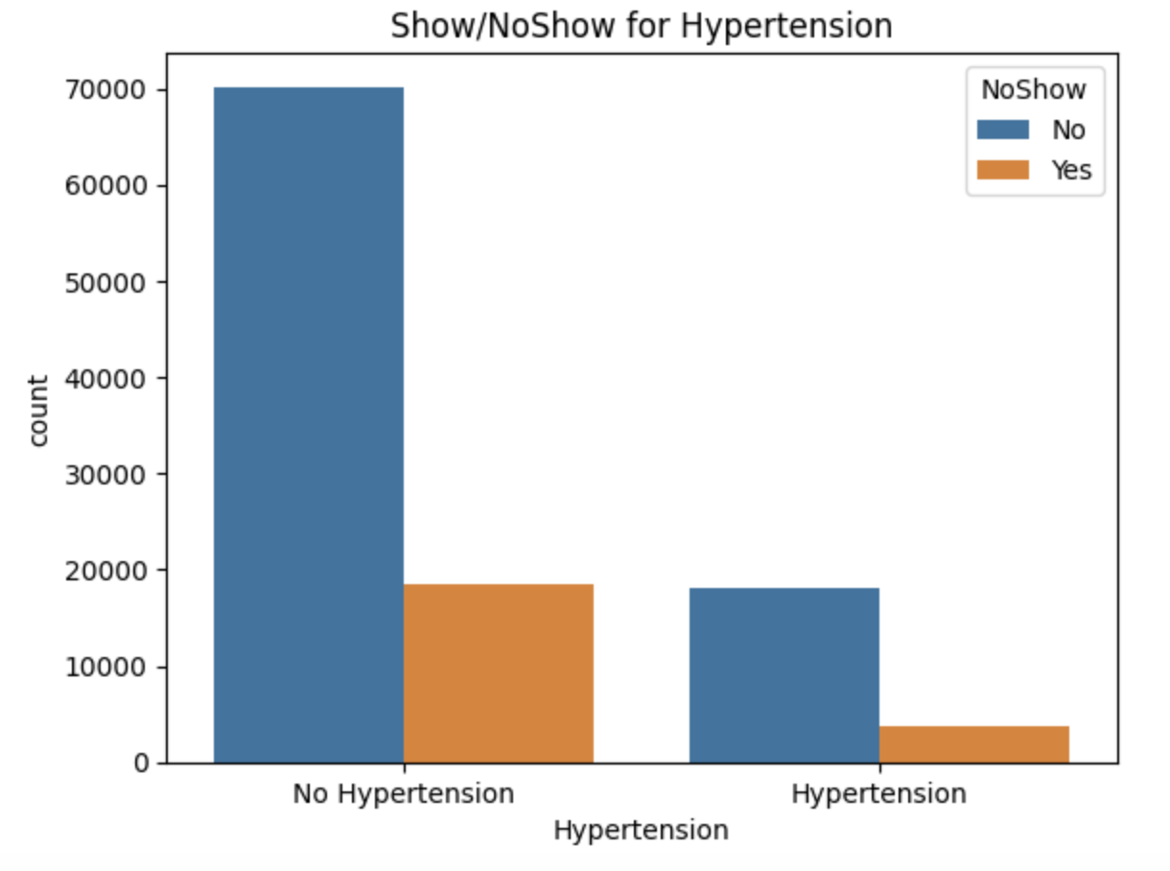
EDA, Exploration and Visualization
Hypertension: the below visualization shows the relationship between Show/NoShow for Hypertension

Slide 17
04
Age
EDA, Exploration and Visualization

Slide 18
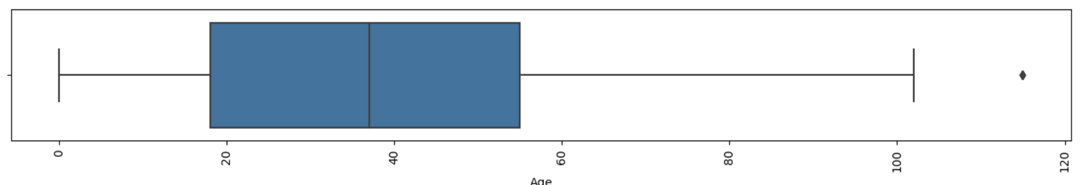
EDA, Exploration and Visualization
Age: From the below BoxPlot we can see that the Median Age is around 30 and the IQR is between 18 and 55. Though the BoxPlot shows few datapoints as outliers we will not consider them as true outliers for this case.

Slide 19
05
Diabetes
EDA, Exploration and Visualization

Slide 20
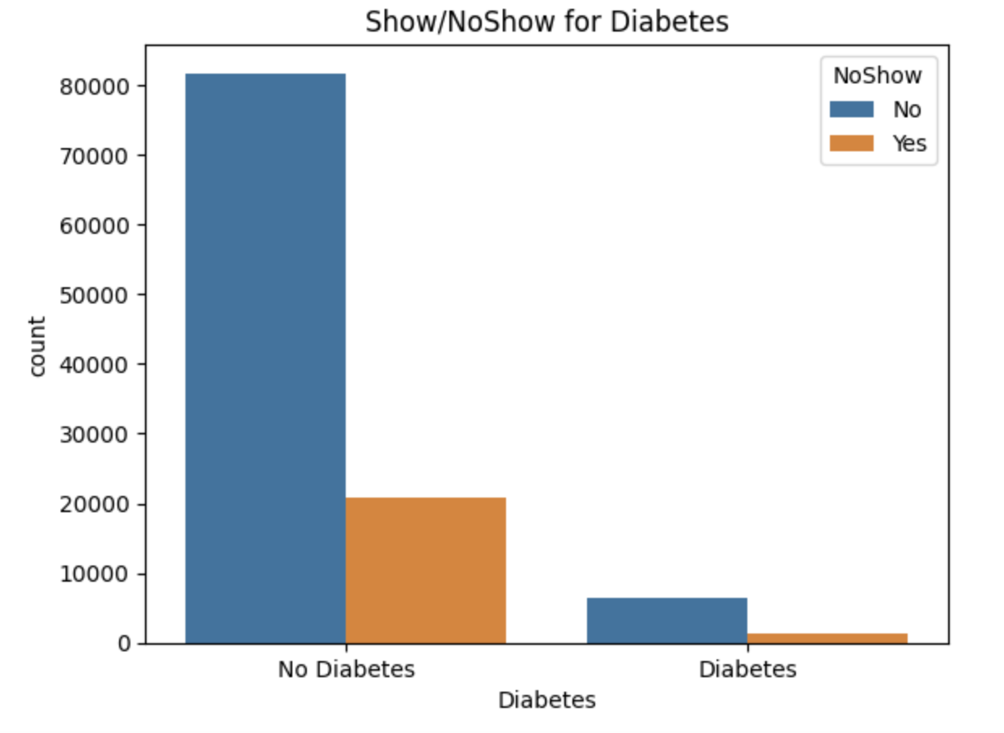
EDA, Exploration and Visualization
Diabetes: the below visualization shows the relationship between Show/NoShow for Diabete.

Slide 21
No of Appointments by Age
06
EDA, Exploration and Visualization

Slide 22
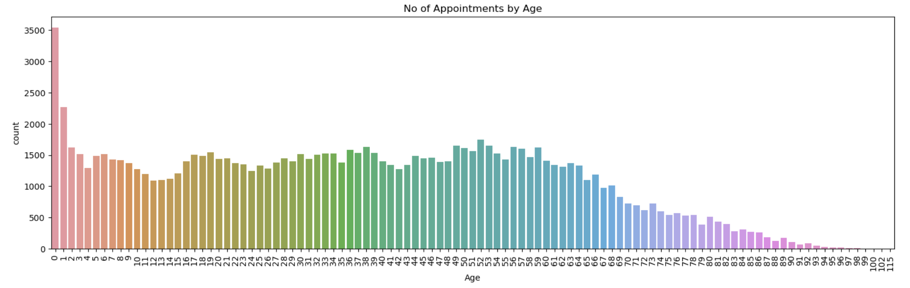
EDA, Exploration and Visualization
No of Appointments by Age: Below we will plot the number of patients for different Age.

Slide 23
Neighbourhood
07
EDA, Exploration and Visualization

Slide 24
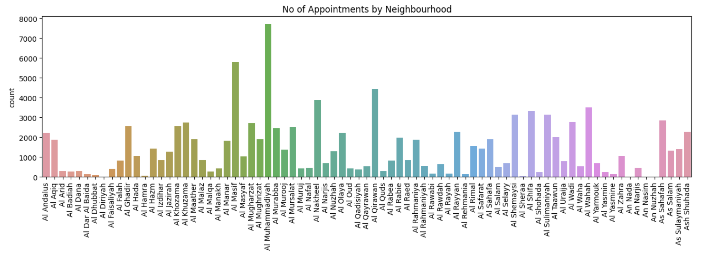
EDA, Exploration and Visualization
Neighbourhood: From the above visualization we can see that the number of patients for few Neighbourhood's is very high.

Slide 25
Handicap
08
EDA, Exploration and Visualization

Slide 26
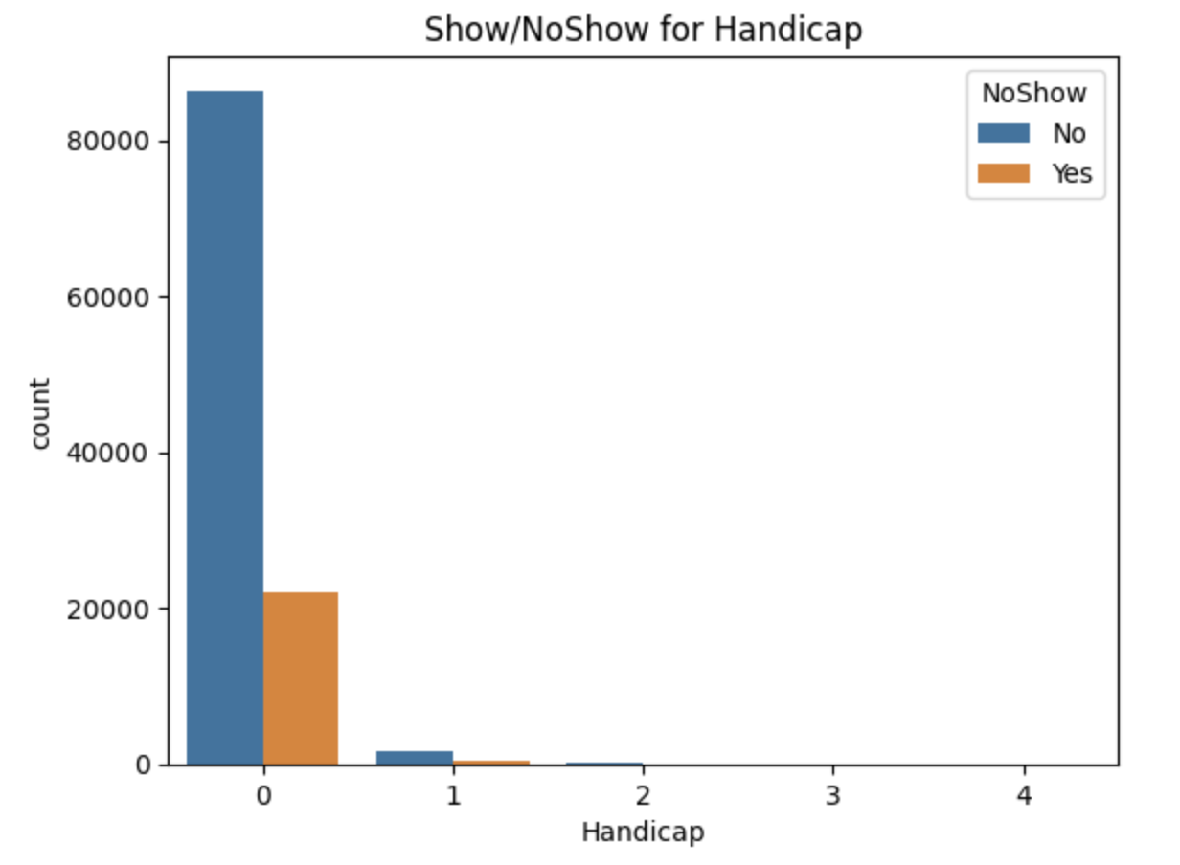
EDA, Exploration and Visualization
Handicap : the below visualization shows the relationship between Show/NoShow for Handicap.

Slide 27
SMSReceived
09
EDA, Exploration and Visualization

Slide 28
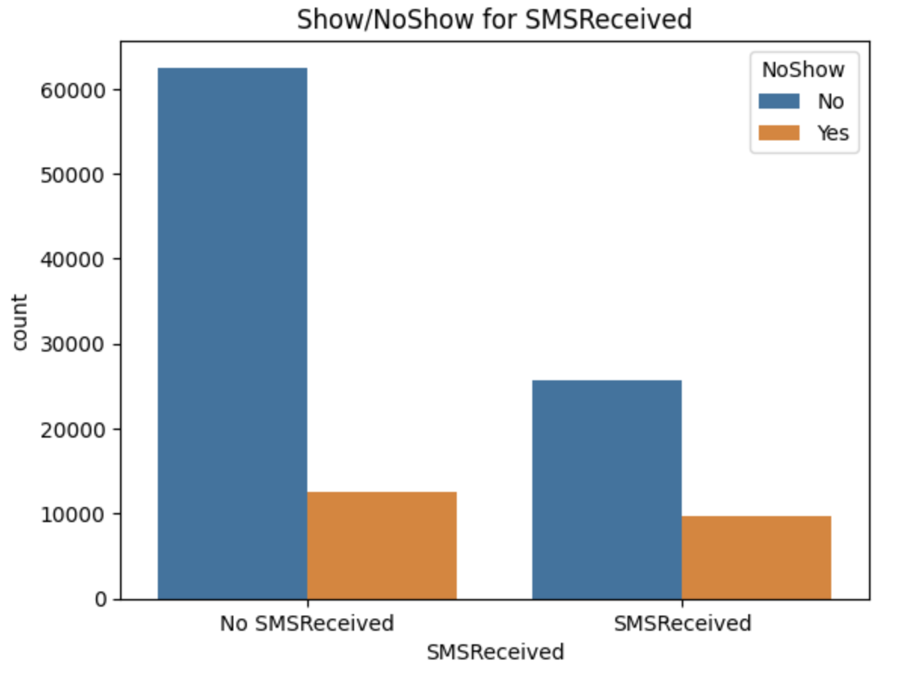
EDA, Exploration and Visualization
SMSReceived : the below visualization shows the relationship between Show/NoShow for SMSReceived.

Slide 29
Waiting_Time
10
EDA, Exploration and Visualization

Slide 30
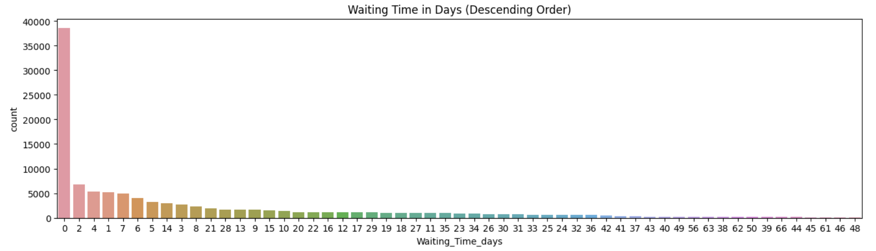
EDA, Exploration and Visualization
Waiting_Time: From the below visualization we can see that most of the patients are booking their appointments on the same day. The next highest waiting times are 2days, 4 days and 1 day.

Slide 31
AppointmentDay_DOW
11
EDA, Exploration and Visualization

Slide 32
EDA, Exploration and Visualization
AppointmentDay_DOW : There looks like a pattern with the appointments from the above visualizations. Also, we can see there are very less appointments on Saturday and no appointments on Sunday.
So, AppointmentDay_DOW could help in determining if a patient visits the hospital after taking an appointment.

Slide 33
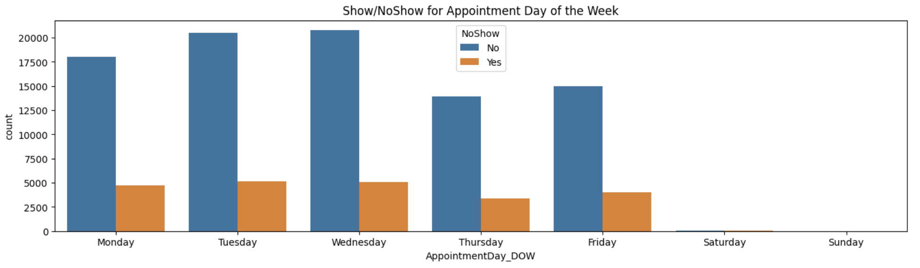
EDA, Exploration and Visualization

Slide 34
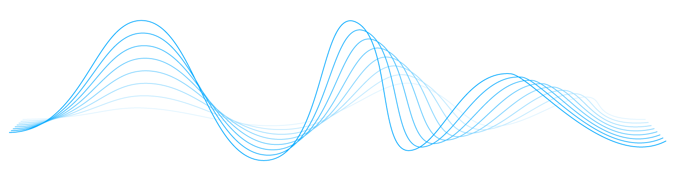
Models

Slide 35
Models
Many algorithms were tried to reach a result to solve this problem, and the algorithms used were as follows:
DecisionTreeClassifier
RandomForestClassifier
GridSearchCV
KNN
SVM
SVM GridSearch Parameter
XG Boost
Deep learning with KERAS library
4

Slide 36
K-Nearest Neighbor Model

Slide 37
KNN (K-Nearest Neighbor) model:
The K-Nearest Neighbors (KNN) algorithm is a popular machine learning technique used for classification and regression tasks. It relies on the idea that similar data points tend to have similar labels or values.
KNN Algorithm can be used for both classification and regression predictive problems.
KNN model showed the best results as shown in the next slides.

Slide 38
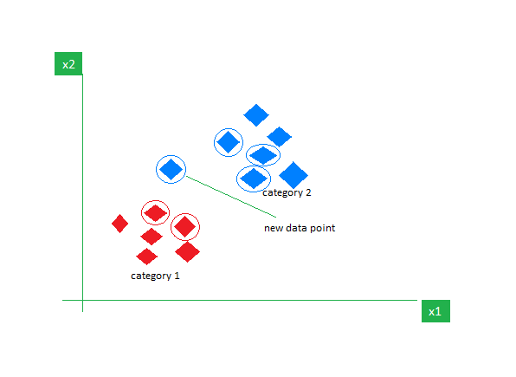
Why KNN (K-Nearest Neighbor) model?
KNN Algorithm can be used for both classification and regression predictive problems. However, it is more widely used in classification problems in the industry. To evaluate any technique, we generally look at 3 important aspects:
1. Ease of interpreting output
2. Calculation time
3. Predictive Power

Slide 39
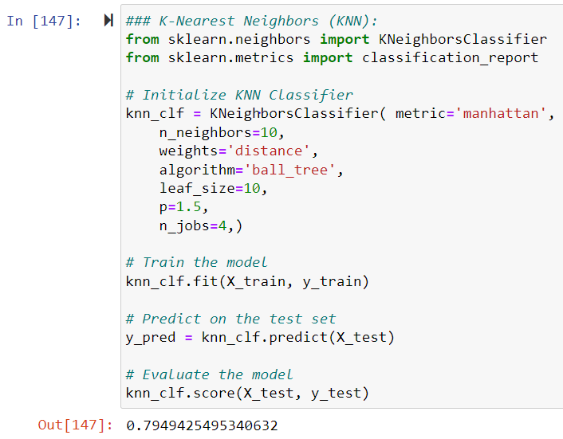
KNN (K-Nearest Neighbor) model
Below is the python code with output:

Slide 40

Project Challenges
Difficulty finding data
Bias in the data used
Find the appropriate algorithm
Difficulty in cleaning data

Slide 41

FUTURE PLAN
Increasing the attendance rate for appointments by applying the model in real environment.
Improving the quality of service provided to patients.
Supporting Vision 2030 through optimal use of resources.
Improving patient experience

Slide 42

PROJECT TEAM
Ali M Alribi
Ahmed Al Doshi
Alaa Al Logmani
SFHP - Riyadh
SFHP - Dammam
Saad Al Shamrani
Hisham Abu Thiyab

Slide 43
THANK YOU
T5 Bootcamp Project – 27/02/2024

