Slide 1

Exploratory Data Analysis of Movies Database
Ain Shams University
Faculty of Computer and Information Science
Software Engineering Department
Student: Hesham Said Ahmed By supervision of: Prof. Sherine Rady TA. Mariam Hassanein

Slide 2
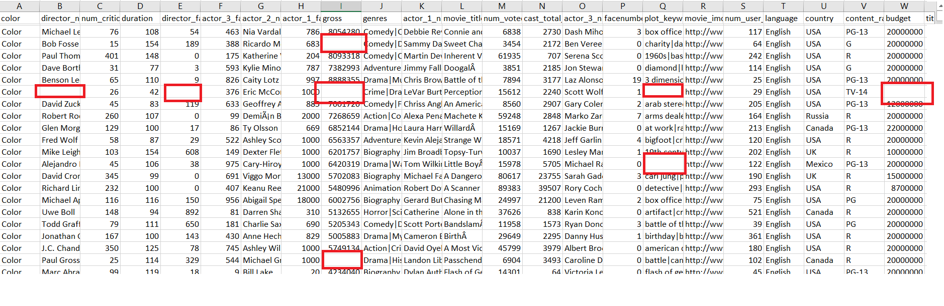
Preprocessing
Notes:
For the numeric attributes, average was calculated to replace the missing values,
And for the factors and characters, mode was used.

Slide 3
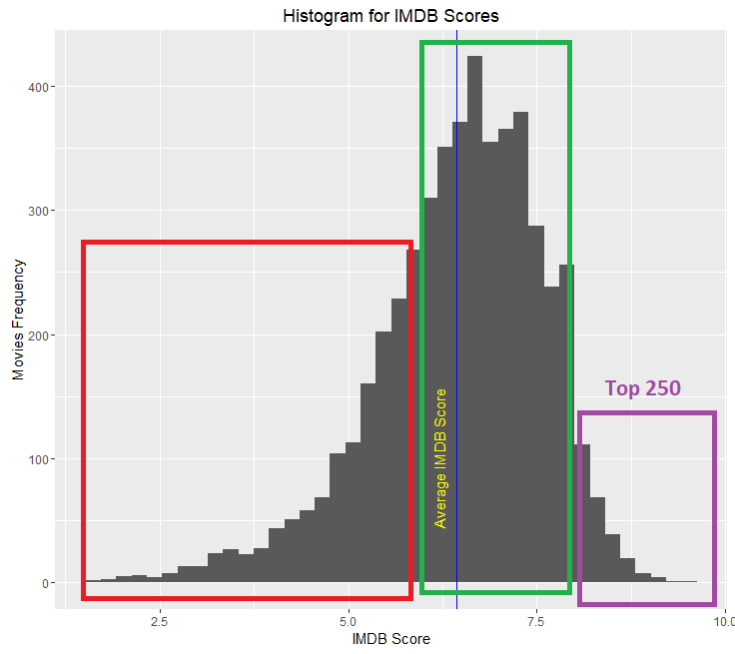
EDA
Notes:
Movies having rating larger than 8.0 are listed in the IMDB top 250, these are excellent movies, based on wins and nominations
Movies with rating from 6.0 to 8.0 are still good movies and interesting to watch. However, Movies with rating from 1 to 5~6 are sometimes considered bad, in one way or the other. We may want to avoid such movies.

Slide 4
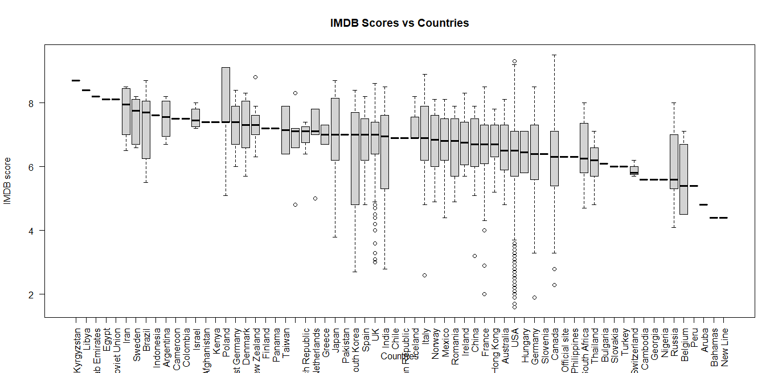
Notes:
USA and UK are the most occurring countries in the dataset in terms of movie production for the past 100 years. Surprisingly their median is not the highest among the other countries Some developing countries, such as Egypt, Iran and Argentine, have higher median for IMDB score despite the lower number of produced movies.
Conc: Production rate of movies isn’t necessarily a measure of how good movies are?

Slide 5
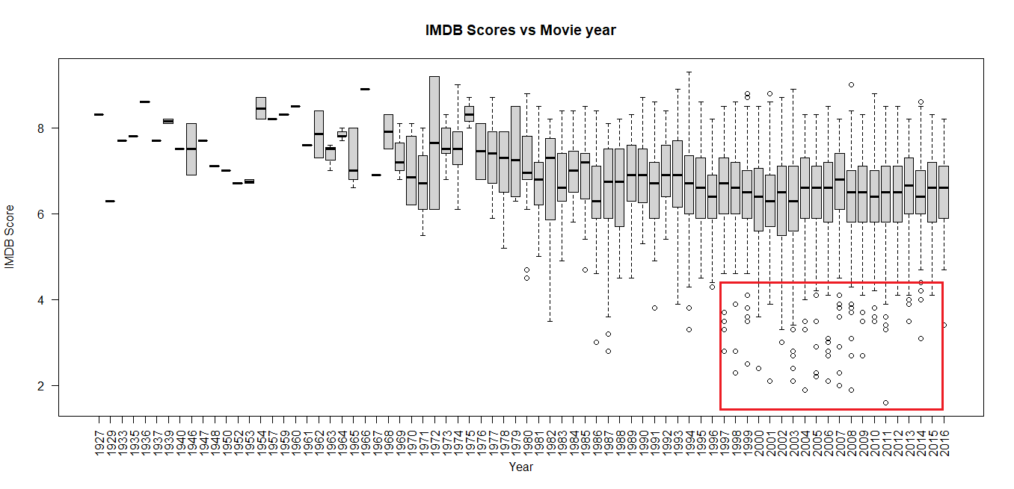
Notes:
the number of movies produced increases yearly since the 1906s. This makes sense because the evolution of filming industry is connected to the development of science and technology, anybody may make a startup company for production with very low cost and start producing a movie but the result would be a drop in the ratings of such movies if inexperienced people are working on it.

Slide 6
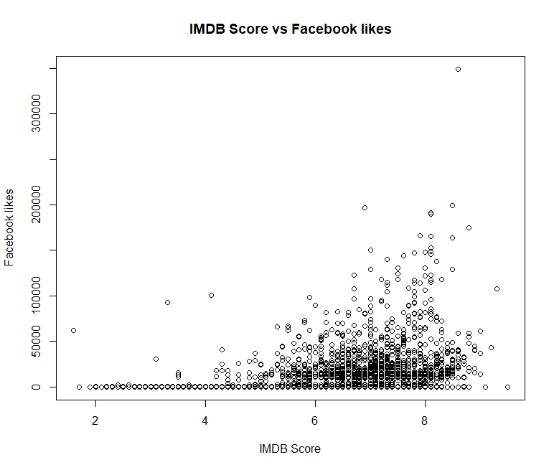
Notes:
The impact of social media can be used to evaluate or make an assessment for an event. From the plot we can see that there is correlation between the Facebook likes of a movie and the IMDB score. Conc: There are many high rated movies having high Facebook likes.

Slide 7
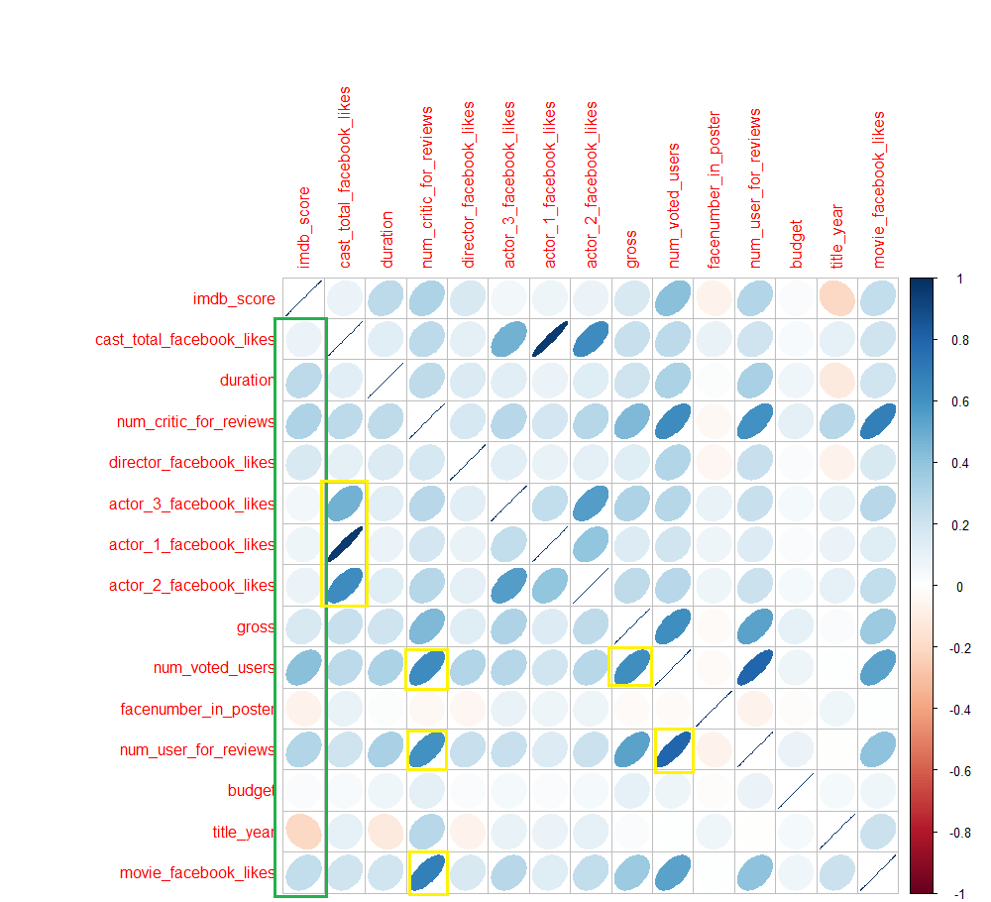
Correlogram of Numeric Variables
Correlation
Notes:
"actor_1_facebook_likes“ is strongly correlated to the “cast_total_facebook_likes”, similarly “actor2” and “actor3”
“num_critic_for_reviews” is strongly correlated to “movie_facebook_likes”, which means that a popular movie on Facebook may attract many critics.
“movie_facebook_likes” is again correlated to “num_voted_users”
“gross” is also strongly correlated to the ”num_voted_users”
Now for the imdb_score:
The "imdb_score" is slightly correlated correlated to "director_facebook_likes", which means that a well known director may affect the rating of a movie. Same goes for actors(1,2,3)
The "imdb_score" is positively correlated to "duration". Which means that highly rated moves tend to be long.
The "imdb_score" is negatively correlated to "face_number_in_poster". So it might not be a good idea to have a movie poster with many faces.
The "imdb_score" There might be a very slight correlation with "budget”. Investing a lot of money in a movie won’t necessarily make it highly rated.

Slide 8
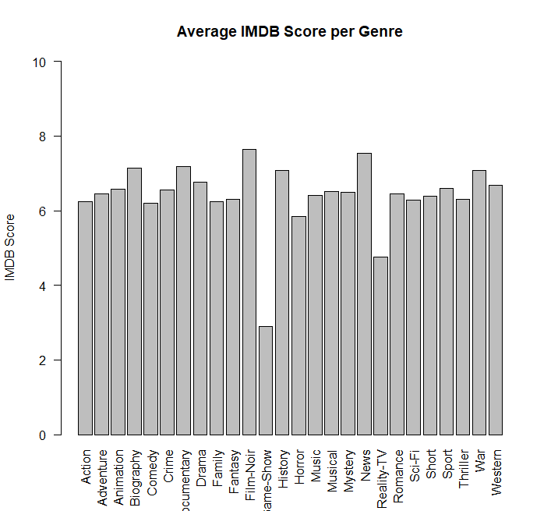
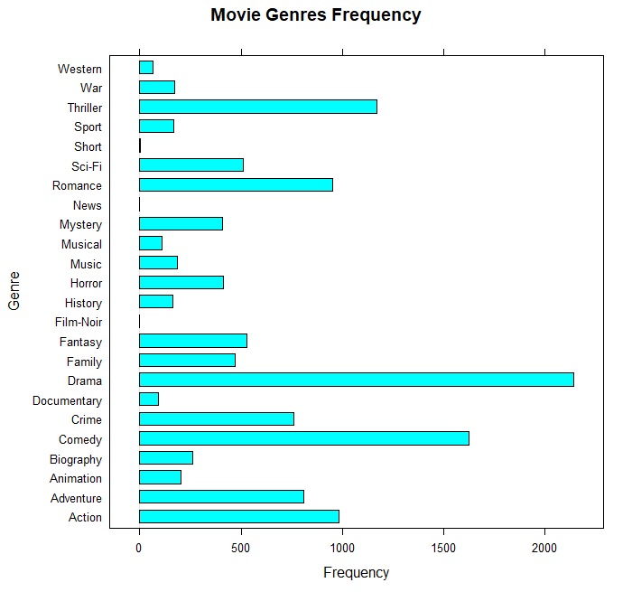
Notes:
#We can observe that the average rating for all genres is the same #except for Reality-TV or Game - Show, so a production company might want to think twice,
#before investing in one of these

Slide 9
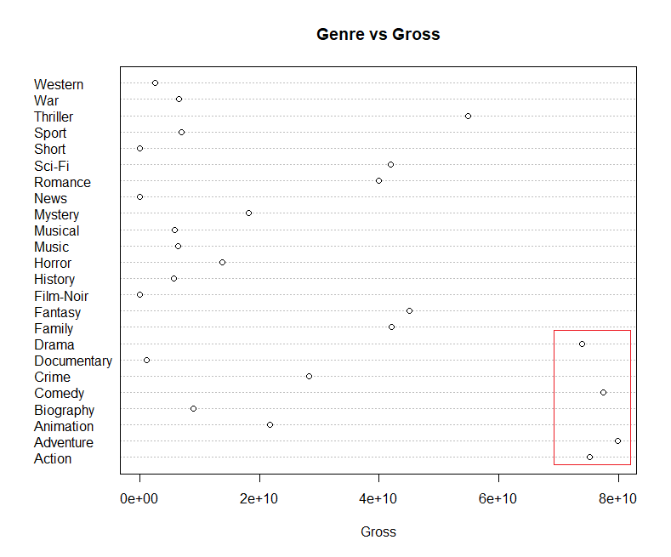
Notes:
Adventure movies have the highest gross although they are not the most frequent genre. So a production company may be interested to invest in one of those.
Its also visible that movies Drama, Comedy, Action and Adventure genres dominate the gross from the rest.

Slide 10
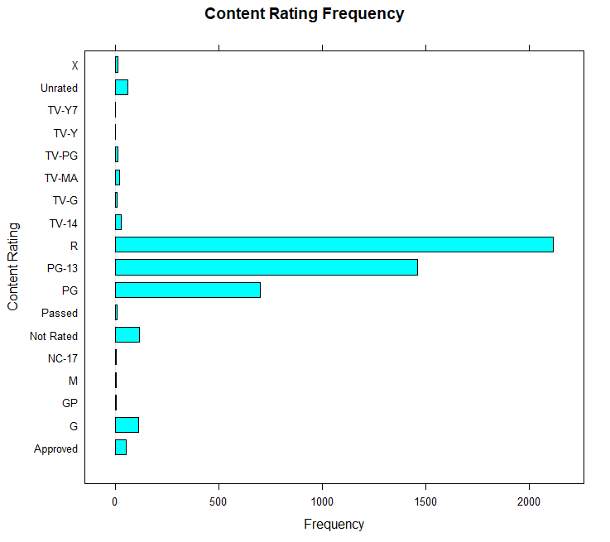
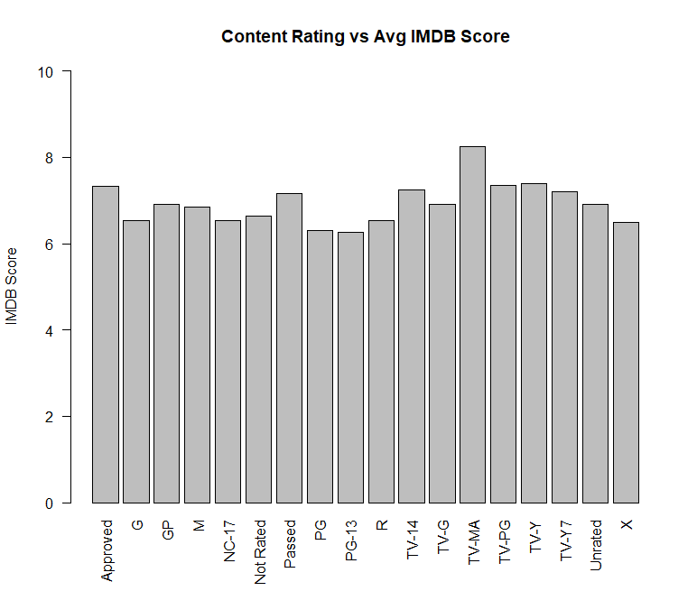
Notes:
Even though R, PG-13 and PG rated movies are the most frequent across the dataset they tend to have the least average IMDB Score among other ratings, and that may support the previous claiming of how the rapid development of science and technology affected the filming industry
G (general audiences):
PG (parental guidance): Parental Guidance Suggested
PG (parental guidance for under 13) Parents Strongly Cautioned
R (restricted): No one under 17 admitted without an accompanying parent or guardian
Unrated: Typically reserved for previews of films not yet officially rated
X-rated(NC-17): intended for adults only
TV-Y: appropriate for all children
TV-Y7: appropriate for children more than 7 years old

Slide 11
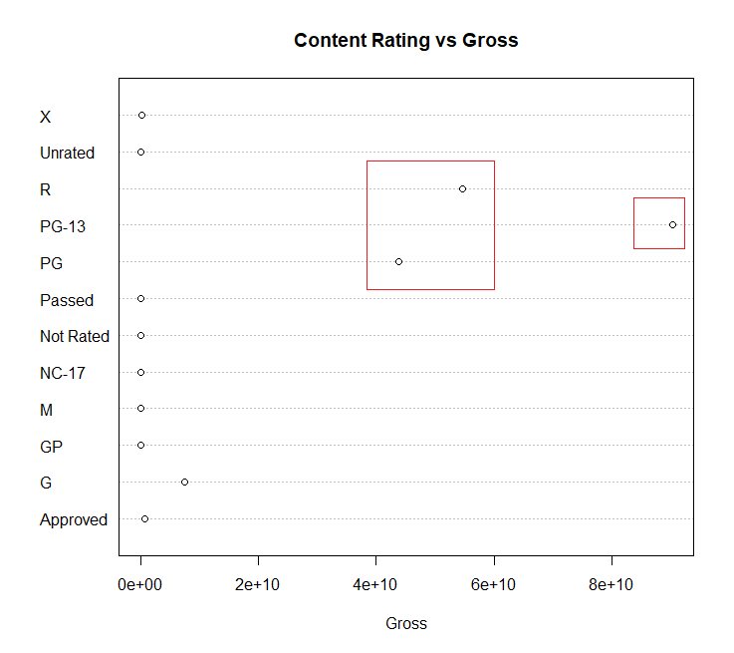
Notes:
Even though R rated movies are the most frequent across the database they don’t have the highest gross. A company might want to consider that.
Overall PG-13, R and PG have significant summation of gross and that is due to the frequency of such types

Slide 12
Correlogram of Numeric Variables
Correlation

Slide 13
Prediction of Movie Ratings
Choice of predictors:
Some attributes won’t be selected to fit the linear regression model, because they won’t be available before the release of a movie.
These attributes include: gross, movie_facebook_likes, num_voted_users_ and num_critic_for_reviews
Other excluded attributes are.
cast_total_facebook_likes, because it correlates strongly with the actor_1_facebook_likes, and that might bring up the collinearity problem, where one predictor can be linearly predicted by other predictors.
Actors(1,2,3) names, Movie_URL, Director Names

Slide 14
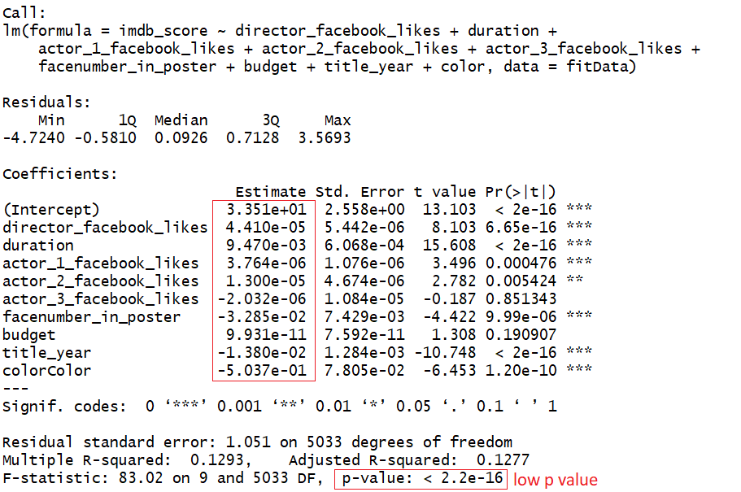
Prediction of Movie Ratings(Cont.)
Notes:
After studying the correlation of these variables:
We notice that color, title_year, facenumber_in_poster and actor_3_facebook_likes all have negative weights. Duration on the other hand is an important coefficient in determining the rating of a movie. Also, the p value of the model is small which makes the model significant

Slide 15
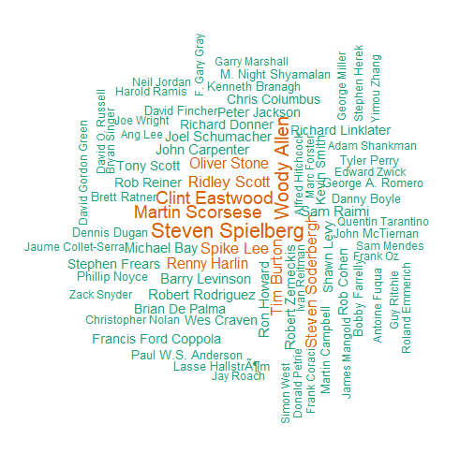
Directors with most number of produced movies
More Visualizations

Slide 16
