Slide 1
Toronto Robbery Analysis
April 17,
2019
University of Toronto
SCS 3250
Group 5
Baraka, hesham // clark, maggie (margaret) // jin, jiaying // Lewis, Phillip // rudani, sandipkumar // Tu, Yuxi

Slide 2
Background

Slide 3
Toronto: A Changing City
Canada ranked 6th safest country in the world [1]
Toronto ranked 4th safest city [2]
Toronto is rapidly changing:
4.5% increase in population from 2011 to 2016 [3]
GTA expected to account for 65% of Ontario immigration by [4]
Housing affordability decreasing
Gentrification increasing
Notes:
[1] Martin, W. “The 31 safest countries in the world.” Business Insider, 27 June 2018. https://www.businessinsider.com/safest-countries-in-the-world-2018-6
[2] “Safe Cities Index 2017”. The Economist Intelligence Unit. 2017. https://dkf1ato8y5dsg.cloudfront.net/uploads/5/82/safe-cities-index-2017-eng.pdf
[3] “Focus on Geography Series, 2016 Census – Toronto, CSD.” Statistics Canada, 2016. https://www12.statcan.gc.ca/census-recensement/2016/as-sa/fogs-spg/Facts-csd-eng.cfm?LANG=Eng&GK=CSD&GC=3520005
[4] “Ontario Population Projections Update, 2017-2041.” The Ontario Ministry of Finance, 2017. https://www.fin.gov.on.ca/en/economy/demographics/projections/

Slide 4
Objective of Analysis
Is citizen safety in Toronto changing?
Evaluate recent robbery data as a proxy for safety
“343 Every one commits robbery who:
steals, and for the purpose of extorting whatever is stolen or to prevent or overcome resistance to the stealing, uses violence or threats of violence to a person or property;
steals from any person and, at the time he steals or immediately before or immediately thereafter, wounds, beats, strikes or uses any personal violence to that person;
assaults any person with intent to steal from him; or
steals from any person while armed with an offensive weapon or imitation thereof.”

Slide 5
Data Preparation & Cleaning
Toronto Police Robbery dataset: data captured from 2014 - 2018
29 variables and 18,128 records
Largely clean – 100% rows populated
13 OOTB features and 20 engineered features
OOTB | Engineered
offence, reportedyear, reportedmonth, reportedday, reporteddayofyear, reporteddayofweek, occurrenceyear, occurrencemonth, occurrenceday, occurrencedayofyear, occurrencedayofweek, neighbourhood, premisetype | Occurrence_TimeOfDayCategory, Occurrence_SkyLightCategory, Reported_TimeOfDayCategory, Reported_SkyLightCategory, Occurred_PostalCode, Occurred_FSA, PopulationCount, PopulationDensity, PopulationCount_AgeCohort, Occurred_TimeOfMonth, Occurred_IsHoliday, Occurred_CalendarQuarter, Reported_TimeOfWeek, Reported_TimeOfMonth, Reported_IsHoliday, Reported_CalendarQuarter , Reported_After_Occurrence_WEEKS, Reported_After_Occurrence_DAYS, Reported_After_Occurrence_HOURS, Reported_After_Occurrence_MINUTES

Slide 6
Data Preparation & Cleaning
SQL and Python
Data augmentation:
Robbery
Dates & Forward Sortation Area (FSA)
Neighbourhood
Data normalization: 6 subsets:
Robbery data
Offences
Dates
Neighbourhood
Premise Types
Time of Day

Slide 7
Analysis

Slide 8
Analysis – Overall Count

Slide 9
Are total robberies per year increasing?
Count
Year

Slide 10
Analysis - Type

Slide 11
What type of robbery is most common?
Ranking | Robbery Type | No. of Robberies (2014 – 2018)
1 | Mugging | 5876
2 | Other | 2926
3 | With weapon | 2904
4 | Business | 1983
5 | Swarming | 1688
6 | Purse snatching | 735
7 | Home invasion | 726
8 | Financial institution | 565
9 | Vehicle jacking | 235
10 | Taxi | 203
11 | Delivery person | 155
12 | ATM | 65
13 | Armoured car | 24

Slide 12
Do robbery rates by type change over time?

Slide 13
Do robbery rates by type change over time?

Slide 14
Do robbery rates by type change over time?

Slide 15
Analysis - Time

Slide 16
In what month is a robbery most likely to occur? Least likely?
Month | 2014 | 2015 | 2016 | 2017 | 2018 | Total
January | 260 | 286 | 260 | 323 | 326 | 1455
February | 275 | 197 | 288 | 270 | 283 | 1313
March | 288 | 265 | 259 | 272 | 357 | 1441
April | 286 | 280 | 305 | 325 | 231 | 1427
May | 363 | 317 | 308 | 341 | 266 | 1595
June | 284 | 287 | 320 | 354 | 268 | 1513
July | 305 | 287 | 360 | 363 | 283 | 1598
August | 240 | 324 | 320 | 317 | 307 | 1508
September | 343 | 288 | 270 | 324 | 293 | 1518
October | 413 | 306 | 321 | 375 | 299 | 1714
November | 282 | 317 | 329 | 356 | 331 | 1615
December | 246 | 310 | 273 | 281 | 278 | 1388

Slide 17
In what month is a robbery most likely to occur? Least likely?
Robberies by month
Count
Month

Slide 18
On what day of week is a robbery most likely to occur? Least likely?
Most robberies occurred late at night (8:00 – 11:00 PM) and early in the morning (00:00 – 6:00 AM)
Day of Week | 2014 | 2015 | 2016 | 2017 | 2018 | Total
Sunday | 476 | 472 | 491 | 555 | 477 | 2471
Monday | 479 | 415 | 491 | 542 | 505 | 2432
Tuesday | 512 | 512 | 465 | 528 | 513 | 2530
Wednesday | 530 | 486 | 522 | 514 | 491 | 2543
Thursday | 490 | 527 | 497 | 494 | 508 | 2516
Friday | 546 | 567 | 526 | 661 | 521 | 2821
Saturday | 552 | 485 | 621 | 607 | 507 | 2772

Slide 19
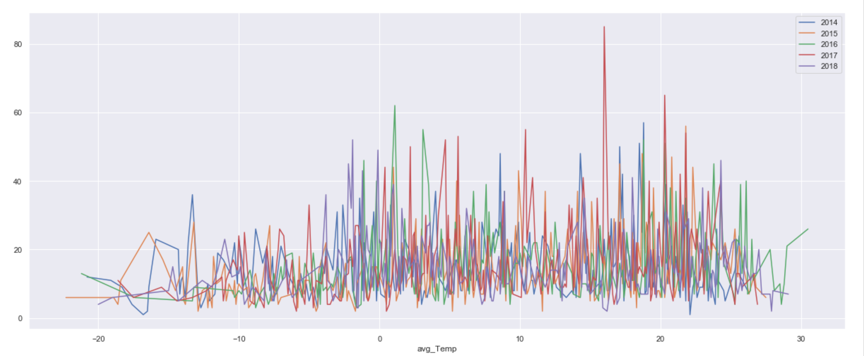
In what weather do most robberies happen?
Robberies by temperature
Count
Temperature (º C)

Slide 20
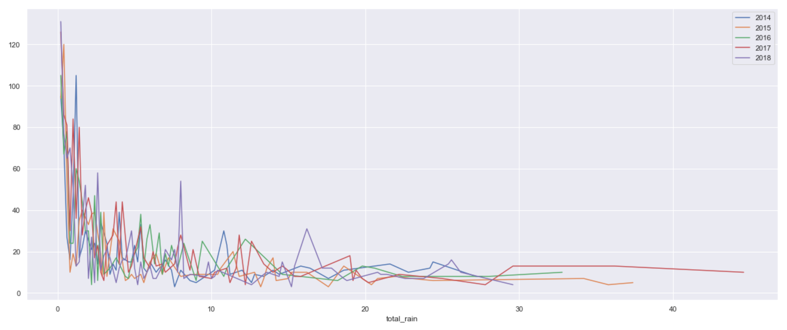
In what weather do most robberies happen?
Robberies by volume of rain
Count
Total rain (mm)

Slide 21
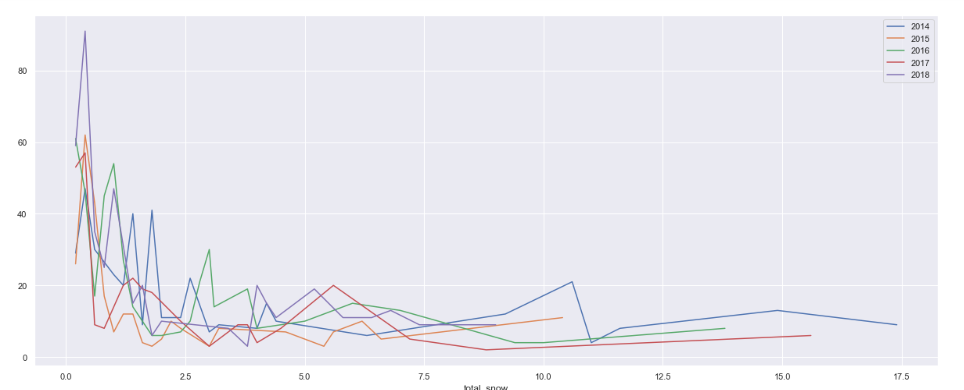
In what weather do most robberies happen?
Robberies by volume of snow
Count
Total snow (cm)

Slide 22
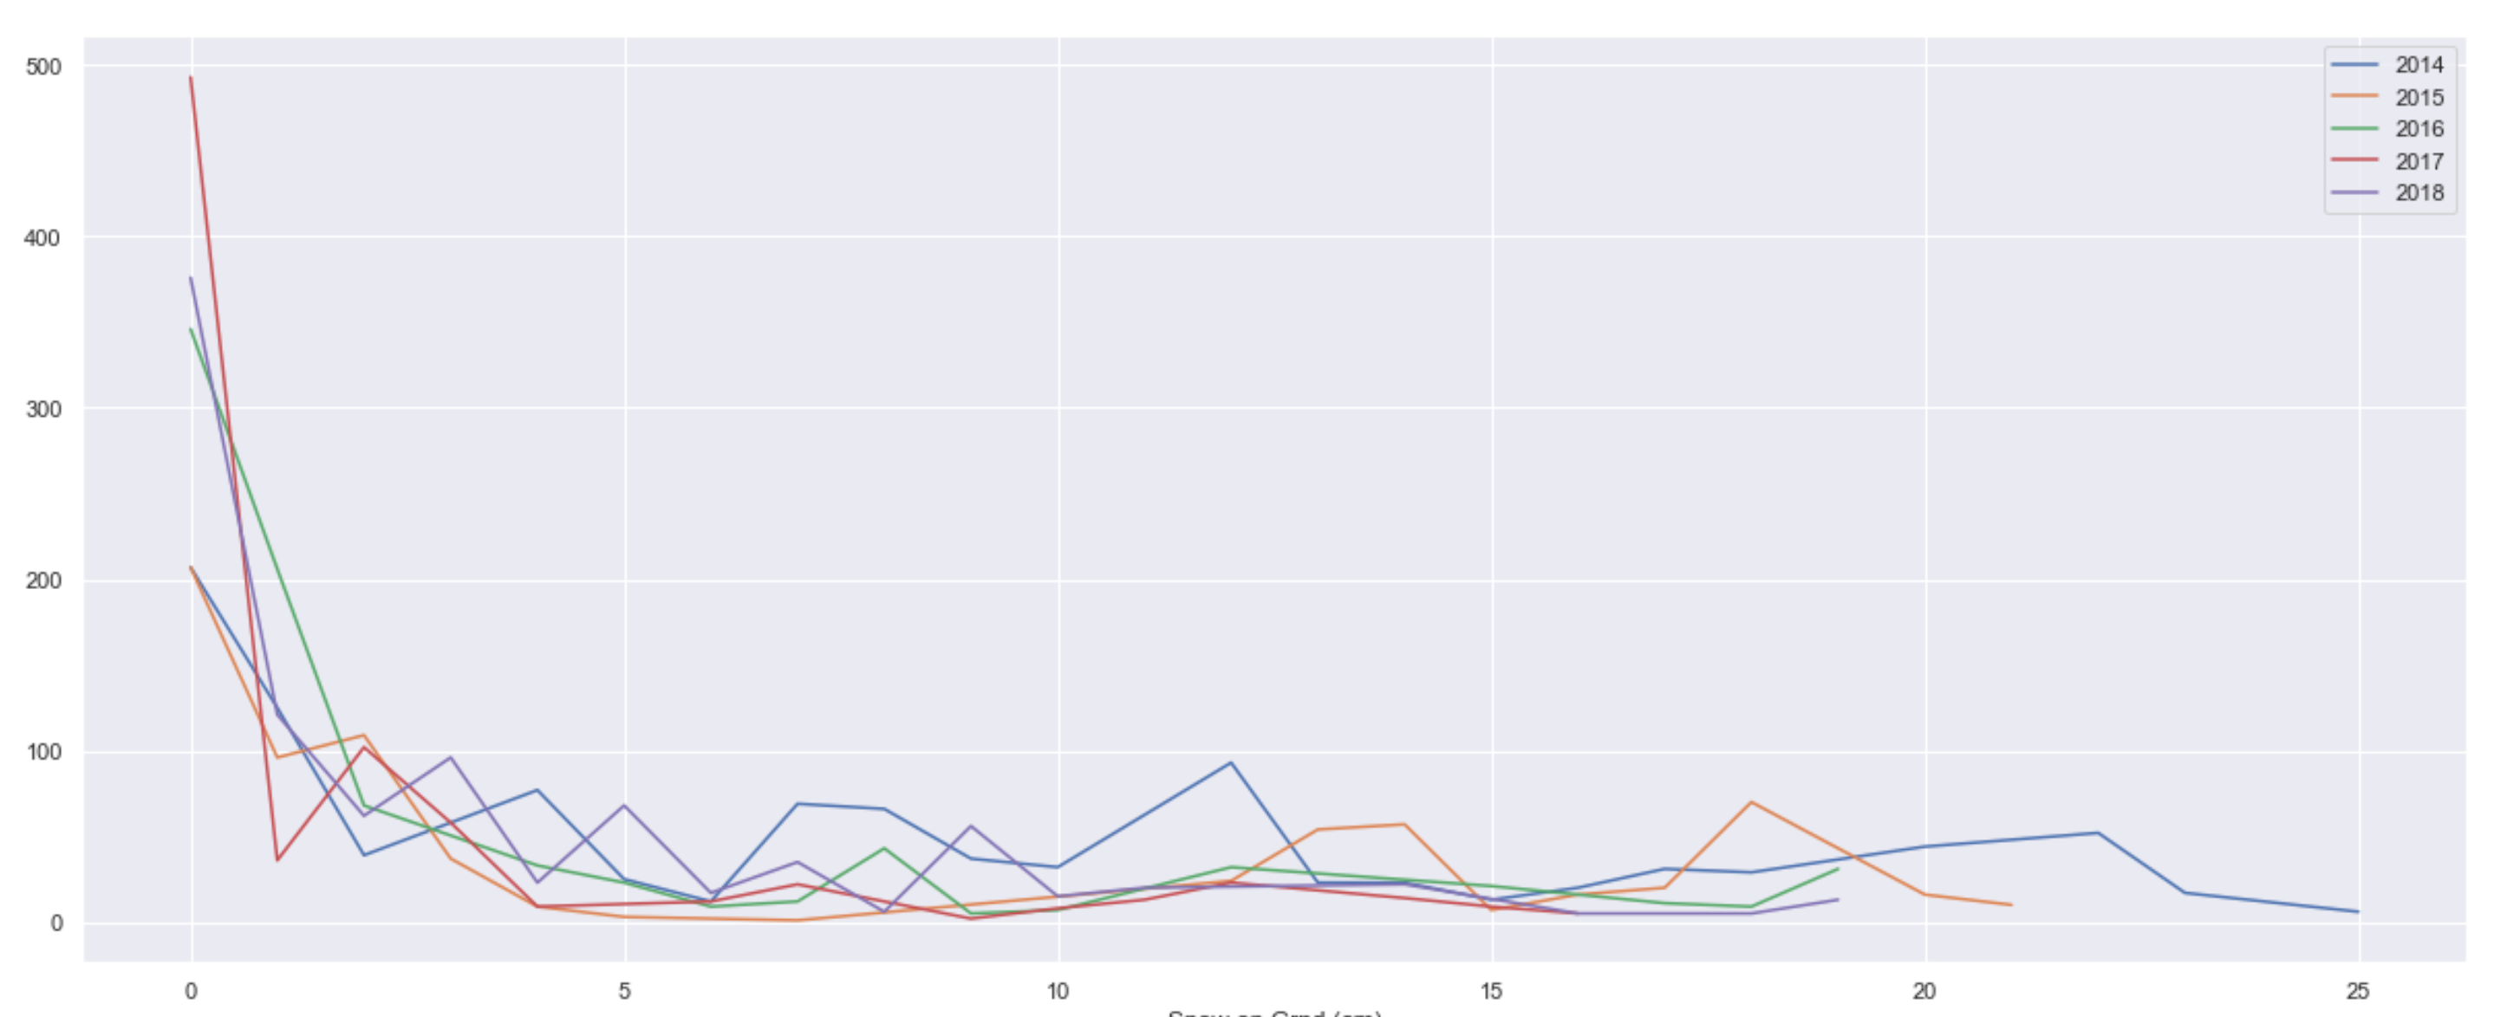
In what weather do most robberies happen?
Robberies by snow coverage
Count
Snow coverage (cm)

Slide 23
Analysis - Location

Slide 24
In what neighbourhoods do most robberies occur? Least?
Ranking | Neighbourhoods with Most Robberies (2014-2018) |  | Neighbourhoods with Least Robberies (2014-2018)
1 | Church-Yonge Corridor | 903 | Bridle Path-Sunnybrook-York Mills | 6
2 | Moss Park | 628 | Yonge-St.Clair | 8
3 | Mount Olive-Silverstone-Jamestown | 460 | Lambton Baby Point | 10
4 | Woburn | 429 | Forest Hill South | 12
5 | West Humber-Clairville | 375 | Lawrence Park North | 18
6 | York University Heights | 370 | Bayview Woods-Steeles | 19
7 | Kensington-Chinatown | 367 | Humewood-Cedarvale | 21
8 | Bendale | 346 | Henry Farm | 23
9 | West Hill | 322 | Broadview North | 24
10 | Dovercourt-Wallace Emerson-Junction | 316 | Centennial Scarborough | 25

Slide 25
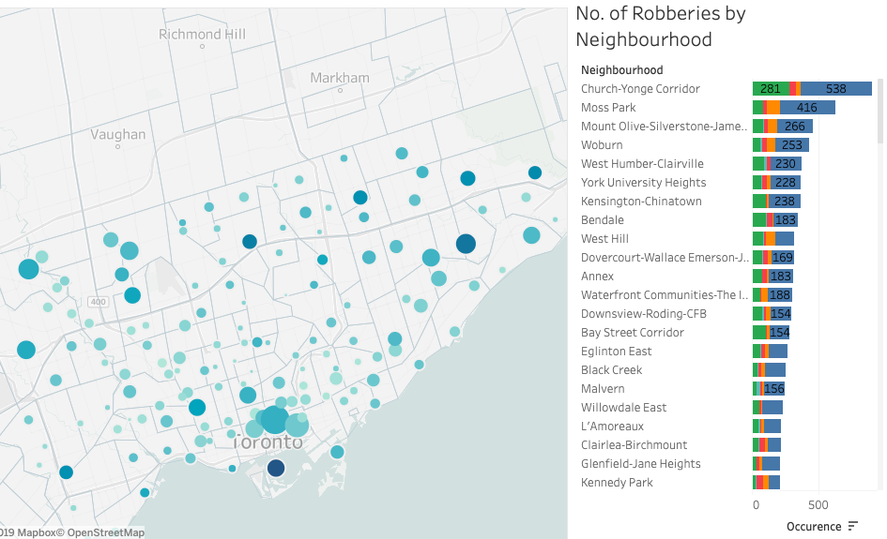

Slide 26
Neighbourhood analysis: What are the profiles of neighbourhoods with the most and least robberies?
Neighbourhood | Population Count | % Household Income > $200K | % Visible minority | % With Bachelor degree or above | Unemployment Rate | % Movers (mobility status 1 year ago)
Church-Yonge Corridor | 31340 | 6% | 41% | 58% | 9% | 27%
Moss Park | 20506 | 7% | 43% | 50% | 7% | 23%
Mount Olive-Silverstone-Jamestown | 32954 | 1% | 87% | 17% | 12% | 12%
Woburn | 53485 | 2% | 76% | 25% | 11% | 13%
West Humber-Clairville | 33312 | 3% | 82% | 22% | 10% | 12%
Bridle Path-Sunnybrook-York Mills | 9266 | 53% | 30% | 62% | 8% | 12%
Yonge-St.Clair | 12528 | 20% | 21% | 61% | 6% | 19%
Lambton Baby Point | 7985 | 21% | 24% | 47% | 8% | 10%
Forest Hill South | 10732 | 30% | 17% | 60% | 6% | 13%
Lawrence Park North | 14607 | 37% | 21% | 62% | 6% | 9%
MOST ROBBERIES
LEAST ROBBERIES

Slide 27
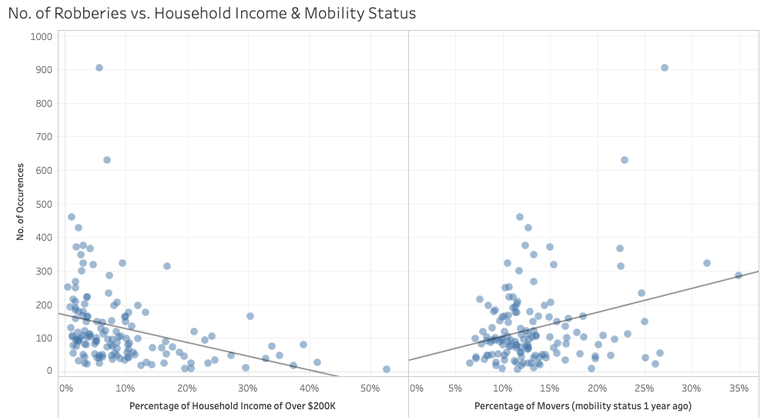
What is the correlation between robbery and income level of the area?

Slide 28
In what location types do most and least robberies occur?
Year | House | Apartment | Outside | Other | Commercial
2014 | 2175 | 336 | 317 | 80 | 677
2015 | 2032 | 342 | 227 | 103 | 760
2016 | 2085 | 293 | 290 | 125 | 820
2017 | 2128 | 351 | 337 | 126 | 959
2018 | 1875 | 311 | 296 | 92 | 948

Slide 29
Analysis - Response

Slide 30
Which police divisions respond to the most robberies?
Division | No. of Robberies (2014-2018)
D51 | 1774
D43 | 1572
D41 | 1428
D23 | 1422
D31 | 1402
D42 | 1242
D14 | 1173
D32 | 1019
D12 | 997
D52 | 930
D22 | 885
D11 | 788
D55 | 781
D54 | 730
D13 | 682
D33 | 645
D53 | 607
D51 :
Church-Yonge Corridor
North St. Jamestown
Moss Park
Cabbagetown-Sotuh St.-Jamestown
D53:
Bridle Path-Sunnybrook-York Mills
Yonge-St.Clair
Forest Hill South
Rosedale-Moore Park

Slide 31
How long do people wait to report a robbery?
Robbery Type | Mean Reported Hours
With weapon | 11.98
Financial institution | 17.03
Armoured car | 4.37
Home invasion | 14.35
Vehicle jacking | 1.95
Purse snatching | 23.42
Taxi | 5.89
Delivery person | 6.65
Swarming | 24.47
ATM | 11.73
Mugging | 19.72
Business | 12.5
Other | 38.85
“0 Hours time difference” = 10942 out of 18085 total robberies
Within 2 hours of occurrence: 1156 incidents
Within 4 hours of occurrence: 332
within 6 hours of occurrence: 105 reported

Slide 32
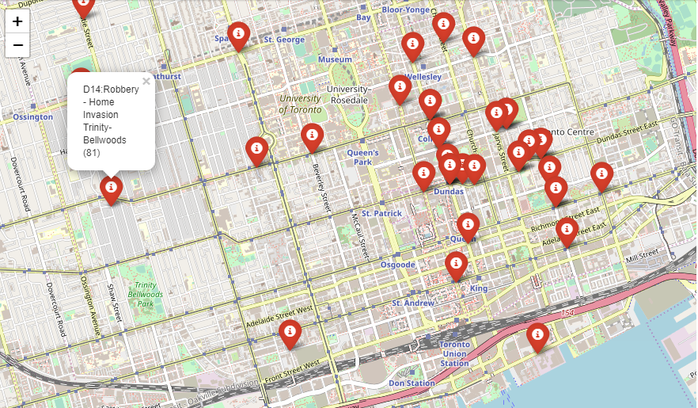
Plotting Divisions responding to Robberies in Toronto using the original data set including the location of the Robbery given in the Original data set Lat & Long

Slide 33
Conclusion

Slide 34
Difficult to conclude if Toronto’s safety (with respect to robbery) has significantly changed over the past 5 years
Most robberies occur:
By Mugging
During October and November
Between 0 – 10ºC
Little rain or snow
Friday and Saturday – late in evening/early in morning
In densely populated neighborhoods with less wealth and high mobility status
Are reported soon after occurrence

