Slide 1
A BETTER ALLOCATION TO REDUCE VOTING QUEUE LENGTH
CMP606 – Group777
Enas Mohamed
Hisham Naiem
Mostafa Izz
Department of Computer Engineering
Faculty of Engineering, Cairo University

Slide 2
Agenda
Motivation
Problem statement
State of the art
Potential contribution
Proposed word and plan
Conference
References
CMP 606 - Group 777

Slide 3
Tool Used
React.NET Discrete Event Simulation Framework
  Open Source Library
  Written in C#.Net
  http://reactnet.sourceforge.net/
CMP 606 - Group 777

Slide 4

Motivation
Egyptian constitutional referendum 2011
First genuinely free vote for Egyptians
High Turnout Rate (41%)
The upcoming parliamentary and presidential elections
CMP 606 - Group 777

Slide 5
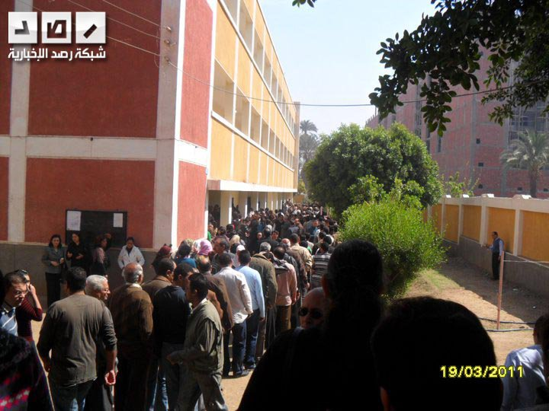
Problem statement
CMP 606 - Group 777

Slide 6
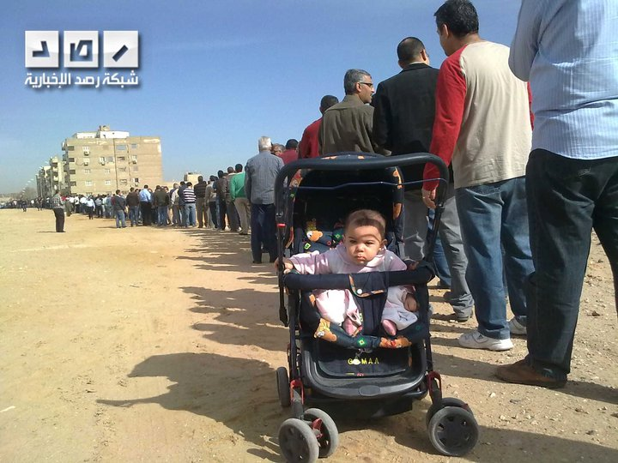
Problem statement
CMP 606 - Group 777

Slide 7
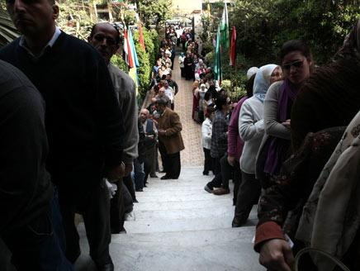
Problem statement
CMP 606 - Group 777

Slide 8

Problem statement
Large queues outside polling stations
Voters waited for hours in lines.
Some voters are forced to leave without voting due to impatience and other time commitments.
Voter Turnout
CMP 606 - Group 777

Slide 9
Problem statement
Design voting systems that result in voters waiting the least amount of time possible.
  Limited number of Judges supervising
  Number of voting precincts
  limited number of machines used in voting
  the distribution of these machines among different counties and precincts
CMP 606 - Group 777

Slide 10
Simulation Model
Precinct Open at 6:30 am and Close at 7:30 pm
After Close Time:
  open until all voters finishes
  not allowing any new voter
One or more identical DRE voting machines inside each precinct.
CMP 606 - Group 777

Slide 11
Input Distributions
Data set based on statistics from the 2004 election in Franklin County, Ohio
Number of voter,
  fit a normal distribution with mean 1070 and standard deviation 319
CMP 606 - Group 777

Slide 12
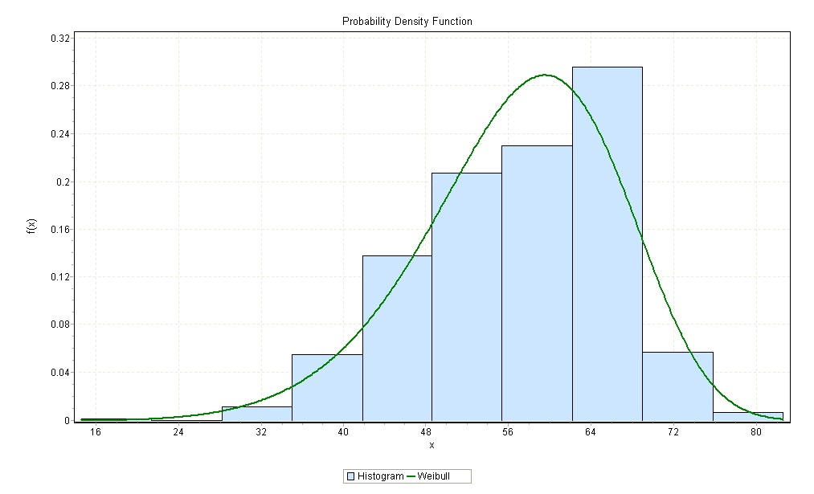
Input Distributions
Voter turnout rate
  fit a Weibull distribution with Shape Parameter α=6.9514 and Scale Parameter β=60.884
CMP 606 - Group 777

Slide 13
Input Distributions
Voting service time
  gamma distribution with shape parameter of 5.71 and scale parameter of 1.05 and 0.58
  Depend on the length of the ballot which requires the voter to read and take decision of his vote.
CMP 606 - Group 777

Slide 14
Input Distributions
Arrival Process
  non-stationary
  We assume that in each time period the number of arriving voters follows a Poisson distribution.
Period of Time | Percentage of Turnout Voters
Before 8 a.m. | 20.61
8 a.m. – 11 a.m. | 27.34
11 a.m. – 3 p.m. | 24.05
3 p.m. – 5 p.m. | 13.26
After 5 p.m. | 13.87
CMP 606 - Group 777

Slide 15
The Greedy Improvement Algorithm (GIA)
We used it to compare our new proposed method with it.
Contains two Phases:
  iteratively allocates a voting machine to the precinct with the largest estimated expected waiting time
  local improvement search to the neighborhood of each precinct
CMP 606 - Group 777

Slide 16
The Random Algorithm (RA)
Our proposed method for allocating machines across precincts. Contains two Phases:
  Allocate machines to precincts randomly
  iterative improvement by adding machine to the precinct with the maximum waiting time and remove one from the precinct with the minimum waiting time.
CMP 606 - Group 777

Slide 17

Performance Metric
Equity Metric
average absolute differences of expected waiting times among precincts
CMP 606 - Group 777

Slide 18
Experimental Design
Factors | Possible Values
Number of Precincts | 20 – 30 - 50 Precincts
Voting Time (Scale Parameter of Gamma Distribution) | 0.58 - 1.05
#Machines/#Precincts | 2 - 3.6
Allocation Strategy | RA - GIA
We use 50 replications for each scenario with 95% confidence-interval
CMP 606 - Group 777

Slide 19
Design Points
Design Point | Voting Time | No. of Precincts | No. of Machines
1 | 0.583 | 20 | 40
2 | 1.05 | 20 | 40
3 | 0.583 | 30 | 60
4 | 1.05 | 30 | 60
5 | 0.583 | 50 | 100
6 | 1.05 | 50 | 100
7 | 0.583 | 20 | 72
8 | 1.05 | 20 | 72
9 | 0.583 | 30 | 108
10 | 1.05 | 30 | 108
11 | 0.583 | 50 | 180
12 | 1.05 | 50 | 180
CMP 606 - Group 777

Slide 20
Results
DP | RA- Equity | RA - CI | GIA -Equity | GIA - CI
1 | 34.949 | 27.88 to 42.02 | 30.027 | 22.25 to 37.80
2 | 67.874 | 56.08 to 79.66 | 65.738 | 53.43 to 78.05
3 | 27.857 | 19.06 to 36.66 | 26.675 | 19.07 to 34.27
4 | 55.567 | 46.26 to 64.88 | 65.880 | 52.18 to 79.58
5 | 31.651 | 19.86 to 43.44 | 29.149 | 22.17 to 36.13
6 | 28.626 | 16.49 to 40.77 | 69.653 | 57.90 to 81.41
7 | 13.354 | 7.29 to 19.41 | 12.0472 | 8.56 to 15.54
8 | 32.961 | 21.26 to 44.66 | 36.377 | 27.52 to 45.24
9 | 14.867 | 7.19 to 22.55 | 16.031 | 9.74 to 22.32
10 | 21.002 | 10.98 to 31.02 | 45.641 | 35.45 to 55.83
11 | 6.689 | 0.00 to 13.47 | 23.236 | 16.31 to 30.17
12 | 9.106 | 2.57 to 15.65 | 41.936 | 32.85 to 51.03
CMP 606 - Group 777

Slide 21
Results
RA outperforms the GIA in the speed of simulation.
RA method is significantly better than GIA at large numbers of DRE Machines
In small numbers of DRE machines the GIA is slightly better than RA
  best result the equity is better with about 5 minutes less than RA equity result
CMP 606 - Group 777

Slide 22
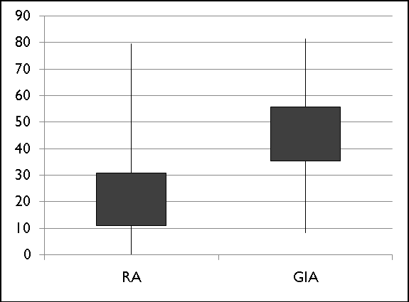
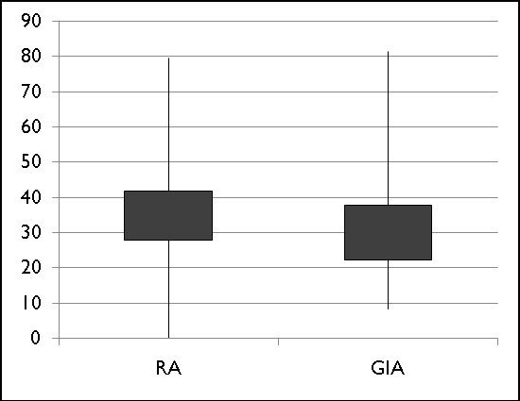
Confidence Interval
Design Point 10
Design Point 1
CMP 606 - Group 777

