Slide 1
AUTOMOBILE SHOP MANAGEMENT SYSTEM
Group T49

Slide 2
 | Name with Initials | Registration Number
 | Kumara K.V.Y.S | IT20299620
2. | Madushanka H.M.A | IT20610616
3. | Madhuranga B.D.H | IT20611910
4. | Withanage P.W.E.L | IT20600334
5. | Dilshan K.S.S | IT20107246
6. | Ashen A.V.S | IT20603472
7. | Karunathilaka A.G.G.N | IT20604462
8. | Lakshana W.N.R.A.S | IT20126056

Slide 3
Outline
Introduction
Client Introduction
Problem statement
Solutions
Benefits of the proposed solution
System overview diagram
Functions
Tools and Technologies
Work distribution
Project management plan

Slide 4
INTRODUCTION

Slide 5
Client Introduction
Gallage Motors is an accepted growing automobile service station in Sri Lanka. The main service here is the installation of vehicle injectors.
Other provided services such as-
Finding and betting a vehicle as a customer choice.
Full vehicle inspection & vehicle Maintenances are done by professional technicians
Finding & Requesting genuine spare parts.

Slide 6
Problem Statement
The client has a problem issuing a hard copy of the warranty certificate to the customer.
The client wants to make an online shop to sell the vehicles and spare parts.
In the current system, the client handles the financial details manually. It is time-consuming and difficult to handle.
The inconvenience to customers who come to get maintenance services.
Lack of a system for customers to submit ideas and suggestions about themselves.

Slide 7
Solutions
provide an interface to issue warranty and generate pdf to warranty.
Provide an interface to the customer to interact with online shop & admin can also manage an online shop.
Provide an interface to manage the company database.

Slide 8
Benefits of the system
Reduce the wasting time of managing the company.
The client can easily generate a new warranty certificate and print a hard copy and issue a warranty to the customer.
Customers can find information and request data about the vehicles and spare parts through the shops.

Slide 9
SYSTEM OVERVIEW DIAGRAM

Slide 10
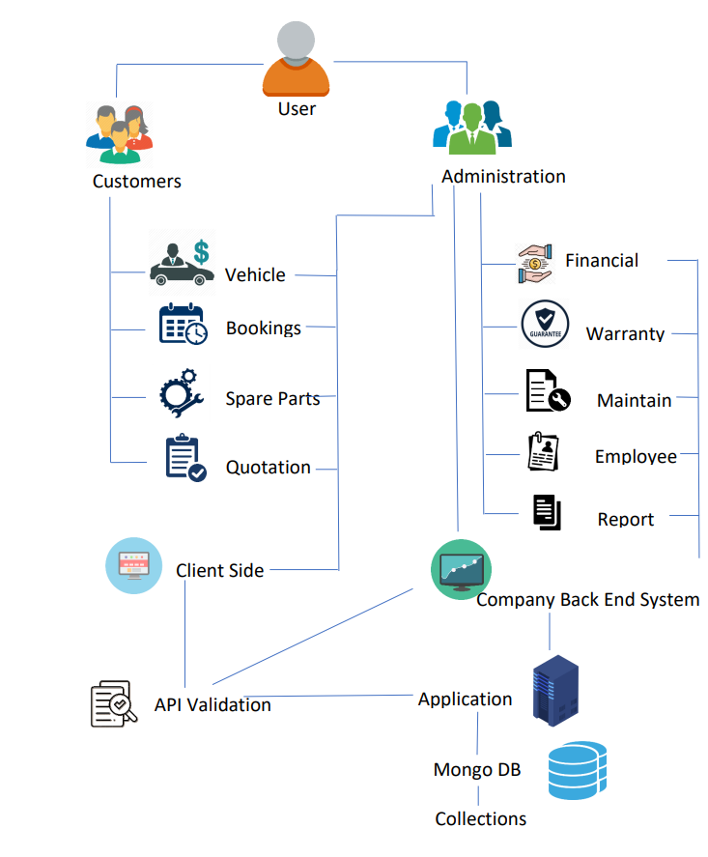
AUTOMOBILE SHOP MANAGEMENT SYSTEM

Slide 11
FUNCTIONS

Slide 12
01.Vehicle Sale Management Function
This function is mainly aims to managing all the used vehicle sales.
Customer can leave a bid for a preferred vehicles.
Through this function ,
Admin can add vehicle details to the system.
It will display the vehicle details and the user as well as the admin can retrieve vehicle details once searched.
Admin can update vehicle details.
Admin can remove vehicles and their details.
Admin can generate the monthly reports on customer responses for each vehicle.
Sell vehicle details are forward to finance management department.

Slide 13
02. Employee Management Function
This function manage all basic information and attendance of an employee.
Basic information based on details such as Employee ID, NIC, Job role, basic salary, etc. It also manages employee attendance, leaves and unpaid leaves.
Through this function
Admin can Update, Delete, and Search employee details.
Generate monthly reports on employee attendance.
Employee attendance details are forward to the finance management department.

Slide 14
03. Warranty Management Function
This function mainly aims to generate a warranty certification for injectors.
If the customer claims the warranty, those details will also be managed.
Warranty claim will be based on details such as Warranty ID, customer name, email, contact number, Technician details, repairing details, etc., claim details and warranty details will appear to admin.
Through this function,
Should be able to generate a PDF for each relevant warranty certificate.
Update warranty status validity and extend the warranty certificate.
Admin can delete expired warranty certificate.
Generate monthly reports for on all warranty claims.
Get details from spare parts management department.

Slide 15
04.Online Reservation Management Function
Customers can place an online reservation for maintenance in this function.
Online reservations are based on customer name, vehicle number, vehicle model, manufactured Year, preferred date, and time.
Using this function,
Online reservation confirmation details will be sent to the customer's email address.
Customers can be updated or delete their reservations.
Search reservation by vehicle number.
Reservation will be forward to maintain department.
Online reservation details are forwarded to the maintenance management unit.

Slide 16
05. Customer Care Management Function
Manage all customer feedback and emergency contact.
Feedback will be based on customer name, email, feedback massage, and ratings.
Using this function,
The customer will be contacted by the admin via email.
Customers can update and delete their feedback.
Search for customer emergency massages.
Generate monthly reports on customer feedback.

Slide 17
06. Finance Management Function
This function helps the owner to maintain financial records of the business.
finance management based on details such as salary information, discount details. Finance details will be sent to the admin.
Through this function,
Admin can generate calculate the profit, Bill data can be updated and deleted bill items. Search for billing information.
Admin can calculate the total expenses, total income & the net profit periodically.
Admin can get Employee details and attendance from employee management department.

Slide 18
07. Spare Parts Management Function
This function helps the admin to manage the spare parts stocks in the shop.
Users can view spare parts products in the shop.
Using this function,
Customer can view products and request them from the shop.
Admin can view buying and selling activities.
Admin can update, delete and add new spare part items.
Admin can generate report based on the available stocks in the shop.

Slide 19
08. Maintain Management Function
Manage vehicle maintenance by this function.
The maintenance is done based on details such as vehicle number, vehicle model, vehicle condition, etc.
Through this function,
Admin can add reviews of old, new and upcoming vehicles.
Admin can update the reviews posted.
Admin can delete the reviews posted.
Admin can generate report based on the reviewed vehicles.
Online reservation maintenance status will be sent to the customer Admin can assign technicians, update and delete maintain details. Search for Maintenance vehicles details.
generate monthly reports on completed maintenance.
Online reservation details are coming from the maintenance management unit.

Slide 20
TOOLS AND TECHNOLOGIES

Slide 21
Tools And Technologies
React js - React is the JavaScript framework that we use to develop the front end of the web application.
Node js - we use nodejs as our backend javascript runtime environment.
Express js - express js is the framework that we use to develop the backend API of the application.
MongoDB - MongoDB is the database program used for our web application.
Github - GitHub platform will be used for version control and collaboration with members.
ReduxTool - redux tool used for manage state in the web application.
Firebase Storage - firebase storage used for uploading files and images.

Slide 22
WORK DISTRIBUTION

Slide 23
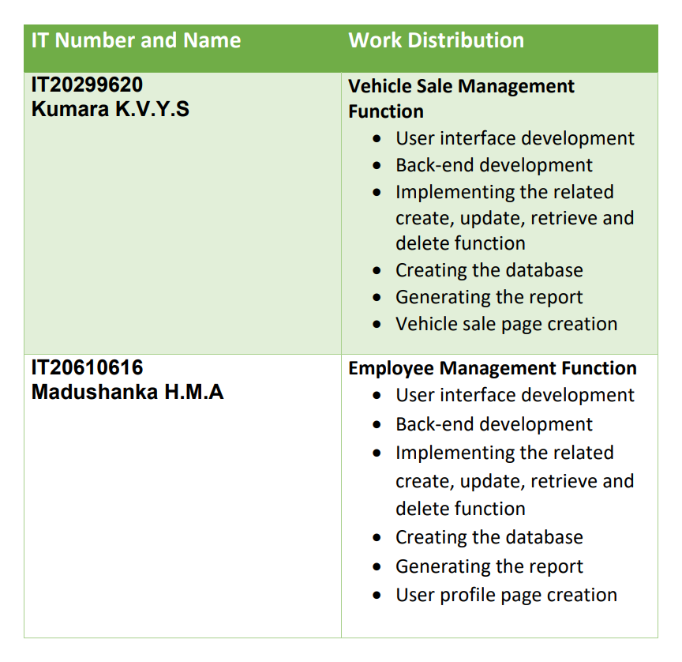

Slide 24
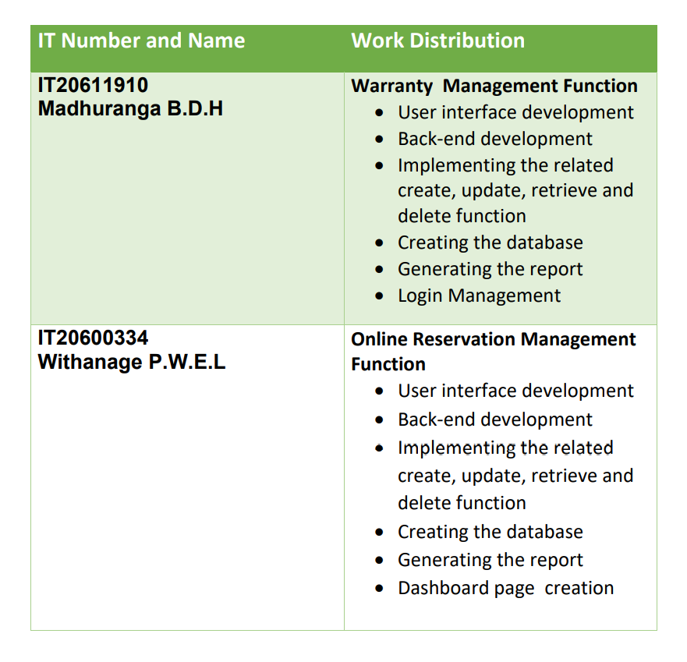

Slide 25
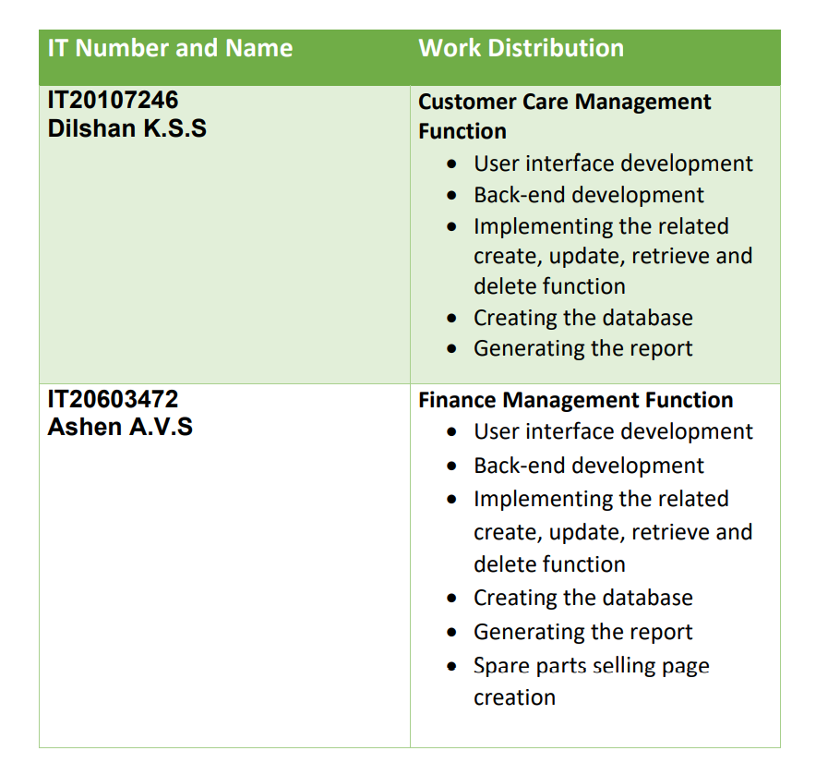

Slide 26
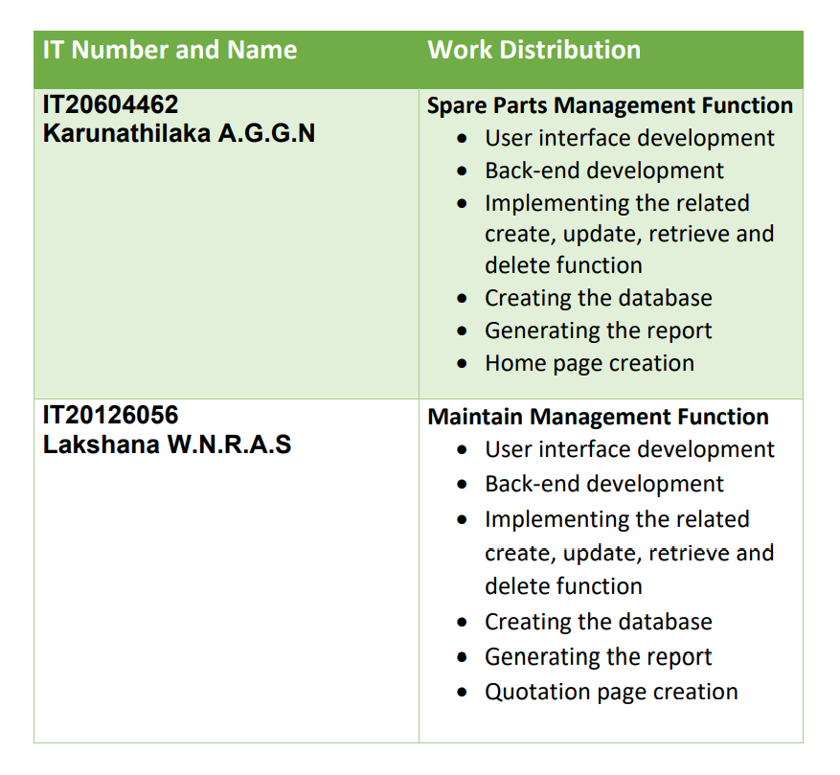

Slide 27
PROJECT MANAGEMENT PLAN

Slide 28
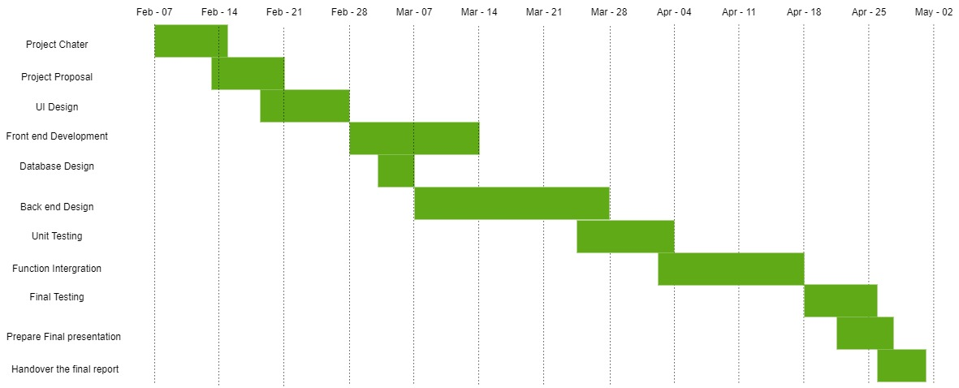

Slide 29
THANK YOU

