Slide 1


DOC330 Designing Innovative Solutions
Group JA-4

Slide 2

Group Members
20200467 - Heshan
20200490 - Maneesha
20200150 - Shanjay
20200519 - Jinithi
20200593 - Abbas
20200547 - Romel

Slide 3
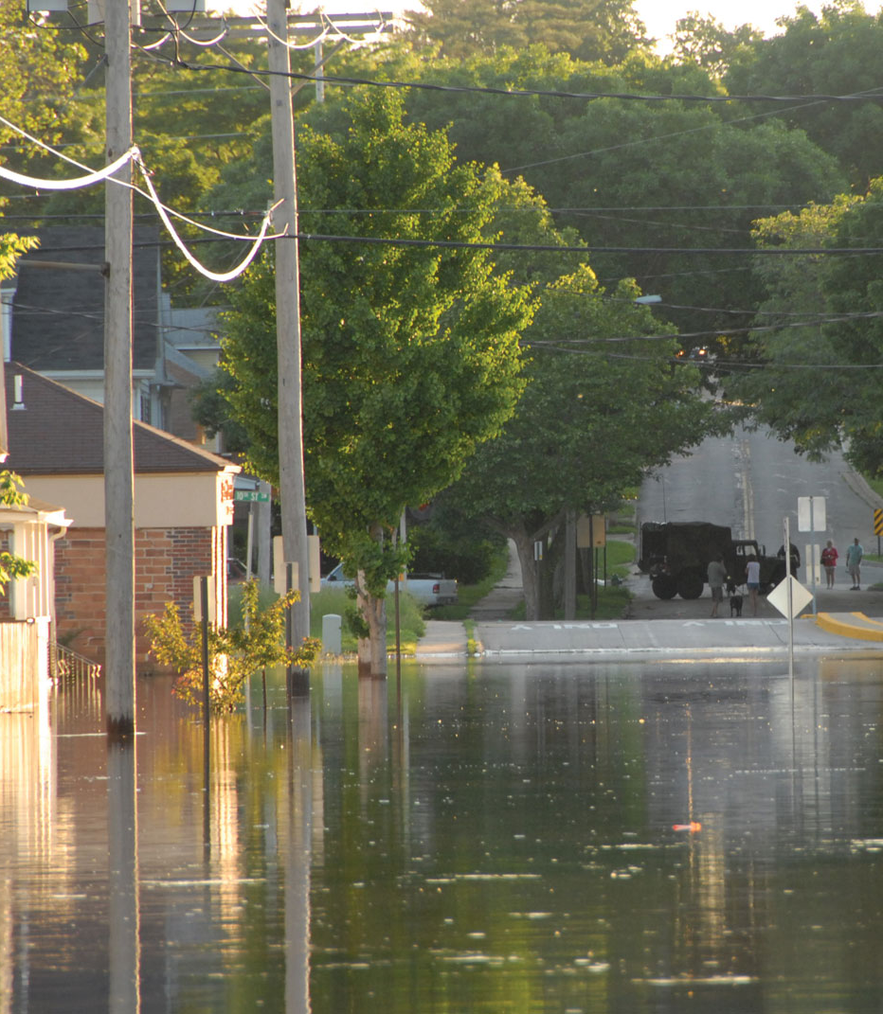
Introduction
The immediate effects of floods
Economic effects of floods
Environmental effects of floods
Effects floods have on the community
How our app provides for user

Slide 4
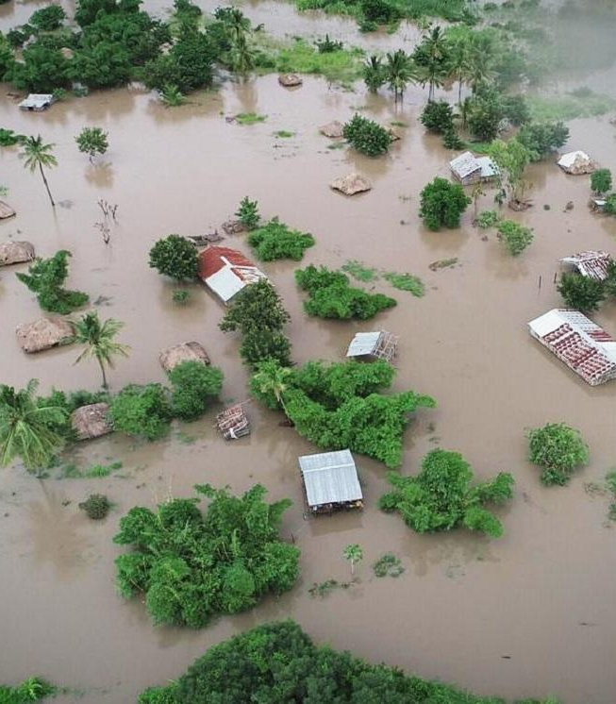
The Problem
What is a natural disaster?
Three types of natural disaster
Small scale
Medium scale
Larger scale
Late Warnings and News.
People are unaware of what do to during a disaster.

Slide 5
Target Market
Countries most effected by floods.
Areas most effected by floods.
People most effected by floods.

Slide 6

Solution

Slide 7

Innovation
Location based alerting system
Finding path feature
Can ask help from the rescue operation team
Opportunity to ask for donations

Slide 8

Key Benefits
Real-time Updates
Versatility
Practicality
Strict Security

Slide 9

Future Enhancement
Gathering information to insert server for more features.
Develop an advanced natural disaster prediction sensor.
Implement the sensors to all the region.
Recruitment of service teams.
Create awareness and importance of the application.

Slide 10

Conclusion
One of the main problems in Sri Lanka is flood and Landslides.
An app called “Disaster Survivor” was created.
The app’s main purpose was to alert the users when there is a natural disaster.
The targeted market people were almost everyone who are affected by floods and landslides.
The innovative features in this app are: interactive quizzes, a user feedback option and emergency services for users.
The future goal of this application is to make this worldwide to alert users on all type of disasters and save human lives.

Slide 11

Thank You!

