Slide 1
操作系统
宫晓利、蒲凌君、张久武
gongxiaoli@nankai.edu.cn、pulingjun@nankai.edu.cn、zhangjiuwu@nankai.edu.cn
南开大学 计算机学院 网络空间安全学院

Slide 2
章节5：进程间通信与并发控制

Slide 3
经典IPC问题

Slide 4
Problem models of IPC
Producer-Consumer
Bounded-buffer problem
Dinning philosophers
Synchronism based on mutual exclusion
Reader-Writher
Multi-process synchronism based on mutual exclusion
Sleeping barber
Synchronism and mutual exclusion under complex application environment

Slide 5

生产者-消费者问题
生产者
消费者
生产者
消费者
缓冲区
■
有界缓冲区的生产者-消费者问题描述
一个或多个生产者在生成数据后放在一个缓冲区里
单个消费者从缓冲区取出数据处理
任何时刻只能有一个生产者或消费者可访问缓冲区

Slide 6
用信号量解决生产者-消费者问题
■
问题分析
（互斥访问）
（互斥访问）
任何时刻只能有一个线程操作缓冲区
缓冲区空时，消费者必须等待生产者
（条件同步）
（条件同步）
（条件同步）
缓冲区满时，生产者必须等待消费者
（条件同步）
■
用信号量描述每个约束
二进制信号量mutex
资源信号量fullBuffers
资源信号量emptyBuffers

Slide 7
用信号量解决生产者-消费者问题
Class BoundedBuffer {
mutex = new Semaphore(1);
fullBuffers = new Semaphore(0);
emptyBuffers = new Semaphore(n);
}
BoundedBuffer::Deposit(c) {
emptyBuffers->P();
mutex->P();
Add c to the buffer;
mutex->V();
fullBuffers->V();
}
BoundedBuffer::Remove(c) {
fullBuffers->P();
mutex->P();
Remove c from buffer;
mutex->V();
emptyBuffers->V();
}
■
P、V操作的顺序有影响吗？

Slide 8
用信号量解决生产者-消费者问题
Class BoundedBuffer {
mutex = new Semaphore(1);
fullBuffers = new Semaphore(0);
emptyBuffers = new Semaphore(n);
}
BoundedBuffer::Deposit(c) {
mutex->P();
emptyBuffers->P();
Add c to the buffer;
fullBuffers->V();
mutex->V();
}
BoundedBuffer::Remove(c) {
mutex->P();
fullBuffers->P();
Remove c from buffer;
emptyBuffers->V();
mutex->V();
}
■
这个解决方案有什么问题吗？

Slide 9
信号量的代码示意
static int semaphore_v(void)
{
struct sembuf sem_b;
sem_b.sem_num = 0;
sem_b.sem_op = 1;
sem_b.sem_flag = SEM_UNDO;
if(semop(sem_id, &sem_b, 1) == -1)
{
fprintf(stderr, "semaphore_v failed/n");
return 0;
}
return 1;
}
static int semaphore_p(void)
{
struct sembuf sem_b;
sem_b.sem_num = 0;
sem_b.sem_op = -1;
sem_b.sem_flag = SEM_UNDO;
if(semop(sem_id, &sem_b, 1) == -1)
{
fprintf(stderr, "semaphore_p failed/n");
return 0;
}
return 1;
}
#include <sys/sem.h>
int semctl(int sem_id, int sem_num, int command, ...);
int semget(key_t key, int num_sems, int sem_flags);
int semop(int sem_id, struct sembuf *sem_ops, size_t num_sem_ops);
■
在实际编程中极易引入错误

Slide 10
Monitor solution
Design rules
Disadvantage of Semaphore: it is very dangerous and difficult for programmer to write proper code
Monitor: a collection of procedures, variables and data structures that can be recognized by compiler
Hoare (1974) and Brinch hansen(1975)
Application
Procedures in monitor: only one procedure can be activated in a monitor at any instant
Wait and signal: like P/V or D/U primitives, realize mutual exclusion and synchronism
Disadvantage: only few languages support this mechanism, such as Pidgin pascal and Java

Slide 11
管程的组成
■
一个锁
控制管程代码的互斥访问
■
0或者多个条件变量
管理共享数据的并发访问
入口队列
共享数据
入口队列
与条件变量相关的等待队列
与条件变量相关的等待队列
x
x
y
y
…
管程的操作成员函数
初始化代码

Slide 12
条件变量（Condition Variable）
■
条件变量是管程内的等待机制
进入管程的线程因资源被占用而进入等待状态
每个条件变量表示一种等待原因，对应一个等待队列
管程的设计思路是面向对象的编程方法与操作系统的权限管理的结合
操作系统负责管理线程的状态
用一个变量与线程紧密绑定，并且不许其他线程访问和操作
■
Wait()操作
将自己阻塞在等待队列中
唤醒一个等待者或释放管程的互斥访问
■
Signal()操作
将等待队列中的一个线程唤醒
如果等待队列为空，则等同空操作

Slide 13
条件变量实现
Class Condition {
int numWaiting = 0;
WaitQueue q;
}
Condition::Wait(lock){
}
Condition::Signal(){
}

Slide 14
条件变量实现
Class Condition {
int numWaiting = 0;
WaitQueue q;
}
Condition::Wait(lock){
numWaiting++;
}
Condition::Signal(){
}

Slide 15
条件变量实现
Class Condition {
int numWaiting = 0;
WaitQueue q;
}
Condition::Wait(lock){
numWaiting++;
Add this thread t to q;
}
Condition::Signal(){
}

Slide 16
条件变量实现
Class Condition {
int numWaiting = 0;
WaitQueue q;
}
Condition::Wait(lock){
numWaiting++;
Add this thread t to q;
release(lock);
schedule(); //need mutex
}
Condition::Signal(){
}

Slide 17
条件变量实现
Class Condition {
int numWaiting = 0;
WaitQueue q;
}
Condition::Wait(lock){
numWaiting++;
Add this thread t to q;
release(lock);
schedule(); //need mutex
require(lock);
}
Condition::Signal(){
}

Slide 18
条件变量实现
Class Condition {
int numWaiting = 0;
WaitQueue q;
}
Condition::Wait(lock){
numWaiting++;
Add this thread t to q;
release(lock);
schedule(); //need mutex
require(lock);
}
Condition::Signal(){
if (numWaiting > 0) {
}
}

Slide 19
条件变量实现
Class Condition {
int numWaiting = 0;
WaitQueue q;
}
Condition::Wait(lock){
numWaiting++;
Add this thread t to q;
release(lock);
schedule(); //need mutex
require(lock);
}
Condition::Signal(){
if (numWaiting > 0) {
Remove a thread t from q;
}
}

Slide 20
条件变量实现
Class Condition {
int numWaiting = 0;
WaitQueue q;
}
Condition::Wait(lock){
numWaiting++;
Add this thread t to q;
release(lock);
schedule(); //need mutex
require(lock);
}
Condition::Signal(){
if (numWaiting > 0) {
Remove a thread t from q;
wakeup(t); //need mutex
}
}

Slide 21
条件变量实现
Class Condition {
int numWaiting = 0;
WaitQueue q;
}
Condition::Wait(lock){
numWaiting++;
Add this thread t to q;
release(lock);
schedule(); //need mutex
require(lock);
}
Condition::Signal(){
if (numWaiting > 0) {
Remove a thread t from q;
wakeup(t); //need mutex
numWaiting--;
}
}

Slide 22
用管程解决生产者-消费者问题
classBoundedBuffer {
…
Lock lock;
int count = 0;
Condition notFull, notEmpty;
}
BoundedBuffer::Deposit(c) {
Add c to the buffer;
count++;
}
BoundedBuffer::Remove(c) {
Remove c from buffer;
count--;
}

Slide 23
用管程解决生产者-消费者问题
classBoundedBuffer {
…
Lock lock;
int count = 0;
Condition notFull, notEmpty;
}
BoundedBuffer::Deposit(c) {
lock->Acquire();
Add c to the buffer;
count++;
lock->Release();
}
BoundedBuffer::Remove(c) {
lock->Acquire();
Remove c from buffer;
count--;
lock->Release();
}

Slide 24
用管程解决生产者-消费者问题
classBoundedBuffer {
…
Lock lock;
int count = 0;
Condition notFull, notEmpty;
}
BoundedBuffer::Deposit(c) {
lock->Acquire();
while (count == n)
notFull.Wait(&lock);
Add c to the buffer;
count++;
lock->Release();
}
BoundedBuffer::Remove(c) {
lock->Acquire();
Remove c from buffer;
count--;
notFull.Signal();
lock->Release();
}
这里wait的作用：释放传入的lock锁，并释放CPU（运行权），直到获得下一次调度机会后，并重新获取lock锁后才返回。在调用者看来，wait的执行期并不长（因为发生了调度），并且没有占据锁

Slide 25
用管程解决生产者-消费者问题
classBoundedBuffer {
…
Lock lock;
int count = 0;
Condition notFull, notEmpty;
}
BoundedBuffer::Deposit(c) {
lock->Acquire();
while (count == n)
notFull.Wait(&lock);
Add c to the buffer;
count++;
notEmpty.Signal();
lock->Release();
}
BoundedBuffer::Remove(c) {
lock->Acquire();
while (count == 0)
notEmpty.Wait(&lock);
Remove c from buffer;
count--;
notFull.Signal();
lock->Release();
}

Slide 26
管程条件变量的释放处理方式
■
Hansen管程
■
Hoare管程
主要用于真实OS和Java中
主要见于教材中
l.acquire()
…
x.wait()
l.acquire()
…
x.wait()
T1进入等待
T1进入等待
T2进入管程
l.acquire()
…
x.signal()
…
l.release()
T2进入管程
l.acquire()
…
x.signal()
T2进入等待
T2退出管程
…
l.release()
T1恢复管程执行
…
l.release()
T1恢复管程执行
T1 结束
T2恢复管程执行
…
l.release()
这里锁的细节需要思考如何实现

Slide 27
Hansen 管程与 Hoare 管程
Hansen-style :Deposit(){
lock->acquire();
while (count == n) {
notFull.wait(&lock);
}
Add thing;
count++;
notEmpty.signal();
lock->release();
}
Hoare-style: Deposit(){
lock->acquire();
if (count == n) {
notFull.wait(&lock);
}
Add thing;
count++;
notEmpty.signal();
lock->release();
}
while
if
■
Hansen管程
■
Hoare管程
条件变量释放仅是一个提示
条件变量释放同时表示放弃管程访问
需要重新检查条件
释放后条件变量的状态可用
■
特点
■
特点
高效
低效

Slide 28
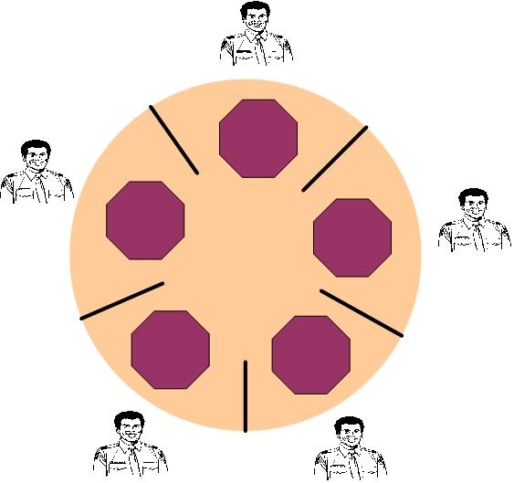
IPC problem: dining philosophers
Problem description
Philosopher: eating and thinking, alternatively
Eating: get left and right chopsticks and eat
Thinking: put two chopsticks
Starvation: all philosophers get one chopsticks

Slide 29
Analysis of “dining philosophers”
Mutual exclusion
Chopstick: only one philosopher can use it
Synchronism
Any philosopher must get two chopsticks before dining
The solution should assure that at most two philosophers can eat at same instant
Deadlock and starvation: the risk should be avoided

Slide 30
常见错误解法
#define N 5 /* 哲学家的数目 */
void philosopher(int i) /* i:哲学家编号,从0到4*/
{
while (TRUE) {
think(); /* 哲学家在思考 */
take_chopstick (i); /* 拿起左边的叉子 */
take_chopstick((i+1) % N); /* 拿起边上的叉子, %是模运算 */
eat(); /* 进餐 */
put_chopstick(i); /* 放下左边的叉子*/
put_chopstick((i+1) % N); /* 放下右边的叉子*/
}
}

Slide 31
聪明一些的解决方案
#define N 5 // 哲学家个数
semaphore fork[5]; // 信号量初值为1

Slide 32
聪明一些的解决方案
#define N 5 // 哲学家个数
semaphore fork[5]; // 信号量初值为1
void philosopher(int i) // 哲学家编号：0 － 4
while(TRUE)
{
think( ); // 哲学家在思考
eat( ); // 吃面条中….
}

Slide 33
聪明一些的解决方案
#define N 5 // 哲学家个数
semaphore fork[5]; // 信号量初值为1
void philosopher(int i) // 哲学家编号：0 － 4
while(TRUE)
{
think( ); // 哲学家在思考
if (i%2 == 0) {
} else {
}
eat( ); // 吃面条中….
}

Slide 34
聪明一些的解决方案
#define N 5 // 哲学家个数
semaphore fork[5]; // 信号量初值为1
void philosopher(int i) // 哲学家编号：0 － 4
while(TRUE)
{
think( ); // 哲学家在思考
if (i%2 == 0) {
P(fork[i]); // 去拿左边的叉子
P(fork[(i + 1) % N]); // 去拿右边的叉子
} else {
}
eat( ); // 吃面条中….
}

Slide 35
聪明一些的解决方案
#define N 5 // 哲学家个数
semaphore fork[5]; // 信号量初值为1
void philosopher(int i) // 哲学家编号：0 － 4
while(TRUE)
{
think( ); // 哲学家在思考
if (i%2 == 0) {
P(fork[i]); // 去拿左边的叉子
P(fork[(i + 1) % N]); // 去拿右边的叉子
} else {
P(fork[(i + 1) % N]); // 去拿右边的叉子
P(fork[i]); // 去拿左边的叉子
}
eat( ); // 吃面条中….
}

Slide 36
聪明一些的解决方案
#define N 5 // 哲学家个数
semaphore fork[5]; // 信号量初值为1
void philosopher(int i) // 哲学家编号：0 － 4
while(TRUE)
{
think( ); // 哲学家在思考
if (i%2 == 0) {
P(fork[i]); // 去拿左边的叉子
P(fork[(i + 1) % N]); // 去拿右边的叉子
} else {
P(fork[(i + 1) % N]); // 去拿右边的叉子
P(fork[i]); // 去拿左边的叉子
}
eat( ); // 吃面条中….
V(fork[i]); // 放下左边的叉子
V(fork[(i + 1) % N]); // 放下右边的叉子
}

Slide 37
Solution of “dining philosophers”
typedef int semph
#define N 5
#define LEFT(i)
(i + N – 1) % N
#define RIGHT(i)
(i + 1) % N
#define THINKING 0
#define HUNGRY 1
#define EATING 2
int state[N];
semph mutex = 1;
semph s[N];
Philosopher
void philosopher(int i)
{
While(TRUE){
think（）；
take_Chs(i);
eat();
put_Chs(i);}
}
take_chs
void take_chs (int i)
{
P(mutex);
state[i] = HUNGRY;
test(i);
V(mutex);
P(s[i]);//得不到叉子阻塞，否则继续执行
}

Slide 38
Solution of “dining philosophers”
Put_chs
void put_forks (int i)
{
P(mutex);
state[i] = THINKING;
test(LEFT(i));//唤醒旁边等叉子的人
test(RIGHT(i));
V(mutex);
}
Test
void test (int i)
{
if((state[i] == HUNGRY)
&& (state[LEFT(i)] ！= EATING)
&& (state[RIGHT(i)] != EATING))
{
state[i] = EATING;
V(s[i]);
}
}

Slide 39
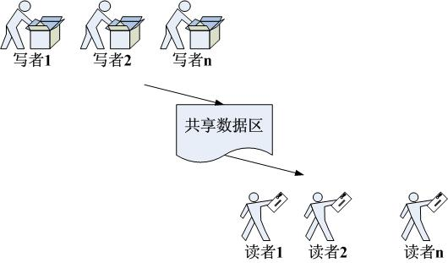
IPC problem: Reader-Writer
Problem description
Writer: put information into shared buffer
Reader: get information from shared buffer
Exclusion: reader/writer can’t access the buffer when any writer is putting item, but multiple reader can get item at same time
Synchronism: Writer sleep when FULL, while Reader sleep when EMPTY

Slide 40
Analysis of “Reader-Writer”
Mutual exclusion
Only one writer can access the buffer at any instant
If there is writer in the buffer, then all other readers and writers will be blocked
Multiple readers can access the buffer at the same time
Synchronism
Writer will sleep until all readers exit the buffer
Reader will sleep until all writers exit the buffer
Give priority to reader
Give priority to writer

Slide 41
用信号量解决读者-写者问题
Writer
Reader
write;
read;

Slide 42
用信号量解决读者-写者问题
Writer
Reader
P(WriteMutex);
P(WriteMutex);
write;
read;
V(WriteMutex);
V(WriteMutex);

Slide 43
用信号量解决读者-写者问题
Writer
Reader
if (Rcount == 0)
P(WriteMutex);
++Rcount;
P(WriteMutex);
write;
read;
V(WriteMutex);
V(WriteMutex);

Slide 44
用信号量解决读者-写者问题
Writer
Reader
if (Rcount == 0)
P(WriteMutex);
++Rcount;
P(WriteMutex);
write;
read;
V(WriteMutex);
--Rcount;
if (Rcount == 0)
V(WriteMutex);

Slide 45
用信号量解决读者-写者问题
Writer
Reader
P(CountMutex);
if (Rcount == 0)
P(WriteMutex);
++Rcount;
P(WriteMutex);
V(CountMutex);
write;
read;
V(WriteMutex);
--Rcount;
if (Rcount == 0)
V(WriteMutex);

Slide 46
用信号量解决读者-写者问题
Writer
Reader
P(CountMutex);
if (Rcount == 0)
P(WriteMutex);
++Rcount;
P(WriteMutex);
V(CountMutex);
write;
read;
V(WriteMutex);
P(CountMutex);
--Rcount;
如果读者持续到达，后续到来的读者不必再争抢，可以持续占据这个锁，称为读者优先
if (Rcount == 0)
V(WriteMutex);
V(CountMutex);

Slide 47
用信号量解决读者-写者问题
Writer
Reader
P(WCountMutex);
P(RCountMutex);
if (Wcount == 0)
if (Rcount == 0)
P(WriteMutex);
P(WriteMutex);
这个实现是不对的！
因为写者之间是存在冲突的，所以多个写者之间，必须还有一个锁！
同时还需要一个锁，防止读者打断连续到来的写者
++Wcount;
++Rcount;
V(WCountMutex);
V(RCountMutex);
write;
read;
P(WCountMutex);
P(RCountMutex);
--Wcount;
--Rcount;
if (Wcount == 0)
if (Rcount == 0)
V(WriteMutex);
V(WriteMutex);
V(WCountMutex);
V(RCountMutex);

Slide 48
用信号量解决读者-写者问题
Writer
Reader
思考：
1.读者连续到来，则后续读者不必重新申请锁WriteMutex，就能连续读取
2.同理，写者连续到来时，写者也不必申请ReadMutex，就能连续写入
3.如果读者连绵不断而写者到来，写者能否打断读者并夺回控制权？
P(WCountMutex);
P(ReadMutex);
if (Wcount == 0)
P(RCountMutex);
P(ReadMutex);
if (Rcount == 0)
++Wcount;
P(WriteMutex);
V(WCountMutex);
++Rcount;
P(WriteMutex);
V(RCountMutex);
write;
V(ReadMutex);
V(WriteMutex);
read;
P(WCountMutex);
--Wcount;
P(RCountMutex);
if (Wcount == 0)
--Rcount;
V(ReadMutex);
if (Rcount == 0)
V(WCountMutex);
V(WriteMutex);
V(RCountMutex);

Slide 49
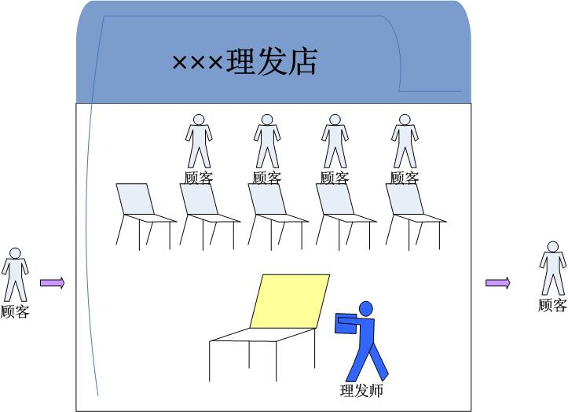
IPC problem: Sleeping Barber
Problem description
One chair for barbering, and N chairs for waiting
Customer: occupy barbering chair, or sit on waiting chair, or leaving when all chairs are full
Barber: 0 customer sleeping, or working

Slide 50
Analysis of “Sleeping Barber”
Mutual exclusion
Barbing chair: only one customer can use it
Synchronism
Barber will sleep until customer appeared
The waiting chair is a “producer-consumer” problem

Slide 51
Solution of “Sleeping barber”
barber
While(TRUE)
{
P(customer);
P(mutex);
waiting = waiting – 1;
V(barbers);
V(mutex);
barbering();
}
customer
While(TRUE)
{
P(mutex);
if(waiting < CHAIRS)
{
waiting += 1;
V(customer);
V(mutex);
P(barber);
}
else
{V(mutex);}
}
#define CHAIRS N
typedef int semph
semph customer = 0;
semph barer = 0;
semph mutex = 1;
int waiting = 0;

Slide 52
Message Passing
Design rules
Semaphore mechanism depends on CPU, under distributed environment, this mechanism is useless
All mentioned method is designed for mutual exclusion and synchronism, general information transferring between processes need more simple and efficient mechanism
Key issues
Stability: avoid data/information losing
Consistency: assure the target is correct
Efficiency: unified format of message and transferring transaction
Method
Simple message passing: send and receive primitive
Mail box: supported by OS
Rendezvous: without intermediate buffer

Slide 53
Solution of “Producer-Consumer”
＃define N 100
Producer
int item;
message m;
While(TRUE)
{
Produce-Item(&item);
recieve(consumer,&m);
build-message(&m,item);
send(consumer,&m);
}
Comsumer
int item,i;
message m;
for(i = 0; i < N; i++)
send(producer,&m); While(TRUE)
{
receive(producer,&m); extract-item(&m,&item);
send(producer,&m); Consume-item(item);
}
Send和Receive是内核提供的函数，能够保证不丢失、不乱序、不被中途打断等特性

Slide 54
基本同步方法
临界区
管程
并发编程
高层抽象
信号量
锁
条件变量
阻塞
(等待队列)
忙等
(自旋锁)
软件
解决
禁用中断
原子操作
(如TS指令)
原子
Load/Store
硬件支持

Slide 55
你需要知道的一些事
没有任何一个哲学家因操作系统的研究被饿死
哲学家就餐问题，或类似问题，极少在工程问题中出现
锁机制的使用远超过信号量
操作系统通常仅向用户提供最简单的同步机制，其他内容由用户自主开发或第三方完成
操作系统的内核代码中反而缺少好的管理
并发与同步引起的错误是极难发现和消除的，目前没有很好的工具和手段
管程在C++中没有支持，在JAVA中也没有完整的实现
锁是一种消极的机制，改进的方案是事务型内存

Slide 56
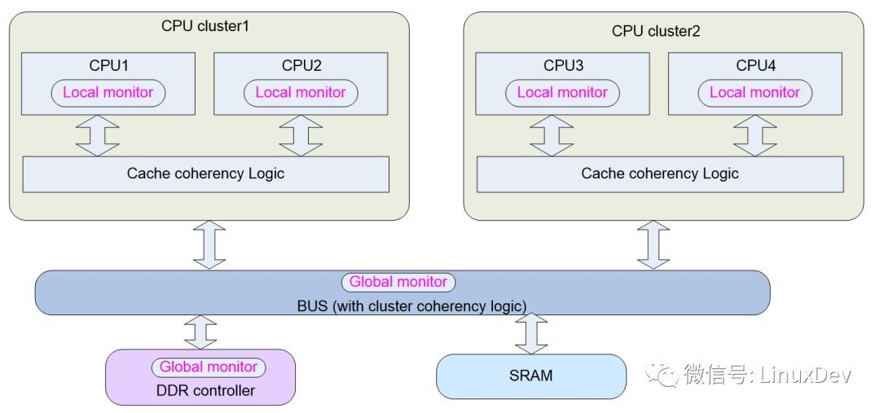
关于锁机制的实现
Test-and-Set是两个内存操作
如何在RISC指令中实现？
Exclusive Monitor
Load-Exclusive && Store-Conditional

Slide 57
为什么程序员倾向于锁，而不是信号量?

Slide 58

中断、异常和系统调用的开销
■
PC跳转，但代价远超过函数调用
开销：
■
引导机制
建立内核堆栈
结论：每个系统调用大概需要1000个指令的执行时间，虽然各种体系结构都尝试过优化，仍需要200ns以上的时间，甚至有的系统实现会到十几个微秒
验证参数
内核态映射到用户态的地址空间
· 更新页面映射权限
内核态独立地址空间
· TLB
https://blog.csdn.net/Rong_Toa/article/details/110350807

Slide 59
让我们来思考一下多核
如何让关中断方法有效？
如何让TSL方法有效？
核间的数据交换的额外代价是什么？
核间的进程调度会带来什么问题？

Slide 60
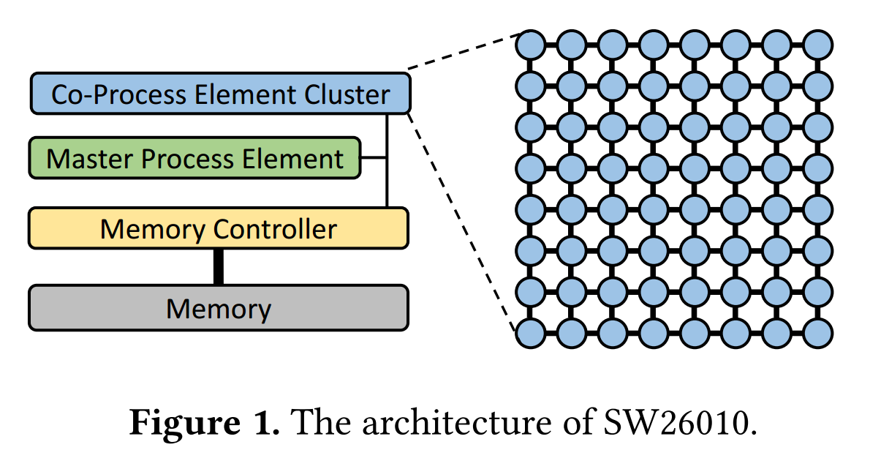
pLock：神威太湖之光上的锁机制
Xiongchao Tang, Jidong Zhai, Xuehai Qian, and Wenguang Chen. 2019. PLock: A Fast Lock for Architectures with Explicit Inter-core Message Passing. (ASPLOS '19).

Slide 61
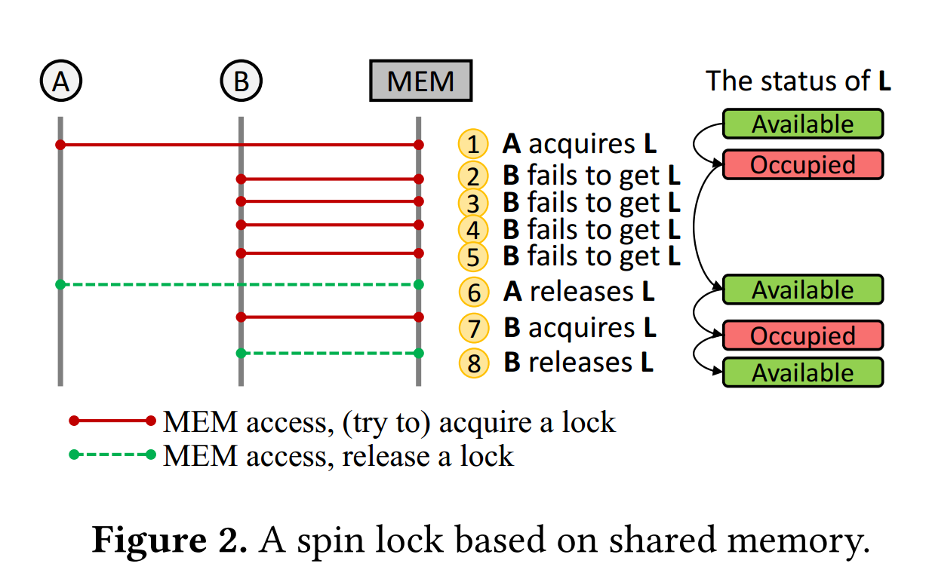
pLock：神威太湖之光上的锁机制

Slide 62
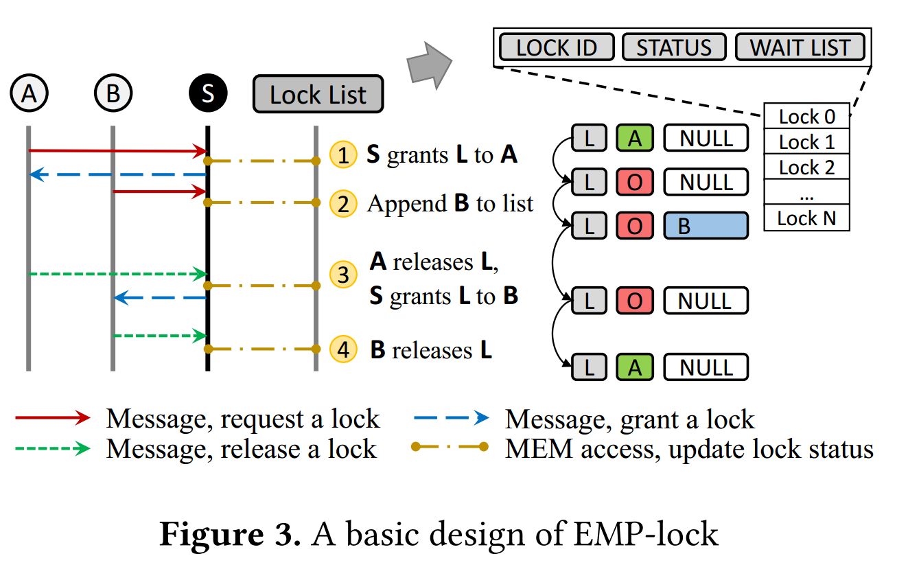
pLock：神威太湖之光上的锁机制

Slide 63
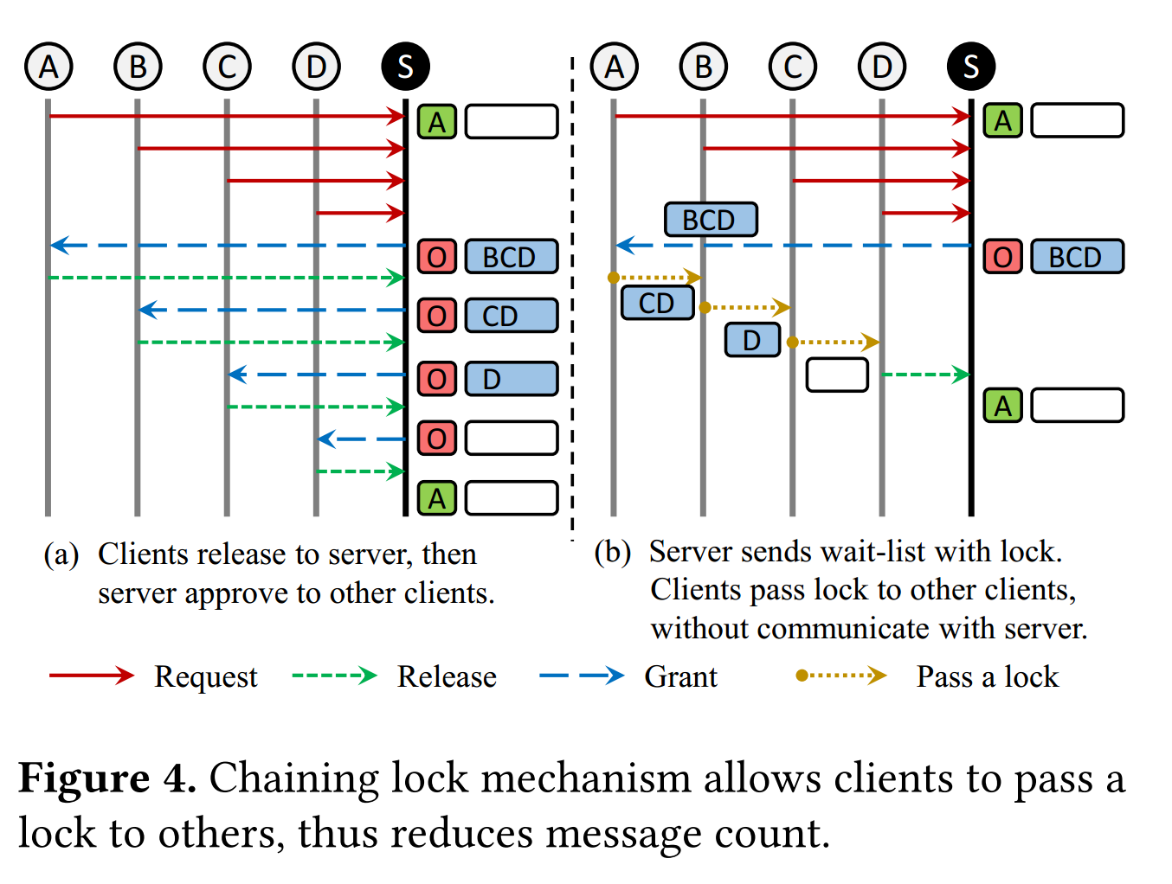
pLock：神威太湖之光上的锁机制

Slide 64
Thanks for your time! Questions & Answers

