Slide 1
操作系统
宫晓利、蒲凌君、张久武
gongxiaoli@nankai.edu.cn、pulingjun@nankai.edu.cn、zhangjiuwu@nankai.edu.cn
南开大学 计算机学院 网络空间安全学院

Slide 2
章节7：设备管理

Slide 3
设备有什么特点？
以鼠标、键盘、显示器为例
速度慢
不易共享
每类设备都有自己的工作逻辑
同一设备，由不同厂商生产，也会有一定的差别
应用程序需要为每一款设备调整吗？
应用程序需要知道其他人在使用设备吗？

Slide 4
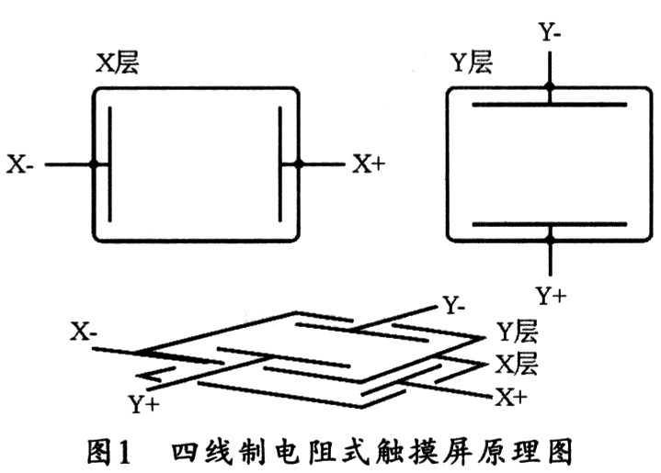
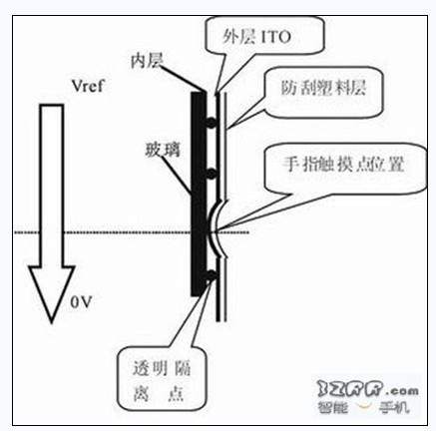
示例：电阻式触摸屏工作原理

Slide 5
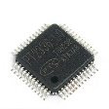
示例：触摸屏与计算机连接示意
计
算
机
主
机
触摸屏
触摸屏控制器
USB控制器
CPU
专用电路连接
CPU仅能支持有限类型的电路连接
（USB，并口等）
设置X向标准电压
采集X向的触点电压
AD转换得到相对位置
类似的处理Y向
周而复始的循环
存在有效点时产生中断
按通信协议取走触点的坐标（X,Y）
按需关闭和开启

Slide 6

Architecture of Device Management System
进程如何简单易用的操作设备？如何在多个进程之间共享设备？
Application level
User Process
Operating System
Hardware Abstract Level
I/O Software
Device Driver
Interrupt Handler
I/O Hardware
Physical device
Controler
Status Reg
CMD Reg
Data Reg
设备如何与系统中的软件交互？如何简化多种多样的设备的管理？

Slide 7
分类和抽象：Categories of Devices
Classified by Function
Storage device: Temporarily or permanently
I/O device: Human-Computer interactive
Communication device: Data exchange and transfer
Classified by Data management method
Block stream: using block in different size as the basic unit for data management
Byte stream: using byte as the basic unit for DM
Classified by Device assignment
Monopolization device: Low-speed I/O device
Sharing device: high-speed I/O device
Virtual device: simulating hardware by software
Classified by working mode
Logical device: data structure maintained by OS
Physical device: different kinds of hardware

Slide 8
Discussion of Devices Management
Complexity of Device
Different devices have different working mode
Different devices use different data format
Different devices support different interfaces
Important issues about devices
Speed: the bottleneck of computer
HCI: operation mistake caused by user
Compatibility: device-independent & OS-independent
Key strategy of device management
Efficient and reasonable: harmonize the speed difference between CPU, RAM and devices. Control and manage devices in more efficient way.
Convenient: compatible, safe and stable
Standardization: the basement of IT industry

Slide 9
设备管理的重要思路
标准化
为了减少应用软件开发人员的工作，上层应尽少感知硬件的差异，例如，所有控制光标的设备，传给上层的数据都一样
为了减少操作系统开发人员的工作，OS应尽量减少为不同硬件做出的修改，例如，所有的鼠标的控制逻辑都一样
分类处理
设备的类型过于多样和复杂 ，不可能所有的设备都归类到同一标准上
灵活性
能够支持某类设备的新款式，例如，鼠标增加了新按键、键盘加了控制灯
能够支持新类型的设备，例如，条码枪

Slide 10
Purpose of Devices Management
Device-independent programming interface
Hide the difference between hardware components
Provide simple and universal control methods for user
Maintain the safety and stability of user process
Efficient management strategy
Allocation and releasing: like process scheduling
Performance enhancement: improve data transferring speed and make devices more adaptive for CPU and RAM
Protection: internal and external protection, deadlock
Difficulties of devices management
Port address management
Control mode design
deadlock: unreasonable device request or assignment

Slide 11
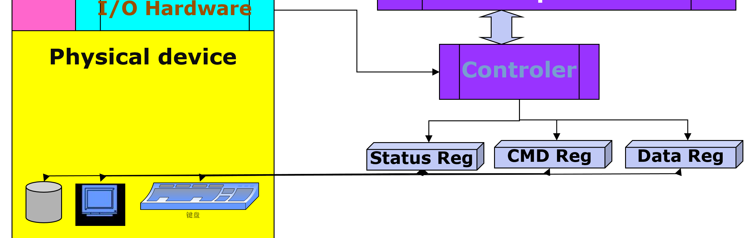
设备的工作
将外部的机械变化（如开关按下抬起）、模拟信号变化（如温度高低变化）等信息，转变为电信号（如电路通断、电压高低等），进而转变成为计算机可以处理的数字信号（按键编码、温度值等）的过程
设备完成上述过程后，将所得到的数据，放于自自的寄存器、数据buffer等结构中，供CPU读取，并准备好控制接口，供CPU发布控制命令
受限于CPU与其他器件连接的方式，设备制造商需要为设备制造“适配器”，以方便完成电路连接和数据格式连接

Slide 12
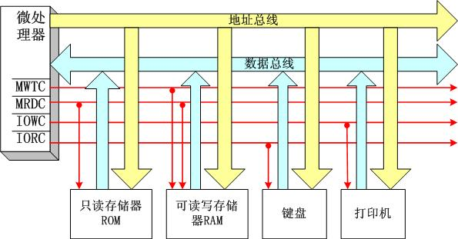
Communication between CPU and devices
CPU如何读写设备提供的数据接口？

Slide 13
How to access devices?
I/O port
ID of the devices’ registers
Computer maintains a I/O port list for I/O communication
Disadvantage: separates memory space and devices’ registers
Memory-mapped I/O
All devices’ registers are mapped into memory space
Each register is assigned a unique memory address
Advantage: uniform address format

Slide 14
Dependent address : I/O port
Advantages
Separate I/O address from memory address, special I/O instructions are designed to access I/O port
It is very easy to distinguish I/O access and memory access, the cost of management is little
Disadvantage
Only simple instructions can be used for I/O communication, complex I/O programming is difficult
The programming model and address-mapping method are different, it is not convenient for programmers

Slide 15
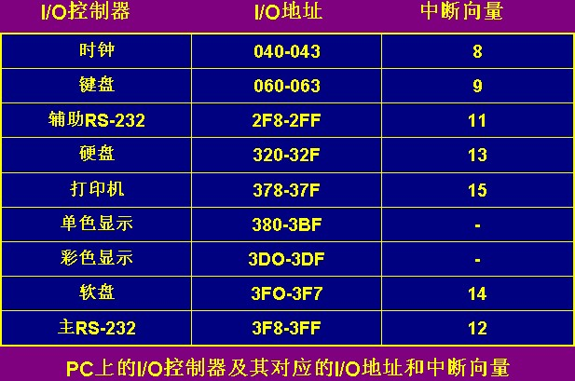

Slide 16
Memory-mapped I/O
Advantages
Treat I/O address as a part of memory address, an global address space is generated
The difference between I/O and memory is hidden, programmer can design complex I/O program
I/O address can be protected efficiently
Disadvantage
It is difficult for hardware to distinguish the address of memory and I/O devices
The cost of management is higher, and it is more complex under double-bus or multi-bus architecture

Slide 17
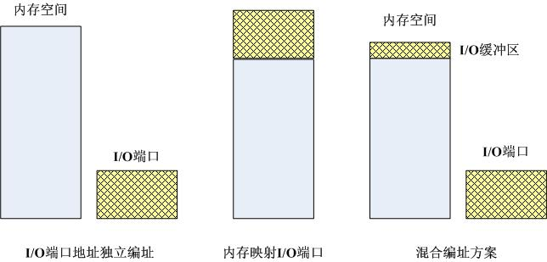
Memory-mapped I/O
Data buffer is mapped into memory space ;
Registers are identified by unique I/O port.
Real Sample: Pentium
这种IO地址映射进入内存的设计，可以使IO设备与内存共享寻址机制与数据传输介质因此使用更为广泛

Slide 18
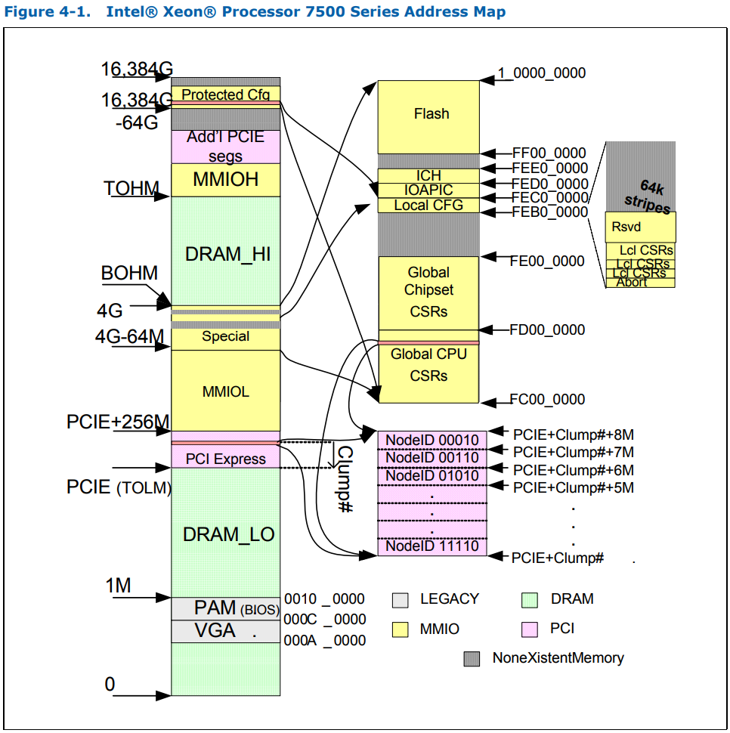
现实中处理器的地址空间布局

Slide 19
设备管理的问题
专用的IO指令以访问专用的IO端口区域读写
普通指令还是特权指令？
IO指令是早于特权模型出现的
设备管理接口映射到地址空间的特定区域
普通区域还是特权区域？
物理内存地址还是虚拟内存地址？
设备管理程序是操作系统的一部分，或者与操作系统一并运转在特权模式
现代高性能系统中，为了提高效率，直接映射到用户空间

Slide 20
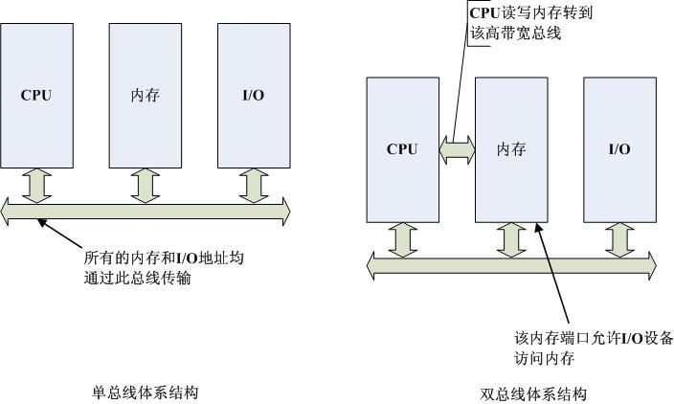
How to access devices---BUS 共享的总线方便了设计但也限制速度

Slide 21
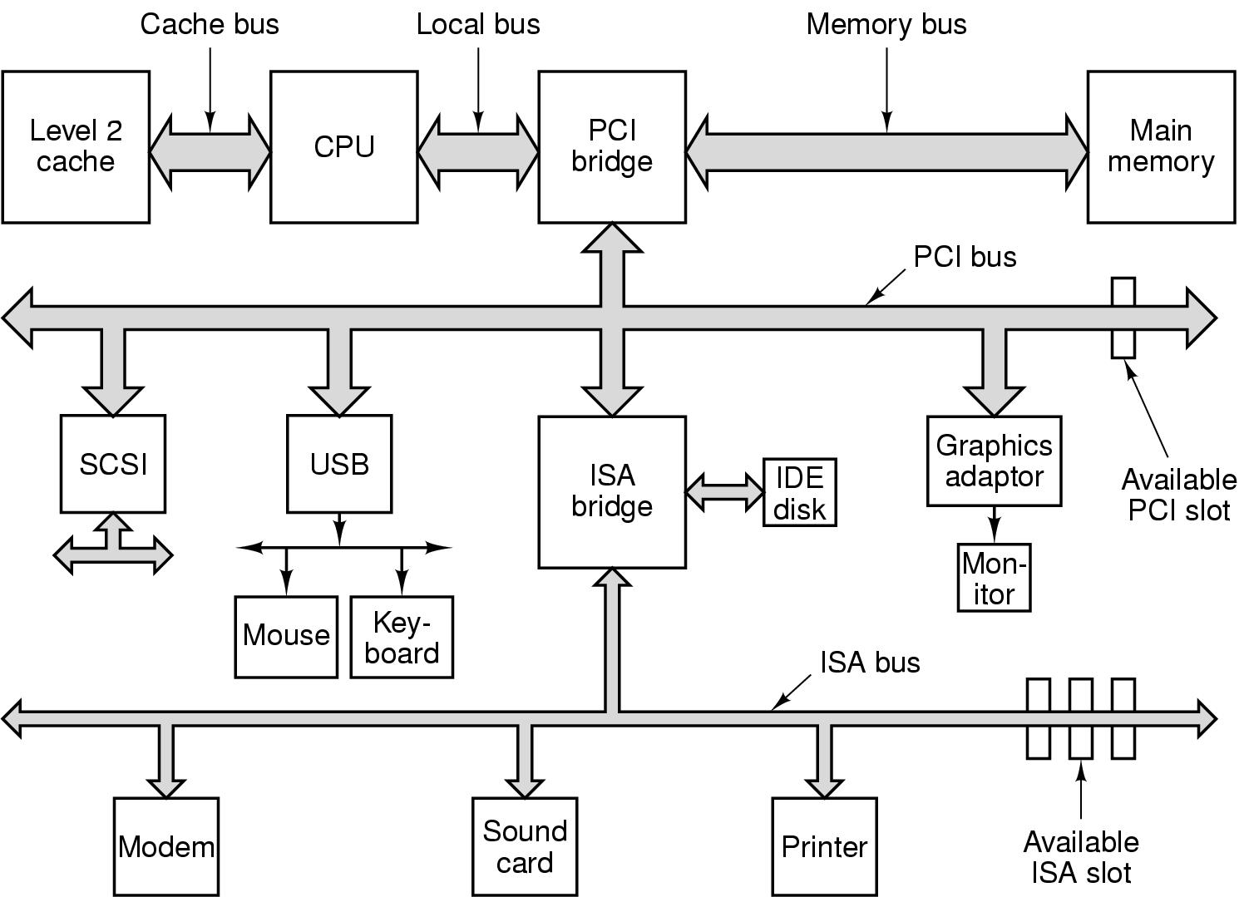
How to access devices---BUS

Slide 22
如何及时发现数据并传输
发现
等待并轮循
中断
传输
由CPU发起，逐字节传输
由DMA设备代为发起，以块为单位传输

Slide 23
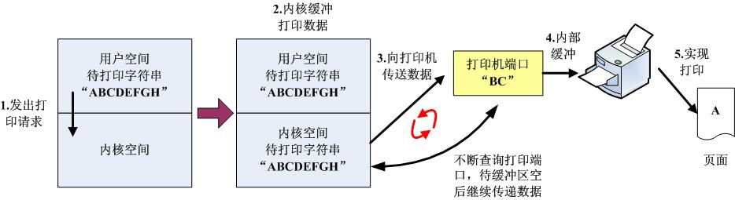
Working mode of devices: busy waiting
Special kernel process sends the data to device port;
The process checks the port repeatedly until the port is available and sends rest data;
The user process continues run after the kernel process is finished;
Disadvantage: CPU is wasted too much

Slide 24
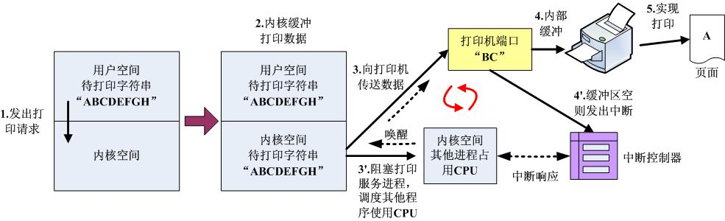
Working mode of devices: interrupt
Special kernel process sends the data to device port;
The process goes to sleep and CPU will run other processes;
The device send interrupt to CPU after the data buffer is empty;
The kernel process is waked up and send the rest data
Disadvantage: frequent interrupts are time-consuming

Slide 25
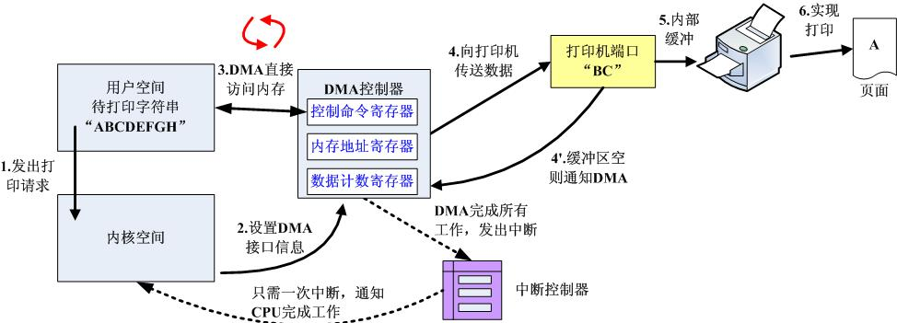
Working mode of devices: DMA
User process causes a CPU trap, the special kernel process sets the registers in device and exits;
Device read data from memory directly;
The device send interrupt to CPU after the job is done;
The user process is waked up and continues run

Slide 26
Thanks for your time! Questions & Answers

