Slide 1
章节9：死锁（Deadlock）

Slide 2
Description of Dead Lock
Scene of dead lock
Process A: Holds CD-Rom, requests printer
Process B: Holds printer, requests CD-Rom
Dead lock: Both processes are blocked, CD-Rom and printer are not available for other processes
Printer
Proc A
Proc B
CD-ROM
Operating System
2
CITS, NanKai University

Slide 3

Analysis of Dead Lock
Definition of dead lock
A process set that any process in this set is waiting for the event executed by another process in this set. This status is named dead lock.
Conditions of dead lock
Mutually exclusive resource allocation: the resource can’t be shared by multiple processes.(nonpreemptable)
Process holding some resource and waiting for some resource, it is blocked until the request is satisfied.
The holden resource can’t be bereft by OS, only its master can release it.
Circular waiting sequence: each process in this sequence is waiting its neighbor to release some resource, and the sequence is circular.
Operating System
3
CITS, NanKai University
Notes:
都在等待这个集合里的其他的进程完成
资源排它使用
占有资源并等待
无法被抢
循环等待

Slide 4
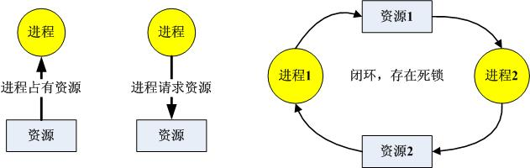
Analysis of Dead Lock
Dangerous of dead lock
The dead lock process set will never be activated and the holden resource will be unavailable for ever.
Unreasonable resource allocation mechanism may cause dead lock.
Describe dead lock via directed graph:
Operating System
4
CITS, NanKai University

Slide 5
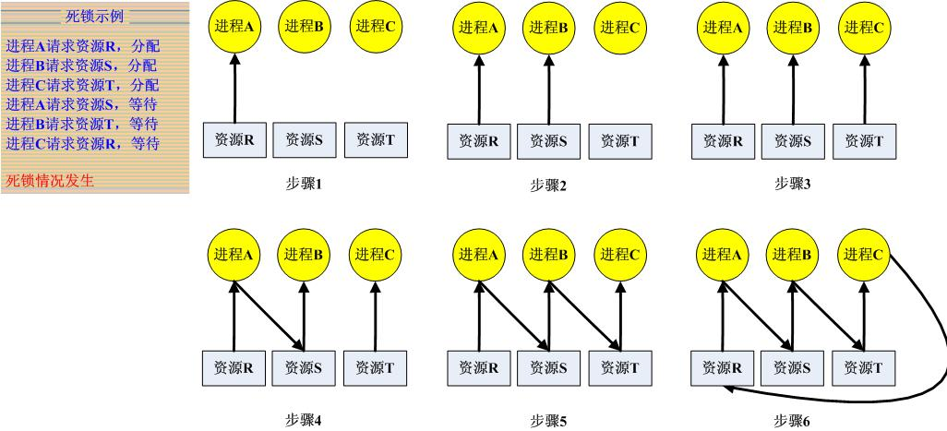
Sample of Dead Lock
Operating System
5
CITS, NanKai University

Slide 6
How to resolve dead lock problem
Dead lock prevention
OS defines some constraint rules and restrict resource request and allocation of process.
The constraint rules will destroy the conditions of dead lock
Dead lock avoidance
OS analyzes current status of resource allocation and try to allocate resource in a safe way
Dead lock detection and system recovery
A special process is in charge of dead lock detection
The dead lock process will be killed and the holden resource will be released.
Ostrich policy
Dead lock is a kind of low-probability event.
Do nothing for low-probability event.
Operating System
6
CITS, NanKai University
Notes:
驼鸟算法，小概率事件
检测并恢复
预防：预先定好议案，宁可浪费不能死锁，如果有任何风险就不用
避免：不断检测，不断预防

Slide 7
Dead lock prevention
Idea of this method
Destroys the conditions of dead lock
Mechanism and constraint rules
Spooling mechanism: sharing resource virtually.
Resource allocating prediction: satisfy all resource requirements of a process in one allocation, otherwise the process will be blocked until all needed resource is available.
Resource bereaving: bereaves the resource of dead lock process and allocates the resource to other process.
Labeled resource sequence: assign type ID for each kind of resource, process must request the resource in ascending/descending order.
Operating System
7
CITS, NanKai University
Notes:
并发运行前先分配资源，设计机制打破死锁的条件，使得死锁不会出现
1. 用spooling方法，不再独占资源，
2. 一次性的分配所有的所需资源给进程
3. 资源剥夺，顺序排列
4. 按照顺序分配资源，消除环形分配
资源剥夺：？？？？可抢占
按IO排序，只能按顺序获取资源，就不会有环了

Slide 8
Spooling工作原理
预输入模块：将作业输入到输入井中；
缓输出模块：将作业结果缓冲式输出到独享设备上；
作业调度模块：控制作业从输入井中取数，向输出井中送数；
输入、输出井：在磁盘上开辟的两个 “井”区域。
8

Slide 9
Dead lock avoidance
Idea of this method
Dead lock preventing is unreasonable and not friendly for user.
OS analyzes the resource allocation status and assures the system to be safe and stable.
Status of resource allocation
Safe status: a reasonable resource allocation sequence is existed to make all process run to end properly.
Unsafe status: can’t find a safe resource allocation sequence to avoid dead lock.
Mechanism of dead lock avoidance
When process request some resource, OS will check whether the status is safe, the resource will be allocated under safe status and won’t be allocated under unsafe status
Operating System
9
CITS, NanKai University
Notes:
预防只是理想情况，难以完全全部情况的预测，所以只能边走过看
这是运行时的死锁避免，也就是动态的确定策略避免
改成请求预测式，如果得到请求，并且判断不可能引起死锁之后，才会分配资源
否则让进程等待
也就是说，对于死锁避免而言，我们承认死锁是存在的，只要不走到那里去就可以了

Slide 10
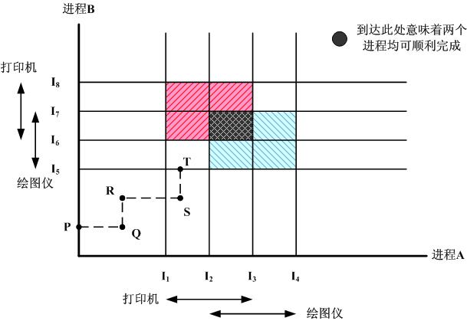
Resource allocation track
Operating System
10
CITS, NanKai University
Notes:
合理安排进程的运行时间，找到不并发使用资源的区域

Slide 11
Banker algorithm: simple condition
Record the max-requirement of resource and current allocation status of all process.
Simulation: allocate the resource to a process and check whether all process can run to end properly.
If the safe allocation sequence is found, the resource can be allocated to this process, otherwise the resource can’t be allocated to this process.
Operating System
11
CITS, NanKai University
Notes:
由著名的Dijkstra提出的算法，在金融领域的使用更广泛
有个假设，就是所有的贷款者都应拿到资源，而且贷款用完了，一定会全数归还
要求知道每个进程最大的资源消耗，利用有限的资源，及时的分配回收，让尽量多的进程能够拿到资源

Slide 12
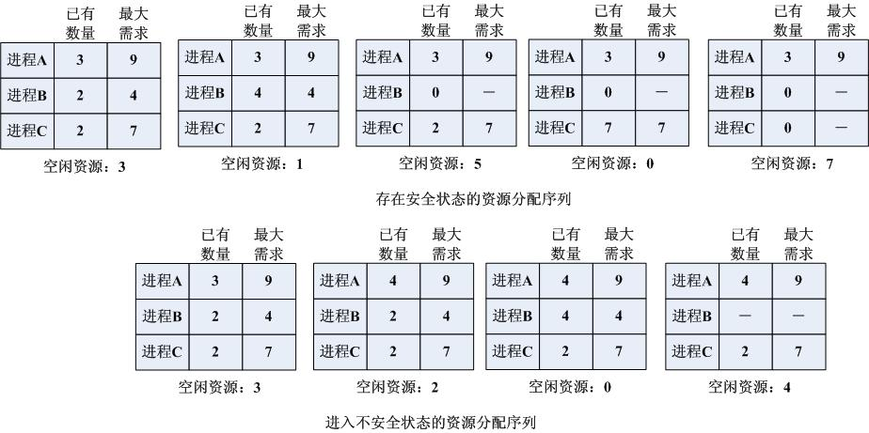
Banker algorithm: simple condition
Operating System
12
CITS, NanKai University
Notes:
银行家算法的主要想法，是用尽量小的钱，满足一个人的需求，满足之后，就可以回收他原来占用的所有资源
但是如果出现某种情况，手里的钱不够满足剩下的任何一个人，就意味着不能再收回新的资源了，就是死锁
这种叫不安全状态

Slide 13
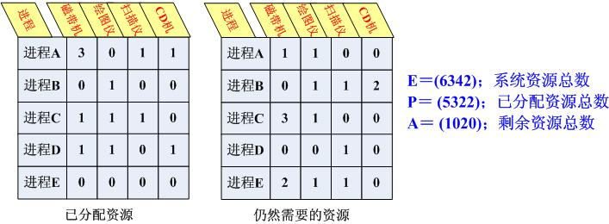
Banker algorithm: complex condition
Using matrix and vector to describe resource allocation status.
Simulation: matrix operation.
Operating System
13
CITS, NanKai University

Slide 14
Banker algorithm: complex condition
Check all resource requests in following steps.
Step 1
Check the rows in “requested matrix” and try to find a row that fewer than A ( available resource).
All rows in “requested matrix” is larger than A, that means the system is under dead lock status.
The request of the process indicated by this row can be satisfied.
Step 2
Assign the resource to the select process.
Label this process to be “end” and release the resource holden by this process, update A.
Step 3
Execute step 1 and step 2 circularly, until all processes are labeled to be “end”.
Step 4
If all processes are labeled to be “end”, that means the resource request is safe and can be executed, otherwise the request is not safe and can’t be executed.
Operating System
14
CITS, NanKai University
Notes:
找到一行，所需资源少于可用资源的，分配资源给他
执行结束，回收资源，加入可用资源中
如果有多可供选择的进程，则依次执行他们就可以了

Slide 15
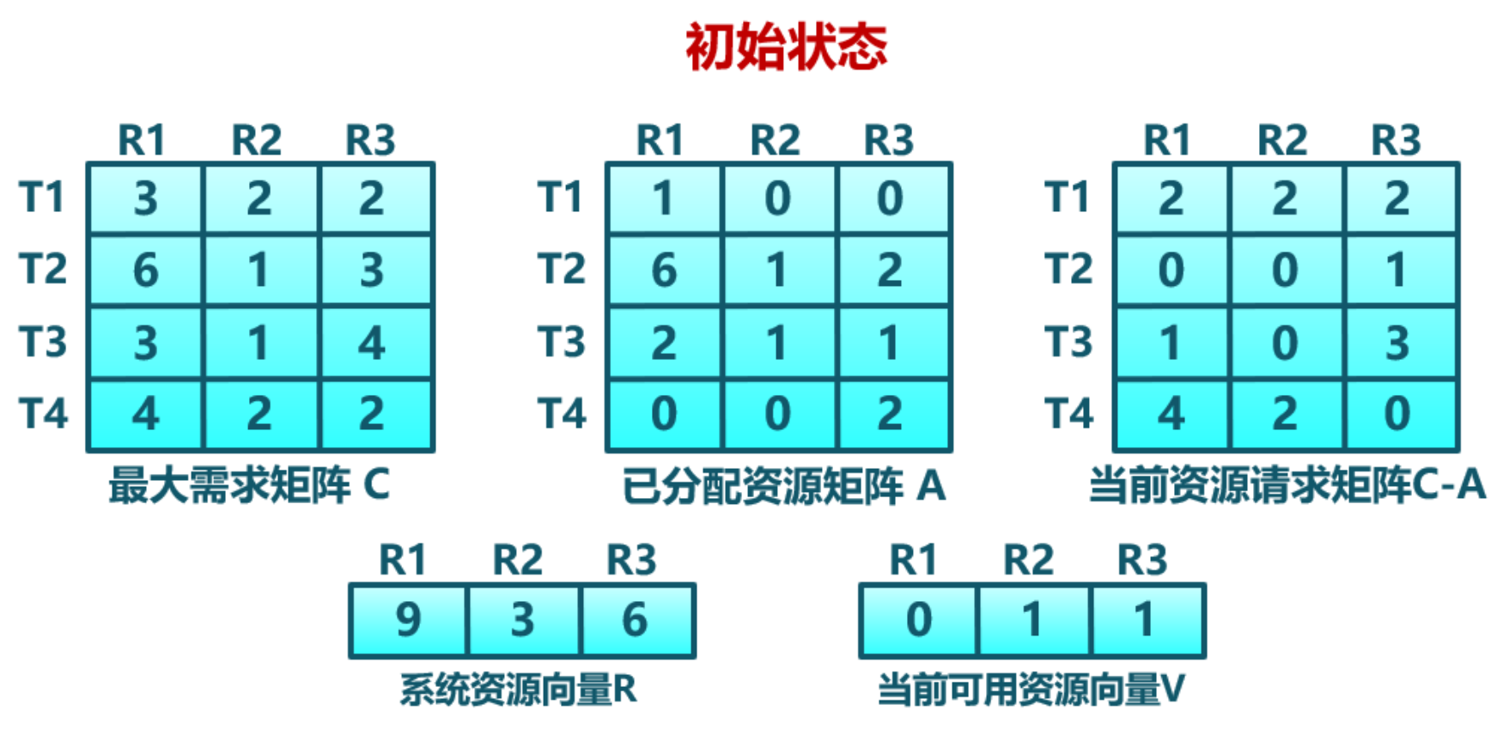
示例

Slide 16
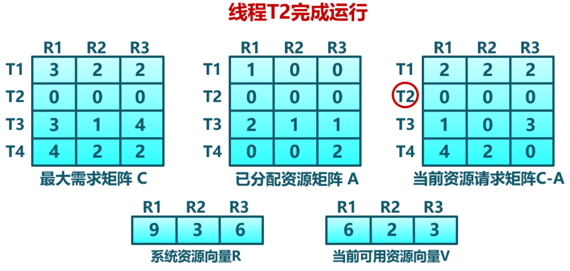
示例

Slide 17
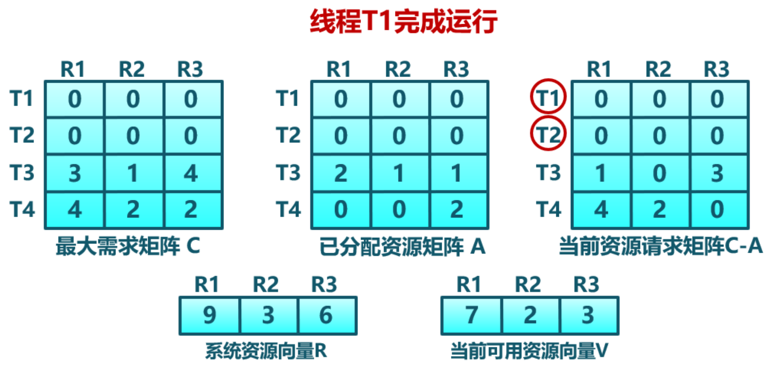
示例

Slide 18
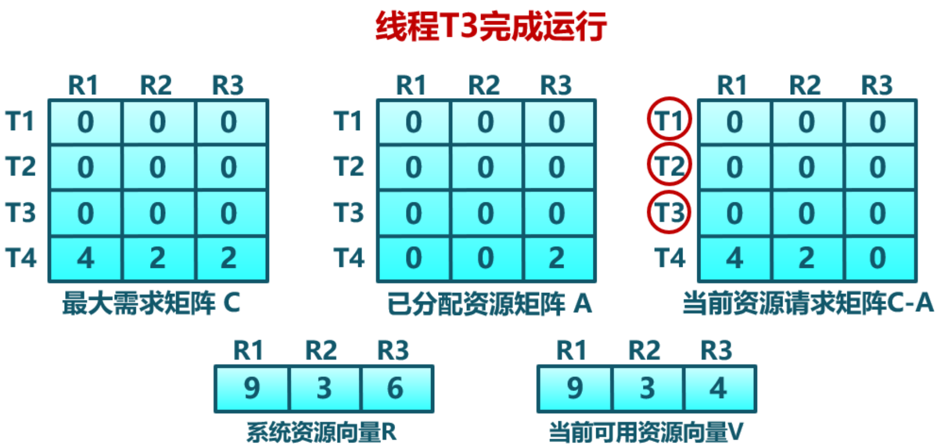
示例

Slide 19

安全状态与死锁的关系
不安全
死锁
安全
■
系统处于安全状态，一定没有死锁
■
系统处于不安全状态，可能出现死锁
避免死锁就是确保系统不会进入不安全状态

Slide 20
Dead lock detection and recovery
Idea of this method
A daemon process is in charge of dead lock detection and try to resume system.
How to detect dead lock
Using graph, set, vector and matrix as data structure to record the status of resource allocation, and try to find circular waiting status .
Discussion about dead lock detection algorithm.

Slide 21
Deadlock Detection
设定分配矩阵Allocation、资源向量、可用向量，分别记录当前系统中已分配的资源、总量和剩余资源
请求矩阵中的向量定义成qij，表示进程i请求类型j的资源量，代表当前进程产生的资源请求
初始态所有进程无标记，通过算法标记进程
最后查看：若有无标记的进程，则说明有死锁现象存在

Slide 22
Deadlock Detection
1）在分配矩阵中标记一行全为0的进程
2）向量W初始化成可用向量Available
3）按下标i查找，进程i未标记并且该进程的请求向量小于等于W，就进行标记；若找不到这样的行，算法终止。
4）若找到这样的行，标记进程i后，再把分配矩阵中的相应行加到W中，返回步骤3。
Notes:
全为0的进程肯定不会死锁，因此先去掉
可用资源如果能够满 足某个进程，则先满足他，满足后，回收其资源

Slide 23
Deadlock Detection
Notes:
这个方法与银行家算法几乎一样
只是拿来的信息不是所申请的资源最大值，只能按照假设前进

Slide 24
Dead lock detection and recovery
How to recover system
Resource bereaving: bereaves the resource of dead lock process and allocates the resource to other process.
Backdating: set check point in process, the process will backdate to the check point when dead lock is detected.
Process killing: kills the process directly.
Notes:
资源剥夺
回溯法：设置检查点，回到检查点去，再试一次
直接杀死

Slide 25
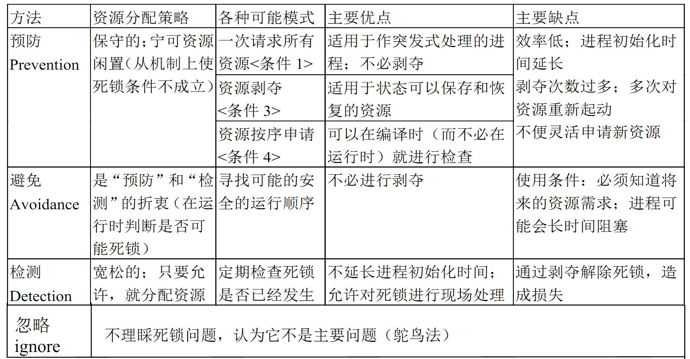

Slide 26
非资源死锁问题
1.两阶段加锁
对需要修改的数据：先请求加锁，再修改数据；若有一个数据已加锁，进程则释放所有加锁的记录。
2. 通信死锁
通信中多个进程发送信息，但需要阻塞当前进程等待对方回复。若发送信息丢失，则死锁。
例如：分布式系统中的通信问题
解决办法：超时中断；

Slide 27
非资源死锁问题
3. 活锁
所谓活锁既是：进程没有死锁，但却无法运行下去，只是在不断的重复尝试，如冲突检测。
4. 进程饿死
由于条件限制使有些进程请求永远无法得到服务，进程被饿死。从饿死进程角度看，像是发生了死锁。

Slide 28
Graduate entrance examination sample
北大1997年OS考研试题
系统中有三种资源（A，B，C）和5个进程P1～P5
资源总数为（17，5，20），T0时刻系统状态如表所示，系统采用银行家算法实施死锁避免策略
 | 最大资源需求量 |  |  | 已分配资源量
 | A | B | C | A | B | C
P1 | 5 | 5 | 9 | 2 | 1 | 2
P2 | 5 | 3 | 6 | 4 | 0 | 2
P3 | 4 | 0 | 11 | 4 | 0 | 5
P4 | 4 | 2 | 5 | 2 | 0 | 4
P5 | 4 | 2 | 4 | 3 | 1 | 4

Slide 29
Graduate entrance examination sample
请解答以下问题：
（1）T0时刻是否为安全状态？若是则给出安全序列
（2）在T0时刻P2请求资源（0，3，4），是否能够实施资源分配，为什么？
（3）在（2）的基础上，若P4请求资源（2，0，1），是否能够实施分配，为什么？
（4）在（3）的基础上，若P1请求资源（0，2，0），是否能够实施分配，为什么？
Operating System
29
NanKai University

Slide 30
Thanks for your time! Questions & Answers
Operating System
30
NanKai University

