Slide 2


output
Preprocess
data
input
Training Pix2Pix
Trained
Pix2Pix
SLDEM 2015
DTM
Apply
SFS to DTM
output
Derived DTM
LRO NAC Orthoimage
input

Slide 3

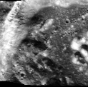
Downsampling, Cutting,
& histogram smoothing
Training Pix2Pix
Generating DTM using Pix2Pix
Apply
SFS
Derived DTM
SLDEM 2015
Cutting
& histogram smoothing
dataset for Pix2Pix
LRO NAC Orthoimage
Figure 1. DTM processing flow

