Slide 1
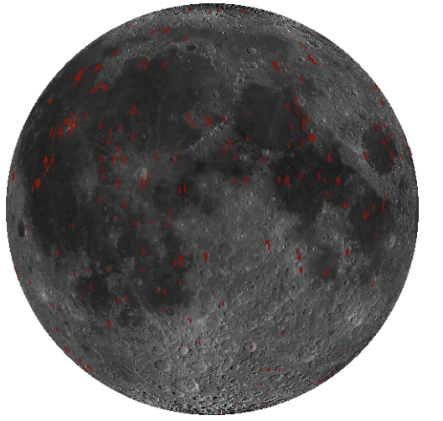
Depth Estimation Based on Monocular Image for the Moon With Machine Leaning and Shape-From-Shading s1270087 IBUKA. Koichiro, Supervisor: Prof. DEMURA. Hirohide
1. Introduction
3. Current Results and Status
Digital Terrain Models (DTMs) of the lunar surface are widely used for lunar exploration planning and studies of topography and geology [1]. LRO NAC DTMs with the highest resolution (~2 m/pix). Coverage of the DTMs shows small percentage with 460 pieces (rectangles in red, Figure 1) [2]. This research proposes a method to complement LRO NAC DTMs by generating the almost the same resolution using Machine Learning & Shape-From-Shading (SFS) [3].
Purpose: 単一の月面可視画像を入力とした高分解能DTMの自動生成
Approach:
Goal:
元データおよび教師データの作成手順について書くつもり
元データ ・SLDEM 2015
・LRO NAC STEREO PHOTO
・LRO NAC DTM
教師データ作成手順 ・LRO NAC をダウンサンプリングし、SLDEM2015のデータ分解能と合わせる
・LRO NAC, SLDEM2015から256 x 256pxで切り出し二つの画像を結合
元データからのデータセット作成する図
4. Remaining Tasks and Tentative Schedule
Figure 1. Footprints of LRO NAC DTMs in red [4]
2. Methodology
This research proposes a method to create DTMs using a machine learning model called Pix2Pix [4] and adapt SFS to the created ones to generate high-resolution DTMs. Pix2Pix can transform an input image into another image type by learning the correspondence between the two image sets [4].
月幅デカすぎ
4月からも入れておく
締め切り入れておく
References
[1] Barker, M. K., et al., A new lunar digital elevation model from the Lunar Orbiter Laser Altimeter and SELENE Terrain Camera, 2016. doi: 10.1016/j.icarus.2015.07.039
[2]Onodera, K., et al., Resolution enhancement of DEM of the lunar surface using machine learning, 2020. doi:10.20637/JAXA-RR-19-006/0003
[3] LROC Quickmap. https://quickmap.lroc.asu.edu/
機械学習のネットワークの図? Shape-From-Shadingの図
Notes:
左の1/3くらいにテキスト縮めといね

