Slide 1
FLEET for Biological Interpretation of GWAS Signals
Jonathan Hess
SUNY Upstate Medical University
Deptartment of Psychiatry

Slide 2
Intuition behind the method
Are functional annotations more likely to overlap GWAS loci that are strongly associated with phenotype?
H3K4me1
H3K4me1
LD block 1
LD block 2
LD block 3
Lead SNP
tagged SNP
4/2/17

Slide 3
Intuition behind the method
Are functional annotations more likely to overlap GWAS loci that are strongly associated with phenotype?
H3K4me1
H3K4me1
LD block 1
Z = 3.94
LD block 2
Z = 0.01
LD block 3
Z = 2.86
General equation:
Shorthand:
4/2/17

Slide 4
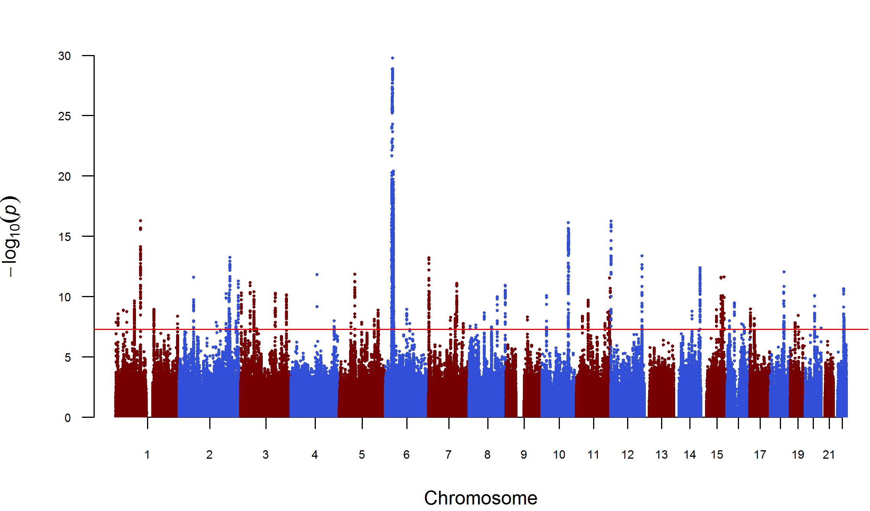
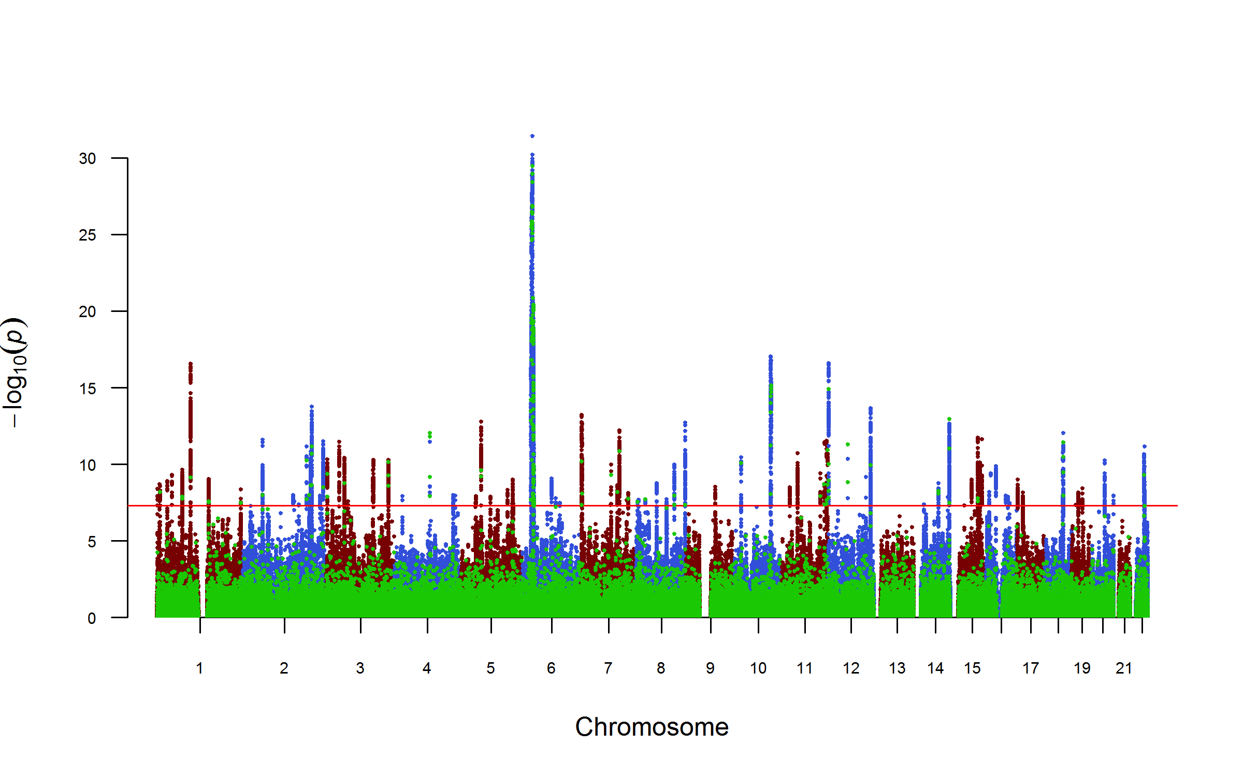
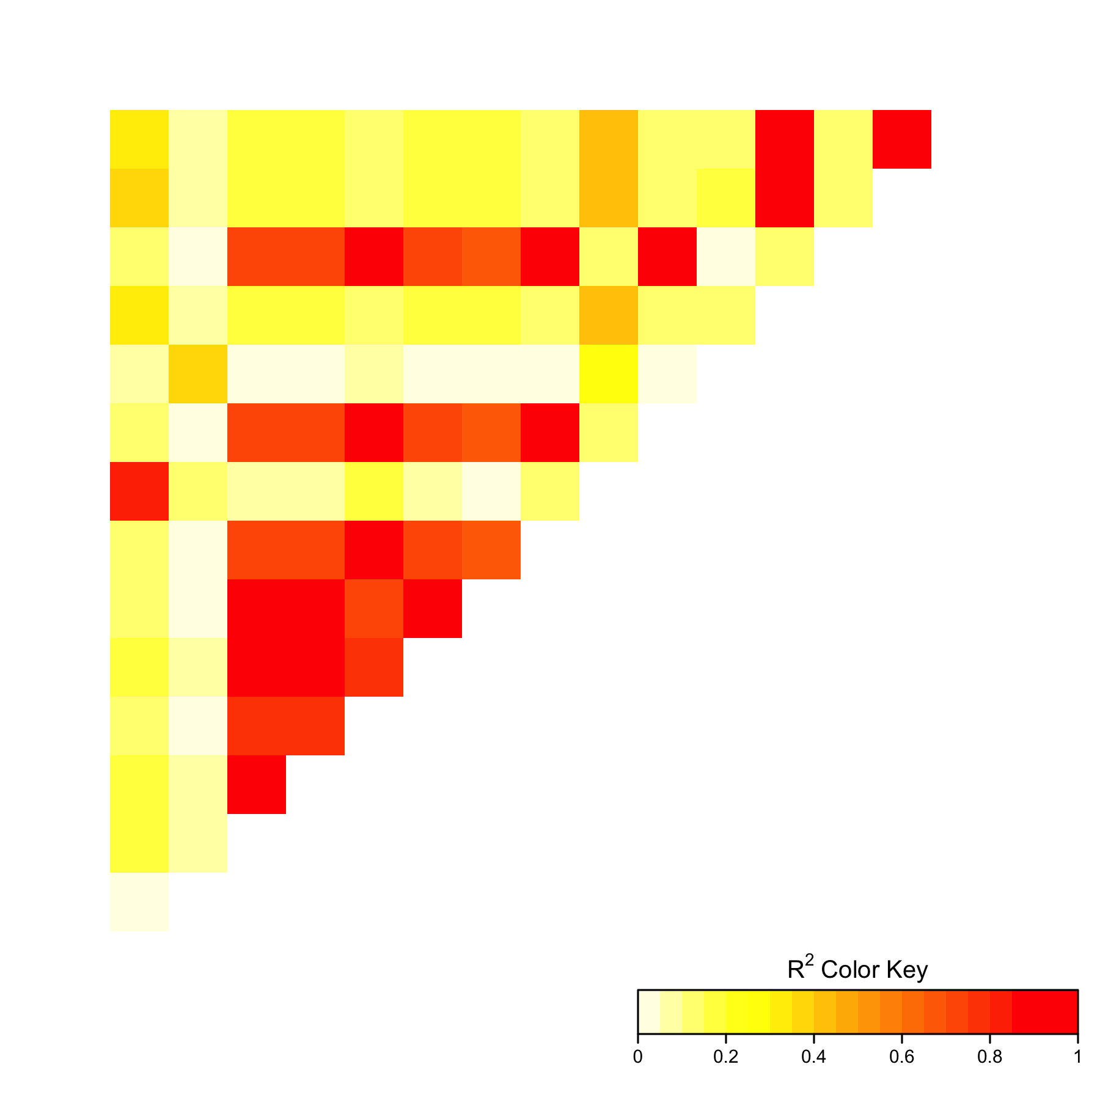
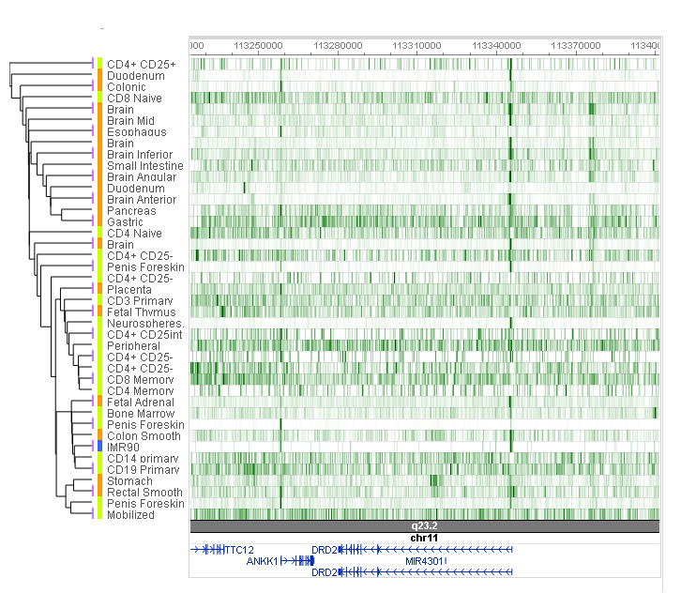
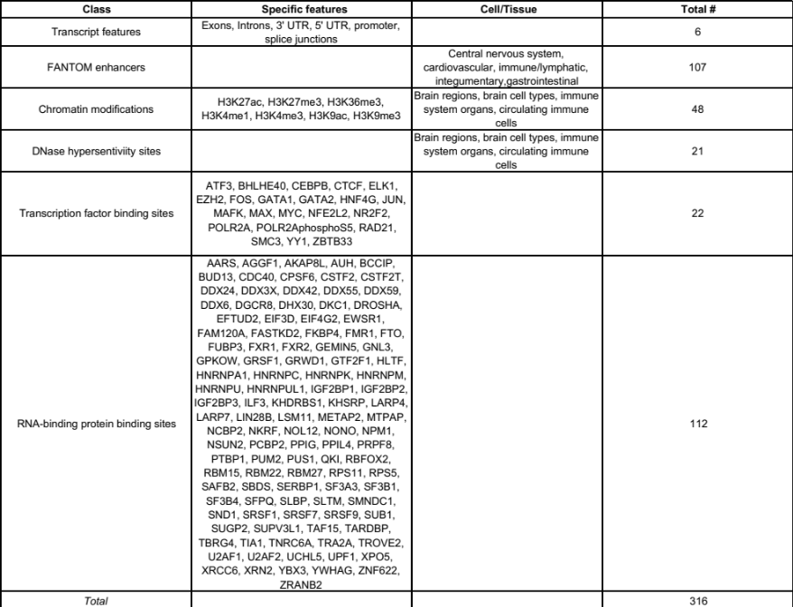
GWAS summary statistics
Pruned + LD-clumped GWAS
LD-structure (1000G)
PLINK
--indep 100 50 2
--clump-r2 0.2 –clump-kb 500 –clump-p1 1 –clump-p2 1
Outdated table
*April 8*
547 TFs total
ENCODE
Roadmap
FANTOM
Entrez hg19 gene maps
Functional annotations
Genome-wide enrichment test
Logistic regression and within-trait Bonferroni correction
correction for LD and MAF (removed MHC)
4/2/17
GWAS results from Ripke et al. (2014)

