Slide 1
Business and marketing.
Mercury
4
5
Jupiter
5
2
Venus
52%
30
150
50
Presented by:
Hessah Abdulaziz Alhedathi
+56%

Slide 2
Table of content
1
3
5
Introduction
Visualization
Tools
2
4
6
Data set
Data Model
Conclusion & Recommends

Slide 3
Introduction
Recently years, with the spreading of using technologies especially smartphones and competition between companies that make up these smartphones, different features and prices for smartphones appeared to attract people to buy these devices.
We have tried to analyze the relationship between the features of smartphones and the unevenness of their prices that help the manufacturers of smart devices, mobile phone dealers in their trade and help users to buy smart devices at the best prices.
We apply a machine-learning approach with specific classification algorithms to classify mobile prices based on 20 features for smartphones such as battery power, ram and so on.

Slide 4
Mobile price information
Purpose
Question
Dataset
Target
Price range
We are used in our project from Kaggle source that is one of the big sources for the dataset.
range
3
The purpose of our dataset is for business and marketing.
Which features affect the price of the mobile?
2
1
0

Slide 5
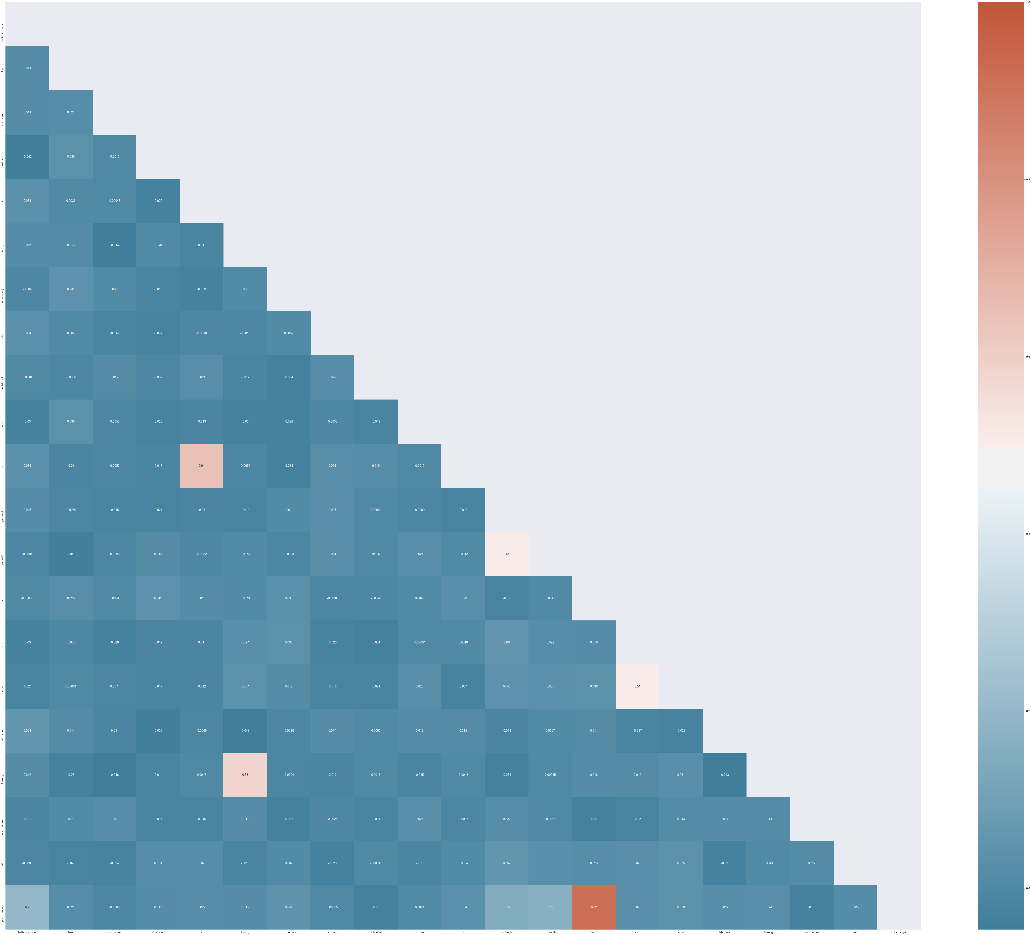
Exploratory Data Analysis (EDA)
Correlation between different variables

Slide 6
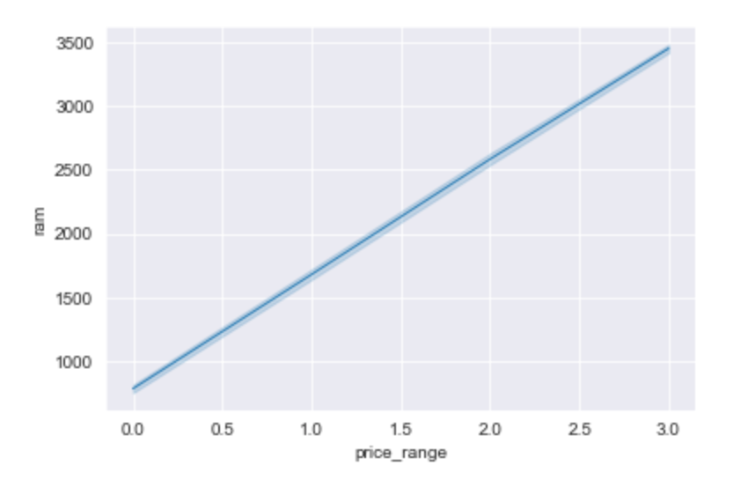
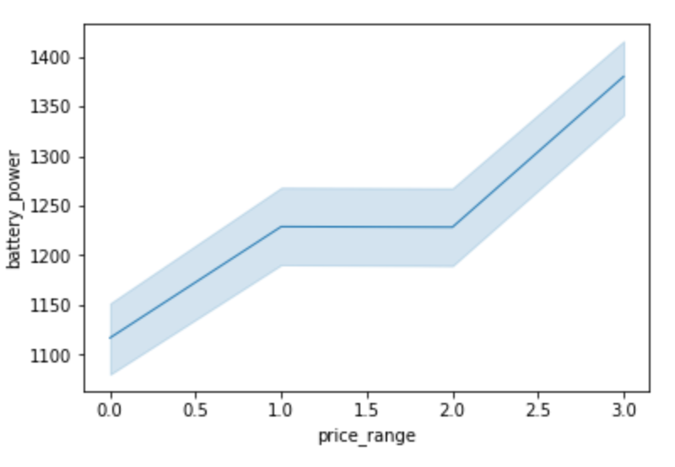
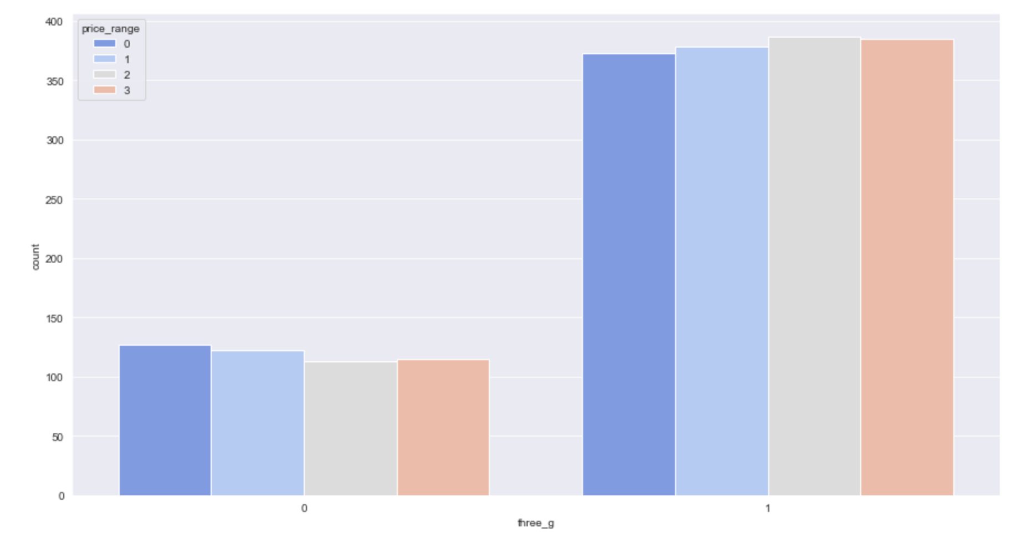
Exploratory Data Analysis (EDA)
1
Ram
2
Battery power
3
4G
Random Access Memory in Megabytes is the highest relation with price range.
There is a relation between mobile price & battery power (this means the total of energy that battery can store in one time).
There is no direct relation between mobile price and if the mobile has and support 4G or not.

Slide 7
Modeling and Results
K-neighbors Classifier
Random
Forest
Naïve
Bayes
Logistic
Regression
Decision Tree
Accuracy
Accuracy
Accuracy
Accuracy
Accuracy
93.17%
87.67%
81.17%
79.83%
78.50%

Slide 8
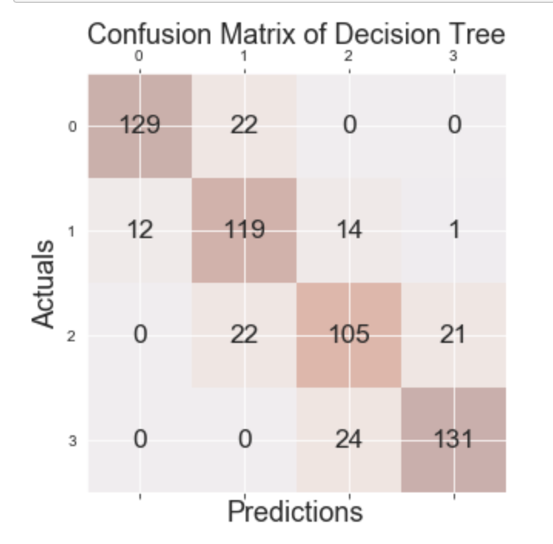
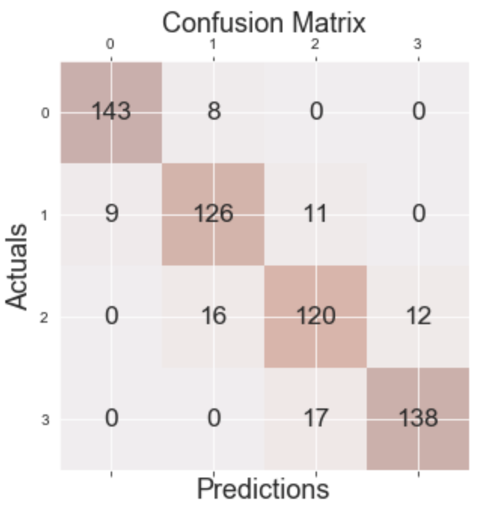
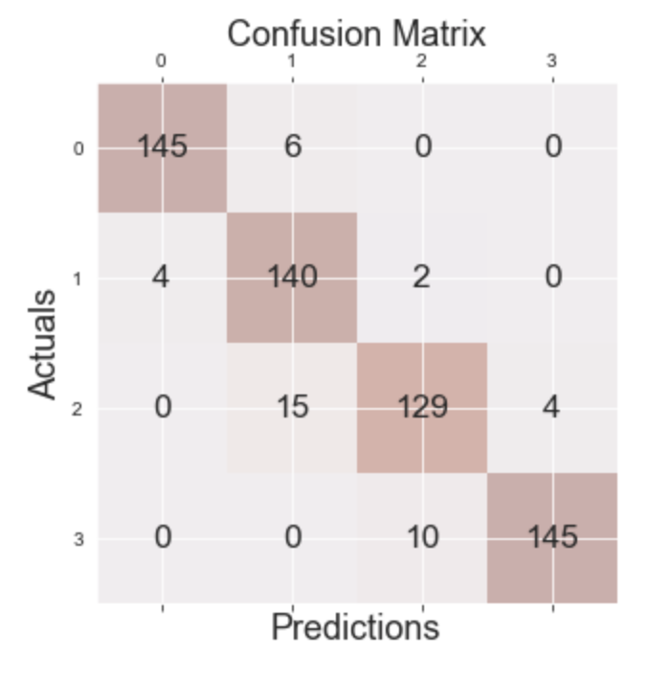
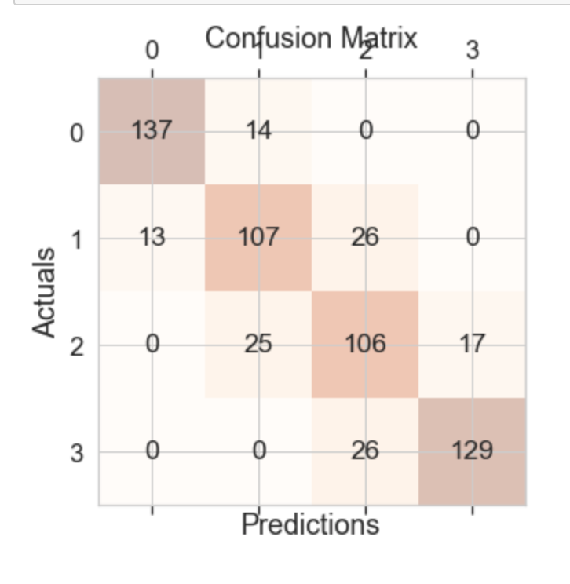
Confusion matrixes
Decision Tree
1
Random Forest
2
K-Neighbors Classifier
3
Naïve
Bayes
4

Slide 9
Tools used
Data Pre-processing
1
Building The Model
2
Visualization
3
Pandas
NumPy
Scikit-learn
Matplotlib

Slide 10
CONCLUSION
* Our results show that the highest accuracy of classification.
* We apply classification techniques.
K-Neighbors Classifier

Slide 11
Recommendations
1
2
Increase the size of the dataset
Extend the idea of the dataset
To increase the accuracy of classification
and applied on different things like power banks
3
Record the mobile prices as the price itself in integer format
not as category and apply regression technique on it to observe the effectiveness of mobile features on mobile prices

Slide 12
THANK YOU
Do you have any question?
01

