Slide 1




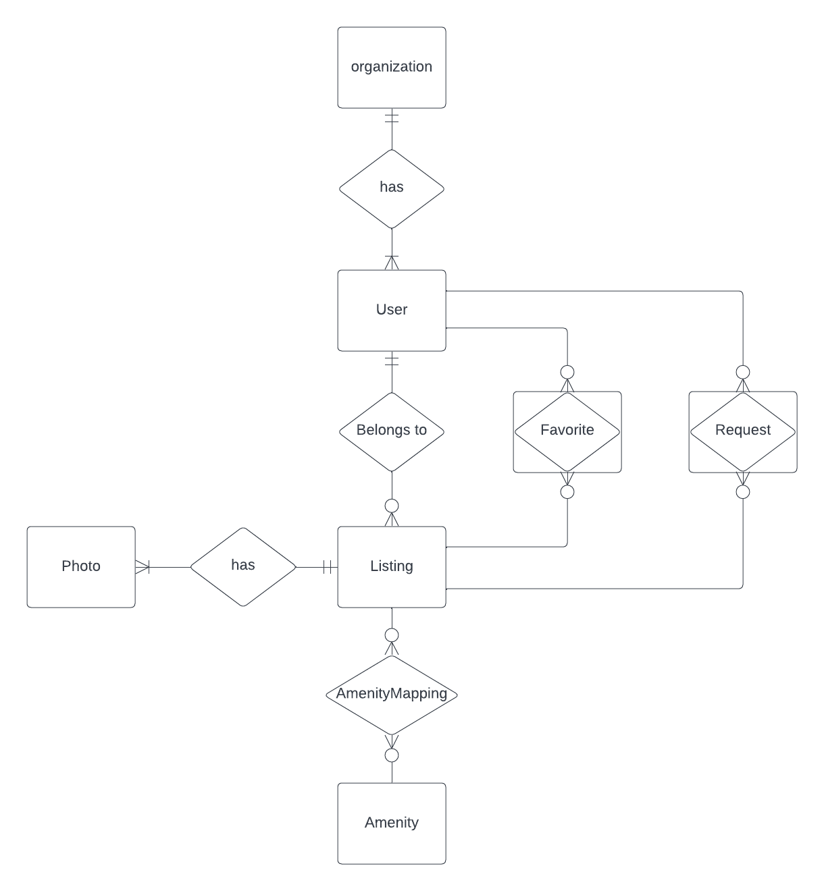
Hesti
Hesti is an application that was designed to cater specifically to students searching for housing around their schools. By using Google authentication to sign up, users were placed under the correct organization associated with their email. This ensures that users are communicating with other students in the same community.
There are a variety of tools we provide such as favorting and requesting a listing that help streamline the subleasing process. Users who have a place to sublease can post a listing about it. Users who want a sublease can scroll through the listings and can either favorite or request them.
Users who are either searching for a sublease or creating listing can ensure they will find a reliable contract through our webapp. When they request a listing, the user who listed that listing will be able to see their contact information so that they can further discuss/negotiate a possible deal.
Database Design
Our Challenges
you are: looking for a sublease
you can:
filter through available subleases within your org
bookmark a sublease
request a sublease
Versioning : matching correct versions of our extensive tech stack was difficult
Time Delegation : allotting enough time for each iteration was uneven
Scope management : fine tuning the extent of our project
you are:
looking for a subleaser
you can: market your listing
view and contact users who have requested your listing
What we learned
We learned that BDD and TDD are effective ways of developing our service. We knew how our service should look and behave from the beginning, unlike past experiences where we did not use BDD or TDD, and we had a solid foundation to start developing our service and to add features along the way.
you are:
an organization
you can:
personalize hesti
monitor users within your organization
Mariel Alexis Lopez, Carolyn Nguyen, Jennifer Yuan, Emma Ziesmer

