Slide 1
Group Name : Non-Techies
Group members :
Virag Koradia
Vraj Sanghvi
Het Thakkar

Slide 2
Problem
Currently when we saw the topic and have to develop something on the “Space Technology”, We were just blank cause we are not very familiar with space technology and then we asked chatGPT but even that didn’t work very well. So it was a really a bit of stressful work to get the knowledge of space technology in simple words.

Slide 3
Solution:
The solution for this is that we actually can develop an AI Chat bot that can help people to get the knowledge of Space technology and Real time updates that are very surprising for common people (Here common people means the people who are not familiar with space and other universe).

Slide 4
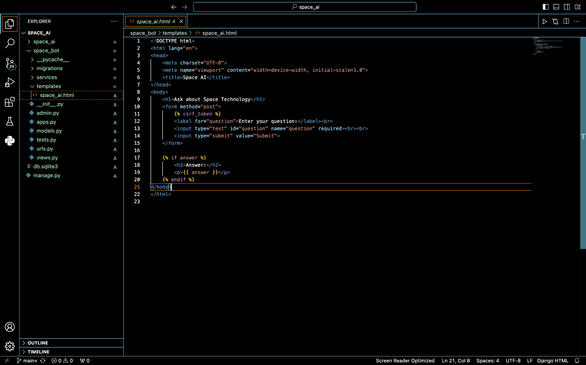
Code

Slide 5
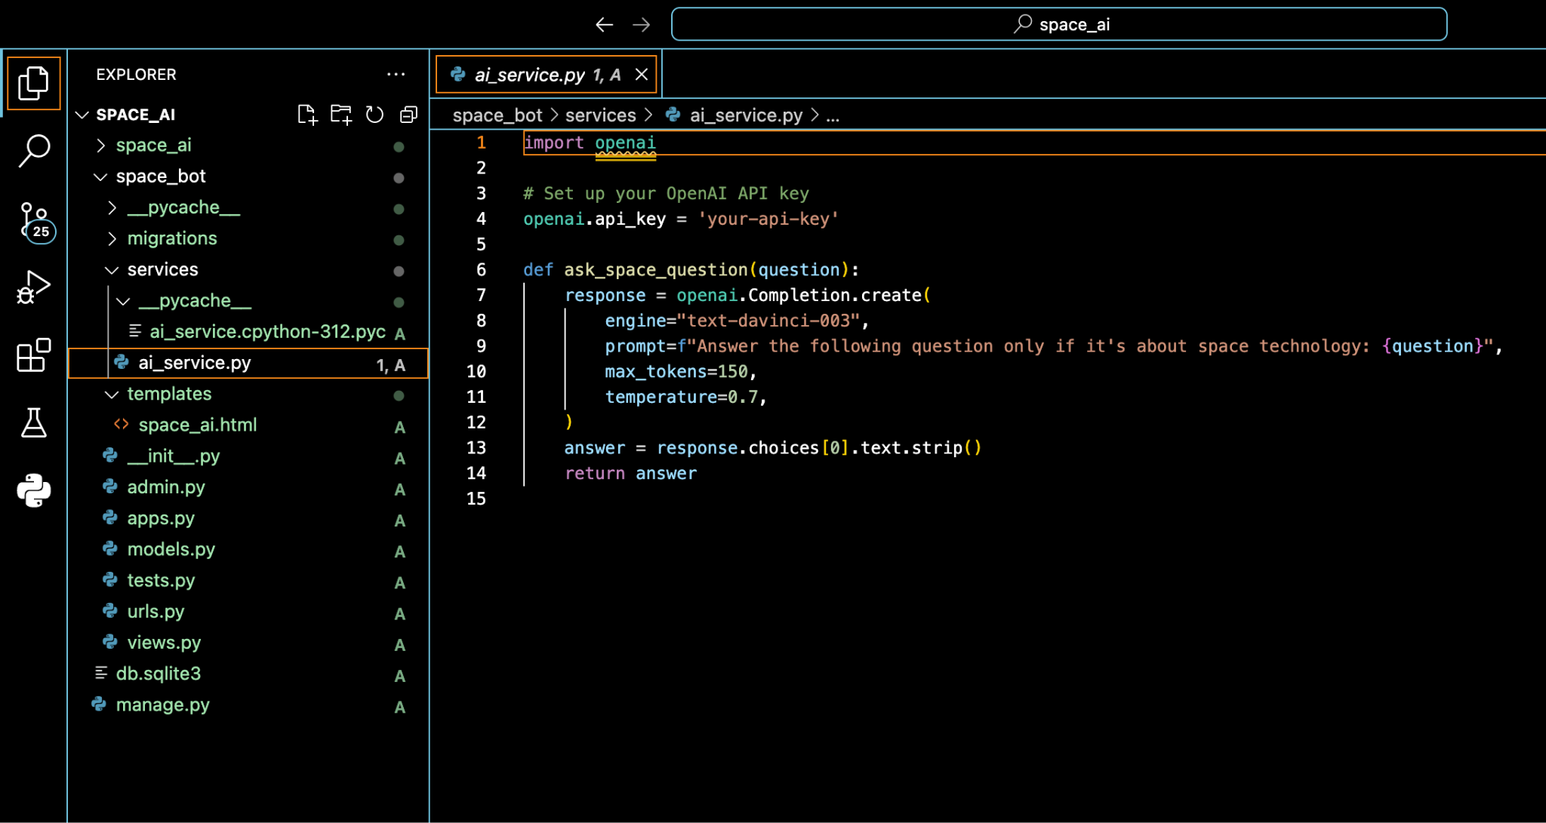
Code

Slide 6
Conclusion
So finally we tried and did our best for this project.
But if one can built this a much better way then this will surely help people to get the knowledge about The Space Technology and The thighs that are happening in Space. People would love to see that pictures and read about it.

Slide 7
Thank You

