Slide 1

Dharmsinh Desai University
CSV Insights
Guided by,
Prof. (Dr.) H. B. Prajapati
Prof. (Dr.) V. K. Dabhi
Submitted by,
Doshi Het (IT026)
Gajdhar Viraj (IT028)

Slide 2
Concept
Our Table Question Answering Model is designed to simplify tasks related to querying data. Upload your CSV files in a structured format, and ask your questions in natural language. Powered by the "NumbersStation/nsql-350M" model, the system translates your queries into precise SQL commands, executing them in real-time against your database. Get answers to your questions now, regardless of the content of your CSV files.

Slide 3
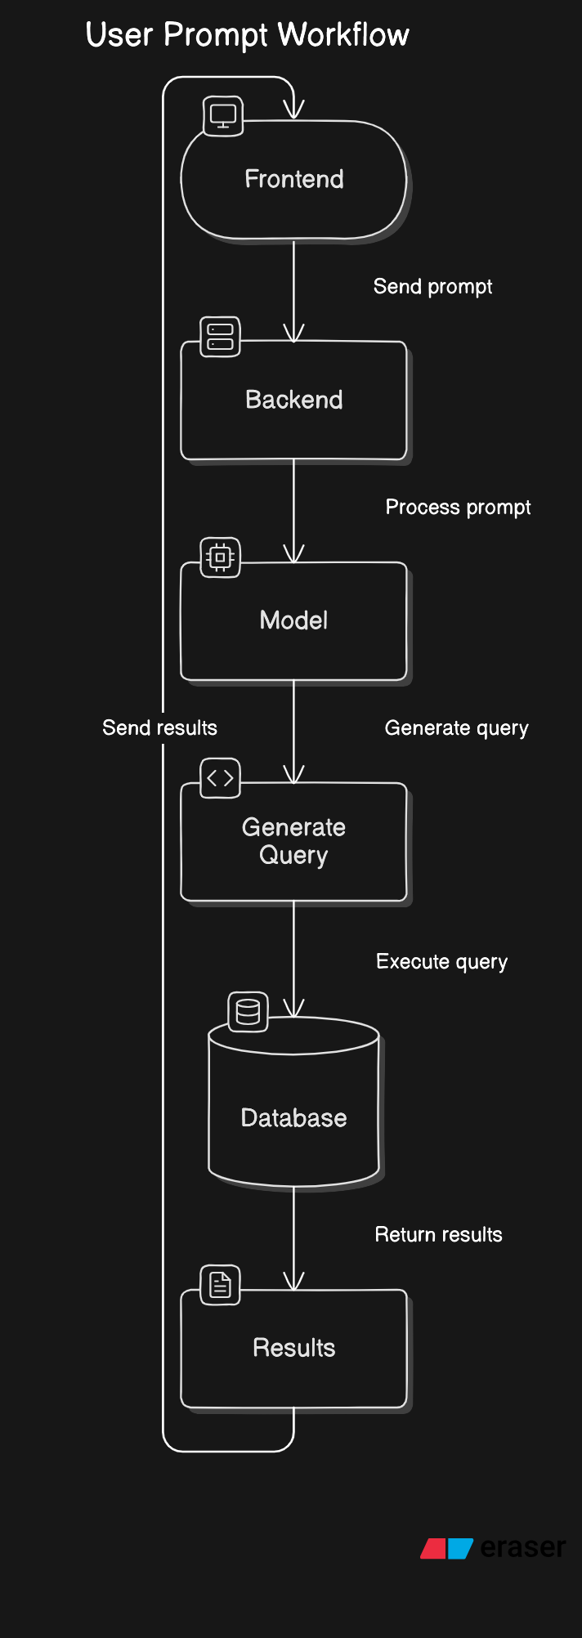
Workflow Diagram

Slide 4
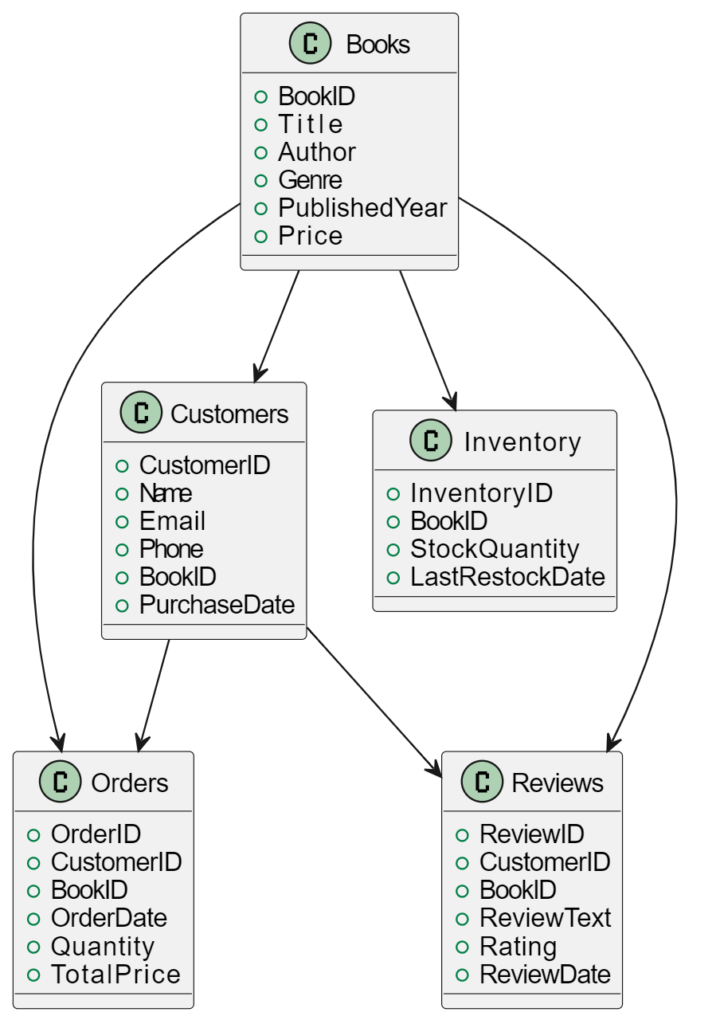
Demonstration using these Schema

Slide 5
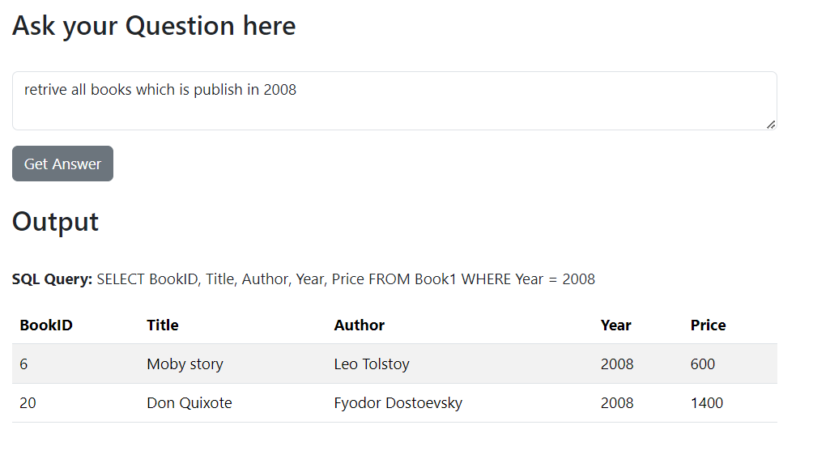
Testing Retrieve

Slide 6
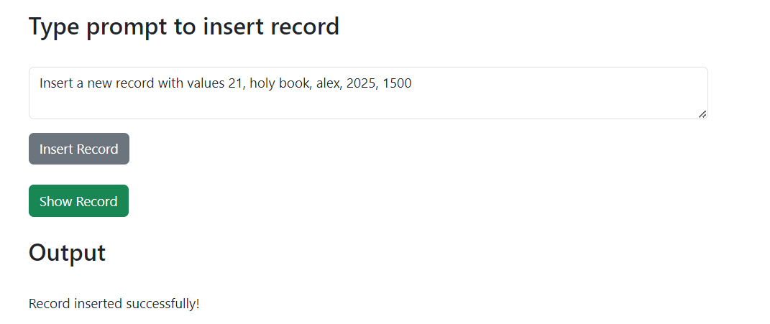
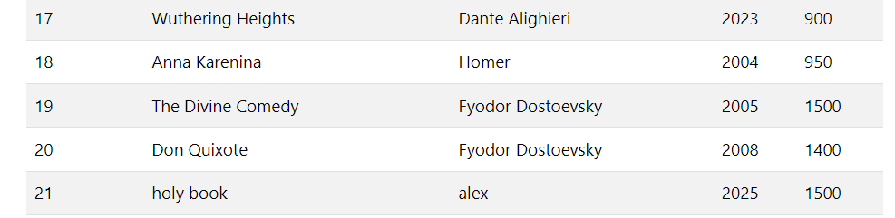
Testing insertion

Slide 7
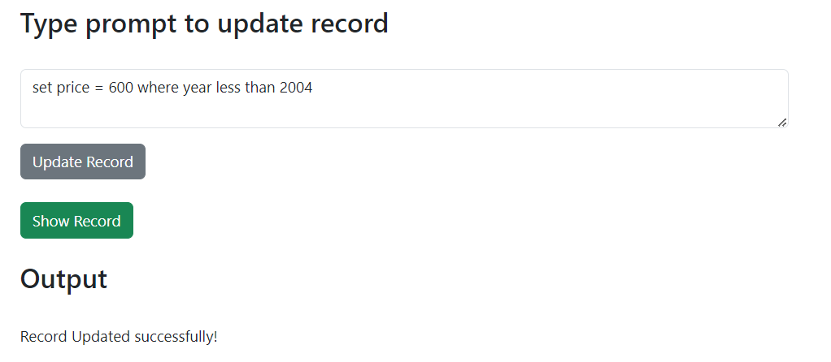
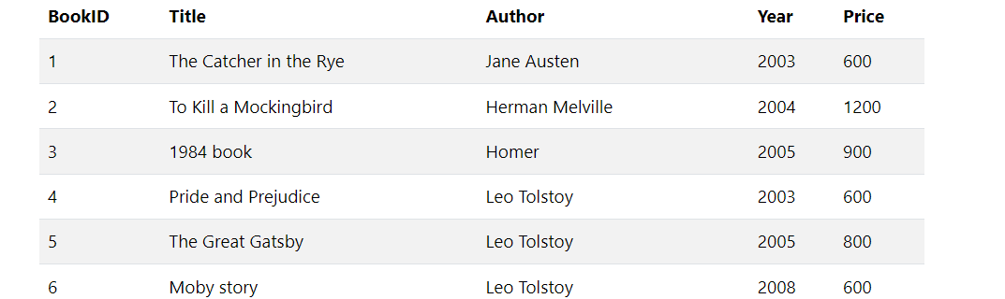
Testing Update

Slide 8
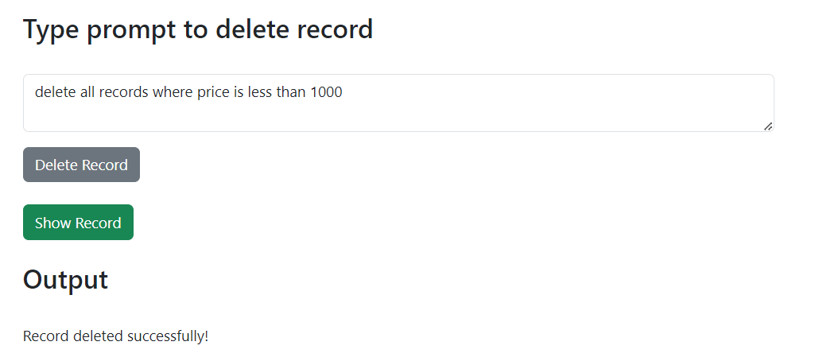
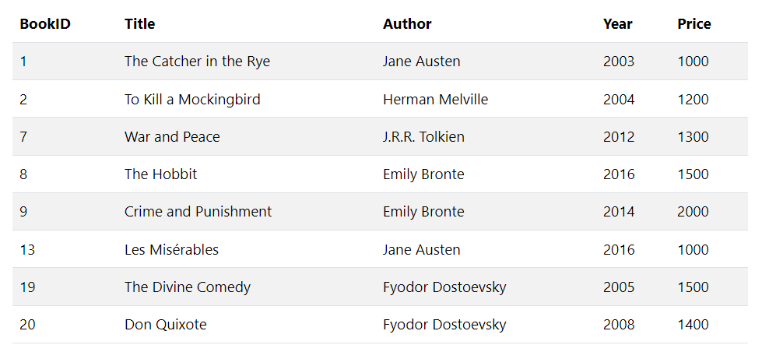
Testing Delete

Slide 9
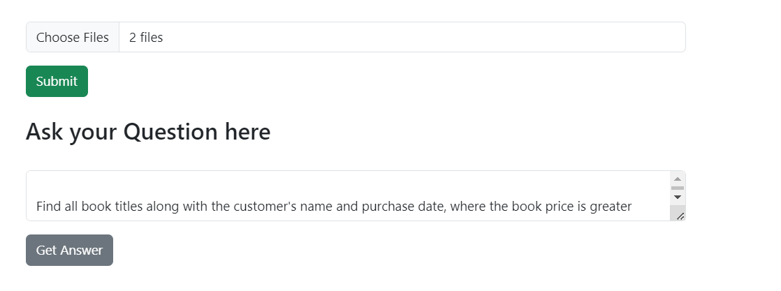
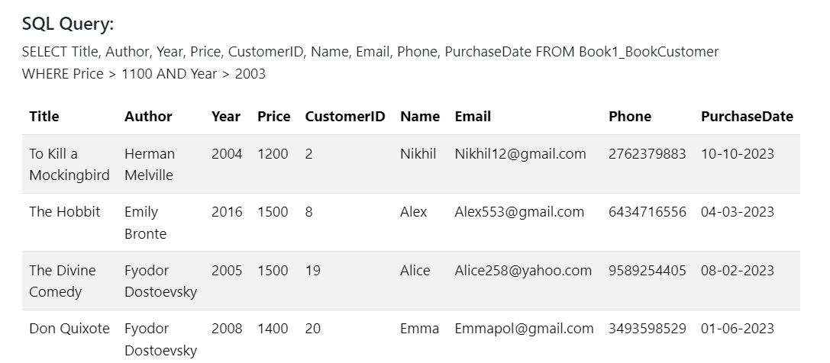
Testing using Multiple tables :
Books, Customer

