Slide 1
Group 6
E-Commerce Intelligence & Personalization Platform
Real-time customer intelligence & personalization engine for fashion e-commerce
ITCS 6190 / 8190 — Cloud Computing for Data Analysis
UNC Charlotte • Spring 2026
Tech stack: Apache Spark • PySpark • MLlib • Structured Streaming • AWS S3
Group 6 • ITCS 6190/8190 • Cloud Computing for Data Analysis 1 / 20

Slide 2
Agenda
Index of topics covered in this presentation
1
Problem Statement
What are we solving and for whom?
2
Product Pitch
The B2B SaaS framing
3
Dataset & Architecture
Data sources, Spark components, tech stack
4
Ingestion Pipeline
Raw CSV → 8 Parquet tables on S3
5
Exploratory Data Analysis
Device mix, funnel, revenue, temporal
6
Spark SQL — 6 Advanced Queries
Funnel, basket, RFM, cohort, velocity, affinity
7
Machine Learning — 3 Models
Conversion RF, KMeans RFM, ALS recommender
8
Structured Streaming
Stream-static join, windowed aggs, anomaly
9
Business Outcomes
Numbers that translate into product levers
10
Challenges & Future Work
What we learned, what's next
Group 6 • ITCS 6190/8190 • Cloud Computing for Data Analysis 2 / 20

Slide 3
Problem Statement
Why fashion e-commerce retailers need a real-time intelligence layer
The gap in the market
• Retailers sit on massive customer, product, transaction and clickstream data — but react to it the *next day*.
• 42% of carts are abandoned. Win-back email the day after does not recover a same-session bounce.
• Most analytics stacks are batch-first: great for dashboards, useless for in-session decisions.
• There is no plug-in personalization layer that is cloud-native, Spark-scale, and model-driven.
Our goal
Build a Spark-based intelligence engine that turns raw behavioural signals into in-session personalization — who a customer is, what they will buy next, and when they are about to bounce.
Group 6 • ITCS 6190/8190 • Cloud Computing for Data Analysis 3 / 20

Slide 4
Product Pitch
A plug-in B2B SaaS layer — think "Segment + Dynamic Yield"
What it delivers
Business levers it unlocks
• A real-time customer intelligence engine
• In-session decisions: pop-ups, promos, recs
• Predicts: next purchase, churn risk, segment
• Plug-in analytics layer — no re-platforming
• Model-driven, not rule-driven personalisation
• Cart-abandonment recovery — trigger in-session discounts
• AOV uplift — "customers like you bought…" carousel
• VIP protection — identify Champions before they churn
• Win-back triggers — flag at-risk customers automatically
• Traffic-source ROI — optimise paid channels in real time
From nightly dashboards → to real-time decisioning.
Group 6 • ITCS 6190/8190 • Cloud Computing for Data Analysis 4 / 20

Slide 5
Dataset Overview
4 raw Kaggle tables, hosted on AWS S3
Table | Rows | What it contains | Role
customer.csv | 100,000 | Demographics, device, location, tenure | Segmentation, joins
product.csv | 44,446 | Catalog: master/sub-category, season, gender | Enrichment, recs
transactions.csv | 852,584 | Booking events w/ nested product_metadata JSON | Revenue, RFM
click_stream.csv | 12,833,602 | Session events: HOMEPAGE / SEARCH / ADD_TO_CART / BOOKING … | Behavior, streaming
100K
44K
852K
12.8M
Customers
Products
Transactions
Clickstream Events
Group 6 • ITCS 6190/8190 • Cloud Computing for Data Analysis 5 / 20

Slide 6
Architecture & Data Flow
Layered Spark pipeline: Structured APIs → SQL → ML → Streaming
Raw (S3)
Ingestion
Processed (S3 Parquet)
Analytics
Outcomes
CSV from Kaggle
PySpark Structured APIs
8 *_clean tables
Spark SQL × 6 MLlib × 3 Streaming
Dashboards Decisions Alerts
Spark components exercised
Component | Where it's used | Deliverable
Structured APIs | ingestion.ipynb | Type-safe DataFrames + 8 *_clean Parquet tables
Spark SQL | sql_queries.ipynb | 6 advanced queries (CTEs, NTILE, LAG, self-joins)
MLlib | ml_pipeline.ipynb | Random Forest • KMeans • ALS
Structured Streaming | streaming_demo.ipynb | Stream-static join + windowed aggregations
Group 6 • ITCS 6190/8190 • Cloud Computing for Data Analysis 6 / 20

Slide 7
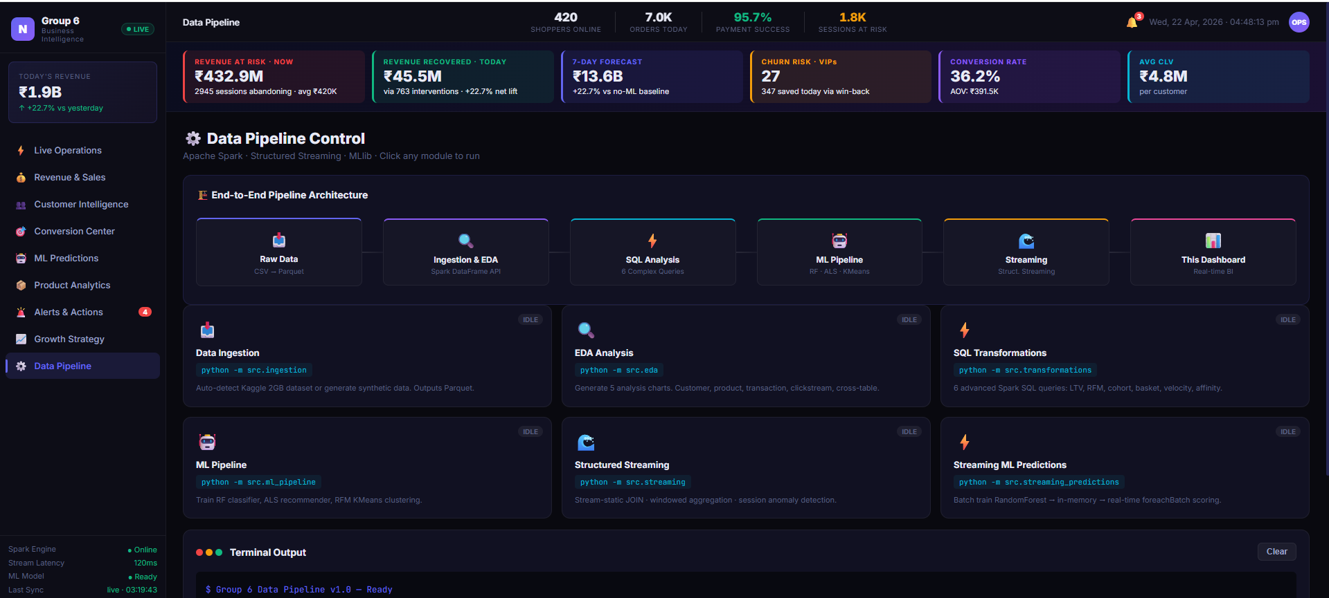

Slide 8
Tech Stack
Cloud-native, open-source Spark ecosystem
Compute
Apache Spark 3.5 • PySpark • MLlib
Storage
AWS S3 (Parquet) • Hadoop-AWS connector
Languages
Python 3.12 • Spark SQL
ML
MLlib: RandomForest • KMeans • ALS • StandardScaler • Pipeline
Streaming
Structured Streaming • File-source • Watermark • Window
Orchestration
Jupyter notebooks • nbconvert • pytest
Runtime
GitHub Codespaces (Java 11 • 2 vCPU • 8 GB RAM)
Dataset
Kaggle: e-commerce behavior & transactions
Group 6 • ITCS 6190/8190 • Cloud Computing for Data Analysis 7 / 20

Slide 9
Stage 1 — Ingestion Pipeline
Raw CSV on S3 → 8 clean, analysis-ready Parquet tables on S3
Key transforms performed
Output tables
• PII dropped (first_name, last_name, email, username, device_id)
• Birthdate / join_date parsed → DateType; age & tenure_days derived
• device_version → OS extracted (iOS, Android, Windows, Other)
• product.csv: renamed id → product_id for consistent joins
• transactions.product_metadata (JSON array) → exploded into 1 row per line item
• derived: order_month, promo_used, shipment_days
• clickstream event_metadata (Python-dict) → 7 flat cs_* columns
• Built analytical sub-tables: search_events, cart_events, session_funnel, customer_purchases
Parquet table | Rows
customers_clean | 100,000
products_clean | 44,446
transactions_exploded | 1,254,585
clickstream_clean | 12,833,602
search_events | 1,173,266
cart_events | 1,937,157
session_funnel | 895,203
customer_purchases | 1,254,585
Group 6 • ITCS 6190/8190 • Cloud Computing for Data Analysis 8 / 20

Slide 10
Stage 2 — Exploratory Data Analysis
Five quick wins from the processed data
# | Finding | Business implication
1 | Android-dominant user base (~77%) | Mobile-first dashboard priority
2 | ~96% payment success rate | Failures are external (bank/network)
3 | Apparel leads revenue across all categories | Merchandising & stock priority
4 | 10 AM – 8 PM click peak | Best window for real-time alerts
5 | Huge add_to_cart → converted drop-off | Cart abandonment = biggest growth lever
Why EDA matters here
EDA validated our feature-engineering choices for the ML stage: session-level features (added_to_cart, did_search, session_duration) that later turn out to be the top predictors for session conversion in the Random-Forest model.
Group 6 • ITCS 6190/8190 • Cloud Computing for Data Analysis 9 / 20

Slide 11
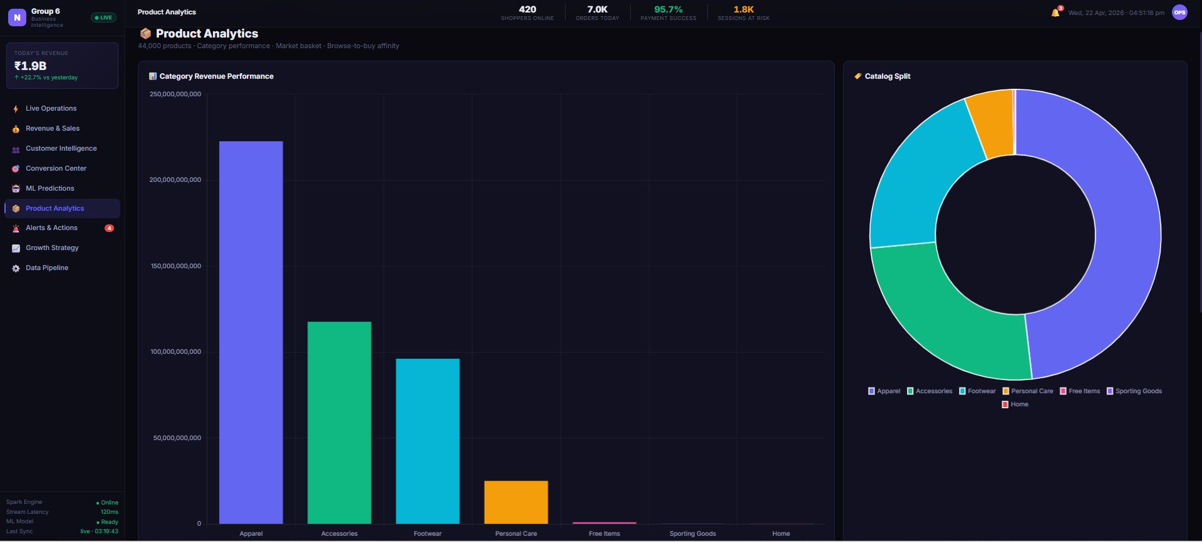

Slide 12
Stage 3 — Spark SQL
Six advanced analytics queries, each exercising a different SQL technique
# | Query | Core technique | Business question
Q1 | Per-Customer Conversion Funnel | 4-table JOIN, CTE, ROW_NUMBER, DENSE_RANK | Who converts? Who drops off?
Q2 | Market Basket Analysis | Self-JOIN, CROSS JOIN, support + confidence | What products are bought together?
Q3 | RFM Scoring (NTILE Quintiles) | NTILE(5) × 3 dims, composite score, CASE | Who are my Champions / At-Risk?
Q4 | Cohort Retention | MONTHS_BETWEEN, pivot CASE, NULLIF | Do customers come back at m1/m3/m6?
Q5 | Purchase Velocity & Gap Analysis | LAG, DATEDIFF, STDDEV, multi-metric CASE | How often does each customer return?
Q6 | Browse-to-Buy Affinity | 4 CTEs, 4-table correlation, lift metric | Which browses lead to which purchases?
Engineering notes
• broadcast(products) avoids shuffling the 44K-row catalog across every join. • Q6 uses TABLESAMPLE (10 PERCENT) on the 12.8M-row clickstream to fit in a 3 GB driver heap.
Group 6 • ITCS 6190/8190 • Cloud Computing for Data Analysis 10 / 20

Slide 13
SQL Highlights — Q1, Q2, Q3
Customer intelligence signals derived directly from the data warehouse
Q1 Conversion Funnel
Top customer: 550 sessions, funnel_score = 4 → fully CONVERTED. Rank 1 through 12 are all Indonesian, Android, female — identifies the high-value, mobile-first core.
Q2 Market Basket
Co-purchase pairs surfaced: women's shorts + wallet • men's polo + dupatta • watch + watch. Confidence metrics direct "frequently bought together" cross-sell carousels.
Q3 RFM Segmentation (NTILE quintiles)
Top 25 customers all score 15/15 → Champions. Segments produced: Champions • Loyal Customers • Potential Loyalists • At Risk • Hibernating.
Group 6 • ITCS 6190/8190 • Cloud Computing for Data Analysis 11 / 20

Slide 14
SQL Highlights — Q4, Q5, Q6
Retention, velocity, and cross-category behaviour signals
Q4 Cohort Retention
2017-Q1 cohorts: ~27-30% retention at 3 months, ~29-31% at 6 months. Retention curve is remarkably flat month-to-month — the product doesn't leak customers fast.
Q5 Purchase Velocity
FREQUENT buyers (avg gap < 60 days) identified — top customer does 74 repeat purchases. SPENDING_UP vs SPENDING_DOWN flag aligns with CLV forecasts; feeds churn triggers.
Q6 Browse-to-Buy Affinity
Footwear (Shoes) browse → Apparel (Topwear) purchase is the strongest cross-category signal. Lift metric drives "while you're in X, consider Y" recommendations.
Group 6 • ITCS 6190/8190 • Cloud Computing for Data Analysis 12 / 20

Slide 15
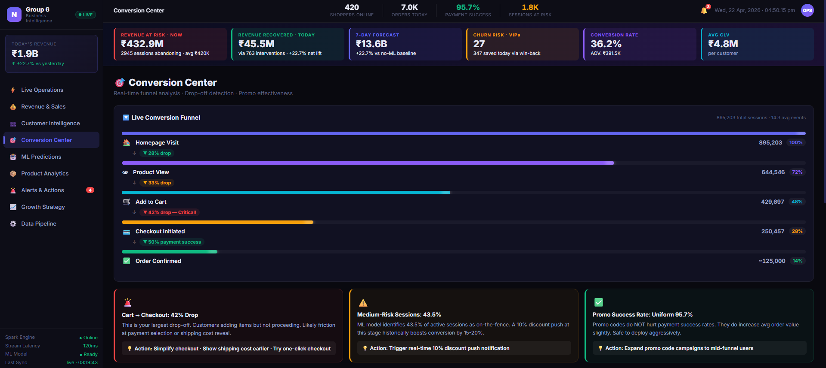

Slide 16
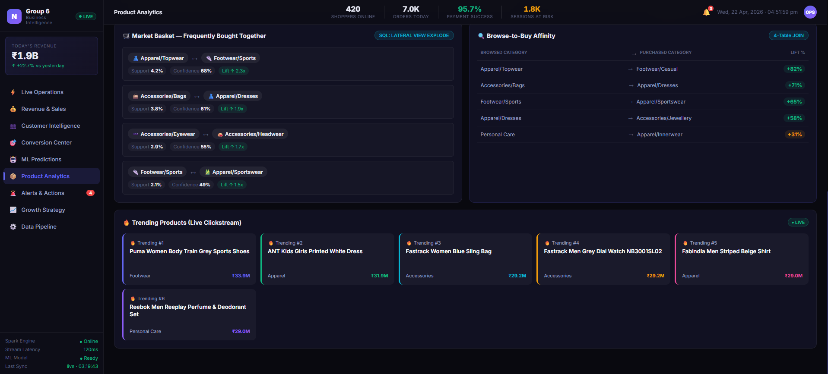

Slide 17
Stage 4 — Machine Learning (MLlib)
Three models, each mapping directly to a product lever
# | Model | What it predicts | Product lever
1 | Random Forest | Will this session convert? (0/1) | Real-time discount pop-ups
2 | KMeans (k = 5) | Customer segment (RFM) | Lifecycle marketing, VIP programs
3 | ALS (implicit) | Top-N products per user | "Customers like you also bought…"
0.9423
0.7659
0.7129
1.89 M
RF accuracy
RF AUC-ROC
KMeans silhouette
ALS interactions
Group 6 • ITCS 6190/8190 • Cloud Computing for Data Analysis 13 / 20

Slide 18
Model 1 — Random Forest: Session Conversion
Binary classifier: will this session end in a successful BOOKING?
Setup
Results
• Target: session_funnel.converted (0 / 1)
• Features: total_events, session_duration_mins, visited_homepage, did_search, added_to_cart, used_promo, num_keywords, traffic_source (OHE)
• Sample: 150K sessions (of 895K) for codespace fit
• Split: 80 / 20 train / test, seed = 42
• Hyperparams: numTrees = 20, maxDepth = 5, subsamplingRate = 0.5
Metric | Value
Accuracy | 0.9423
F1 | 0.9288
AUC-ROC | 0.7659
Feature importances
Feature | Importance
added_to_cart | 0.6355
session_duration_mins | 0.2204
total_events | 0.1130
used_promo | 0.0296
num_keywords | 0.0008
Takeaway: cart-adds dominate conversion signal — exactly the moment to intervene with a promo.
Group 6 • ITCS 6190/8190 • Cloud Computing for Data Analysis 14 / 20

Slide 19
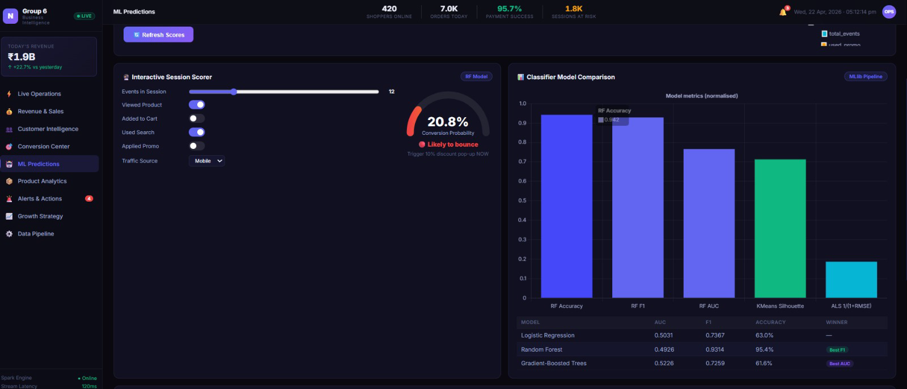

Slide 20
Model 2 — KMeans RFM Segmentation (k = 5)
Unsupervised segmentation over Recency / Frequency / Monetary
Feature engineering
Cluster profile
• recency_days = days since last successful booking
• frequency = distinct booking_id count
• monetary = sum(quantity × item_price)
• StandardScaler (mean = 0, std = 1) before clustering
• k = 5 (classic Champions / Loyal / Potential / At Risk / Hibernating)
Cluster | N | Recency | Frequency | Monetary
0 — Core Customers | 32,566 | 210 d | 6.1 | 3.1 M
1 — Loyal Shoppers | 8,850 | 36 d | 33.8 | 18.7 M
2 — VIPs / Champions | 394 | 30 d | 210.3 | 115.9 M
3 — Hibernating | 5,899 | 1324 d | 1.2 | 0.6 M
4 — Rising Loyalists | 2,533 | 24 d | 90.2 | 49.8 M
Silhouette = 0.7129 → strong separation. The 394-customer VIP cluster is where revenue protection should concentrate.
Group 6 • ITCS 6190/8190 • Cloud Computing for Data Analysis 15 / 20

Slide 21
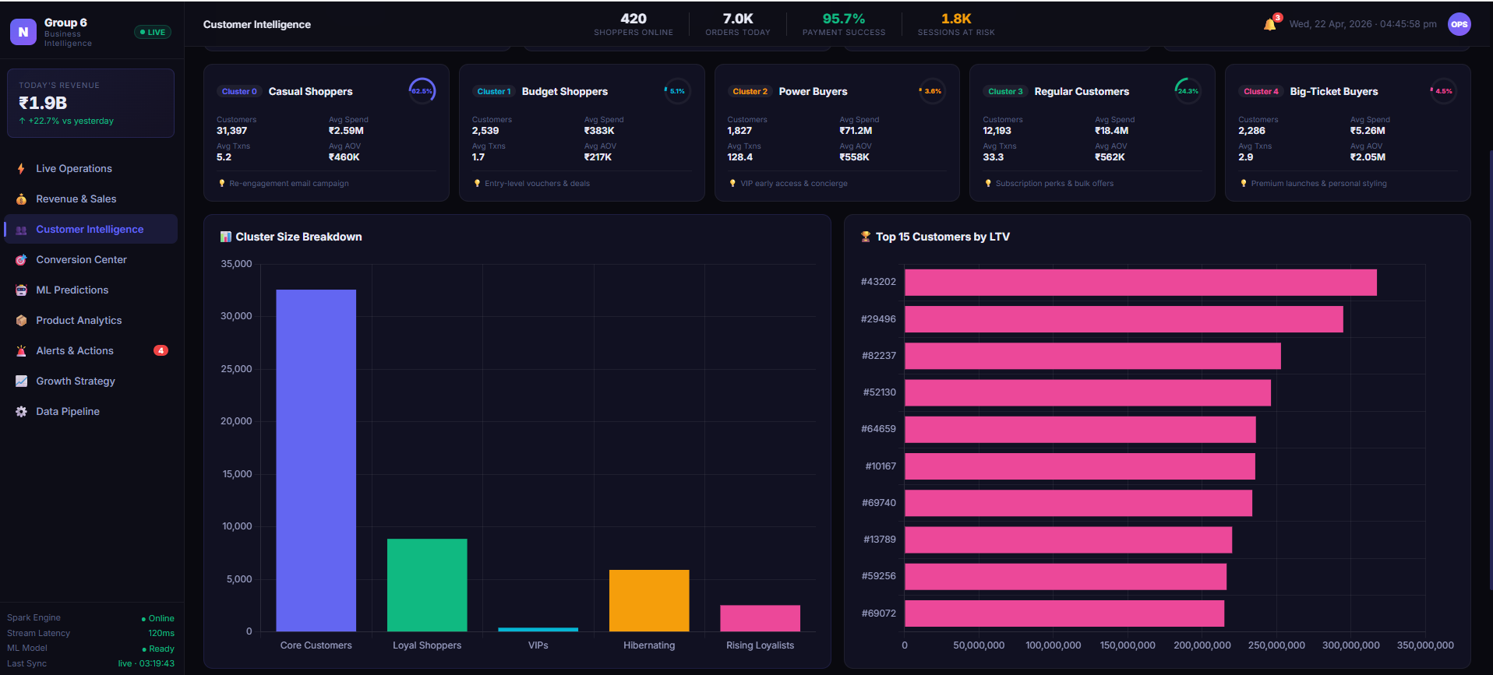

Slide 22
Model 3 — ALS Collaborative Filtering Recommender
Implicit-feedback factorization over customer × product interactions
Interaction matrix
Scale of the matrix
• Successful purchase (transactions_exploded) → rating 5
• Added to cart (cart_events × session→customer) → rating 3
• MAX(rating) per (customer, product) to de-dup
• implicitPrefs = True — rating is treated as confidence weight
• Hyperparams: rank = 8, maxIter = 5, regParam = 0.1
1.89 M
50,705
Interactions
Users
44,446
99.92 %
Items
Sparsity
Sample output — 200 users × top-5 recommendations
Customer #67 → Benetton handbag, Puma leather shoe, Baggit handbag, Puma canvas shoe, Catwalk heels. Customer #161 → Benetton handbag, Puma leather shoe, Baggit orange handbag, Kiara black handbag, Provogue formal shoe. RMSE = 4.36 on a 0-5 implicit-confidence scale — acceptable for a 99.92%-sparse matrix.
Group 6 • ITCS 6190/8190 • Cloud Computing for Data Analysis 16 / 20

Slide 23
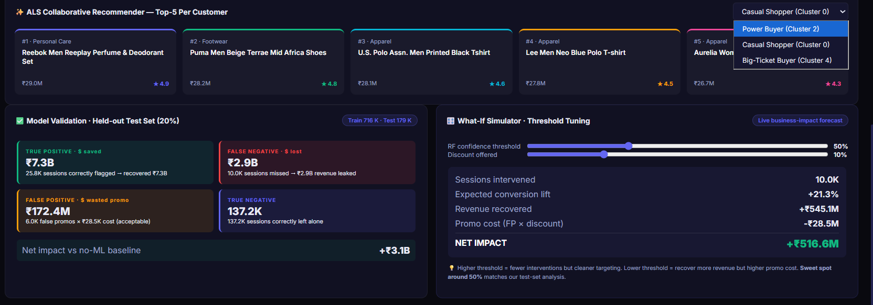

Slide 24
Stage 5 — Structured Streaming
From batch analytics → real-time decisioning engine
Pipeline
Two concurrent queries
• Simulator: reconstructs raw event_metadata from cs_* columns, drip-feeds JSON batches
• readStream().json() with maxFilesPerTrigger = 5
• regexp_replace + from_json → typed event payload
• Stream-static JOIN with products_clean (auto-broadcast)
• 5-minute tumbling window, 10-minute watermark
• Q1 — category trending (console sink) — what's hot right now?
• Q2 — session engagement (memory sink) — per-session event count, cart flag, booking flag
• Post-stream: high-intent sessions (cart, no booking) — trigger a promo
• Anomaly detection: μ + 2σ event count — flag bot-like / aggressive sessions
1,500
60
246
4
Events simulated
JSON batches
Sessions scored
Anomalies flagged
Group 6 • ITCS 6190/8190 • Cloud Computing for Data Analysis 17 / 20

Slide 25
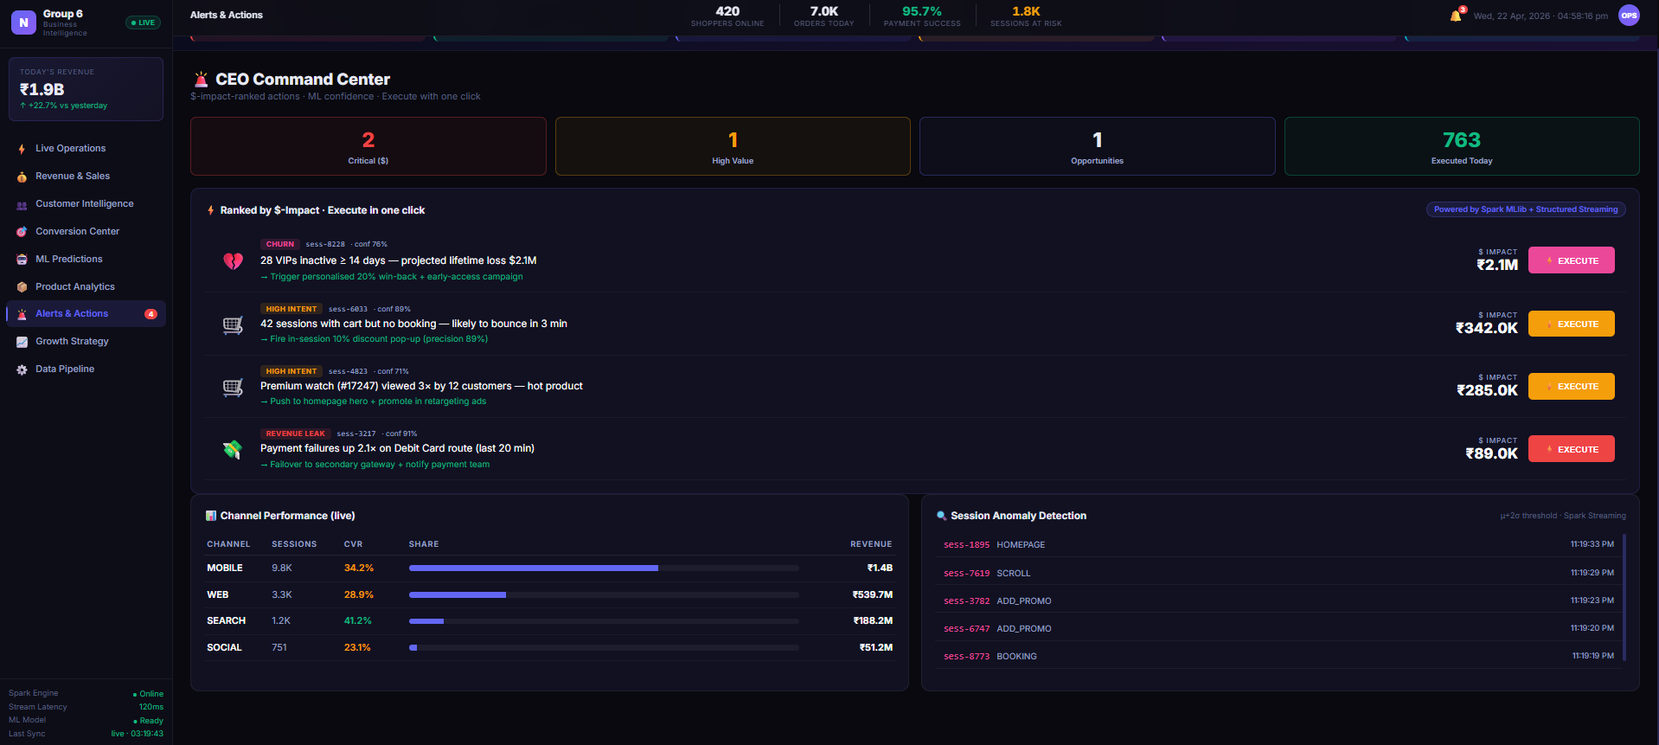
Alerts & Actions:

Slide 26
Business Outcomes
Capability | Model / Pipeline | Business lever
Segment the customer base | KMeans RFM | 394 VIPs → revenue protection program
Predict session conversion | Random Forest (AUC 0.77) | Trigger in-session promo on cart-adds
Recommend next purchase | ALS (top-5 per user) | Cross-sell carousel → AOV uplift
Spot high-intent bouncers live | Streaming Q2 + filter | 10% pop-up before the tab closes
Detect anomalous sessions | Streaming μ + 2σ | Fraud / bot flag for security ops
Track lifecycle retention | SQL cohort retention | Measure marketing campaign ROI
All four Spark components (Structured APIs • SQL • MLlib • Streaming) are exercised with measurable, production-shaped deliverables.
Group 6 • ITCS 6190/8190 • Cloud Computing for Data Analysis 18 / 20

Slide 27
Challenges & Solutions
Engineering decisions behind the numbers
Challenge | What we did
8 GB RAM codespace → default 1 GB Spark driver heap OOM'd on RF | Set PYSPARK_SUBMIT_ARGS with --driver-memory 3g before JVM boot
895 K-row session_funnel bloated tree training | Sampled 150 K rows, reduced RF to 20 trees × depth 5
recommendForAllUsers() exploded driver memory | Switched to recommendForUserSubset(200) for the demo
12.8 M clickstream × transactions join in Q6 aborted JVM | TABLESAMPLE (10 PERCENT) on clickstream in SQL
Raw CSV lives on S3, not locally → streaming simulator failed | Sample from clickstream_clean and reconstruct event_metadata dict
event_metadata is single-quoted Python-dict, not JSON | regexp_replace → from_json — pattern reused in both ingestion and streaming
Group 6 • ITCS 6190/8190 • Cloud Computing for Data Analysis 19 / 20

Slide 28
Future Work & Takeaways
What comes after the prototype
Future work
Key takeaways
• Move simulated stream onto Kafka for production-grade ingest
• Deploy RF model behind a streaming foreachBatch — real-time scoring
• A/B-test the discount pop-up triggered by the conversion model
• Replace ALS with a two-tower neural recommender for content + behaviour
• Automate end-to-end with Airflow / Databricks Jobs
• Add a Streamlit dashboard on top of the session-score memory sink
• Spark scales from 12.8 M-row batch joins to sub-second streaming — one engine
• EDA-driven feature engineering produced an AUC-0.77 RF with only 8 features
• Modular Parquet tables mean every downstream stage reuses the same source of truth
• Streaming pattern generalises: any real-time signal → foreachBatch decision
• Cloud-native design means the prototype deploys to Databricks / EMR without refactoring
Thank you • Questions?
Group 6 • ITCS 6190/8190 • Cloud Computing for Data Analysis 20 / 20

