Slide 1


Book
Store
--The Book Store app
Guided by:
Rohit Adhav Sir

Slide 2

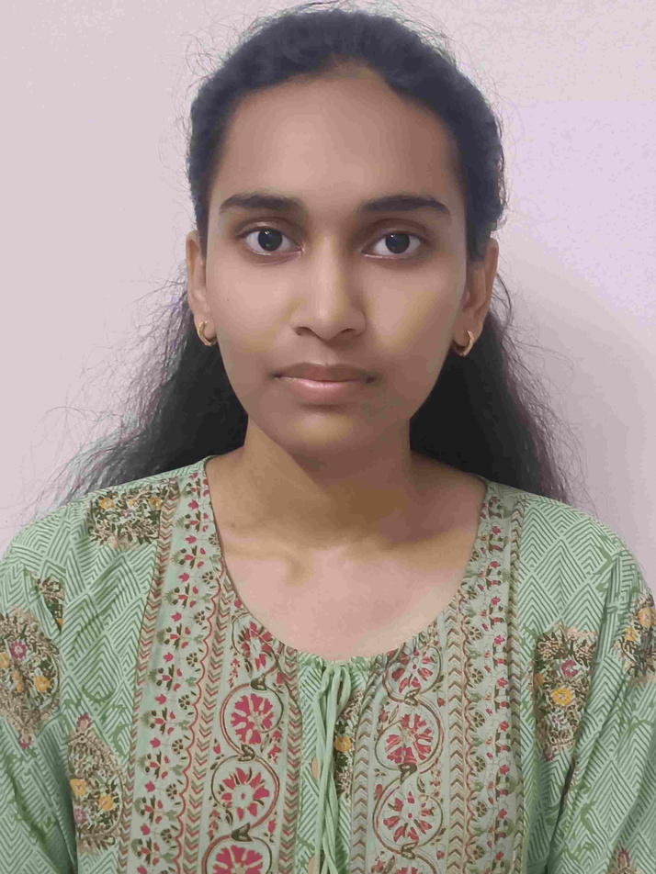
Team Members
Tejaswini Kere
Hetal Patel

Slide 3

Project Overview
Buy and search books online easily
Simple cart and order system

Slide 4

Objective
  Make book shopping quick and convenient
  Simple UI
  Provide a simple and user-friendly platform

Slide 5
Features
User registration & login
Product Search & Filters
Add products to wishlist
Order management
Add to Cart

Slide 6





Technology Used

Slide 7

Thank you!

