Slide 1
Insights from Airbnb Analysis from Pre-COVID Period
By
Hetal Khanapure

Slide 2
Agenda
Objective
Background
Key findings
Recommendations
Appendix:
Data Source
Data model assumptions
Other insights

Slide 3
Background
The COVID-19 pandemic affected Airbnb business due to travel restrictions.
The revenue took the largest hit in NYC in the Q2 of 2020.
Now that the travel restrictions are lifted, the business should be operated to recover the loss.

Slide 4
Objectives of the analysis of Airbnb data
Customer preferences and ratings of different hosts of Airbnb were analyzed
The data was analyzed to derive key insights from the Pre-COVID period
The insights will be used to take decisions for the NYC Airbnb business for travel in post-COVID period.

Slide 5
Data Preparation
Missing values have been identified for name,hostname,last_review and reviews per month columns in the data. Percentage of missing value is less than 20% so kept as it is.
Outliers removed from price and minimum_nights as the same insights could be identified without Outliers.
The visualization were derived using Tableau tool to understand key inferences from the analysis.

Slide 6
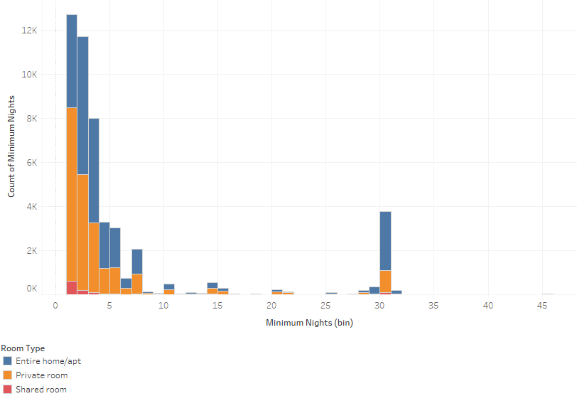
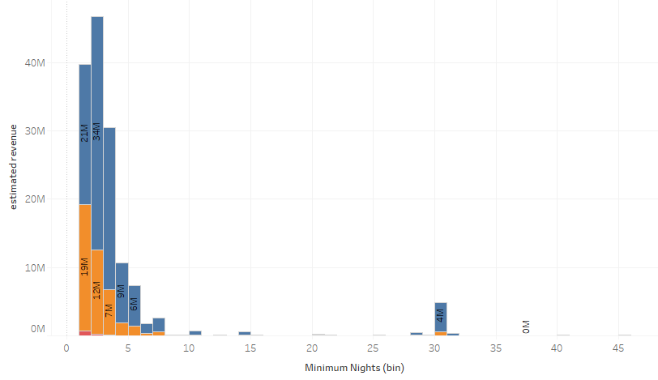
Properties having least minimum night are likely to get more bookings
Most of the bookings are made for minimum night stay as 1,2,3 and 30 days.
Interestingly, those who booked for Private Room and Entire home got the maximum revenue for minimum stay 1 night.
Overall we should focus more on properties having 1,2,3 and 30 minimum night stay.
Min nights | No of Booking
1 | 370K
2 | 350K
3 | 208K
4-7 | 149K
5-29 | 21K
30 | 29K

Slide 7
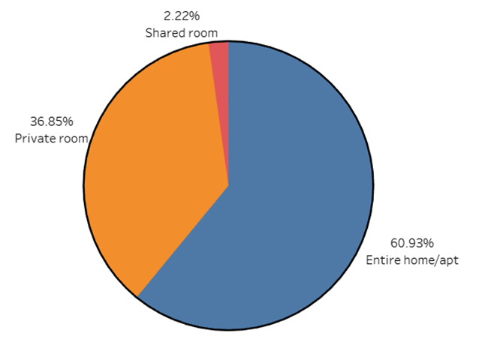
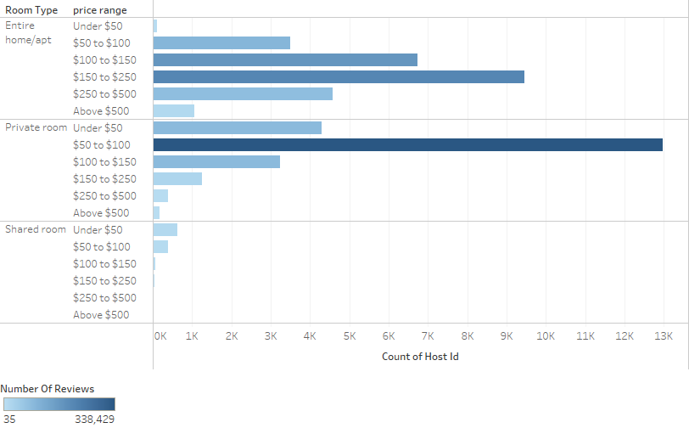
Entire home and Private room to get more bookings
Most of the bookings are for Entire Home/Private room across all the locations.
Interestingly the highest listings are of Entire Home /apt in Manhattan (61%) whereas Private Room has the highest listings in other neighborhoods.
Customers prefer Private rooms mostly in the price range 50$ to 100$.

Slide 8
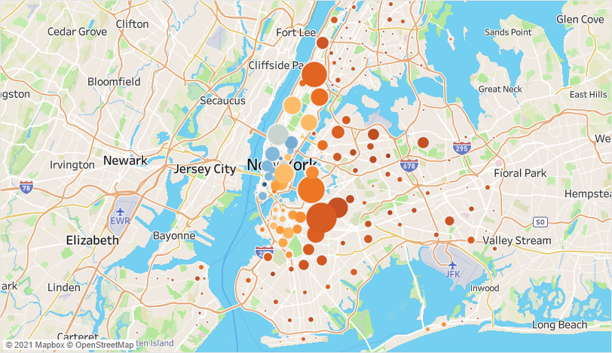
Properties in Bronx likely to get more customers due to high price in Manhattan
Properties in Bronx has the least price and should target acquiring properties from Bronx.
Due to high price in Manhattan, people prefer less priced locations such as Queens and Bronx.
Queens has the decent price and airport is located in the same borough(Neighborhood group) can be one reason to get more customers.
Borough | Average Price | No. of Bookings
Manhattan | $197 | 455 K
Brooklyn | $124 | 487 K
Queens | $100 | 157 K
Bronx | $89 | 28 K
Staten Isalnd | $115 | 12K

Slide 9
Recommendations
Focus efforts on private room or entire home/apt within price range of $50 to $100 for minimum night stay 1 or 2or 3 days
Target the host from Bronx borough in future Locations: Kingsbridge, Bronx; Astoria, Queens
Focus on the host whose property is available through out 365 days/year.

Slide 10
Appendix – Data Source
Data source : New York Airbnbs Dataset provided.
Comprises of 48895 records with 16 columns.
Categorical columns – 3; Numerical columns:6 ; Location variables:2; Time variable:1
Binned variable:1 (Price column binned to categorical column.

Slide 11
Appendix - Methodology
I have performed thorough Analysis of Airbnb Data using the tools Tableau(Data visualization),Python(Statistical Analysis) and Microsoft Excel.
I have created calculated fields in Tableau to find Total Revenue using price and Number of Reviews(assumed Number of Reviews = Number of bookings)
Price Range: Created bin for price column for the better categorization.
For more detail methodological document is provided here. methodology_doc.pdf

Slide 12
Appendix-Data Assumption
We assumed the data prior to the COVID – 19 period was achieving the desired revenue.
The company’s strategies are decided considering the travel will be increased in the post COVID period.
We assume that number of reviews means that many times at least the property is booked, or more than that. But not less than that.
We assume that if availability 365 is 0 , means that property is fully booked or delisted.

Slide 13
Appendix – Other insights
The host who get maximum reviews are of having private room and from Manhattan , Brooklyn or Queens.
highest estimated earning is from Manhattan($73M) and Brooklyn($59M).
The words like cozy, spacious, sunny, beautiful etc can be use to describe property name can get more visibility.
Most of the listing have available through out the year have got maximum bookings.

