Slide 1
Reviving Airbnb NYC business in post covid period
By Hetal Khanapure

Slide 2
Agenda
Objective
Background
Key findings
Recommendations
Appendix:
Other Insights
Data source
Data methodology
Data model assumptions

Slide 3
Objective
Improve the strategy and prepare for the upcoming challenges after Pandemic.
Understand the customer’s preferences and User experience trends for Airbnb business in NYC.
Rebuild the strategy for unpopular properties so it picks up the steam.

Slide 4
Background
In covid19 pandemic due to travel restriction Airbnb seen major decline in revenue.
Now the travel restrictions lifted , business should expand to recover the losses during pandemic.

Slide 5
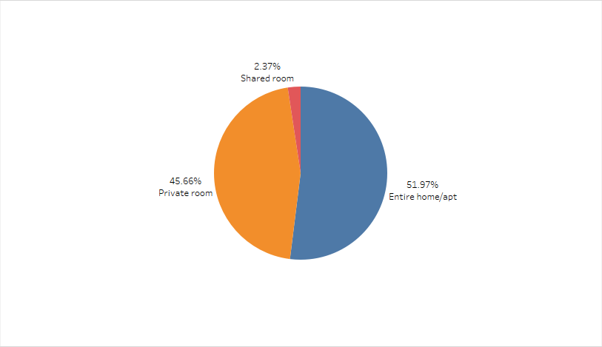
Customer preferences are for Entire apt OR private room is higher
Customer prefer Entire home Or Private room among 3 property type in NYC.
Entire home or Private room took a major portion of the listed properties , around 97.6%.
Shared room contains only 2.3% of all listed properties.

Slide 6
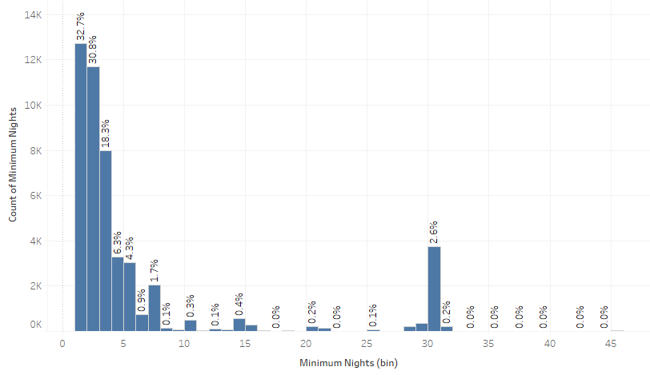
Target host offering less minimum nights stay option
It has been observed that most of the bookings are made for minimum night stay as 1,2,3.
In past Around 92% of bookings done for minimum nights are between 1-5.
Beside properties with minimum nights as 30 also got 2.6% bookings.

Slide 7
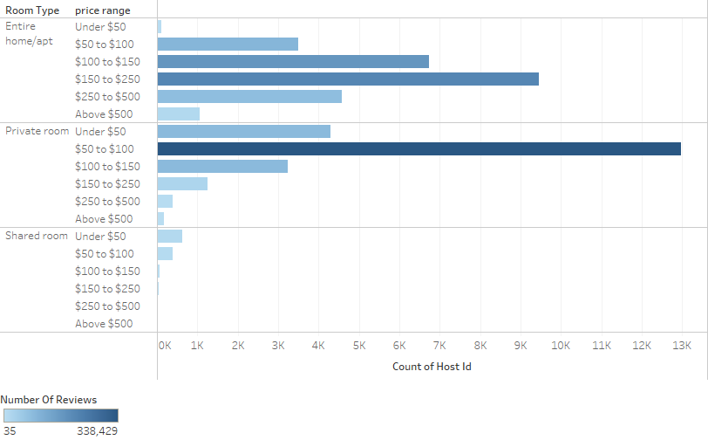
Customers prefer reasonable price range
Customers prefer price range between $50 to $100 for private room and $150 to $250 in Entire home.
We should target host offering the price for Entire home($150-$250) and Private room($50-$100).

Slide 8
Queens and Bronx should be target next
Very less properties listed in Bronx and Queens .
There are two Airport in Queens so company should target host who provide reasonable rate property for minimum nights in Queens.
Bronx have less price of property among all 5 borough also its connected to Manhattan and Queens by a dozen bridges and railroad tunnels .
As Manhattan has highest price of properties so customer may prefer to stay at Bronx.
Company should next target the host having properties listed in Bronx and Queens.

Slide 9
Recommendations
As per past data customer preference are private room or entire home/apt within price range of $50 to $100 for minimum 1-2 nights anywhere in New York.
Company should target the host from Bronx borough in future, because Bronx has cheap house prices and also its connected to Manhattan.
Properties which are available for booking for all days get more bookings.

Slide 10
Appendix – Other Insights
Most hosts having single property listed getting more reviews followed by 2 or 3properties per host.
Host who get maximum reviewed are of having private room.
It has been seen the properties available for booking through out the year get maximum bookings.
Harlem ,Manhattan and Williamsburg ,Brooklyn is the borough company needs to target to increase revenue.
Other locations can be focused are followed
Kingsbridge, Bronx
Astoria, Queens
St. George, Staten island

Slide 11
Appendix – Data Source
Here is a snapshot of our data dictionary.
Property information such as name, property type, location, neighborhood, reviews, price, host name, minimum nights, availability days.
The team used the following data source:
Property listing Data set for NYC

Slide 12
Appendix – Data methodology
We conducted detailed analysis of Airbnb NYC dataset. Which includes
Cleaning the Dataset for missing values and outliers
Using exploratory data analysis to identify customer preferences based on
Area preferences
Popular Price
Minimum nights stay
Listing Preferences

Slide 13
Appendix – Data Assumption
We assume that number of reviews means that many times at least the property is booked, or more than that. But not less than that.
We assume that if availability 365 is 0 , means that property is fully booked or delisted.

