Slide 1
Sentiment Analysis of U.S. Cellphone Market
Hetal Khanapure

Slide 2
AGENDA
Objective
Background
Key findings
Recommendations
Appendix
Data Source
Data model assumptions
Other insights
Model

Slide 3
OBJECTIVE
To understand competitors and preferences of cellphone users which would help to design new products optimally.
Provide features to customers that adds value and close the demand-supply gap
Increase the market share as well as the brand value.

Slide 4
BACKGROUND
Company entered in the market 3 years ago. They are new entrant in this sector, so they want to understand about user preferences.
In the world of digitization, industries are trying to fine-tune their strategies to suit the consumer needs based on the insights available from their choices and selections during their online presence.

Slide 5
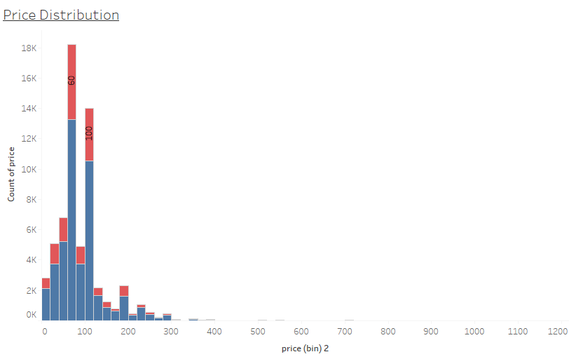
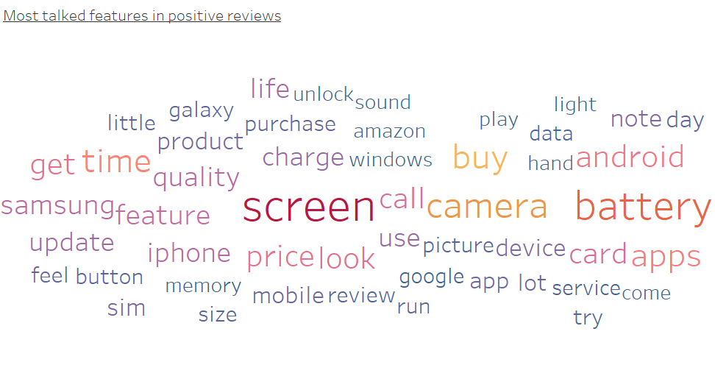
Customers prefers good screen , camera and battery in cellphone with price range $40-$100
Most talked features in positive and negative reviews are battery, screen and camera which shows that customer are more incline towards good battery , HD screen display and high-resolution camera.
Customers prefer price between $40-$60 or $80-$100 .

Slide 6
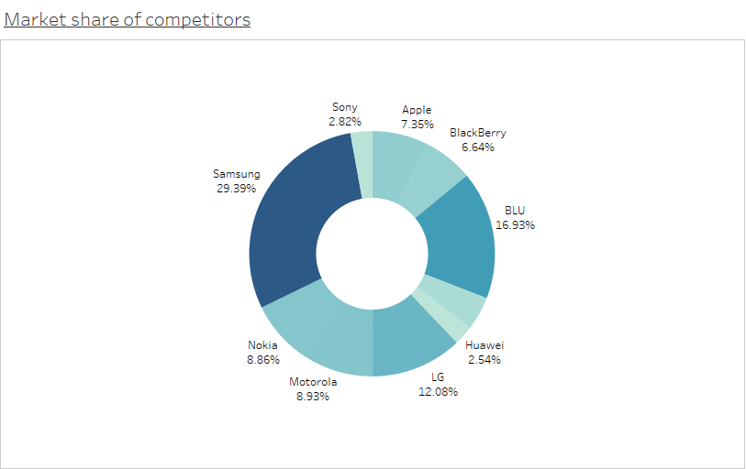
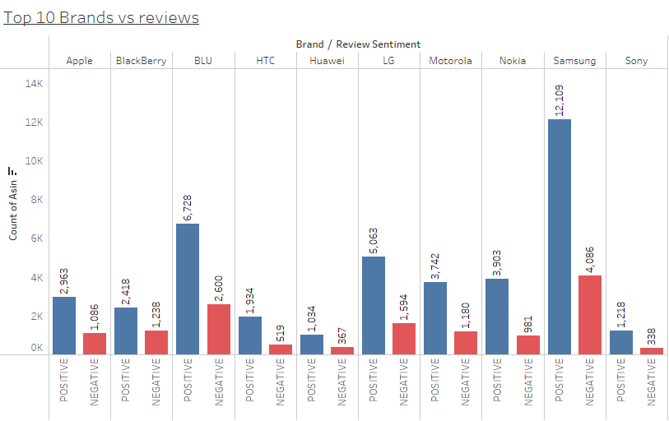
Samsung brand have highest market share for all years
Samsung have highest market share(29%) followed by Blu(17%) and LG (12%)
Samsung got highest reviews (16K) for all years, followed by Blue (9K) and LG(7K)

Slide 7
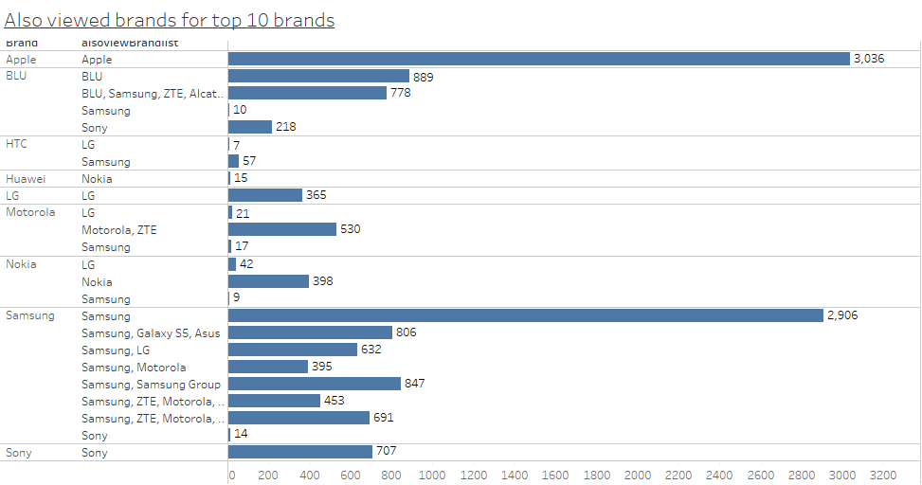
Apple and Samsung have customers who are loyal to the brand
Customers who buys cellphone of Apple or Samsung prefers only that brand products
While for other brands, customer looks for top 10 brands(Nokia, Blu, Motorolla, LG, Sony, Samsung) before they decide to buy a cellphone.
Other brand customer never look for Apple Brand products.

Slide 8
Recommendations
Company should focus on features like long lasting battery, High resolution
camera and HD display .
Price range for cell phone should be in range $40-$60 or $80-$100
To capture the market which is dominated by top ten brands, company should enter with a strategy to provide similar features at lower price along with some distinct features developed in house.

Slide 9
APPENDIX : Data Source
Data source
Data is collected from amazon between 1996 and 2018 for cellphone reviews and metadata.
Data dictionary
Data contains important information about cell phone like asin , brand, also view, price, review text

Slide 10
Appendix : Other Insights
The price spread of Samsung brand is wider compared to other brands.
Positive reviews are more verbose (having more content) than the negative reviews.
For samsung, Blue, LG and Nokia positive reviews are slightly more than negative reviews. Wherein for other brands it is at same level.

Slide 11
APPENDIX : Data Model Assumption
The popularity of the brand is proportional to the number of reviews
Blank value in Also_View columns means customer didn’t viewed any other items while buying the cellphone.
Missing price of item is imputed with average price of that brand.

Slide 12
APPENDIX : Model
Build naïve bays model for given data set .
Model has evaluated on base of following matrix
accuracy(86%),sensitivity (95%),specificity(59%)
precision(87%),recall (95%),F1 score(91%)
The matrix shows that the model can identify positive and negative reviews correctly.

Slide 13
THANK YOU

