Slide 1
Crack Growth Monitoring and Expansion Joints Monitoring of Concrete using RF Sensors
By:-
Hetansh Patel

Slide 2
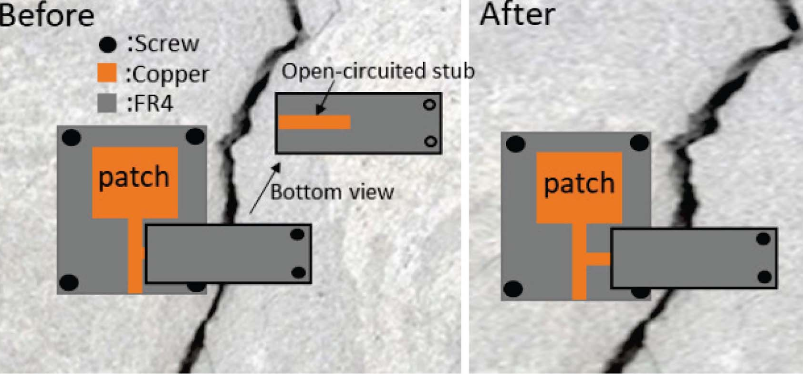
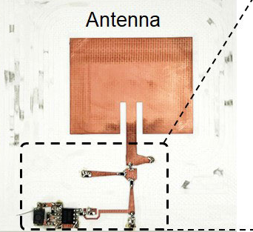
Literature Survey
Journal Name & Year | Title of the Papers | Design & Geometry | Structure | Frequency | Sensitivity Parameters
IEEE Journal of Selected Areas in Sensors (Vol.: 1) - 2024 | Stub-Loaded Patch Antenna for Development of High Sensitivity Crack Monitoring Sensor | The design includes a Microstrip-fed patch antenna with a shunt open-circuited stub on FR4 substrate. |  | 4 GHz | Detects up to 2 mm crack expansion with a 110 MHz frequency downshift.
IEEE Sensors Journal (Vol.: 24) - 2024 | A Compact, Batteryless, and Chipless Intermodulation Sensor for Wireless Crack Detection | The sensor design features a microstrip patch antenna printed on a Rogers RO4003C substrate with a dielectric constant of 3.55. The copper patch has dimensions of 41.8 mm by 38.5 mm. |  | 2.3-2.5 GHz | Detects shifts in the antenna's resonance frequency, which changes with surface cracks.

Slide 3
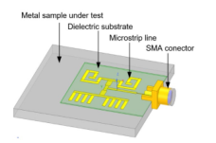

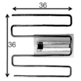
Literature Survey
Journal Name & Year | Title of the Papers | Design & Geometry | Structure | Frequency | Sensitivity Parameters
IEEE Sensors Journal (Vol.: 24) - 2024 | A Phase Shift-Based and Quadrant-Distinguishable Passive Microstrip Antenna Sensor for Metal Crack Detection | The PMA sensor features two comb-shaped and two spiral-shaped structures connected to a one-to-four power divider. |  | 2.83 GHz | Crack Length: 16.08° phase delay per mm. Crack Width: 626° phase delay per mm. Crack Depth: 24.9° phase delay per mm
IEEE Sensors Journal (Vol.: 16) - 2016 | Passive Wireless Frequency Doubling Antenna Sensor for Strain and Crack Sensing | The sensor includes a receiving antenna, a sending antenna, and a diode-integrated matching network. |  | 2.9-5.8 GHz | The Strain Sensitivity is −5.232 kHz per µε, which detects small strain changes and crack growth.
IEEE Transactions on Antennas and Propagation (Vol.: 59) - 2011 | Passive RFID Strain-Sensor Based on Meander-Line Antennas | The MLA sensor changes shape & radiation perf. with strain. It features a folded copper wire connected to a T-match section on a substrate. |  | 870 MHz | Strain Sensitivity: 10% power change per 0.43 mm elongation. Dynamic Range: Up to 6% strain.

Slide 4
Problem Statement
Crack monitoring refers to the process of detecting and tracking the growth of cracks in order to prevent structural failures.
The existing crack detection methods often require lengthy cable connections, are costly, have limited sensing perimeters, short sensing distances, small frequency deviations, and can cause structural damage or deformation.
Hence, it is necessary to overcome these shortcomings and provide an improved Crack monitoring system.

Slide 5
Objective
To develop antenna based RF sensor using microstrip antennas
To enable High Sensitivity Detection with reusability

Slide 6
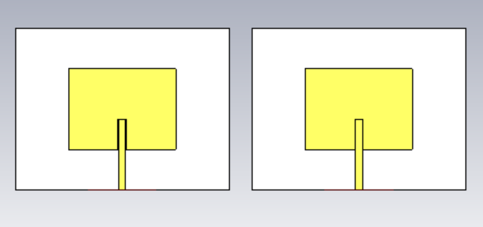
Proposed System Introduction
The proposed system aims to monitor cracks in concrete as accurately as possible.
The system will consist of a two Microstrip Patch Antennas placed side by side.
Each antenna in the system will be judiciously positioned to provide coverage for an extended area to be monitored.
The antennas will shift as the cracks propagate. This will be detected and measured in real time for information relative to the degree of crack processes.
Dual Antenna System

Slide 7
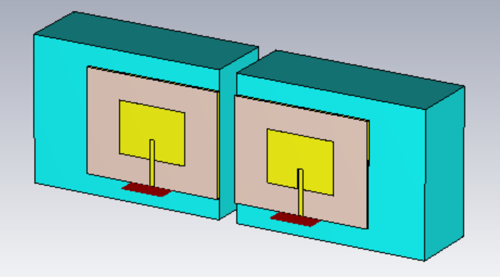
Proposed System Diagram
This project demonstrates the design and analysis of two microstrip patch antennas arranged side by side; designed for monitoring concrete crack in structures.
The proposed design is a dual-antenna system working at a frequency of 2.44 GHz. It’s performance parameters such as reflection coefficient (S11) and transmission coefficient (S12) are varying based on variations caused by the cracks.
In this report, the study finds out how crack formation has impacted this set of parameters.
Proposed System Design

Slide 8
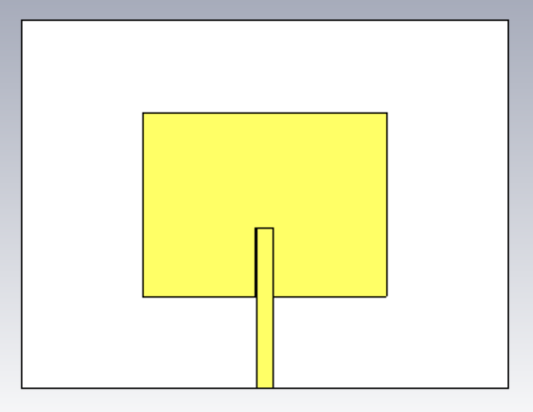
Explanation of all the Modules of the System
1) Single Antenna Design
The first step is to design a single antenna and calibrate it according to the calculated specifications.
Patch Dimensions:
• Patch Length (L) = 37.93 mm
• Patch Width (W) = 28.61 mm
• Feed Width = 2.5 mm
• Slot Length = 10.7 mm
• Slot Width = 2.9 mm
• Thickness of Copper Conductor = 0.035 mm
Substrate Dimensions:
• Substrate Length (Ls) = 75.85 mm
• Substrate Width (Ws) = 57.23 mm
• Substrate Height (h) = 1.6 mm
Single Antenna Design

Slide 9
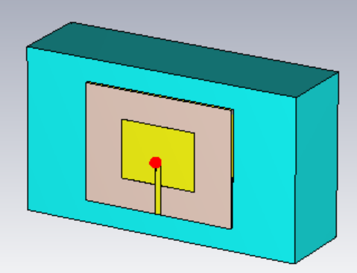
Explanaton of all the Modules of the System
2) Single Antenna Design on a Concrete Slab
The second step is to mount the designed antenna on a concrete slab which is constructed for the calculated parameters.
Concrete Dimensions:
Length (Lc) = 140mm
Width (Wc) = 80mm
Height (hc) = 40mm
Concrete Properties:
Dielectric Constant (εr) = 4.5
Loss Tangent = 0.0111
Antenna Mounted on a Concrete Slab

Slide 10
Explanation of all the Modules of the System
3) Dual Antenna Design and Implementation
The next step in the design procedure is to take two antennas of the same specifications and placing them side by side. This creates a dual antenna system.
The final step is to mount the dual antenna system on a concrete slabs. The separation between the slabs simulate the condition where crack is present on the slab.
Dual Antenna System
Dual Antenna System on Concrete Slabs

Slide 11
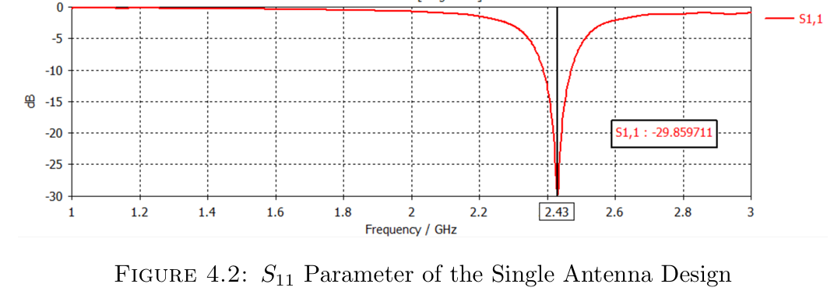
Simulation Results & Anslysis
1) Single Antenna Design
After finishing the design in the software, the analysis can be performed.
The isolated antenna demonstrates a resonant frequency around 2.43 GHz.
At this frequency the S11 parameter is found to be -29.86 dB
This depicts efficient power radiation and good impedance matching of the antenna.
Single Antenna Design

Slide 12
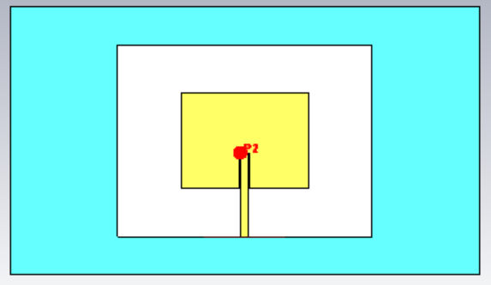
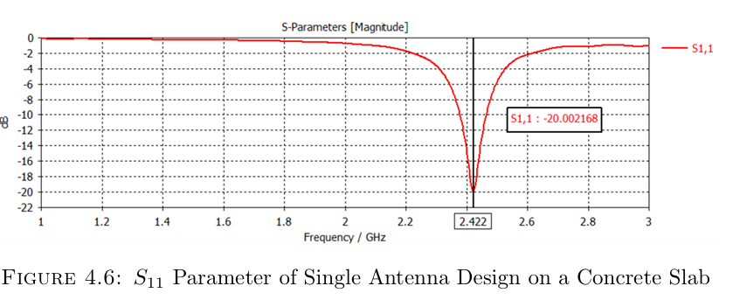
Simulation Results & Anslysis
2) Single Antenna Design on a Concrete Slab
After designing the antenna on a concrete slab, the analysis can be performed.
The single antenna mounted on a concrete slab resonates at around 2.422 GHz.
At that frequency, the value of the S11 parameter is found to be -20.002168 dB.
This indicates good power radiation for the antenna.
Single Antenna Design on a Concrete Slab

Slide 13
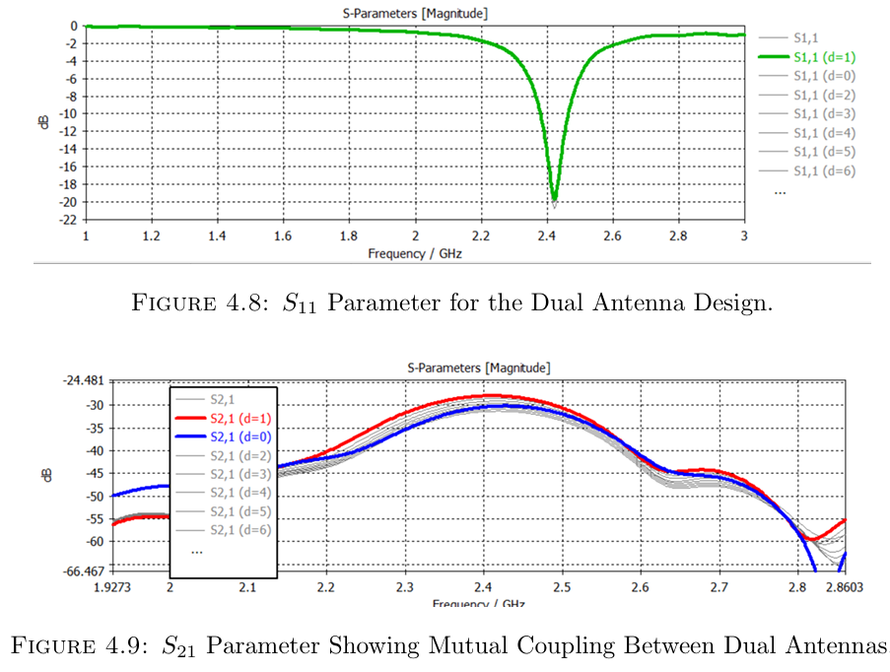
Simulation Results & Anslysis
3) The Dual Antenna System
The antenna for each design is in resonance of around 2.43 GHz.
The distance (d) between antennas impacts the mutual coupling (S21) and reflection coefficient (S11) for the system.
Larger d leads to increase in the mutual coupling between the antennas which is clearly demonstrated in the simulation graphs shown.
This leads to increased efficiency of transmission.
Dual Antenna System Design

Slide 14
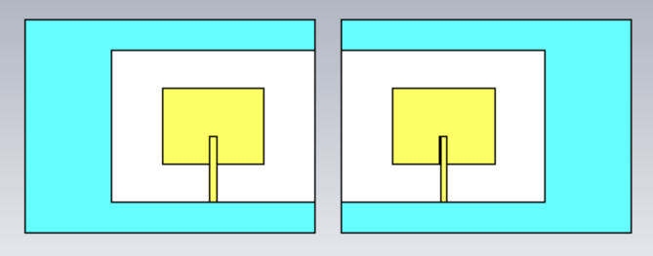
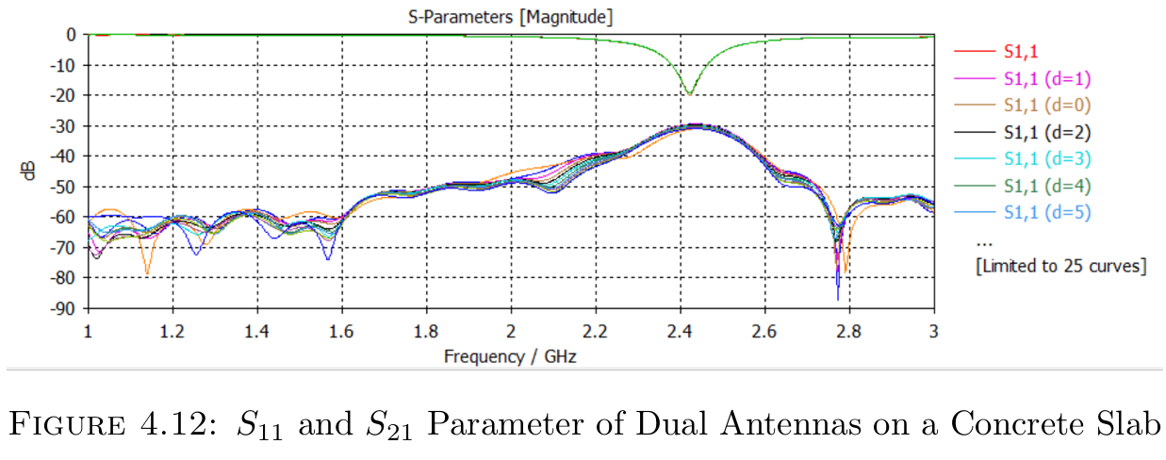
Simulation Results & Anslysis
4) Dual Antenna System on Concrete Slabs
Each antenna is resonating at about 2.43 GHz.
The concrete slab impacts the effective wavelength and thus causes a small shift in the resonant frequency.
When two antennas are mounted on the slab, the mutual coupling (S21) is determined by the distance (d).
Smaller d leads to stronger coupling, whereas cracks increasing the d weakens the coupling.
Dual Antenna System on Concrete Slabs

Slide 15
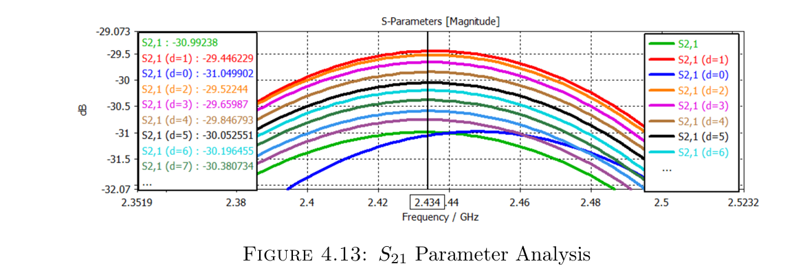
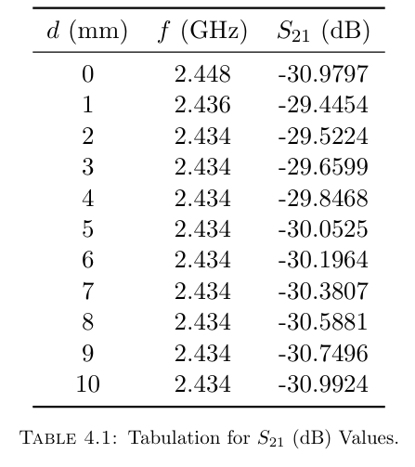
Simulation Results & Anslysis
The Change in the mutual coupling parameter S21 can be traced with the table. The table gives an idea of the behavior of the S21 parameter against distance (d) between antennas.
As the d between the antennas increases, the mutual coupling (S21) decreases, giving a good opportunity to measure crack progression.
The resonant frequency (f) remains stable for d ≥2 mm, thus it guarantees constant performance monitoring on changes.
The analysis indicate increase in isolation ensuring the system focuses on significant structural changes.
Larger cracks are associated with more visible changes to the S21 Parameter.

Slide 16
Conclusion
We have demonstrated experimentally how the two antenna system is effectively used for crack detection and monitoring.
As the formation of a crack may separate the moving apart of the antennas, it also changes their isolation coefficient and mutual coupling between the two antennas.
Hence, the design has been performed successfully and its outcome is well shown by the S21 parameter marking the appearance of cracks on the concrete surface.

Slide 17
References
Stub-Loaded Patch Antenna for Development of High Sensitivity Crack Monitoring Sensor
A Compact, Batteryless, and Chipless Intermodulation Sensor for Wireless Crack Detection
A Phase Shift-Based and Quadrant-Distinguishable Passive Microstrip Antenna Sensor for Metal Crack Detection
Passive Wireless Frequency Doubling Antenna Sensor for Strain and Crack Sensing
Passive RFID Strain-Sensor Based on Meander-Line Antennas
A Method for Damage Detecting of Large Reflector Antennas Wheel-Rail Based on Electromagnetic Ultrasonic Technology
Chipless RFID Sensor Tag for Metal Crack Detection and Characterization
Metal cracks detection based on circular patch microstrip antenna
Research of Crack Defect Detection in Metal Pipes Based on Microwave Antenna Array
Design and Development of Planar Monopole Antenna for Bone Crack/Void Detection

