Slide 1
Deblurring and Enhancing Astrophotographs Using PSF Based Digital Image Processing
Group 19

Slide 2
Introduction
Astrophotography is limited by blurring due to atmospheric seeing (ground telescopes) and telescope optics.
When the light passes through an optical telescope, its intensity distribution spreads out because of the diffraction effects, giving us a blurred pattern described by the Point Spread function (PSF).
The Point Spread function is the response of a focused imaging system to a point source or a point object.

Slide 3
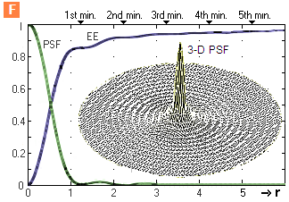
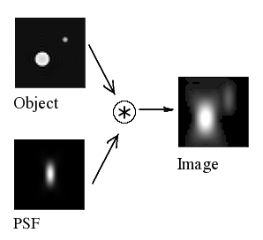
Source: https://www.telescope-optics.net/diffraction_image.html

Slide 4
Literature review
In Astronomical Imaging: Image I(x,y) is the convolution between true sky intensity with the point spread function of the system with additive noise.
PSF removal method depends on the desired properties, noise and other qualitative properties.
PSF is variable because of:
the field of view
the intensity of light
the construction of the telescope
I(x, y) = O(x, y)*P(x, y) + N(x, y)

Slide 5
Dataset
– Source:
Hubble Legacy Archive
https://hla.stsci.edu/hlaview.html
– Images of COSMOS:
Format: .fits (raw image with astronomical metadata)
Processing: Contrast Stretching and Noise Removal

Slide 6



Methodology
Input Image:
Weiner Filtering (Noise reduction by inverse filtering):
Richardson-Lucy Deconvolution:

Slide 7
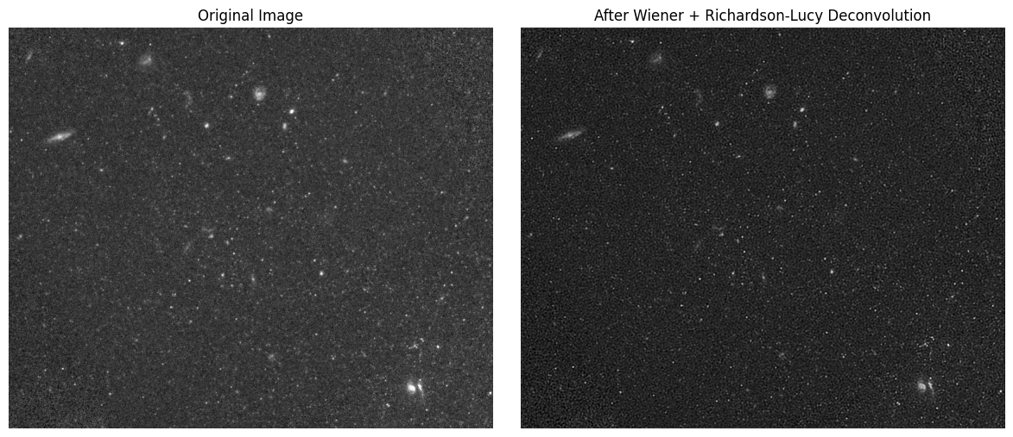
Results

Slide 8
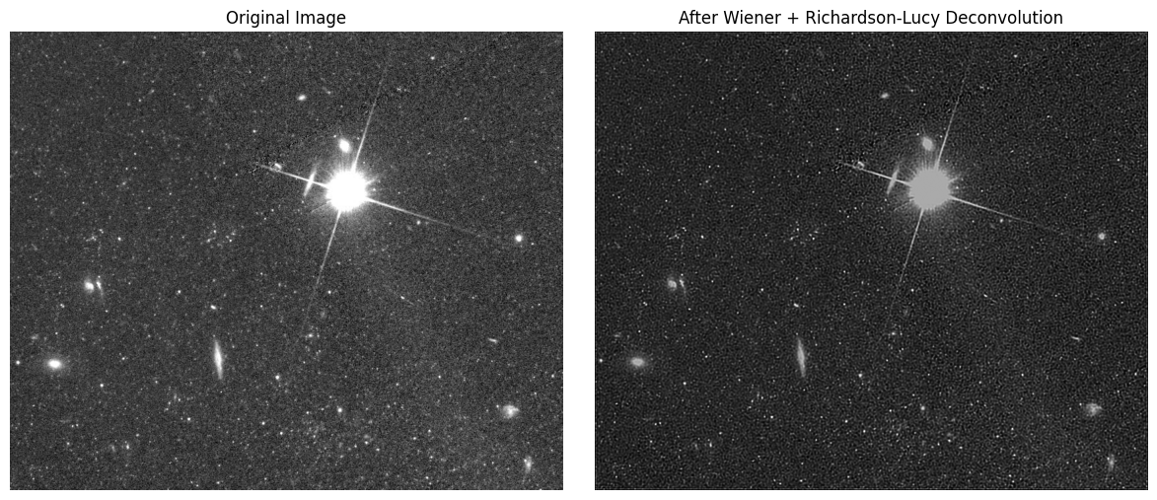
Results

Slide 9
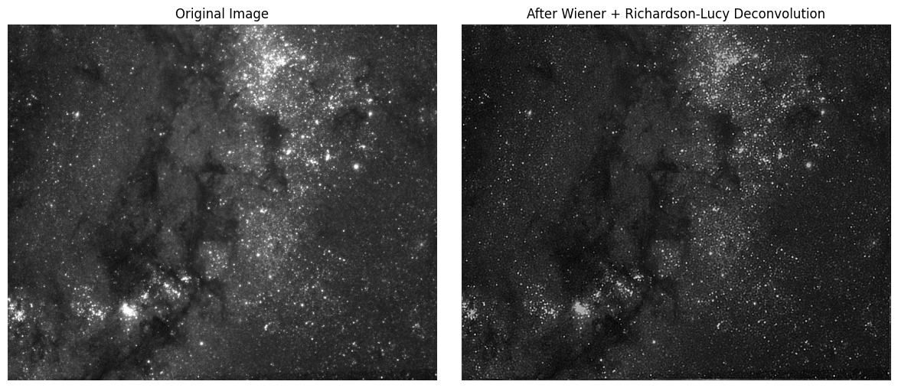
Results

Slide 10
Conclusion
Deconvolution applied to a slightly processed image was able to produce results with enhanced visibility and reduced blurriness.
Implementation of different types of PSFs and their convolution with the original image simulated the blurring effect which helped in determining the suitability of the chosen PSF.
There is scope for further improvement via advanced processing techniques.

Slide 11
Next set of work
Addition of other pre-processing techniques i.e. contrast stretching, to improve PSF for deblurring.
Color mapping for enhanced visibility of faint features of astrophotographs
Optimizing deconvolution of images

Slide 12
References
https://www.telescope-optics.net/diffraction_image.htm
https://www.stsci.edu/files/live/sites/www/files/home/hst/instrumentation/wfc3/documentation/instrument-science-reports-isrs/_documents/2022/WFC3-ISR-2022-05.pdf
https://www.stsci.edu/hst/instrumentation/wfc3/data-analysis/psf
https://pmc.ncbi.nlm.nih.gov/articles/PMC3986040/
https://science.nasa.gov/wp-content/uploads/2024/08/draft-pasp-article.pdf
https://jwst-docs.stsci.edu/jwst-near-infrared-camera#gsc.tab=0
https://opg.optica.org/oe/fulltext.cfm?uri=oe-32-16-27278

Slide 13
Thank you

