Slide 1
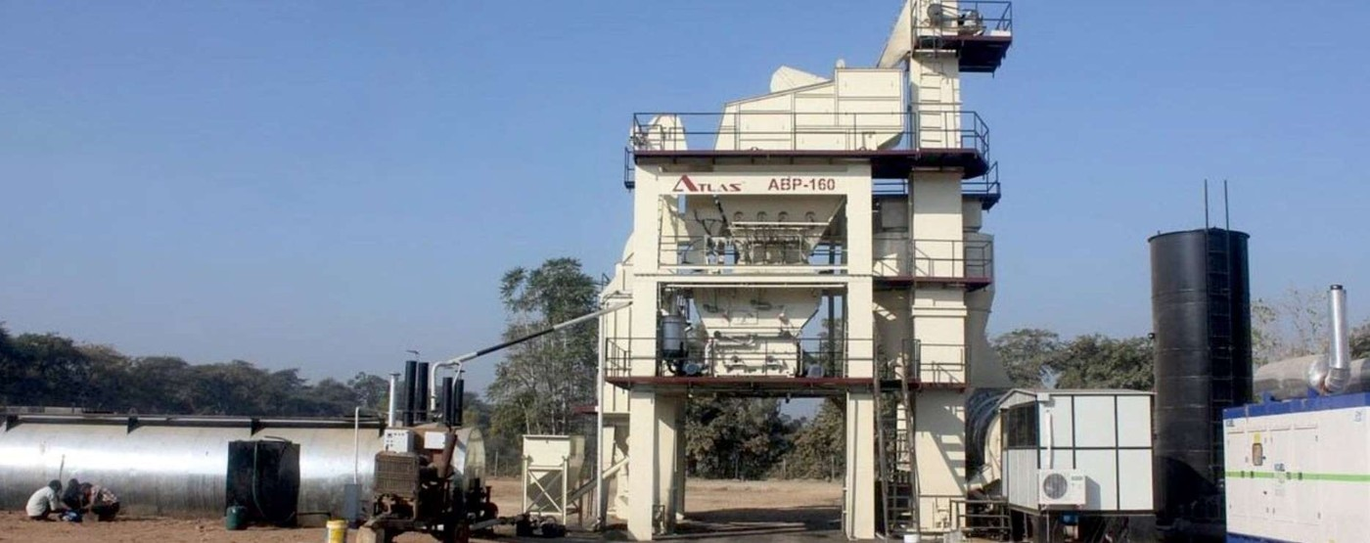
AHT CONSTRUCTION
HIGHWAY
TO HIGHRISE
Road, Industrial & Real Estate development across South Gujarat, Daman and Silvassa — since 2001.
COMPANY PROFILE
VAPI · DAMAN · SILVASSA
Notes:
AHT Construction Pvt. Ltd. — company profile. Highway to Highrise. Established 2001, Vapi / Daman / Silvassa.

Slide 2
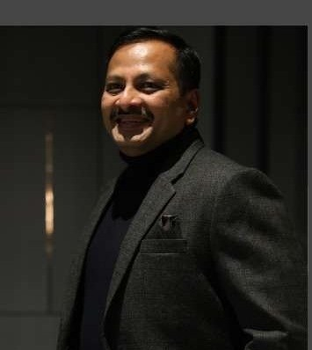
WHO WE ARE
TWO DECADES BUILDING SOUTH GUJARAT
Two decades ago, one road crew in Daman set out to build South Gujarat. Today, AHT Construction leads Road, Industrial and Real Estate development across the private and government sectors — with our own quarries, ready-mix concrete and asphalt plants feeding every job.
AJAY H. THAKUR
Founder & Chairman
OUR VISION
OUR MISSION
“Each of our clients is an A-Lister. When nationally respected companies place repeat orders with us, that is the trust we have built.”
Creating super value for our clients, business associates and society — on a continuous basis.
To remain a company South Gujarat trusts — built on commitment, care and faith.
AHT CONSTRUCTION
02

Slide 3
SINCE 2001
BY THE NUMBERS
1,056+ km
25+ lac sq.ft.
8+ lac sq.ft.
ROADS LAID
INDUSTRIAL BUILT
COMMERCIAL SPACE
2 lac sq.ft.
3
7
BUNGALOWS DELIVERED
OWNED QUARRIES
INTEGRATED DIVISIONS
150+ PROFESSIONALS
300+ ENGINEERS
2,000+ FIELD EMPLOYEES
AHT CONSTRUCTION
03

Slide 4
WHAT WE DO
SEVEN DIVISIONS, ONE COMPANY
01
Road Development
02
Industrial Development
Highways, bituminous & concrete roads, paver-block work — supplied by our own drum mix plants.
Industrial buildings and warehouses up to 8 m floor-to-floor, delivered around live production.
03
Real Estate
04
Commercials
Turn-key residential bungalows taken from foundation through to handover.
Retail stores, offices, showrooms and mixed-use developments.
05
Government & Industrial
06
Mining & Quarries
Trusted by Panchayats, Municipal Councils and Corporations across the region.
Stone, aggregates, sand and road base from three owned quarries.
07
Ready-Mix Concrete
Automated batching plants backed by our own in-house testing laboratory.
AHT CONSTRUCTION
04

Slide 5
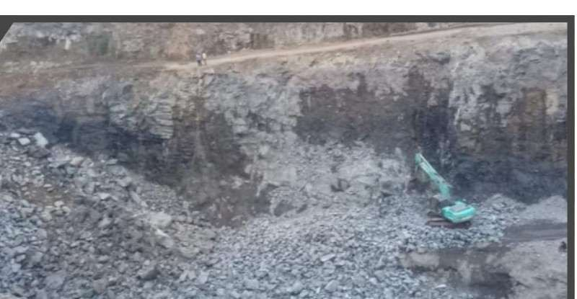
WHY WE CAN HOLD A PROGRAMME
WE OWN THE GROUND
WE BUILD ON
Three quarries, three ready-mix plants and two asphalt drum mix plants. When the aggregate, the concrete and the mix all come from inside the company, a programme stops depending on someone else’s delivery date.
100 TPH
250 TPH
100 TPH
Kyrie Infra Stone Quarry
Shiv Shakti Stone Quarry
Shiv Stone Works
Dunetha, Daman
Maroli, Sarigam
Kunta, Daman
30 cum/hr ×3
80/100 TPH
80/100 TPH
Ready-Mix Concrete
Asphalt Drum Mix
Asphalt Drum Mix
Naroli · Silvassa · Vapi
Degam, Valsad
Maroli, Sarigam
AHT CONSTRUCTION
05

Slide 6
CAPABILITIES
PLANT & MACHINERY — ALL OWNED
PLANT, CRANES & VEHICLES
FORMWORK & SITE EQUIPMENT
RMC Plant 30 m³/hr (Schwing Stetter) | 3
Concrete Pump 1800 HP | 3
Tower Crane 18 m | 2
Tower Lift 115 ft | 3
Hydraulic Paver Finisher (Apollo) | 2
Sensor Paver Finisher (Apollo) | 5
Static / Vibratory Road Roller | 2 / 4
Transit Mixer | 10
Excavator 200 | 4
Backhoe Loader | 5
Tipper / Dumper | 35
Tractor / Pickup / Loader | 5 / 5 / 2
Shuttering Plate | 3,500
Vertical Cup-Locks | 7,000
Ledger | 12,000
Screw Hand Jack | 4,000
Jack | 2,000
Spun | 2,500
MS Channel (MT) | 60
Concrete / Needle Vibrators | 15 / 16
Bar Cutting / Bending Machine | 5 / 4
Core Cutting / Testing Lab | 2 / 2
AHT CONSTRUCTION
06

Slide 7
MARQUEE PROJECTS
DELIVERED ACROSS THE REGION
PROJECT | CLIENT | VALUE | STATUS
POY, PSF, BELLER & CP Buildings + RCC Road | Bhilosa Industries | ₹48 Cr | Completed
Manufacturing Facility | Polycab India Ltd. | ₹35.5 Cr | Ongoing
Expansion of Manufacturing Unit | Sumilon Polyester Ltd. | ₹22 Cr | Completed
Toray Kusumgar Advanced Textile Plant | Toray, Sarigam | ₹21 Cr | Completed
Pre-Clinical Research Organisation | Jai Research Foundation | ₹14 Cr | Ongoing
New D-Tax Building | Filatex India Ltd. | ₹8 Cr | Completed
Sock Manufacturing Facility | Infiiloom India Pvt. Ltd. | ₹4.5 Cr | Completed
13-Storey Commercial Complex | Odhav Developers, Vapi | — | Completed
The Frontage Park — Retail, Hotel & Multiplex | ARTH Group, Vapi | — | Ongoing
R.K. Desai Group of Colleges | R.K. Desai | — | Completed
+ 12 further industrial, commercial, institutional and road projects across Vapi, Daman, Silvassa, Sarigam and Valsad.
AHT CONSTRUCTION
07

Slide 8
PUBLIC SECTOR
GOVERNMENT ROAD WORKS
Valsad Jilla Panchayat
₹25 Cr
Valsad District, Gujarat
₹68 Cr
Umargaon
₹15 Cr
Umargaon, Gujarat
OF GOVERNMENT ROAD WORKS COMPLETED
Daman Municipal Council
₹12 Cr
Daman
Across five public authorities — Panchayats, Municipal Councils and Corporations. Tender documentation, measurement and billing are routine work for us.
District Panchayat, Daman
₹10 Cr
Daman
Silvassa Municipal Council
₹6 Cr
Silvassa, D&NH
AHT CONSTRUCTION
08

Slide 9
OUR TEAM
150+ PROFESSIONALS · 300+ ENGINEERS
Ajay H. Thakur
Shubham Singh
Shivam Singh
Lalit Singh
FOUNDER & CHAIRMAN
INDUSTRIAL HEAD
SHIV STONE WORKS
SHIV SHAKTI STONE
Sanjay Prajapati
Hetal Mistry
Pradeep Desai
Dipti Sharma
ADMIN / HR HEAD
PURCHASE & MAINTENANCE
LIASONING
CHARTERED ACCOUNTANT
Janish Patel
Dilip Gehalot
Paresh Rana
ACCOUNT HEAD
PROJECT MANAGER
PROJECT MANAGER
AHT CONSTRUCTION
09

Slide 10
LET’S BUILD
WHAT’S NEXT.
HIGHWAY TO HIGHRISE
VAPI · HEAD OFFICE
DAMAN
SILVASSA
275–277, 2nd Floor, Amidhara Complex,
GIDC Char Rasta, Vapi – 396195, Gujarat
F-12, Ace Shopping Mall, Plot 1/23,
Katheri, Nani Daman – 396210
Behind Ramji Mandir, Dadra – 396230,
D & NH
+91 96385 10000 ajaythakurconstruction@yahoo.in www.ahtconstruction.in
GST (Gujarat) 24AXSPS8572J1ZI · PAN AXSPS8572J · Auditor: Dipti Sharma & Co.

