Slide 1


Adaptive energy & abnormal
Dectection
Patel Het Shaileshbhai – 230670132008
Mentor Name: Jesal Desai
Rohit Bhadoauriya
College Name - SAL Education

Slide 2

Project Objectives
Problem Statement
Project Overview – Introduction
End Users
Wow Factor in Project
Modelling/Block Diagram/Flow of Project
Result/outcomes
Conclusion
Future Perspective

Slide 3
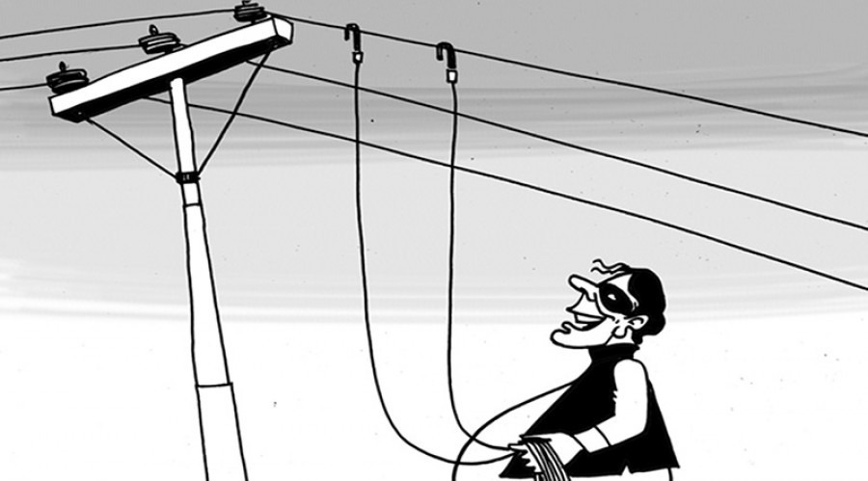
Problem Statement
Electricity consumption is increasing every year due to the addition of new electrical appliances and growing dependency on power systems.
Due to the gradual rise in energy usage, abnormal electricity consumption caused by inefficient usage, system losses, or unauthorized usage often goes unnoticed.
Traditional monitoring systems only display total consumption and lack intelligent analysis to distinguish normal load growth from abnormal behavior.

Slide 4
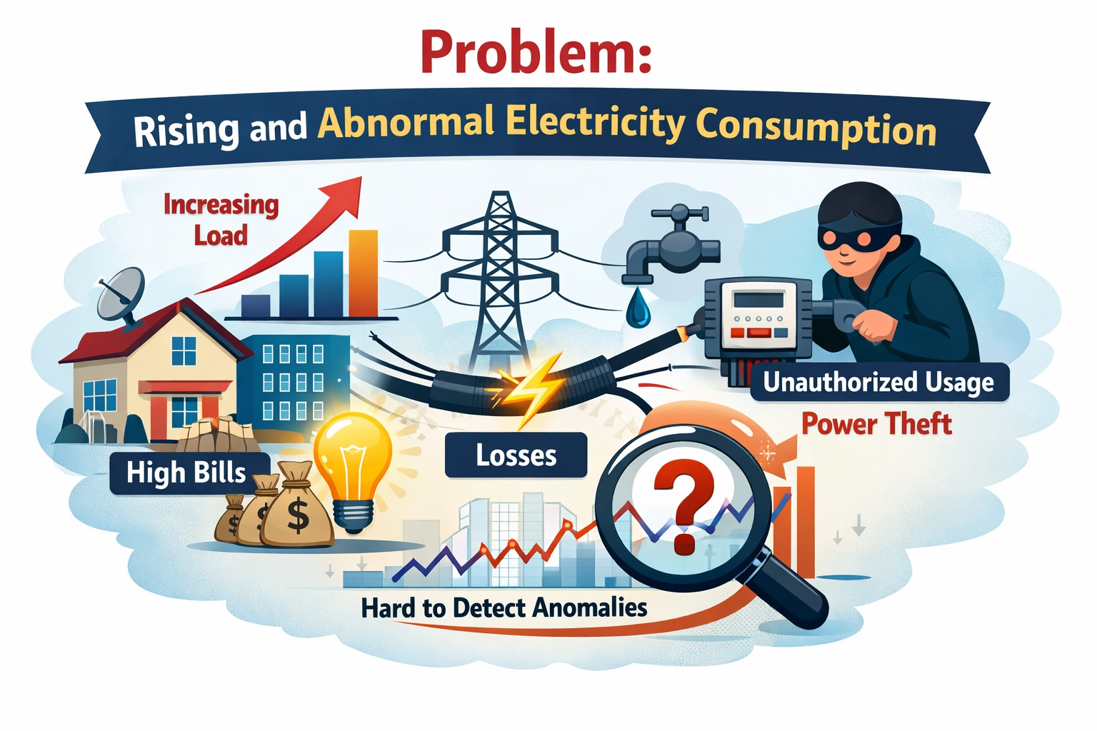
Project Overview - Introduction
This project presents a Smart Energy Usage Monitoring and Anomaly Detection System using machine learning.
The system analyzes electricity consumption patterns and detects abnormal usage while adapting over time to changes in normal behavior, such as the installation of new appliances.
The proposed solution is scalable and can be implemented at:
Small scale – Households
Medium scale – Offices and Colleges
Large scale – Power distribution systems
The core ML concept remains the same only data scale and configuration need adjustment.

Slide 5

Project Overview - Introduction
To monitor energy consumption continuously
To detect abnormal or inefficient electricity usage
To reduce false alerts using adaptive learning
To provide live visualization of energy data
To support scalable deployment from home to grid level

Slide 6

End Users
The proposed system is designed to be scalable and can be implemented at different levels of electricity consumption, from small households to large power distribution systems.
Household Users:
To monitor daily electricity usage, detect abnormal consumption, reduce unnecessary energy wastage and bills.
Offices and Commercial Buildings:
To analyze consumption trends, identify unusual load behavior, and improve overall Efficiency.
Educational Institutions:
To monitor large-scale energy usage across campuses and detect inefficient or abnormal patterns.
Power Distribution Authorities:
To apply anomaly detection at feeder or grid level for identifying system losses or irregular consumption patterns.
The same machine learning framework can be applied at all levels, with only minor adjustments in data scale and configuration.

Slide 7
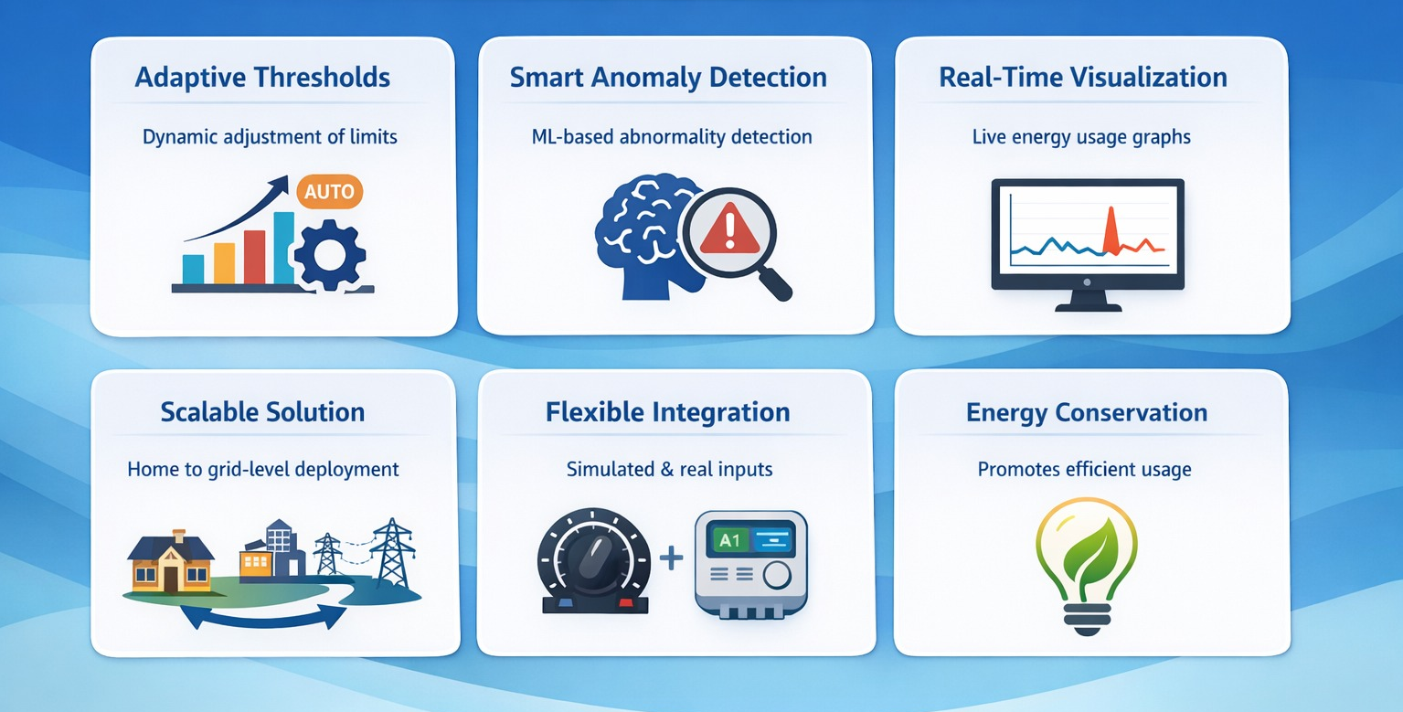
Wow Factors in Project

Slide 8
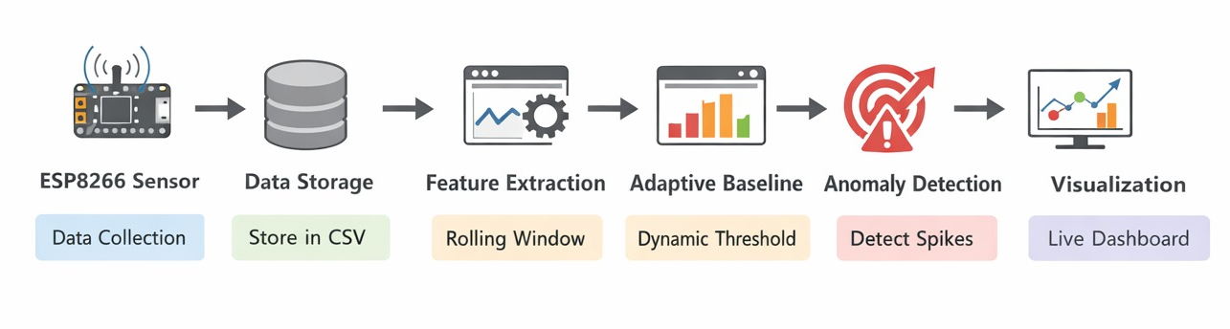
Modelling/Block Diagram/Flow of Project

Slide 9
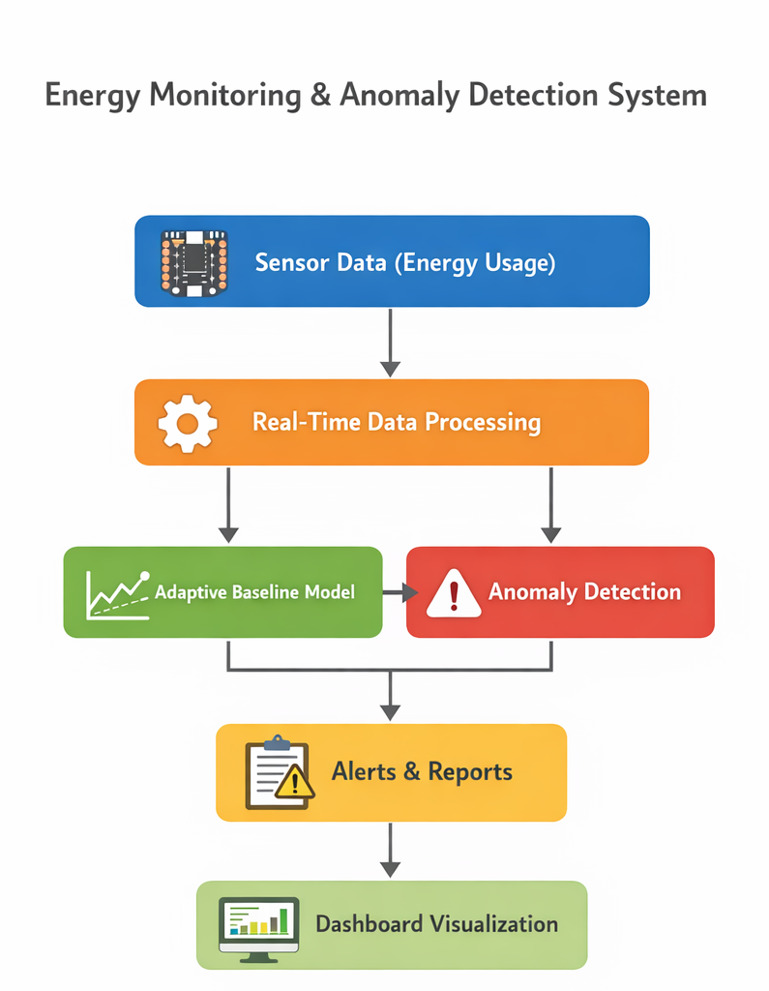
Technology Stack
The proposed system integrates hardware, software, data processing, and visualization technologies to enable real-time adaptive energy monitoring.
🔹 Hardware Layer
ESP8266 (NodeMCU) – Data acquisition
Wattage meter module - extract consumption data
🔹 Communication Layer
Serial Communication (USB) – Real-time data transfer from ESP to Python
🔹 Programming & Processing
Python – Core application logic
Pandas – Data handling and aggregation
CSV Module – Data storage
PySerial – Serial data reading
🔹 Data Modeling & Analysis
Rolling Window Statistical Model – Adaptive baseline calculation
Dynamic Threshold Algorithm – Anomaly detection logic
🔹 Visualization
Matplotlib – Real-time line and bar graphs
Interactive Plotting (plt.ion) – Live dashboard behavior

Slide 10
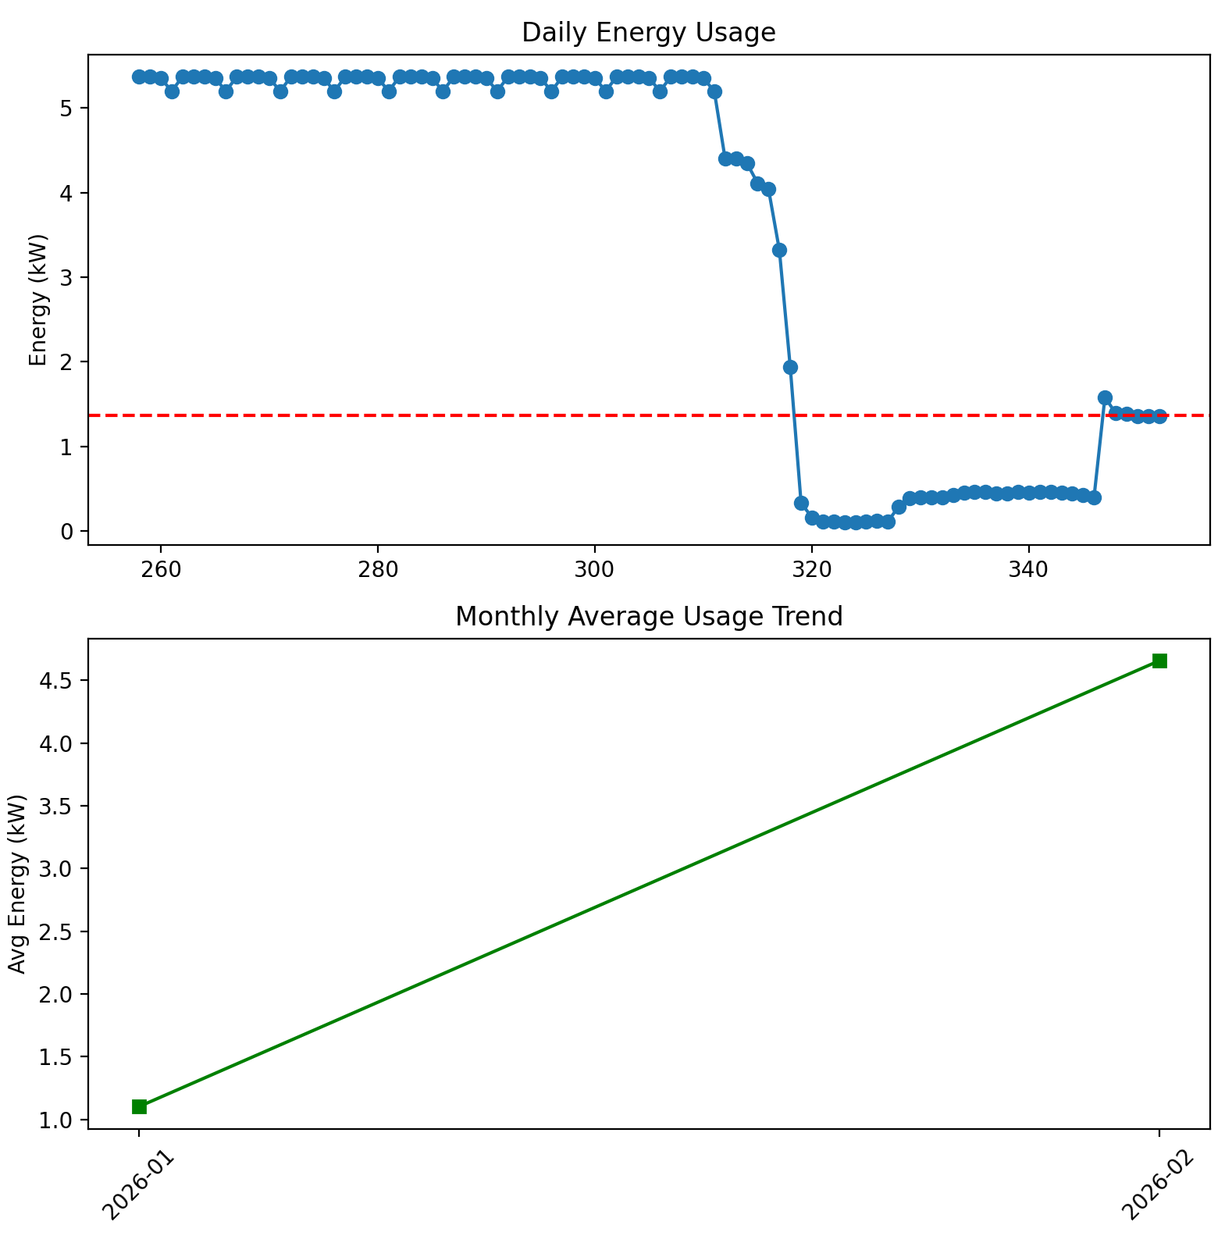
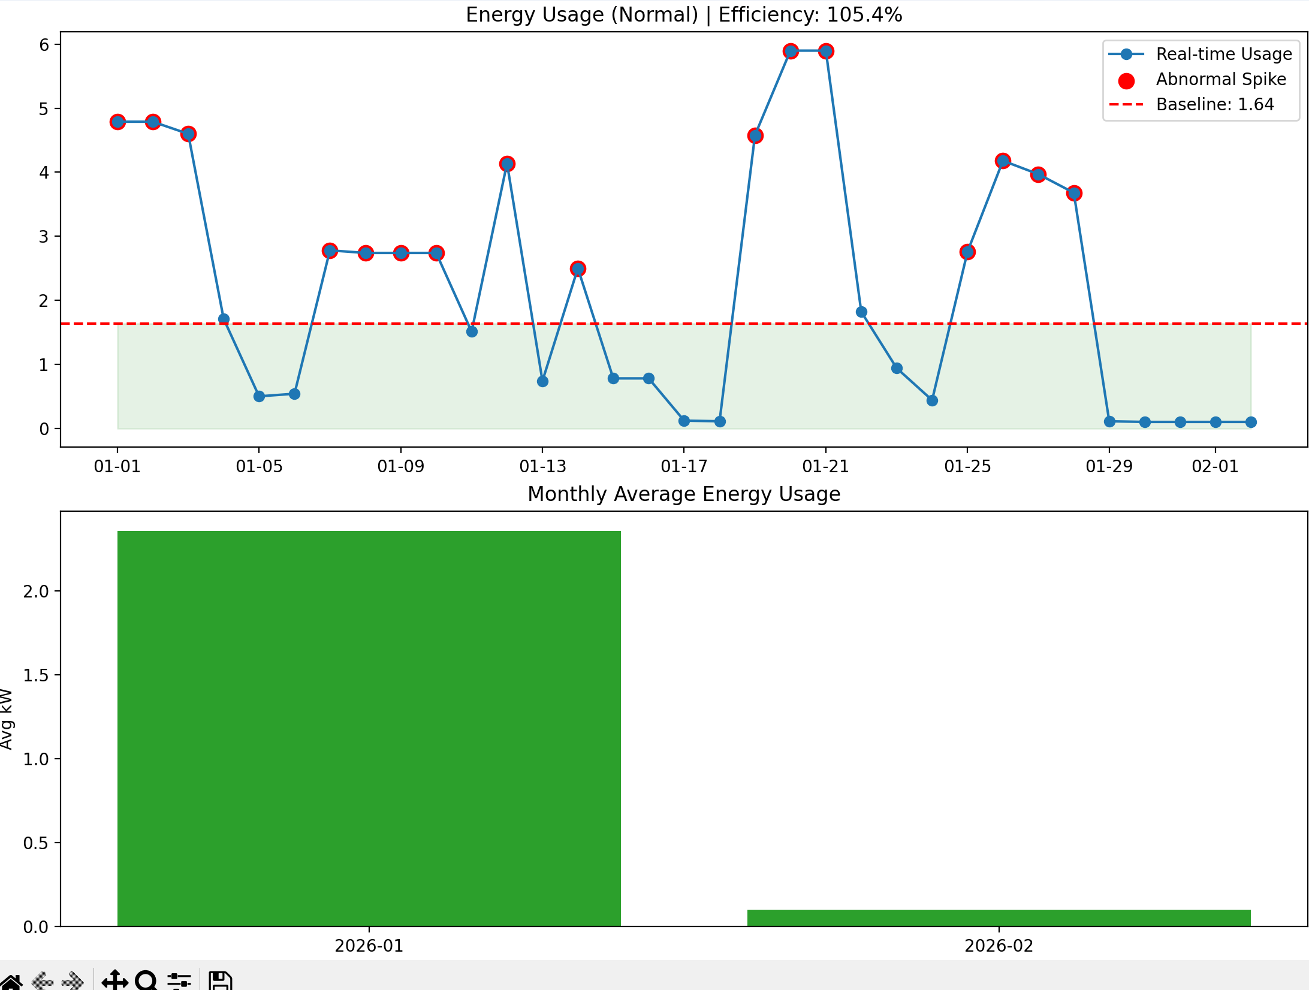
Result/Outcomes:

Slide 11

Conclusion
The proposed Smart Energy Usage Monitoring and Adaptive Anomaly Detection System successfully demonstrates how machine learning can be applied to intelligently analyze electricity consumption patterns.
Unlike traditional systems that rely on fixed thresholds, the proposed model adapts to changing energy usage behavior, reducing false alerts while maintaining accurate abnormality detection.
The system is scalable, flexible, and suitable for deployment at household, institutional, and grid levels. By integrating real-time data visualization with adaptive anomaly detection.
The project contributes toward efficient energy management and sustainable power usage.

Slide 12
Future Perspective
The proposed energy monitoring system can be further enhanced and expanded to support real-world smart energy management applications.
🔹 Integration with Real Energy Meters
The system can be connected to actual smart energy meters instead of a simulated load to enable real household or industrial deployment.
🔹 Cloud-Based Monitoring
Energy data can be stored and analyzed on cloud platforms for remote monitoring and large-scale data analytics.
🔹 Advanced Machine Learning Models
More sophisticated ML models such as Isolation Forest, LSTM, or time-series forecasting can be integrated to improve anomaly detection accuracy.
🔹 Mobile and Web Dashboard
A user-friendly web or mobile dashboard can be developed for live monitoring, alerts, and historical trend analysis.
🔹 Smart Grid Integration
The system can be extended to feeder-level or grid-level monitoring to support utility companies in detecting system losses and abnormal power consumption.
🔹 Energy Efficiency Optimization
Future versions can provide optimization suggestions, load scheduling, and energy-saving recommendations.

Slide 13
Thank You
Notes:
Thank You !!

