Slide 1
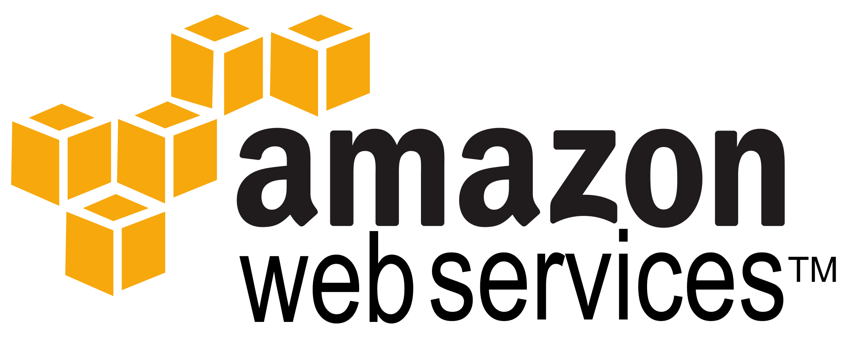
A Comprehensive Cloud Computing Platform
DANIEL DEVOS
KAVYA RAO
PALLAVI RAO
HEMA CHANDRA REDDY ETHAPU
TEAM: CODE EXECUTIONERS

Slide 2
Agenda
Introduction to AWS
Identity & Security Management
Messaging services like SES, SNS and SQS
Compute services like EC2, Elastic Beanstalk and Lambda
Storage and content delivery services like S3, Cloudfront, Elastic File System, Glacier and Storage Gateway.
Database services like RDS, DynamoDB, ElastiCache and Redshift.

Slide 3
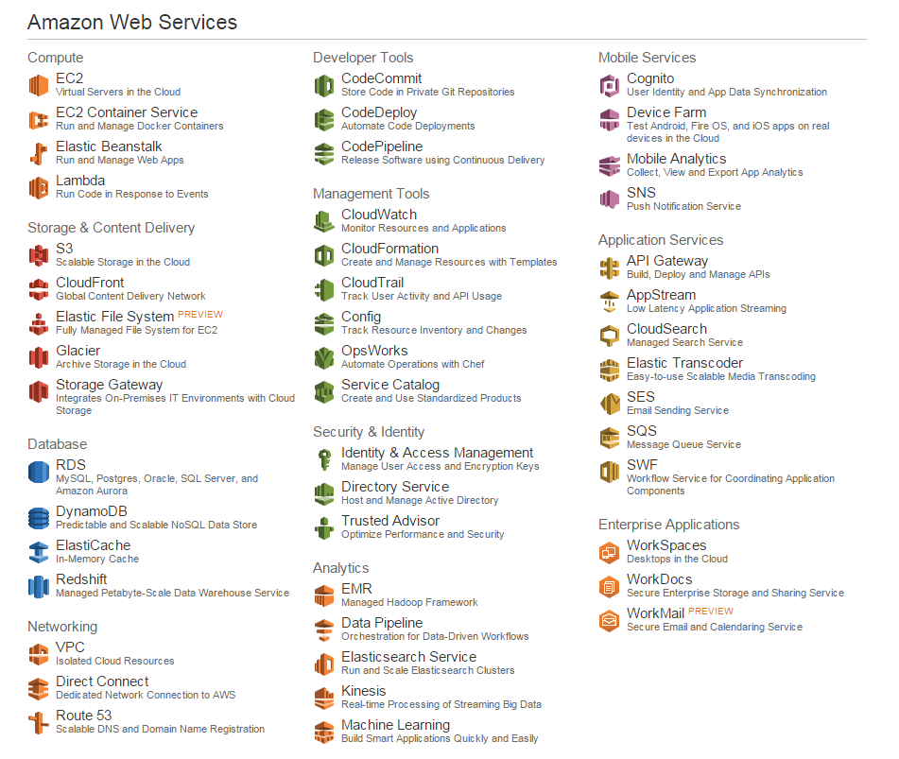


Slide 4

Identity & Access Management Manage User Access & Encryption Keys
Manage IAM users and their access.
Creation of users in IAM and assign them with security credentials like access keys and password policies.
Creation of user groups and applying policies for groups.
Manage IAM roles and their permissions.

Slide 5

Simple Notification Service (SNS) Push Notification Service
Enables applications, end-users and devices to instantly send and receive notifications to and from the cloud respectively.
SNS makes it simple and cost effective to send push notifications to mobile device users and email recipients.
With SNS we can create topics & subscriptions and publish messages.
View/add topics & subscriptions.

Slide 6
SES & SQS Email sending and message queue services
SES is Amazon’s Simple Email Service for sending transactional emails, marketing messages to the customer.
All email IDs must be authorized before we send or receive any emails through SES.
SQS is Amazon’s Simple Queue Service for transmitting any volume of data with any level of throughput.
In SQS, we can perform operations like creating a queue, set latency for the queue and there is no ordering of messages in the queue.

Slide 8

EC2 Virtual Servers in the Cloud
Obtain virtual servers or compute instances
Amazon Machine Image(AMI)
Linux or Windows based
Runs in conjunction with Amazon VPC
Pay based upon use

Slide 9

EC2 Container Service Run and Manage Docker Containers
Docker is an open source project for application deployment
Container holds an application and its dependencies
The container can run anywhere
Deploy, Manage and Scale containers
Integrated with Elastic Load Balancing and EC2 security groups

Slide 10

Elastic Beanstalk Run and Manage Web Apps
Simple tool to Deploys and Manage Webapps and services
Languages: .NET Node.js, Java, Python, PHP, Ruby
Platforms: Apache Tomcat, Apache HTTP Server, nginx, Passenger, Microsoft IIS
Load Balancing
Auto Scaling
Monitor Health
Our Hangman Beanstalk

Slide 11

Lambda Run Code in Response to Events
Back-end Services that scale
Runs on high availability compute infrastructure
You provide code
Triggered by Amazon S3, SNS, Dynamo DB, or Kinesis

Slide 13

S3 - Simple Storage Service
Secure durable high scalable object storage
Data stored in ‘buckets’.
Copied in multiple locations . Pay per use
Create Bucket → Store data in buckets (also called objects)
can store versions
Access Control list
Reduced redundancy storage,

Slide 14

CloudFront - Global Content Delivery Network
Web service that speeds up distribution of static and dynamic web content.
Data centres are called edge locations.
Data is retrieved from edge location with a low latency
Save data (web page, image and media files) in an S3 bucket - origin server

Slide 15
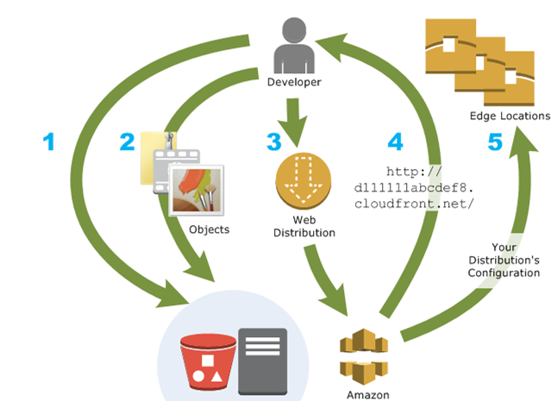

Slide 16

Glacier - Archive Storage in the cloud
It is a secure and durable storage for data archiving and long-term backup(cold data)
Retrieval time of several hours is suitable.
Storage time is months upto decades. Data stored redundantly

Slide 17

Storage Gateway- Integrates on premise IT environment with cloud storage
Provides seamless and secure integration between an organisations on premise IT environment and AWS’s storage infrastructure
Uses industry standard storage protocols
Low latency - maintains frequently accessed data on-premises.
Backs up and stores data at regular time intervals

Slide 18

Elastic File System- Fully managed file system for EC2
File storage service for EC2 instance
Applications running on multiple EC2 instances can make use of EFS shared file system
Protocol- NFSV4
Ideal for big data applications where scaling and performance is important

Slide 20

RDS My SQL, Postgres, Oracle, SQL Server, and Amazon Aurora
Amazon RDS Components:
DB Instances
Multi-AZ Deployment
Security Groups
Available RDS Interfaces: Amazon RDS Console, Command Line Interfaces, Programmatic Interfaces.
Monitoring an Amazon RDS Instance: Cloud Watch service
Benefits: Easy to Administer, Scalable, Available & Durable, Fast, Secure and Inexpensive

Slide 21

DynamoDB Predictable and Scalable NoSQL Data Store
Stores data in tables, each table contains multiple items
Two kinds of Primary Keys:
consisting of a hash attribute
consisting of hash and range attributes
Secondary Indexes
Why DynamoDB over normal DB?

Slide 22
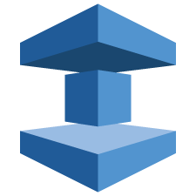
ElastiCache In-Memory Cache
Detects and replaces faulty nodes in a self-managed infrastructure.
Supports two open-source in-memory caching engine
Memcashed, Redis node
Easy to deploy, manage, backup and scale an in-memory cache in the cloud.
Significantly improves latency and throughput for many read-heavy application workloads.

Slide 23

Redshift Managed Petabyte-Scale Data Warehouse Service
Amazon Redshift is a fully-managed, petabyte-scale data warehouse service in the cloud.
The set of nodes is called an Amazon Redshift cluster.
SQL data warehouse solution
Cluster Access and Security, Monitoring Cluster through DB audit logging and Databases
Fault Tolerant
Automated Backups
No Up-Front Costs

Slide 24
Queries?

