Slide 1
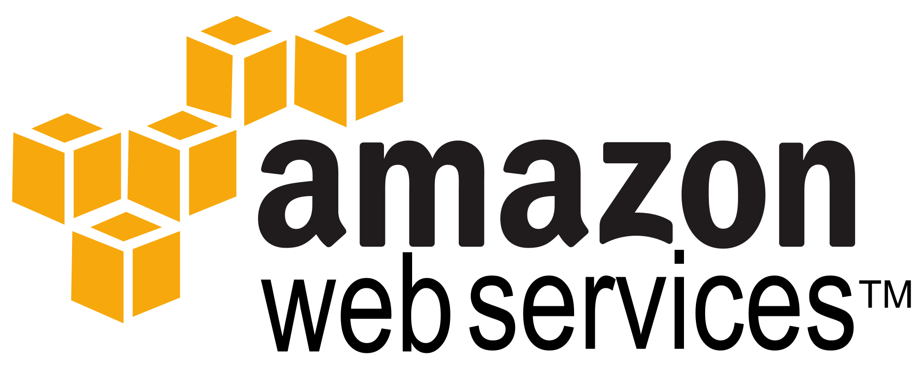
A comprehensive cloud computing platform

Slide 2
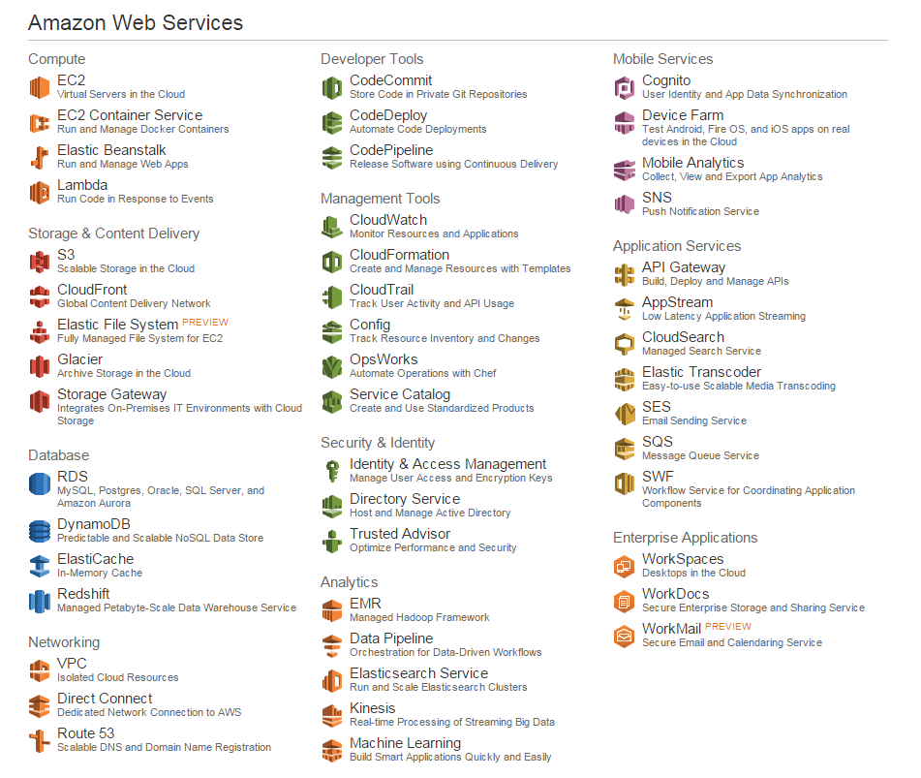

Slide 4

EC2 Virtual Servers in the Cloud
Obtain virtual servers or compute instances
Amazon Machine Image(AMI)
Linux or Windows based
Runs in conjunction with Amazon VPC
Pay based upon use

Slide 5

EC2 Container Service Run and Manage Docker Containers
Docker is an open source project for application deployment
Container holds an application and its dependencies
The container can run anywhere
Deploy, Manage and Scale containers
Integrated with Elastic Load Balancing and EC2 security groups

Slide 6

Elastic Beanstalk Run and Manage Web Apps
Simple tool to Deploys and Manage Webapps and services
Languages: .NET Node.js, Java, Python, PHP, Ruby
Platforms: Apache Tomcat, Apache HTTP Server, nginx, Passenger, Microsoft IIS
Load Balancing
Auto Scaling
Monitor Health
Our Hangman Beanstalk

Slide 7

Lambda Run Code in Response to Events
Back-end Services that scale
Runs on high availability compute infrastructure
You provide code
Triggered by Amazon S3, SNS, Dynamo DB, or Kinesis

