Slide 1

LOGIN Doesn’t have an account yet? Sign Up
Email Address
Background Image
You@Genpact.com
Password
Forgot password?
Enter 6 or more characters
Remember me
LOGIN

Slide 2
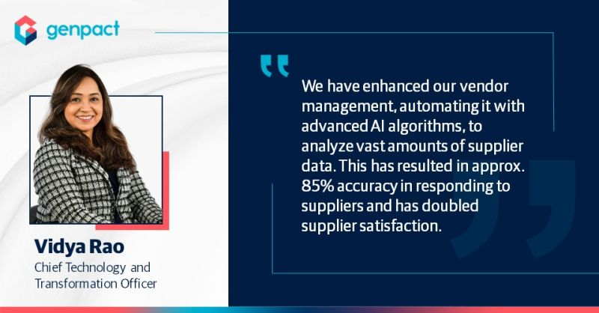

CREATE AN ACCOUNT
Below type images will appear sequentially
Name
Email Address
You@Genpact.com
Enter Password
Enter 6 or more characters
Background Image
Confirm Password
I agree all statements in Terms of service
SIGN UP

Slide 3


Background image:
Go back
Welcome, [Employee Name]
Please enter your security code displayed on your app
Enter 6-digit code
SUBMIT

Slide 4
[Genpact logo] Genpact
Hi, [ Manager’s Name]
Assigned(3) | On Bench(2)
Download Details
Project ID | Project Name | Start Date | End Date | Billability | Manager ID | Manager Name
21007450 | Kore AI | 01/01/25 | 08/24/25 | Yes | 37997576 | Vineeth
79574985 | AWS Connect | 04/31/24 | 07/11/26 | No | 70989808 | Ankit
84654068 | Python | 08/11/24 | 05/02/26 | No | 65987589 | Megharaj

Slide 5
[Genpact logo] Genpact
Hi, [ Manager’s Name]
Assigned(3) | On Bench(3)
Download Details
End of previous project | Project Name | Skills | Certifications | Ongoing Learning paths | Approver ID | Approver Name
04/06/22 | Kore | Python… | Python… | Udemy Azure … | 37997576 | Vineeth
09/08/23 | Zeta | Java… | Java… | AWS …. | 70989808 | Ankit

Slide 6

[Logo] GENPACT
Transformation happens here

