Slide 1
Long term goal
“Single cell” energy transfer quantification
Spatial and temporal location of energy transfer (cytochromes) in bacterial membrane
  Jan Liphardt (UCB Biophysics prof)

Slide 2
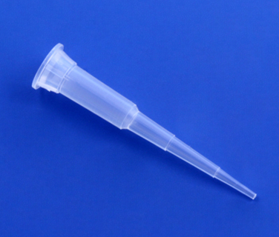
Short term
Goals:
Perfecting chamber
  Sealing (all glass/no PDMS) → Use SU8 for channels and UV epoxy for SU8/glass bonding
  Thin electrode wafer for higher magnification
Addition of reference electrode
  Will be implementing capillary/agar/silver electrode added after assembly (no microfabrication)
Silver wire
Agar junction
Tip into chip
Ag/AgCl reference electrode

Slide 3
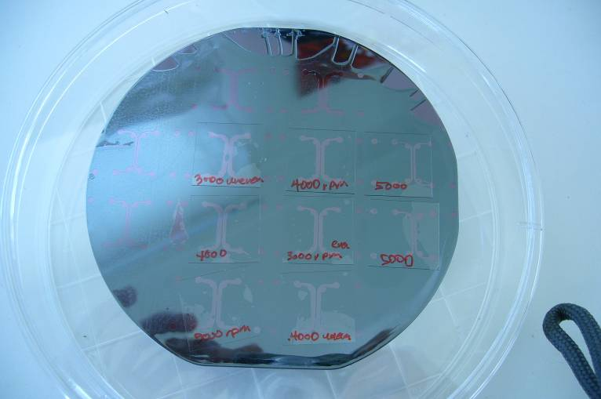
Short term results
All have passed individual tests
Proposed architecture
glass
SU8
ITO
ITO
glass

Slide 4
Right now
Mask for MEMS
  My chamber for few cell signal
  Adrienne’s biofilm impedance

Slide 5
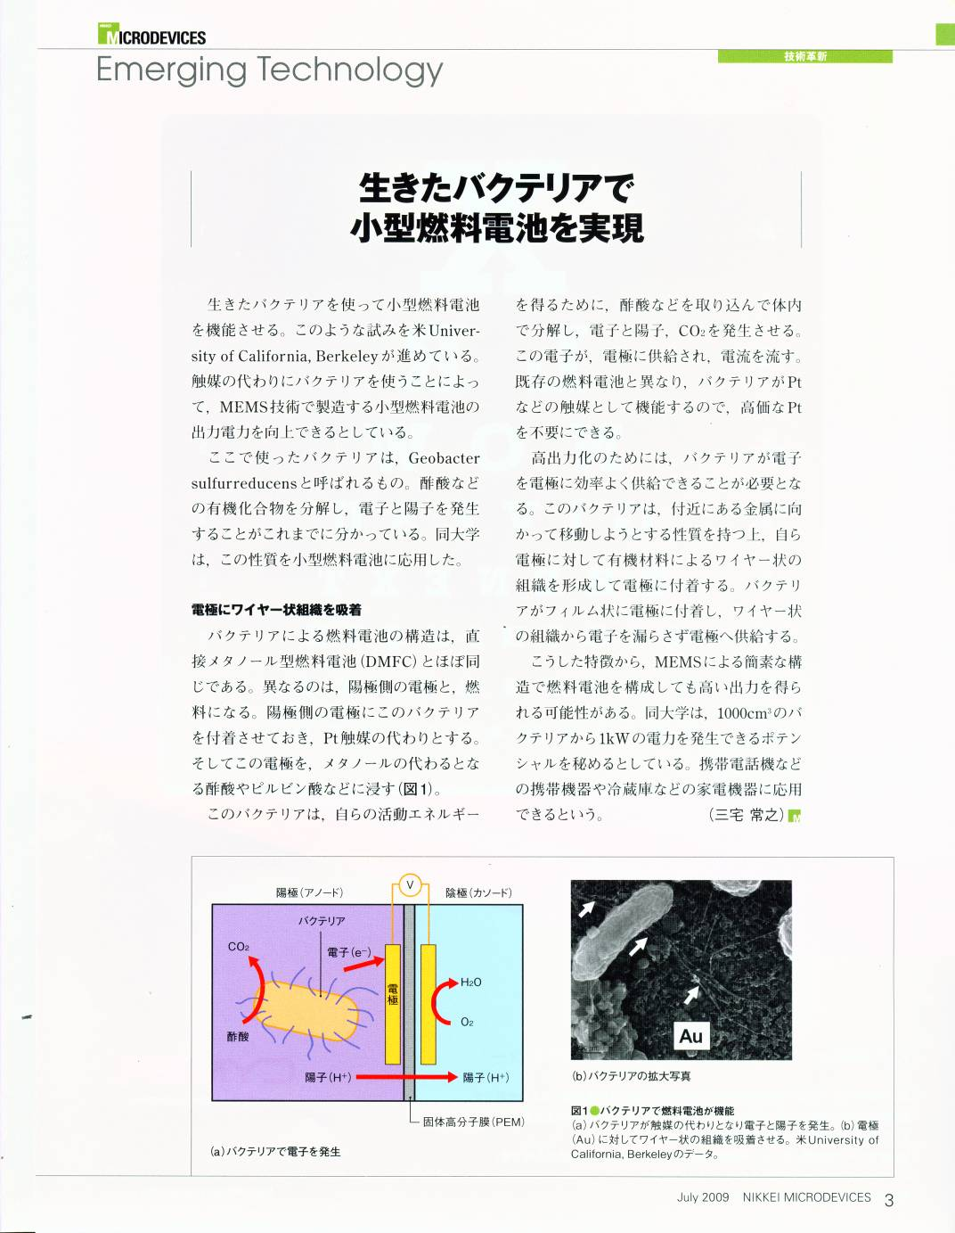
Other news
Nikkei Microdevices
  Put us on p. 3
  Didn’t include any names!
IAB
ARPA E – any news?

