Slide 1
STABLE-Single bunch tracking manual
Tianlong He (何天龙)
USTC

Slide 2
Motivation
This manual aims at introducing how to use the STABLE-Single bunch tracking code.
It is GPU-accelerated so that it can be efficiently used for studying the MWI driven by CSR or RW.

Slide 3
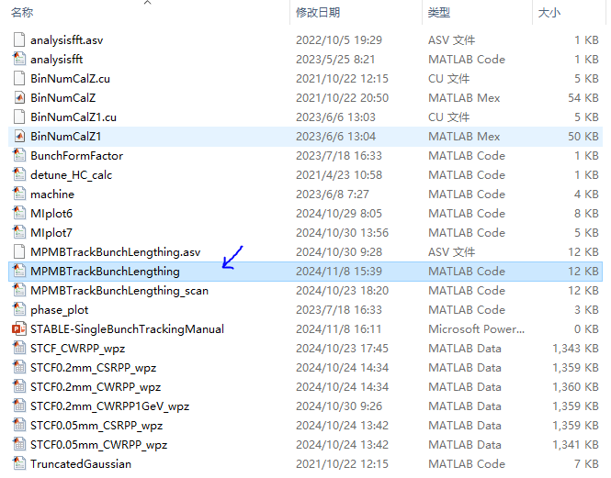
Source codes
Count the bunch distribution
Open this file at first
Show the phase
Wake potential data of STCF
To generate the truncated Gaussian distribution

Slide 4
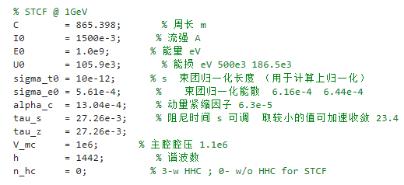
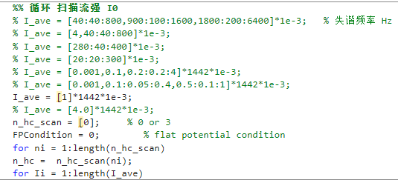
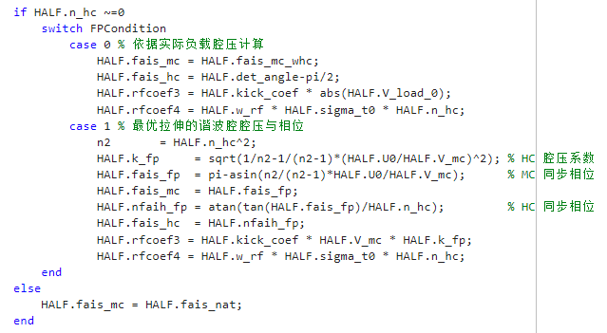
Parameters setting
Parameters related to longitudinal dynamics
Scan the single bunch current
w/o HHC
If with HHC, n_hc_scan =3.
FPCondition=0, using the real beam loading voltage

Slide 5
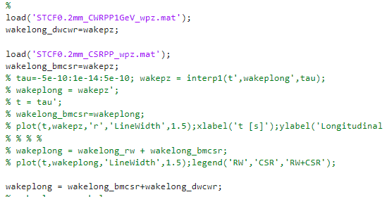
Load the wake potential data
CWR
CSR
CWR+CSR

Slide 6
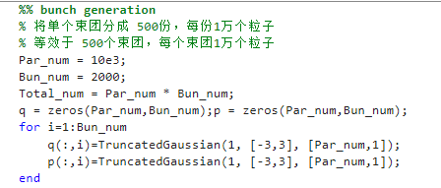
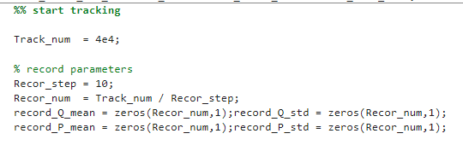
Other setting
Total particle number:10e3*2000
Tracking turn
Record every 10 turns

Slide 7
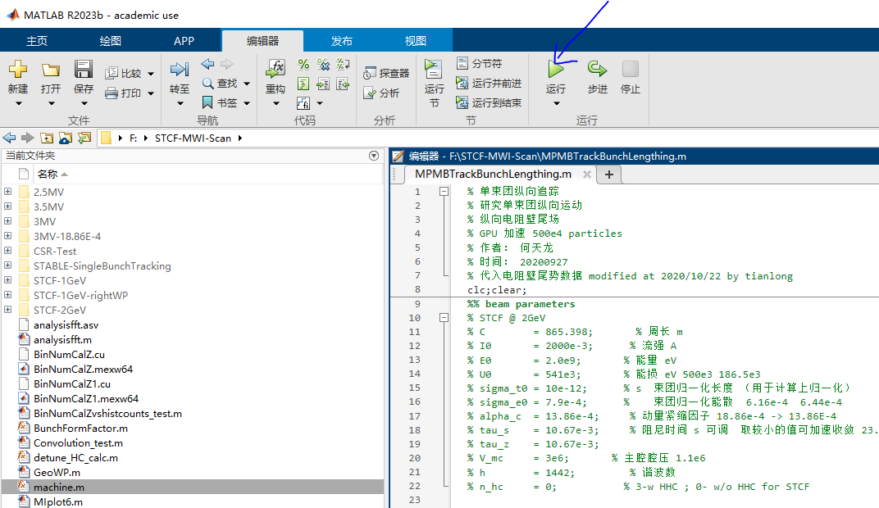
START the tracking

Slide 8
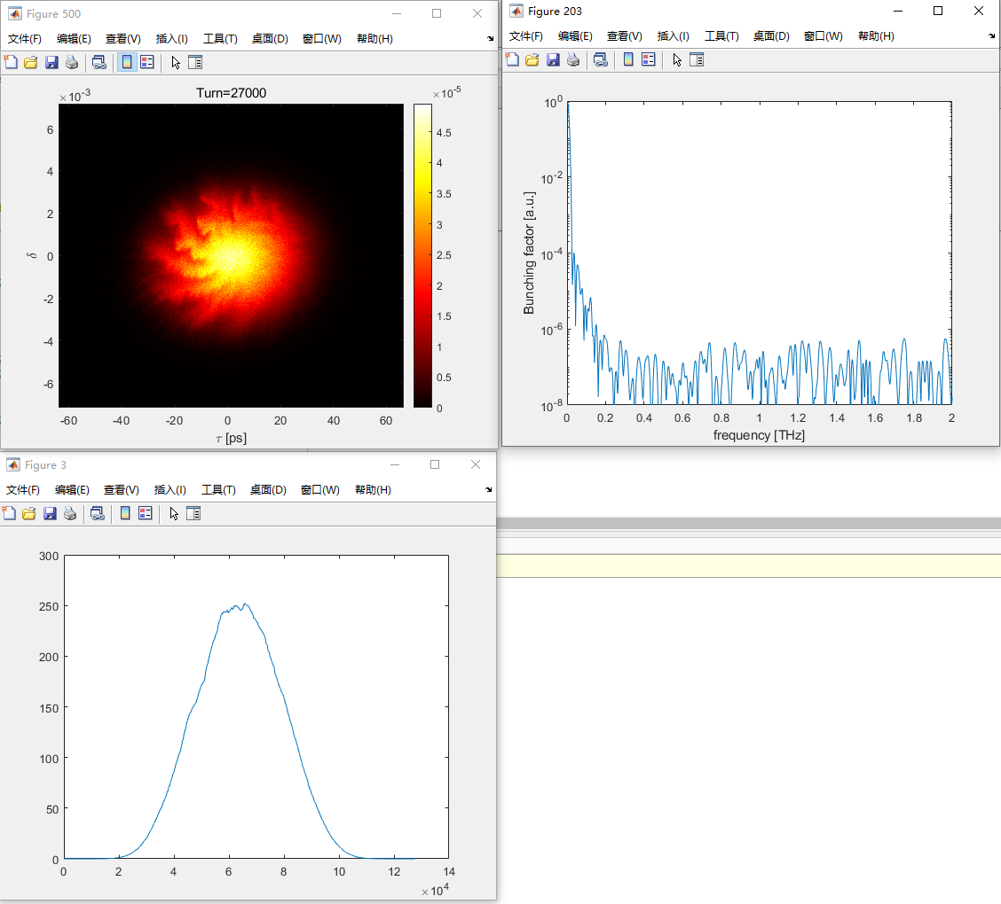
Tracking results
Real time display of phase space!

Slide 9
End
Enjoy the tracking!

Slide 10
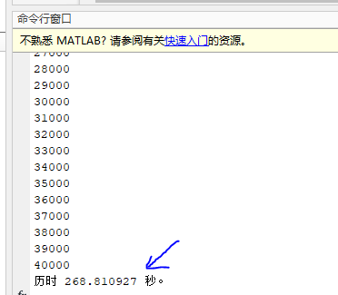
Computing efficiency

