Slide 1
Calibrated Stochastic Gradient Descent for Convolutional Neural Networks
Li‘an Zhuo¹, Baochang Zhang¹,* Chen Chen², Qixiang Ye⁵, Jianzhuang Liu⁴, David Doermann³
¹School of Automation Science and Electrical Engineering, Beihang University, Beijing
²University of North Carolina at Charlotte, Charlotte, NC
³Department of Computer Science and Engineering University at Buffalo, Buffalo, NY
⁴Huawei Noah's Ark Lab
⁵University of Chinese Academy of Sciences, China

Slide 2
Outline
1. Introduction
2. Related work
3. Theoretical analysis
4. Implementation and Experiments

Slide 3

Introduction
By optimizing the gradient descent algorithm
By designing a new network architecture
By increasing the number of parameters
By optimizing activation function
Regularization
…
Gradient Disappear

Slide 4
Introduction
The main contributions of this work :
A theorem is developed to reveal that an unbiased estimator can be obtained in a probabilistic way based on a Lipschitz assumption, leading to an calibrated SGD algorithm (CSGD) for deep neural network optimization.
We develop a generic gradient calibration layer(GClayer), which can be easily applied to existing CNN architectures.
Experimental results reveal that popular CNN architectures employing the proposed CSGD algorithm, termed CCNNs, yield state-of-the-art performance for a variety of tasks.
Notes:
Scale, speed.

Slide 5
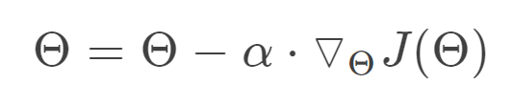
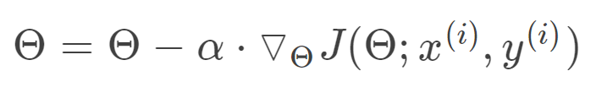
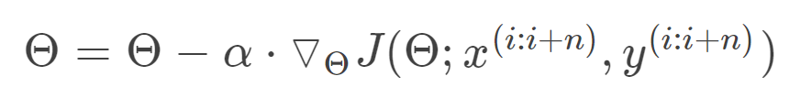
Related work
Gradient Descent Algorithms
Batch gradient descent(BGD)
Stochastic gradient descent (SGD)
Mini-batch gradient descent (MBGD)
Notes:
Scale, speed.

Slide 6
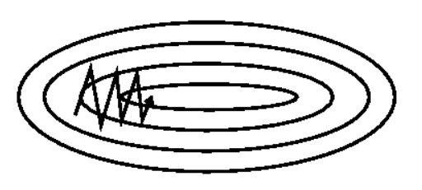
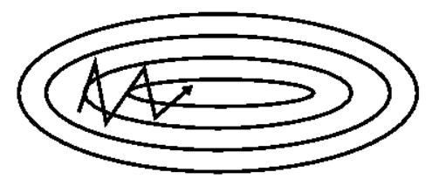
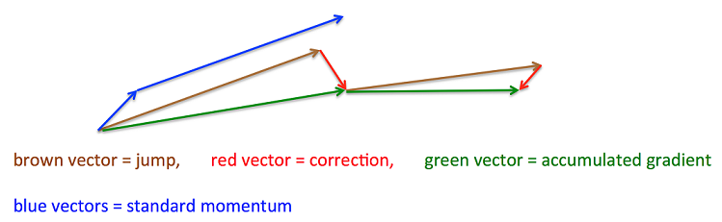
Related work
Gradient Descent Optimization Algorithms
Momentum
(a) SGD without momentum (b) SGD with momentum
Nesterov accelerated gradient
Notes:
Scale, speed.

Slide 7

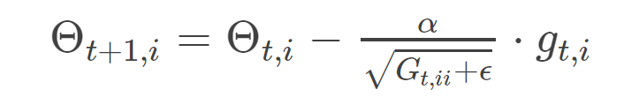
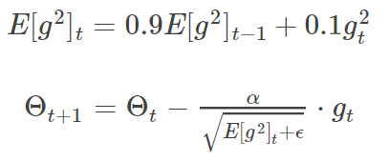
Related work
Gradient Descent Optimization Algorithms
Adagrad
Rmsprop
Notes:
Scale, speed.

Slide 8
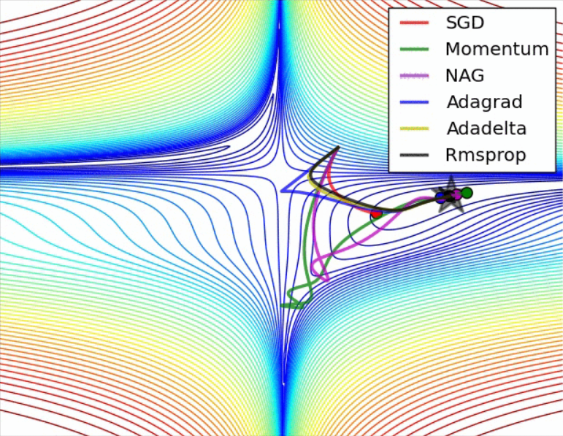
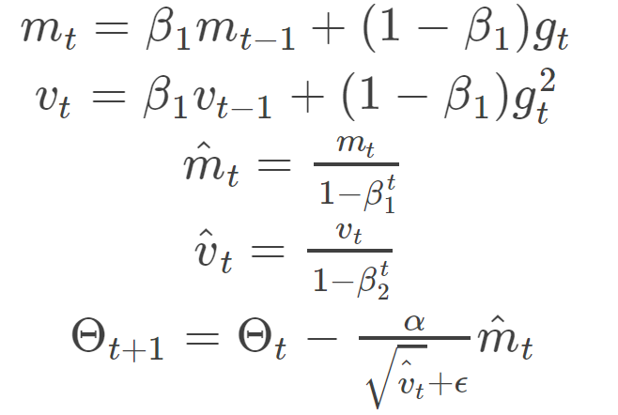
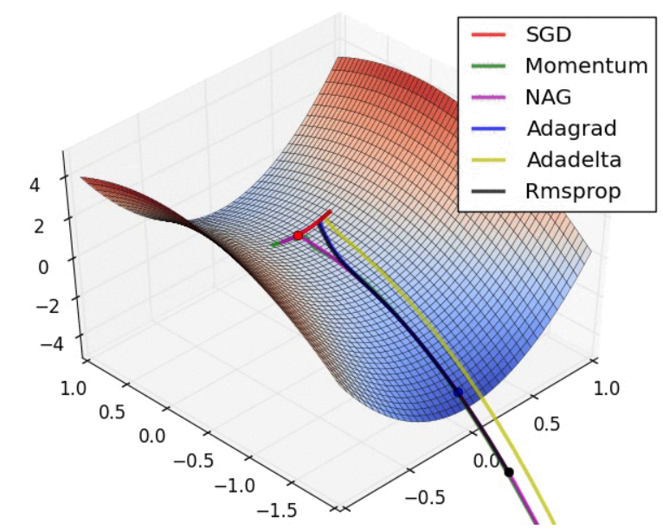
Related work
Gradient Descent Optimization Algorithms
Adam
Notes:
Scale, speed.

Slide 9
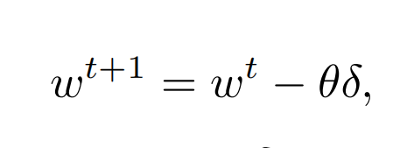
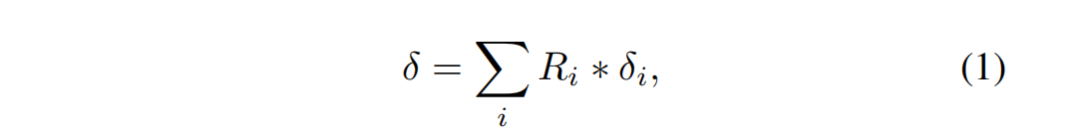
Theoretical analysis
A function f(w) is defined and differentiable in a neighborhood of a point, then f(w) decreases fastest if one goes from a given position in the direction of the negative gradient of f(w). It follows that:
where θ is the learning rate and δ is the gradient vector. Then we project the gradients onto a subspace, leading to a true gradient for an unbiased estimator, as:
each element of Ri denotes the probability of its corresponding element in δi, which measures δi’s importance or contribution to the final δ.

Slide 10
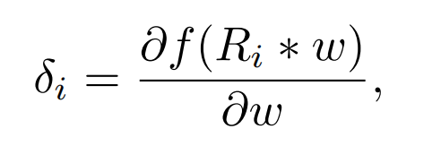
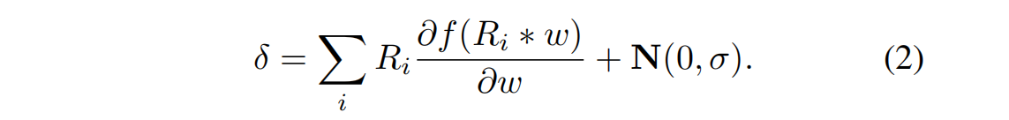
Theoretical analysis
We further use it to weigh w, which means that the more important Ri is, the larger corresponding weight is imposed on w. We then define:
To better estimate the true gradient we add a Gaussian function N(0, σ), as:

Slide 11
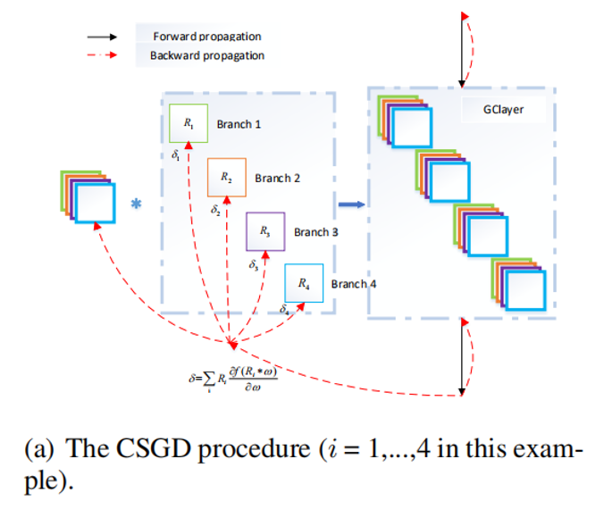
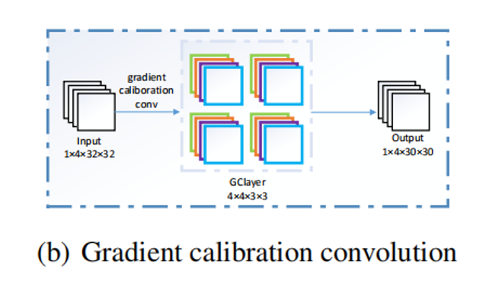
Theoretical analysis
The illustration of the CSGD procedure and gradient calibration convolution in our CCNNs

Slide 12
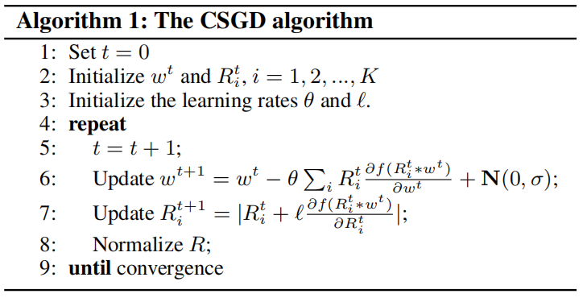
Theoretical analysis
The CSGD algorithm

Slide 13
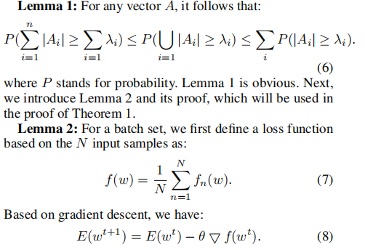
Theoretical analysis
The Lemma 1&2

Slide 14
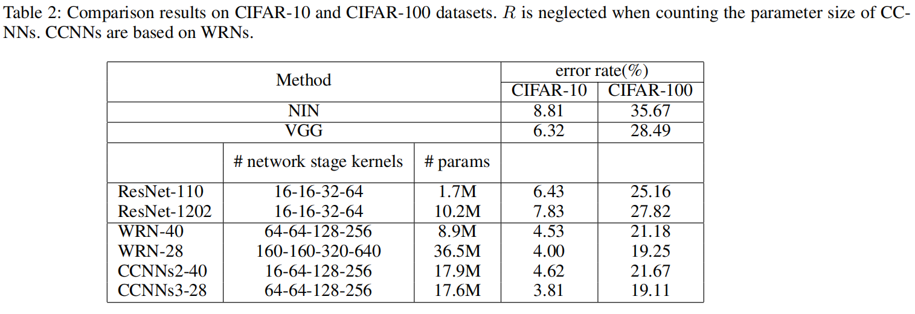
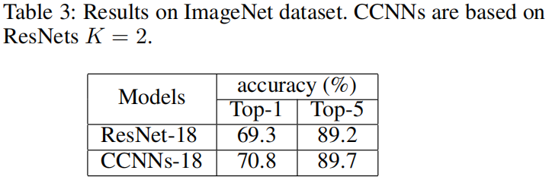
Implementation and Experiments
Results on CIFAR and ImageNet dataset

Slide 15
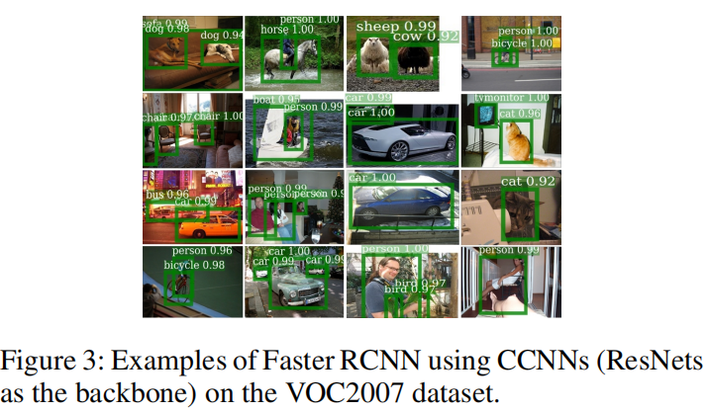
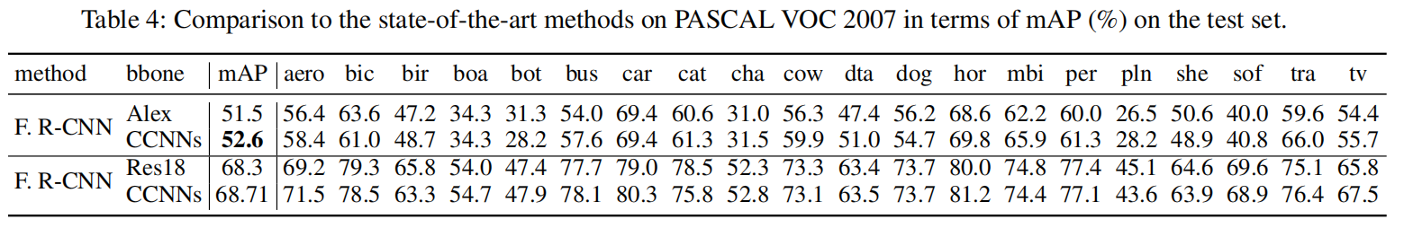
Implementation and Experiments
Results on VOC2007 dataset

Slide 16
Thanks

