Slide 1
EMPLOYEE LEAVE MANAGEMENT SYTEM
SUBMITTED BY : -
Hetal Makwana
Vandana Prajapati
GROUP NO : -
Exam No :-
GUIDANCE BY :-
Pro.Maheshbhai Chaudhary
MANAGED BY : -
Shree Akhil Anjana Kelavani Mandal,
Shree Adarsh B.C.A College,
Radhanpur
Year : 2023 - 2024

Slide 2
INDEX
No. | Description | Page No.
1 | Project Profile | 3
2 | Hardware & Software Requirement
 | 2.1 Minimum Server-Side Requirement | 4
 | 2.2 Minimum Client-Side Requirement | 5
3 | Introduction | 6
4 | Feature and Functionalities | 7
5 | User Interface Design | 9
6 | System Design | 11
7 | Data Flow Diagram
 | 7.1 Context Level Diagram | 13
 | 7.2 Zero Level Diagram | 14
 | 7.3 First Level Diagram Of (1.0) | 15
 | 7.4 Second Level Diagram Of (2.0) | 17
8 | Data Dictionary | 25
9 | Screen Layout
 | 9.1Employee Panel | 30
 | 9.2Admin Panel | 37
10 | Reference | 53

Slide 3
PROJECT PROFILE
Project Title | Employee Leave Management System
Developed For | Shree Adarsh BCA College Radhanpur
Front-End Tool | HTML, CSS, JavaScript, PHP
Back-End Tool | MySQL
Operating System | Windows,
Prepared By | Hetal Makwana Vandana Prajapati
Project Guide | Pro. Maheshbhai Chaudhary

Slide 4
Minimum Server Side Requirement
Hardware Requirement
Ram
Processor
Hard Disk
: 2GB
: Pentium (R) Dual Core Processor
: 128 GB
Software Requirement
Application Software
Front-End Tool
:HTML, CSS, JavaScript, PHP
Back-End Tool
Other Tool
: MySQL
: Xampp and Wamp Server

Slide 5
Minimum Client Side Requirement
• | Hardware Requirement
 | Ram | :2GB
 | Processor | : Pentium (R) Dual Core Processor
 | Hard Disk | : 128 GB
• | Software Requirement
 | Operating System | : Windows
 | Application Software | : Internet Explorer 5.0 OR Above

Slide 6
Introduction
An employee leave management system is a crucial tool for any organization to manage their employee's leave requests efficiently. With an efficient system in place, companies can reduce the administrative burden of managing employee leave requests and improve productivity.
Overview of employee leave management system:
The employee leave management system is designed to provide a user-friendly interface for employees to submit leave requests and for managers to review and approve those requests. The system automates the entire process, from the time an employee submits a leave request until it is approved or rejected.
Objectives of the project:
The primary objective of the employee leave management project is to create an efficient and user-friendly system for managing employee leave requests. The project aims to achieve the following goals:
Streamline the leave request process: The project aims to automate the entire process of leave request submission, review, and approval, thus eliminating manual paperwork.
Improve accuracy: By automating the process, the system can reduce the risk of human error and ensure that leave balances and entitlements are accurately calculated.
Increase transparency: With the employee leave management system, employees and managers can easily track leave balances and leave requests, which increases transparency and reduces conflicts.
Improve efficiency: The system enables managers to make quick
decisions on leave requests, which reduces the time taken to process leave requests.

Slide 7
Features and Functionalities
Employee profile management
The employee leave management system allows employees to create and manage their profiles, which includes personal and contact information, employment details, and leave entitlements. Employees can update their profiles to reflect any changes in their personal or professional lives.
Leave request submission and approval
The system enables employees to submit leave requests online, and managers can review and approve those requests in real- time. Employees can track the status of their leave requests, and managers can view the team's leave calendar to ensure that leave requests do not clash.
Leave balance tracking
The system tracks each employee's leave balances, including annual leave, sick leave, and other types of leave. Employees can view their leave balances in real-time, and managers can generate reports on the leave balances of individual employees or the entire team.
Automated notifications and reminders
The system sends automated notifications to employees and managers regarding the status of leave requests, approvals, and rejections. The system also sends reminders to employees to take their leave before the end of the year to prevent leave accumulation.

Slide 8
Reports and analytics
The employee leave management system generates reports and analytics on employee leave balances, leave requests, and approvals. The reports provide insights into leave patterns, such as peak leave periods, leave types, and the impact of leave on productivity. Managers can use the reports to make informed decisions on leave requests and plan for leave cover.
Overall, these features and functionalities of the employee leave management system ensure that employees can manage their leave requests efficiently, and managers can make informed decisions on leave requests, leading to increased productivity and reduced administrative burden.

Slide 9
User Interface Design
Login Screen
Username and password fields
"Forgot password" link
"Create account" link (if applicable)
Remember me option
Login button
Error message for incorrect credentials
Captcha verification (if necessary)
Dashboard
Overview of leave balances (e.g. sick leave, vacation leave)
Quick links to frequently used pages (e.g. Apply for Leave, View Leave History)
Notification section for pending leave requests, approved leaves, and upcoming leaves
Calendar view of leave schedule
Personal details and employee ID
Employee Profile Management
Personal details (e.g. name, contact information, address)
Employment details (e.g. department, job title, supervisor)
Emergency contact information
Edit profile button

Slide 10
Leave Application Management
Type of leave (e.g. sick leave, vacation leave)
Start and end date of leave
Reason for leave
Supporting documents (if necessary)
Submit button
Cancel button
Leave Balance Management
Overview of remaining leave balance for each type of leave
Explanation of how leave is earned and calculated
Breakdown of leave balance by month or year
Leave Approval Management
Pending leave requests awaiting approval
Approve and reject buttons
Comment section for supervisor to provide feedback or reason for rejection

Slide 11
System Design
In this section, we will discuss the design of the employee leave management system. The system design will include the architecture of the system, modules and components, data model and database design, and user interface design.
Architecture of the system
The employee leave management system will follow a client- server architecture, where the client is a web application and the server is a database server. The web application will be developed using the Model-View-Controller (MVC) design pattern. The client-side application will be built using HTML, CSS, and JavaScript, and the server-side application will be built using a server-side programming language such as PHP or Python.
Modules and components
The employee leave management system will consist of the following modules:
Employee module: This module will allow employees to view their leave balance, apply for leave, view their leave history, and cancel leave requests.
Manager module: This module will allow managers to approve or
reject leave requests, view leave requests of their subordinates, and view leave reports.

Slide 12
Admin module : This module will allow the system administrator to manage user accounts, system settings, and system logs.
Data model and database design.
The data model for the employee leave management system will include the following entities:
Employee : This entity will contain the details of all employees, such as their name, employee ID, email address, and department. Leave: This entity will contain the details of all leave requests, such as the employee ID, leave type, start date, end date, and status.
Leave Balance: This entity will contain the leave balances of all employees, such as the number of days of annual leave, sick leave, and other types of leave.
The database design for the employee leave management system
will use a relational database management system (RDBMS) such as MySQL or PostgreSQL.
User interface design
The user interface design for the employee leave management system will be simple and intuitive, with a clean and modern look. The user interface will be designed using HTML, CSS, and JavaScript, with a responsive design that will work well on different devices such as desktops, laptops, tablets, and smartphones. The user interface will be designed to be easy to use and navigate, with clear instructions and feedback for users.

Slide 13
Context Level Diagram
DATA FLOW DIAGRAM
Admin Manage Site Request
Employee Leave Management System
ADMIN
User Fetch Site
EMPLOYEE
Response
Response

Slide 14
Zero Level Diagram
ADMIN
Employee
Check Username &Pass
1.0
Login
Response
Add employee
1.1
Add Employee
Response
1.1
Employee Login
Check Username &Pass
Response

Slide 15
First Level Diagram (1.0)
Employee
Check Username &Pass
1.0
Login
request
tblemployees
Response
Valid / Invalid
Employee Apply leave
1.1
Apply Leave
Request
tblleaves
Response
Response
request
1.2
View leave History
request
Response
tblleaves
Response

Slide 16
Employee
Request For view profile
1.3
Employee View profile
Fetch profile detail
tblemployees
Response
Response
Request For change password
1.4
Emp. Change Password
request
tblemployees
Response
Response
Request
1.5
Logout
Response

Slide 17
Second Level Diagram (2.0)
Admin
Request
2.1
Login
Request
admin
Response
Response
Request
2.2
Manage Employee
Request
tblemployees
Response
Response
Request
2.2.1
Add New Employee
Request
Request
Response
Response

Slide 18
Admin
2.2.2
Edit Employee Details
Request
Request
tblemployees
Response
Response
Request
2.2.3
Inactive employee
Request
Response
Response
Request
2.3
Manage Department
Request
tbldepartmen
Response
Response

Slide 19
Admin
Request
2.3.1
Add New Department
Request
Response
Response
Requests
2.3.2
Edit Department
Request
tbldepartmen
Response
Response
Request
2.3.3
Delete Department
Request
Response
Response

Slide 20
Admin
Request
2.4
Manage Leave Type
Request
Response
Response
Request
2.4.1
Add New Leave Type
Request
tblleavetype
Response
Response
Request
2.4.2
Edit Leave Type
Request
Response
Response

Slide 21
Admin
Request
2.4.3
Delete Leave Type
Request
tblleavetype
Response
Response
Request
2.5
Manage Leave Status
Request
tblleaves
Response
Response
Request
2.5.1
Manage
Padding Leave
Request
Response
Response

Slide 22
Admin
Request
2.5.1.1
Set Action
Request
Response
Response
Request
2.5.2
View
Approve Leave
Request
tblleaves
Response
Response
Request
2.5.3
View
Declined Leave
Request
Response
Response

Slide 23
Admin
Request
Request
2.5.4
View Leave History
tblleaves
Response
Response
Request
2.6
Manage Admin
Request
admin
Response
Response
Request
2.6.1
Add New Admin
Request
Response
Response

Slide 24
Admin
Request
2.6.2
Delete Admin
Request
admin
Response
Response
Request
2.7
Logout
Response

Slide 25
Data Dictionary
Table Name : Admin
Description: It used to store admin login information
Primary Key: Id
Field Name | Data Type | Constraints | Description
User Name | varchar(100) | Not Null | It Can Store Admin UserId
Password | varchar(100) | Not Null | It Can Store Admin UserId
Full name | varchar(255) | Not Null | It Can Store Admin Full name
email | varchar(55) | Not Null | It Can Store Admin email
UpdationDate | timestamp | Not Null | It Can Store updating date

Slide 26

Table Name : tbldepartment
Description: It used to store Department Name
Primary Key: Id
Field Name | Data Type | Constraints | Description
Id | int(11) | Not Null | It Can Store Department Id
DepartmentName | varchar(150) | Null | It Can Store Department Name
DepartmentShortName | varchar(100) | Not Null | It Can Store Department Short Name
DepartmentCode | varchar(50) | Null | It Can Store Department Code
CreationDate | timestamp | Not Null | It Can Store Current Date

Slide 27

Table Name : tblemployees
Description: It used to store Employees Name
Primary Key: Id
Field Name |  |  | Data Type |  |  |  |  |  | Constraints | Description
 | id |  | Int(11) |  |  |  |  |  | Not Null | It Can Store Employee Id
Empid |  |  |  | varchar(100) |  |  |  |  | Not Null | It Can Store Employee Empid
FirstName |  |  |  | varchar(150) |  |  |  |  | Not Null | It Can Store Employee First Name
LastNmae |  |  |  | varchar(150) |  |  |  |  | Not Null | It Can Store Employee Last Name
EmailId |  |  |  | varchar(200) |  |  |  |  | Not Null | It Can Store Employee Email Id
Password |  |  |  | varchar(180) |  |  |  |  | Not Null | It Can Store Employee Password
Gender |  |  |  | varchar(100) |  |  |  |  | Not Null | It Can Store Employee Gender
Dob |  |  |  | varchar(100) |  |  |  |  | Not Null | It Can Store Employee Dob
Department |  |  |  | varchar(255) |  |  |  |  | Not Null | It Can Store Employee Department
Address |  |  |  | varchar(255) |  |  |  |  | Not Null | It Can Store Employee Address
City |  |  |  | varchar(200) |  |  |  |  | Not Null | It Can Store Employee City
Country |  |  |  | varchar(150) |  |  |  |  | Not Null | It Can Store Employee Country
PhoneNumber |  |  |  | char(11) |  |  |  |  | Not Null | It Can Store Employee PhoneNumber
Status |  |  |  | int(1) |  |  |  |  | Not Null | It Can Store Employee Status
RegDate |  |  |  | timestamp |  |  |  |  | Not Null | It Can Store Current Date

Slide 28

Table Name : tblleaves
Description: It used to store Employees Leave
Primary Key: Id
Foreign key: empid
Field Name |  |  | Data Type |  |  |  |  | Constraints | Description
 | id |  | Int(11) |  |  |  |  | Not Null | It Can Store Employee Id
Leave Type |  |  |  | varchar(110) |  |  |  | Not Null | It Can Store Employee Leave Type
TODate |  |  |  | varchar(120) |  |  |  | Not Null | It Can Store Employee ToDate
FromDate |  |  |  | varchar(120) |  |  |  | Not Null | It Can Store Employee FromDate
Description |  |  |  | Varchar(50) |  |  |  | Not Null | It Can Store Employee Description
PostingDate |  |  |  | timestamp |  |  |  | Not Null | It Can Store Current Date
AdminRemark |  |  |  | Varchar(50) |  |  |  | Null | It Can Store AdminRemark
AdminRemarkDate |  |  |  | varchar(120) |  |  |  | Null | It Can Store AdminRemarkDate
Status |  |  | Int(1) |  |  |  |  | Not Null | It Can Store Status
IsRead |  |  | Int(1) |  |  |  |  | Not Null | It Can Store IsDead
empid |  |  | Int(11) |  |  |  |  | Null | It Can Store empid

Slide 29

Table Name : tblleavetype
Description: It used to store Leave type
Primary Key: Id
Field Name | Data Type |  |  |  |  | Constraints | Description
id | Int(11) |  |  |  |  | Not Null | It Can Store Employee Id
Leave Type |  | varchar(200) |  |  |  | Null | It Can Store Leave Type
Description |  | Varchar(50) |  |  |  | Null | It Can Store Description
CreationDate |  | timestamp |  |  |  | Not Null | It Can Store Current Date

Slide 30
EMPLOYEE PANEL

Slide 31
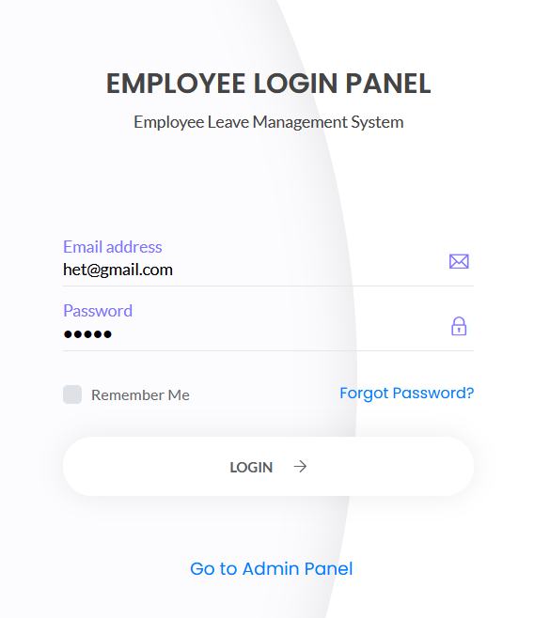
Employee Login.php

Slide 32
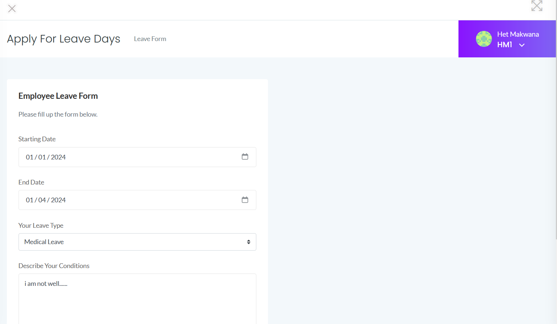
Employee Leave Form

Slide 33
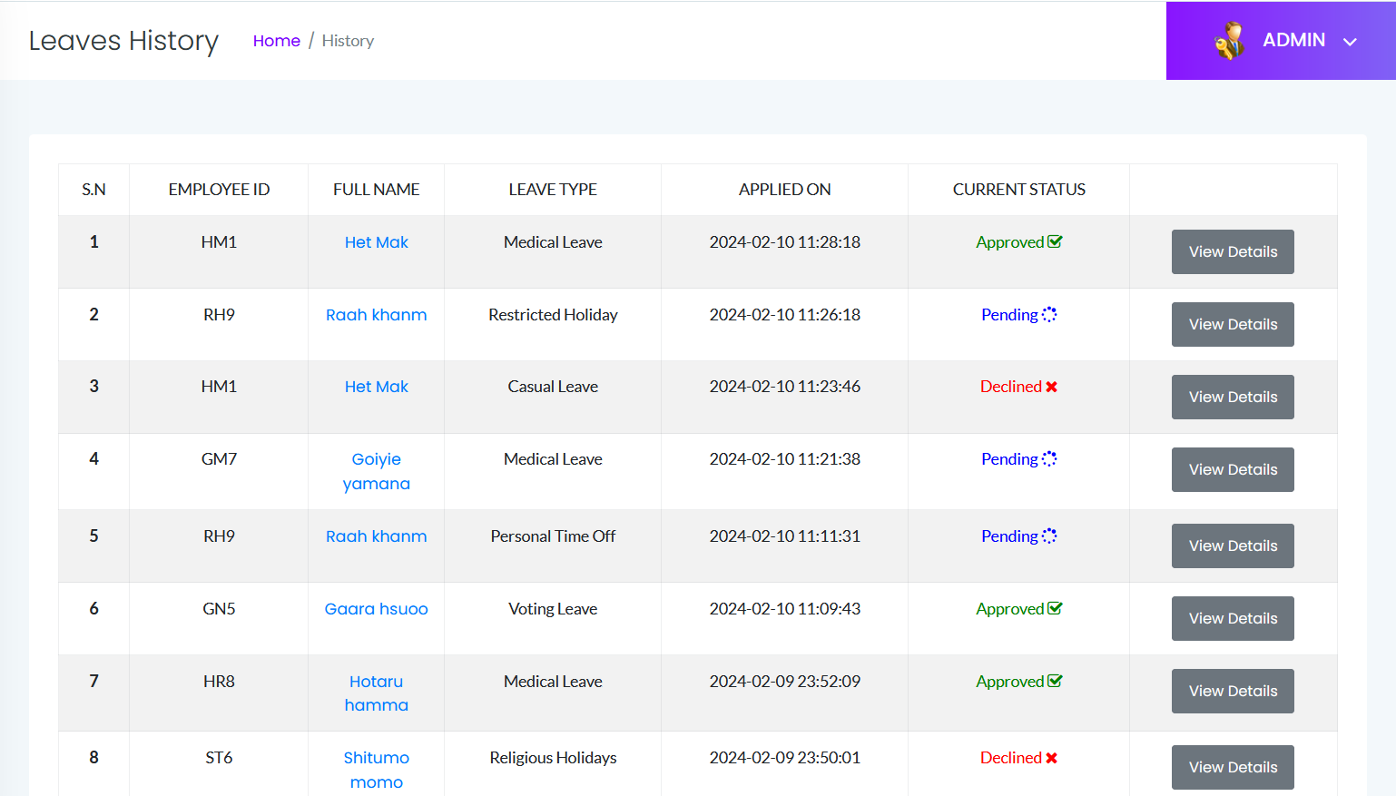
Employee Leave History

Slide 34
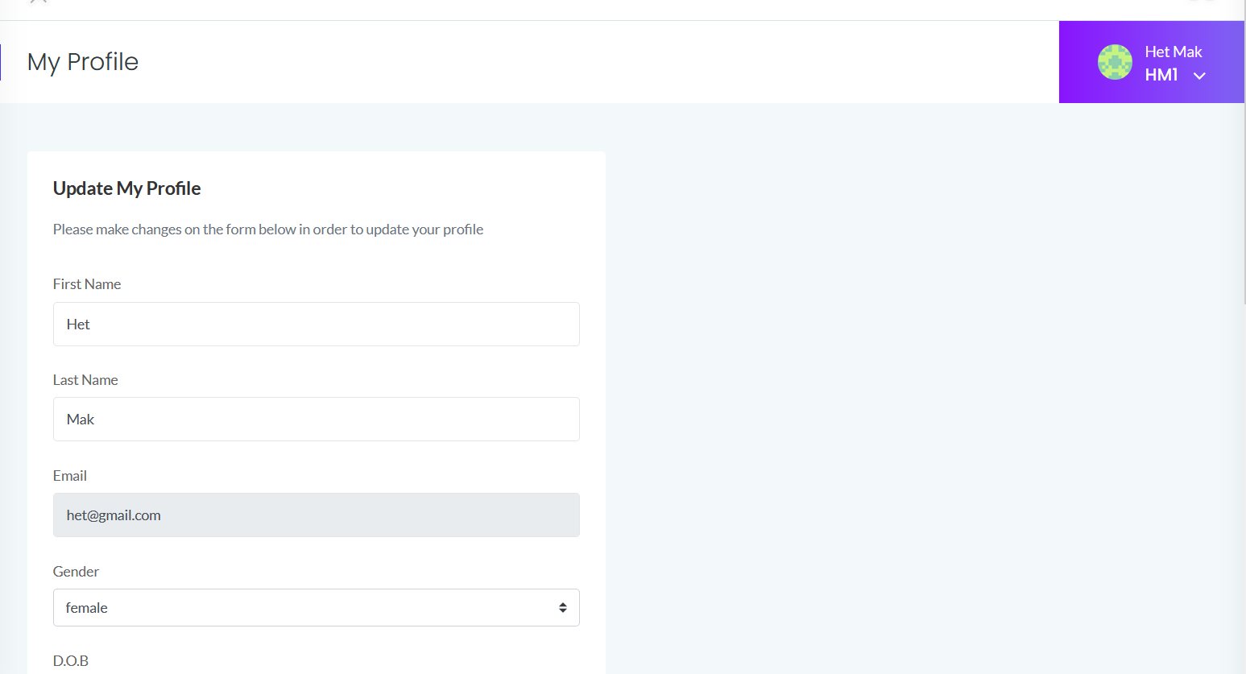
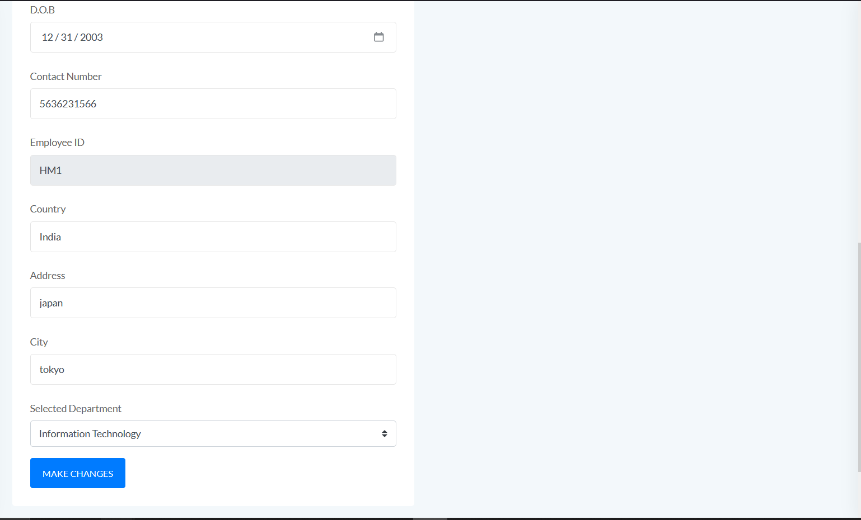
Employee Profile

Slide 35
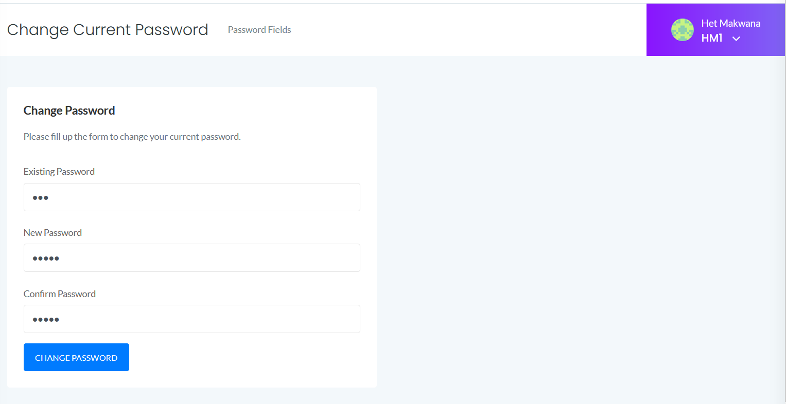
Change password by Employee

Slide 36
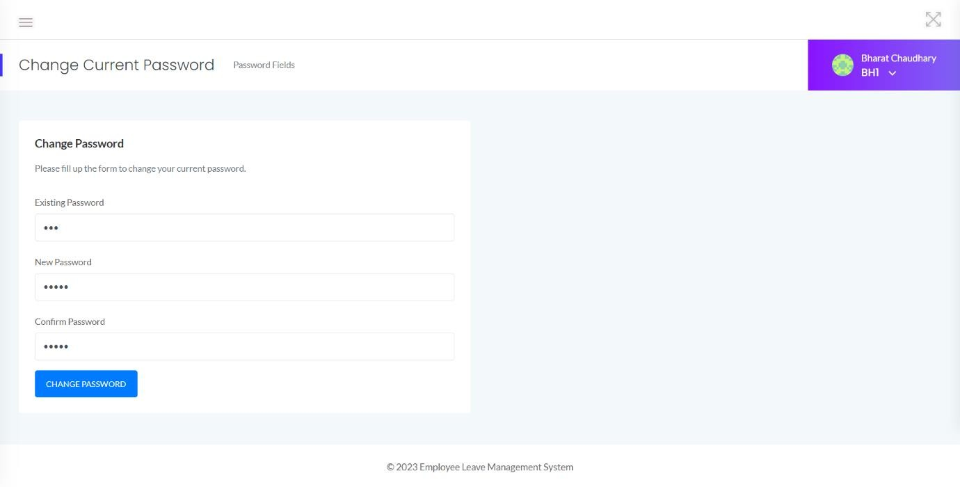
Employee password Change

Slide 37
ADMIN PANEL

Slide 38
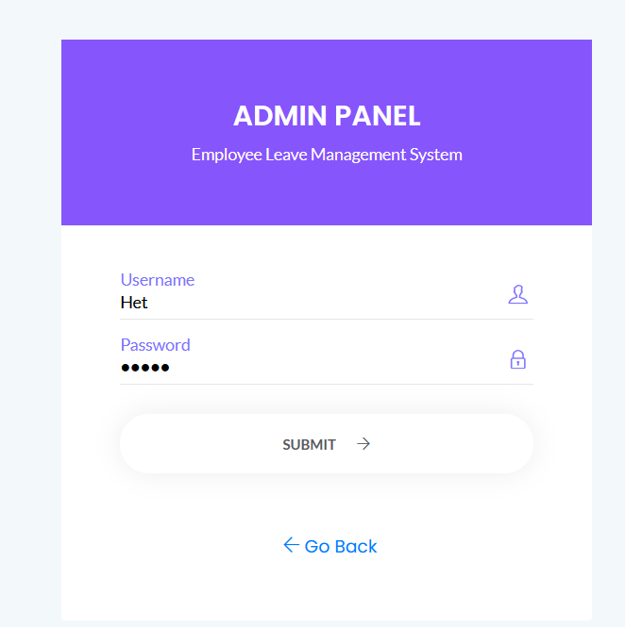
Admin Panel

Slide 39
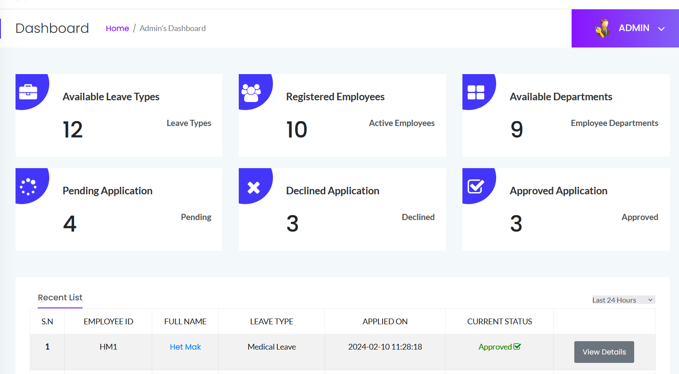
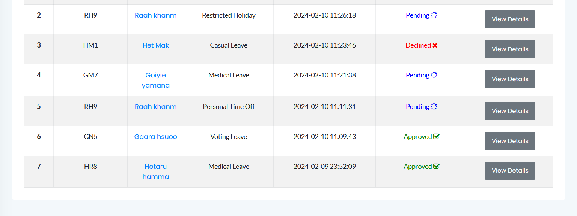
Admin Dashboard

Slide 40
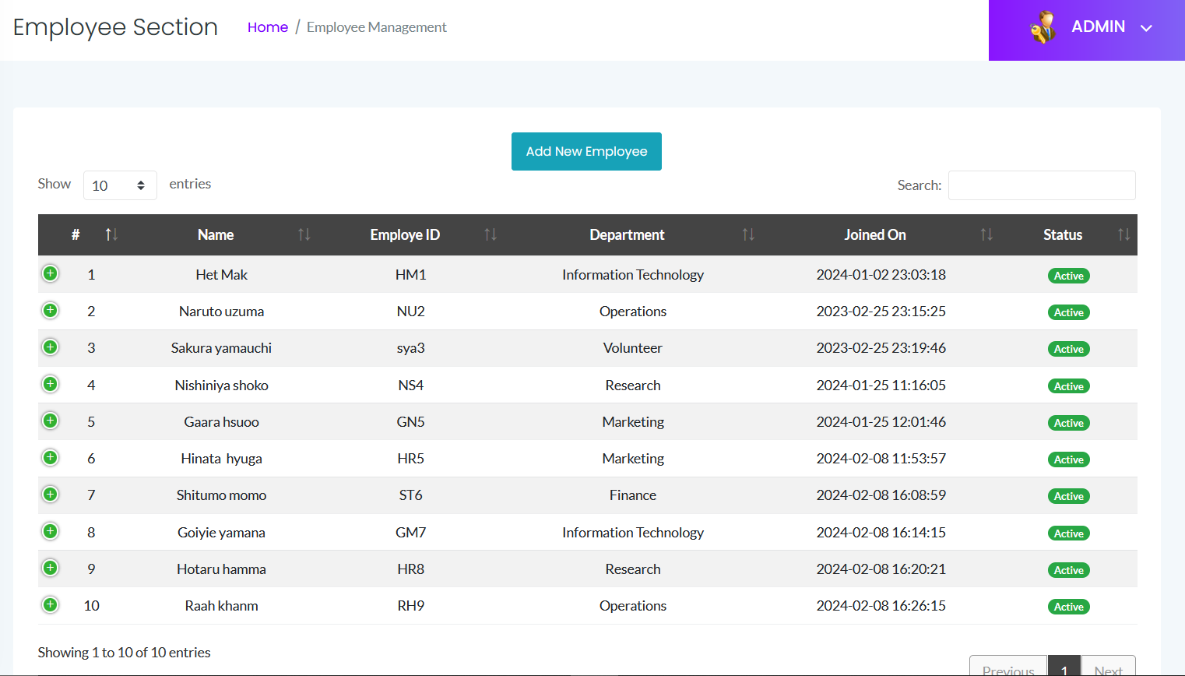
Employee Section

Slide 41
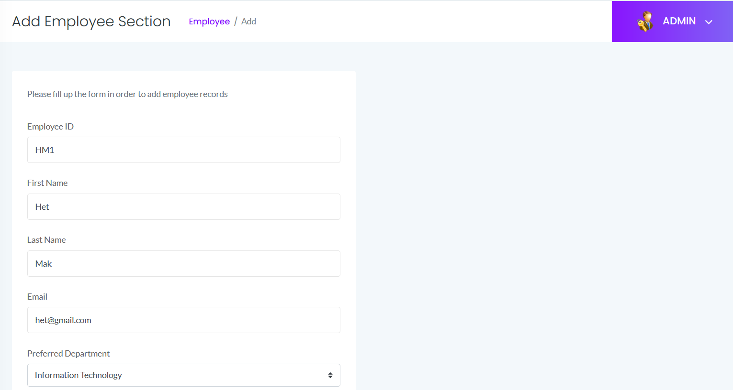
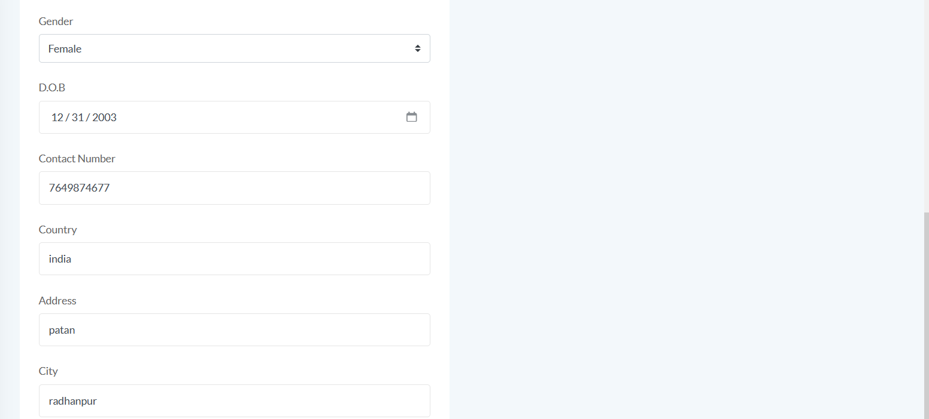
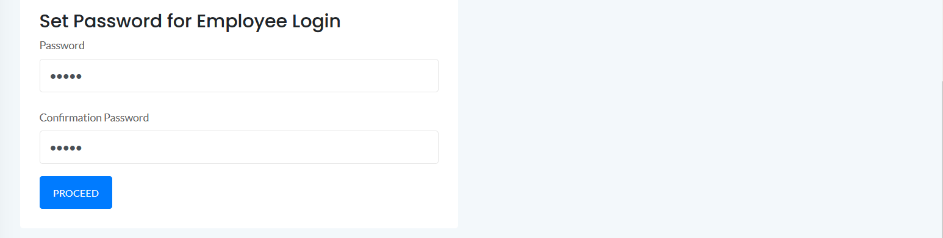
Add Employee Section

Slide 42
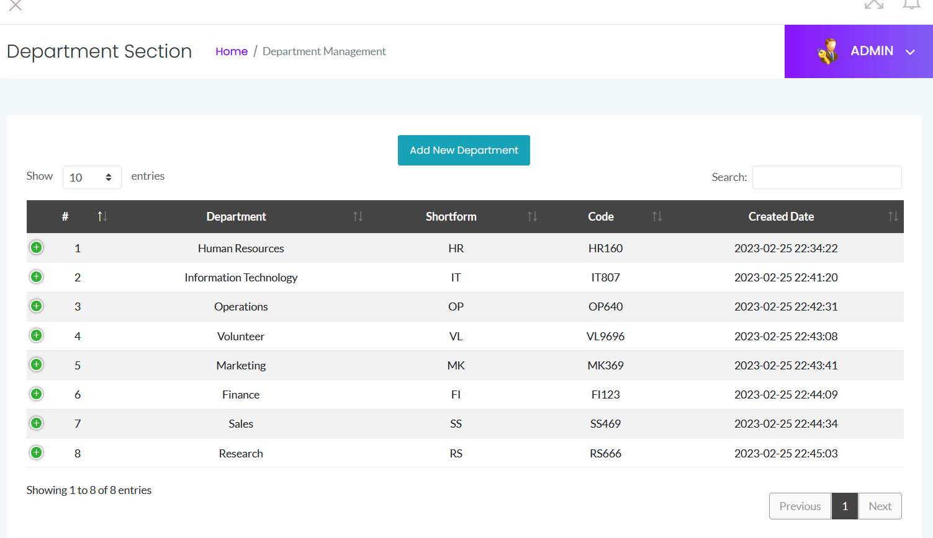
Department Section

Slide 43
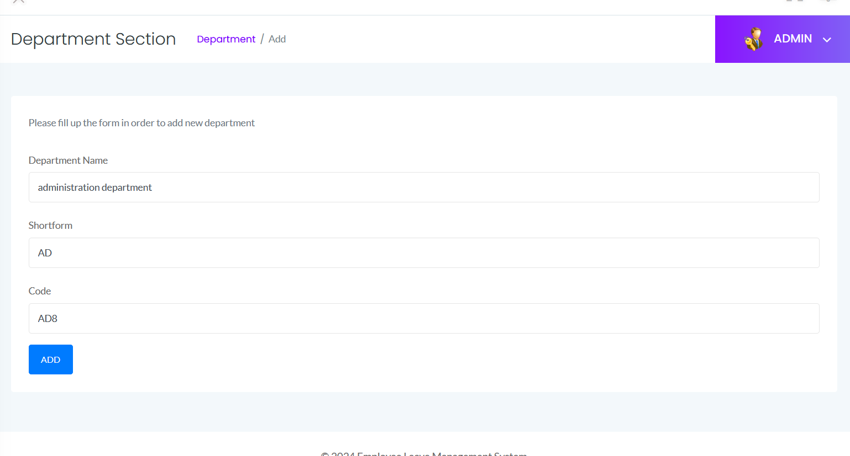
Add Department Section

Slide 44
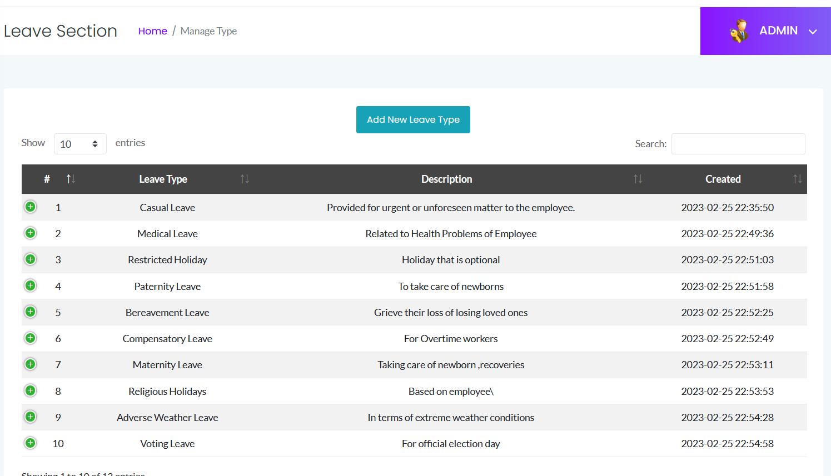
Leave Section

Slide 45
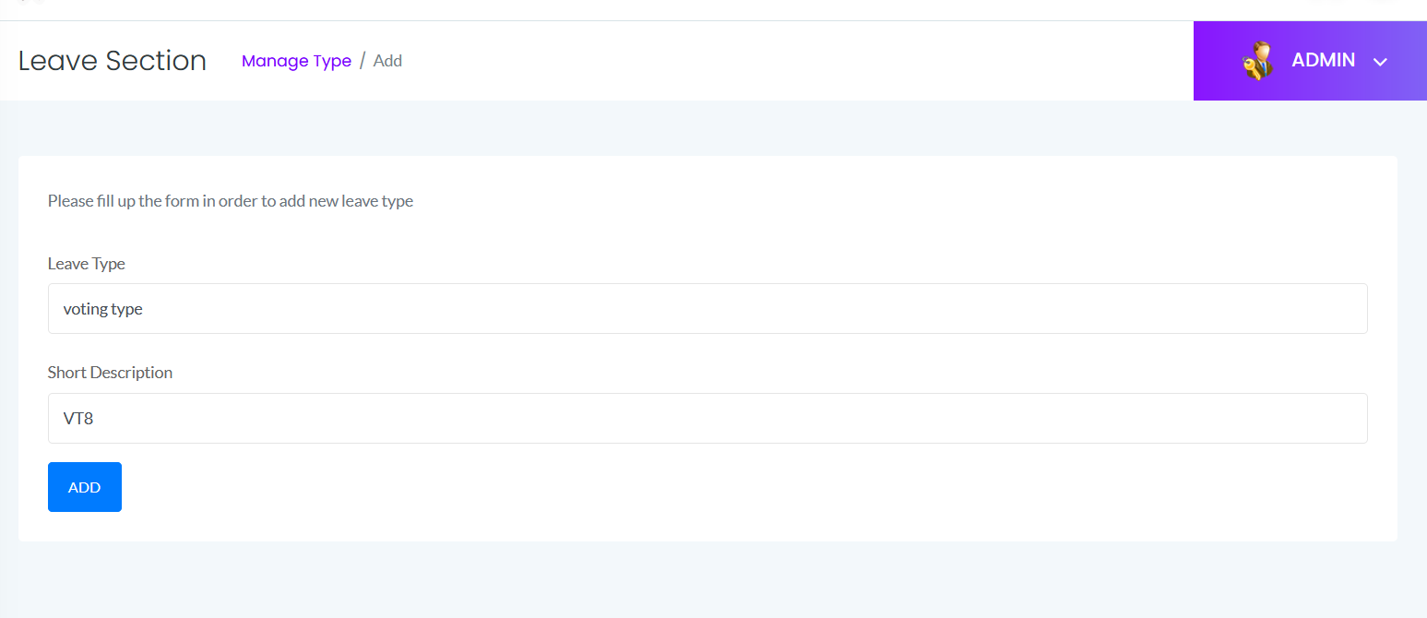
Add Leave Section

Slide 46
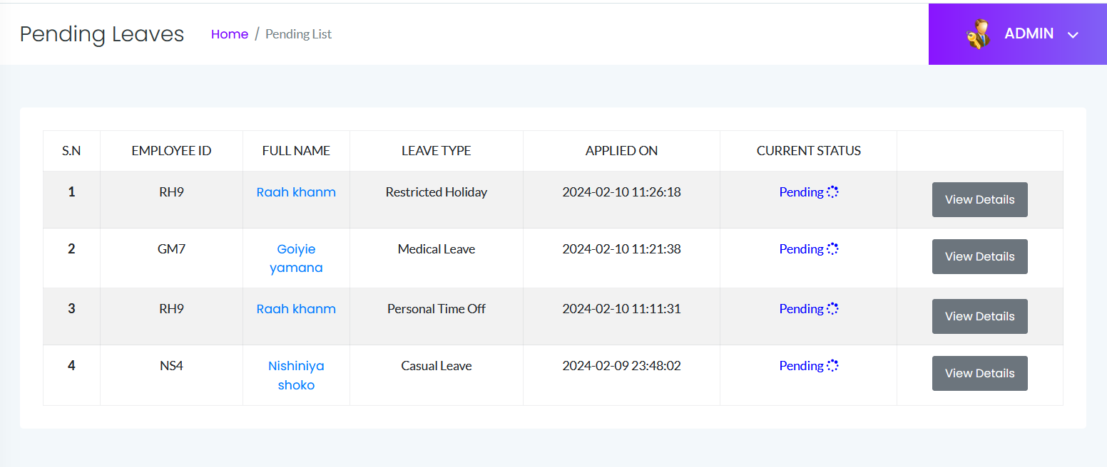
Pending Leaves

Slide 47
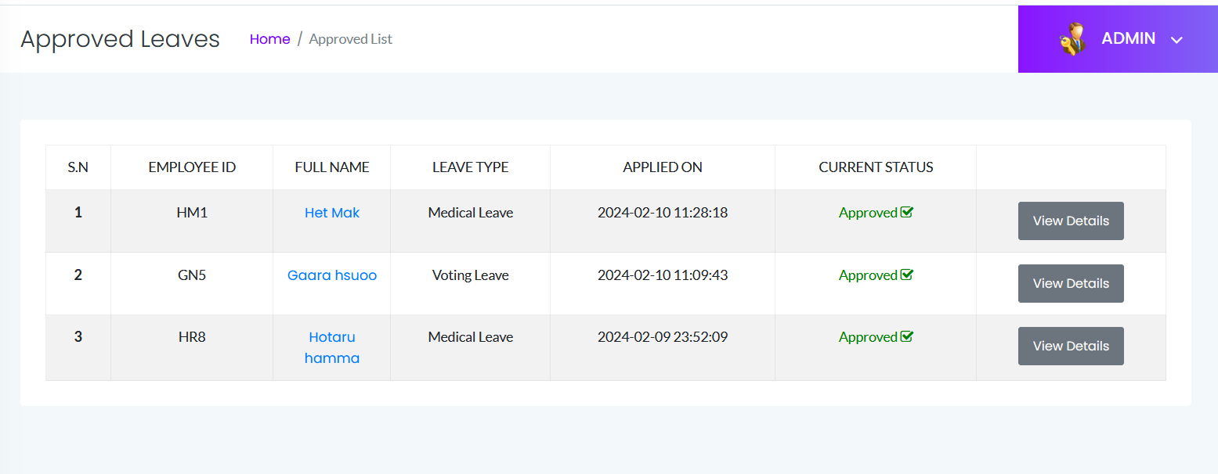
Approved Leaves

Slide 48
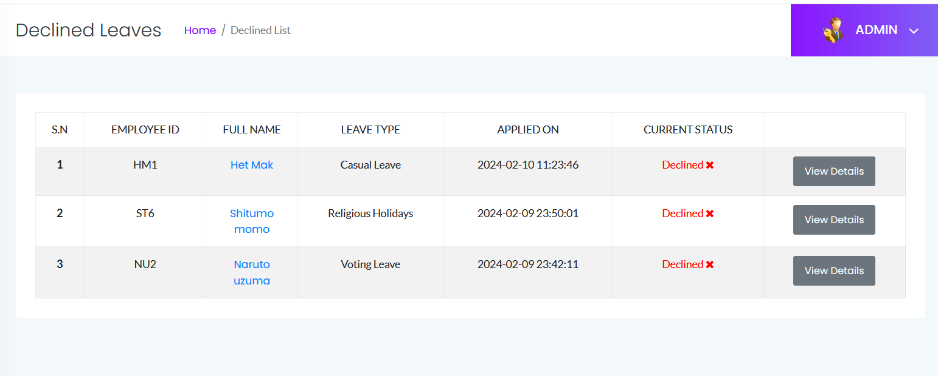
Declined Leaves

Slide 49
Leaves History

Slide 50
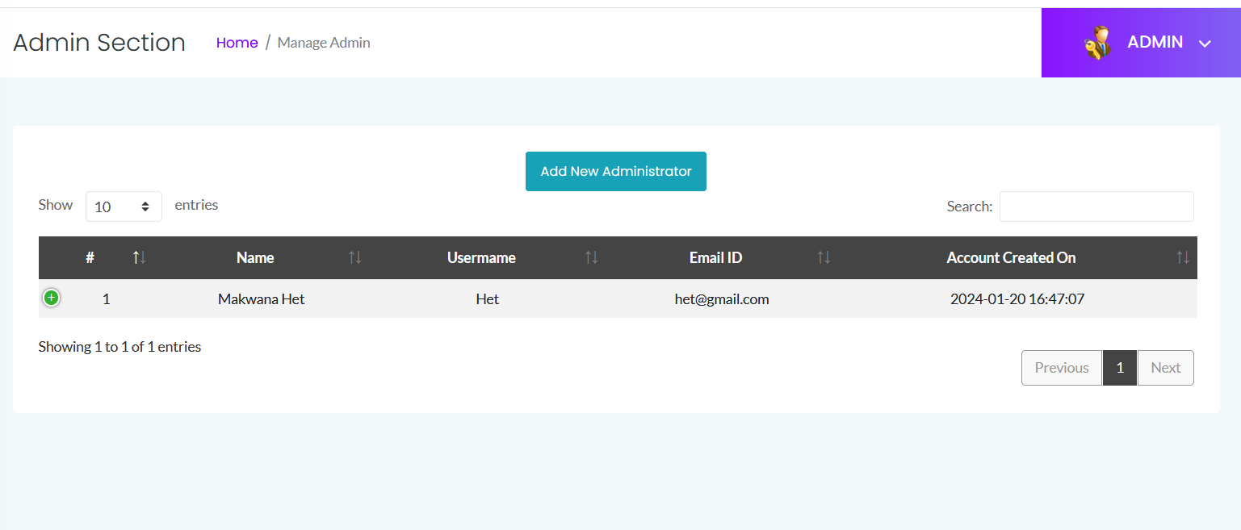
Manage Admin

Slide 51
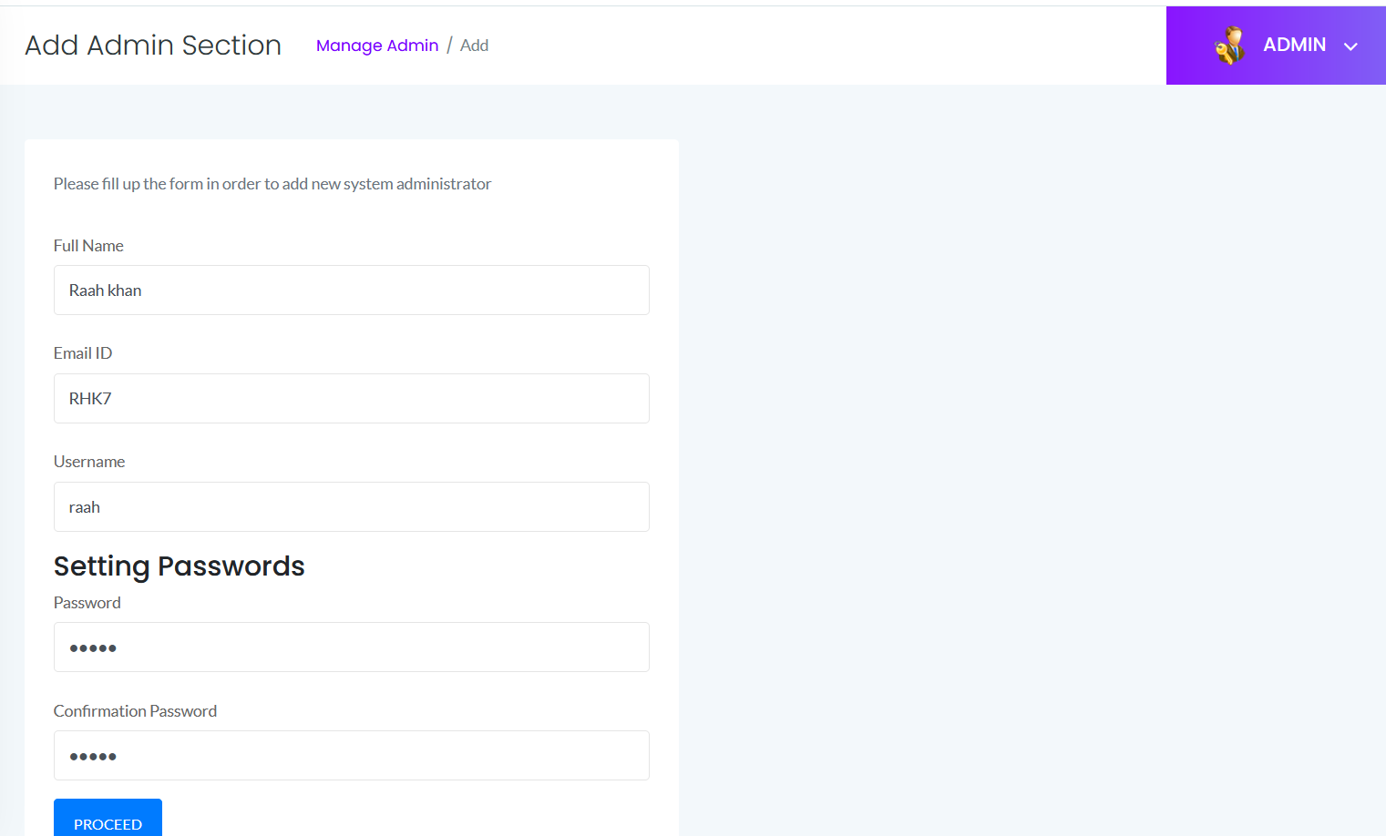
Add Admin Section

Slide 52
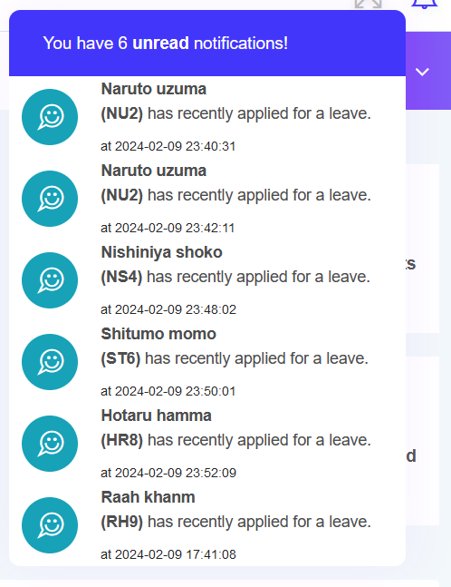
Notification section

Slide 53
REFERENCES
HTML, CSS, JavaScript
W3Schools (https://www.w3schools.com/)
MDN Web Docs (https://developer.mozilla.org/en-US)
PHP
PHP.net (https://www.php.net)
MySQL
MySQL.com (https://www.mysql.com)
Bootstrap
Bootstrap (https://getbootstrap.com)
jQuery
jQuery.com (https://jquery.com)

Slide 54
THANK YOU

