Slide 1
Temporal Difference Learning
By John Lenz

Slide 2
Reinforcement Learning
Agent interacting with environment
Agent receives reward signal based on previous action.
Goal is to maximize reward signal over time
Epoch vs. Continuous tasks
No expert teacher

Slide 3
Value Function
Actual return, R_{t}, is the sum of all future rewards.
Value function: V^{π}(s) = E_{π}{R_{t} | s_{t} = s} is the expected return starting from state s_{t} and following policy π.
State-action value function, Q(s,a), is the expected return starting from state s, taking action a, and then following policy π.

Slide 4
Temporal Difference Learning
Constant-α Monty Carlo method. Update weights only when the actual return is known. ΔV(s) = α[R_{t} – V(s)]
Must wait until actual return is known to update weights. End of epoch
Instead, we estimate the actual return as the sum of the next reward plus the value of the next state

Slide 5
Forward view of TD(λ)
Estimate the actual return by n-step return
R_{t}^{(n)} = r_{t+1} + γ r_{t+2} + … + γ^{n-1} r_{t+n} + γ^{n} V(s_{t+n})
TD(λ) is a weighted average of n-step returns
R_{t}^{λ} = (1 - λ) ∑_{n} λ^{(n-1)} R_{t}^{(n)}
λ=0, we only look at next reward
λ=1, constant-α Monty Carlo

Slide 6
Backward view of TD(λ)
Each state has an eligibility trace. The eligibility trace is incremented by one for the current state, and decayed by γ λ
Then, each time-step, the value function for every recently visited state is updated. The eligibility trace determines which states have been recently visited

Slide 7
Backward view continued
e_{t}(s) = γ λe_{t-1}(s) if s != s_{t}
e_{t}(s) = γ λe_{t-1}(s) + 1 if s = s_{t}
δ_{t} = r_{t+1} + γV_{t}(s_{t+1}) - V_{t}(s_{t})
ΔV_{t}(s) = α δ_{t} e_{t}(s) for all s

Slide 8
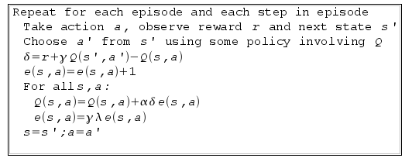
Control Problem: Sarsa(λ)
ε-Greedy policy using Q(s,a) instead of V(s)
Each state-action pair has an eligibility trace e(s,a)

Slide 9
Function Approximation
Until now, assumed V(s) and Q(s,a) implemented as huge table
Instead approximate the Value function V(s) and the state-action value function Q(s,a) with any supervised learning methods
Radial Basis Networks, Support Vector Machines, Artificial Neural Networks, clustering, etc.

Slide 10
My Implementation
C++
Uses a two-layer feed forward artificial neural network for function approximation
Agent implemented on top of neural network, which implements the learning algorithm
Agent is independent of environment.

Slide 11
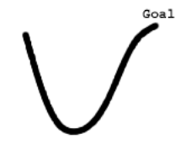
Hill Climbing Problem
Goal is to reach the top of the hill, but the car is unable to accelerate to the top
Car must move away from
the goal to gain
momentum to reach the top.

Slide 12
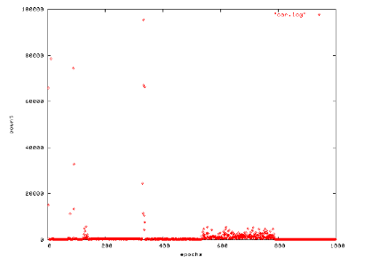
Hill Climbing Results
Initial run took 65,873 steps but by the ninth epoch took 186 steps

Slide 13
Games
N-in-a-row type games like checkers, tic-tac-toe, backgammon, chess, etc.
Use the after-state value function to select moves
TD-Gammon plays at level of best human players
Can learn through self play

Slide 14
Implementation
I implemented tic-tac-toe and checkers.
After around 30,000 games of self play, the tic-tac-toe program could learn to play a descent game.
Checkers was less successful. Even after 400,000 self play games the agent could not beat a traditional AI

