Slide 1
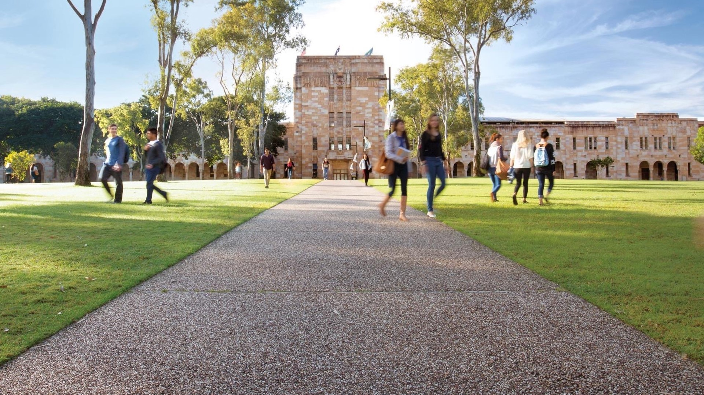

Important Trends in Deepfake
Generation, Detection and Prevention
INTERPOL Deepfake Detection Workshop 2026
Professor Ryan Ko PhD FACS FCSA FQA | | Dr Hetong Jiang

Slide 2






UQ Cyber Research Centre
An Interdisciplinary Research Centre of 70+ academics and their respective groups/labs (100+ PhDs) across UQ.
Industry
Research
Teaching
AusCERT and 400+ members
13 Entities (Faculties and Schools):
Engineering, Architecture and Information Technology (Electrical Engineering and Computer Science)
Science (Maths and Physics)
Humanities and Social Sciences (Criminology, Political Science)
Business, Economics and Law
Medicine
Centre for Policy Futures
Institute for Social Science Research
AusCERT Research
CPD Courses
Bachelor of Computer
Science
(Cyber Security Major)
Information Technology Services Division
Master of Cyber Security
Grad Dipl in Cyber Security
(4 Fields of Study)
Grad Cert in Cyber Security
Industry, Governments & International Organisations
(>100 partners)
PhD & MPhil

Slide 3
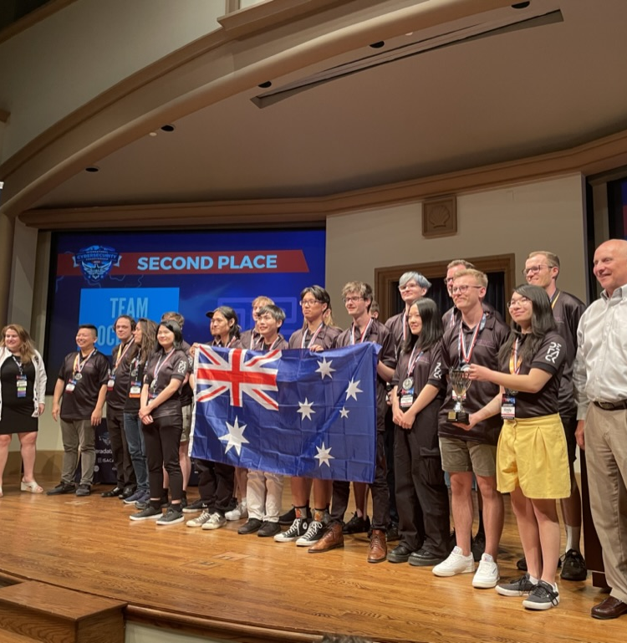
UQ Cyber Achievements
Impact since its 2019 establishment by Professor Ryan Ko:
Pioneered Australia’s first interdisciplinary Master of Cyber Security program that adopted NIST’s National Initiative for Cybersecurity Education (NICE) framework, involving 4 faculties (including 6 schools) across the university. Accredited by Australian Computer Society.
~$165m in research fundingfrom 136 successful proposals.
~$2.1m in philanthropic donations received, which funded 15 academic scholarships (HP, QLD Govt) and will fund new research positions.
Organisers of the International Cybersecurity Challenge 2026 and annual Oceania Cybersecurity Challenge.
2nd place in the International Cybersecurity Challenge, San Diego, California.
Researchers publish regularly in top Q1 journals and A*-ranked conferences across multiple disciplines
Alumni are now sector leaders – making UQ Cyber an internationally renowned research group in Asia Pacific.
UQ is the Australian university with the highest number of vulnerabilities (CVEs) disclosed (e.g. to Microsoft, Google).

Slide 4
We will use Slido for interactive slides, please visit this site with your devices:
Slido Setup
Slido URL:
Code:
Note: Please check if you can load the page. We will do the questions later.

Slide 5
Agenda
Introduction
A timeline of Deepfake
State-of-the-Art Deepfake Creation
State-of-the-Art Deepfake Defence
Our Research
Hands-on-session

Slide 6
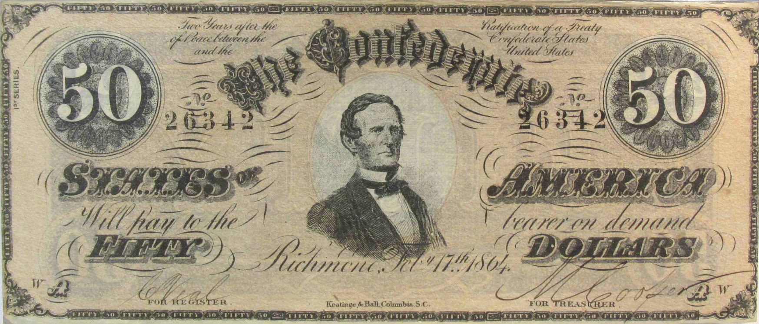
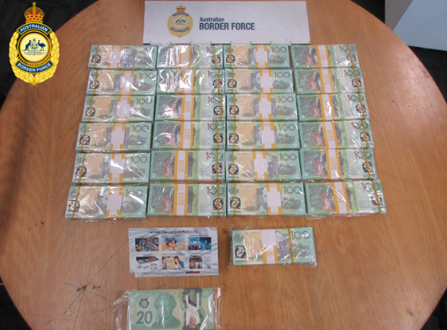
Fakes have existed since the beginning of civilisation...
One example ➔ Fake Currency
During a particular period in American history, a time in which as much as 30% of circulating currency was thought to be counterfeit. This gave birth to the US secret service. [1][2]
In June 2026, the Australian Border Force intercepted 12 air-cargo consignments linked to one importer in Queensland, preventing counterfeit banknotes with a face value exceeding A$2 million from entering circulation. [4]
[1] https://www.secretservice.gov/investigations/digitalassets
[2] https://decaturcoinandjewelry.com/product/1864-50-ct-66-confederate-civil-war-counterfeit-banknote-hoard-pmg-au-pc861/
[4] https://www.abf.gov.au/newsroom-subsite/Pages/Counterfeit-crackdown-%242-million-in-%E2%80%98cash%E2%80%99-that-didn%E2%80%99t-make-cents.aspx#

Slide 7
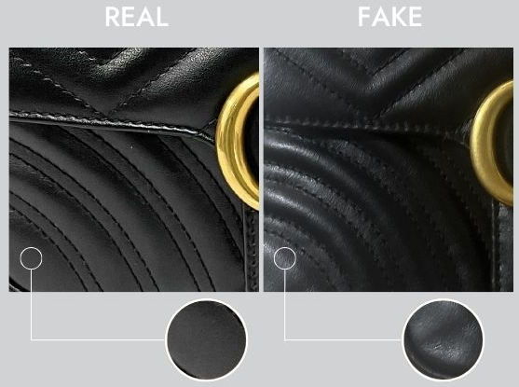
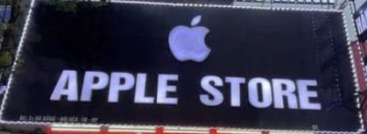
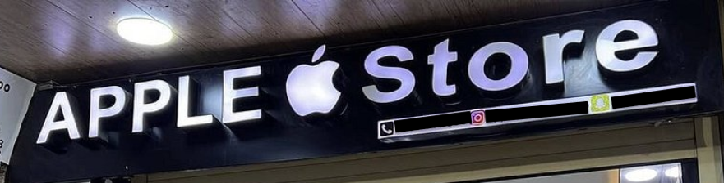
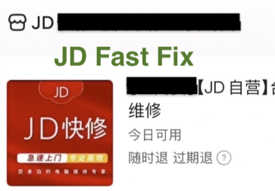

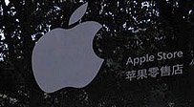


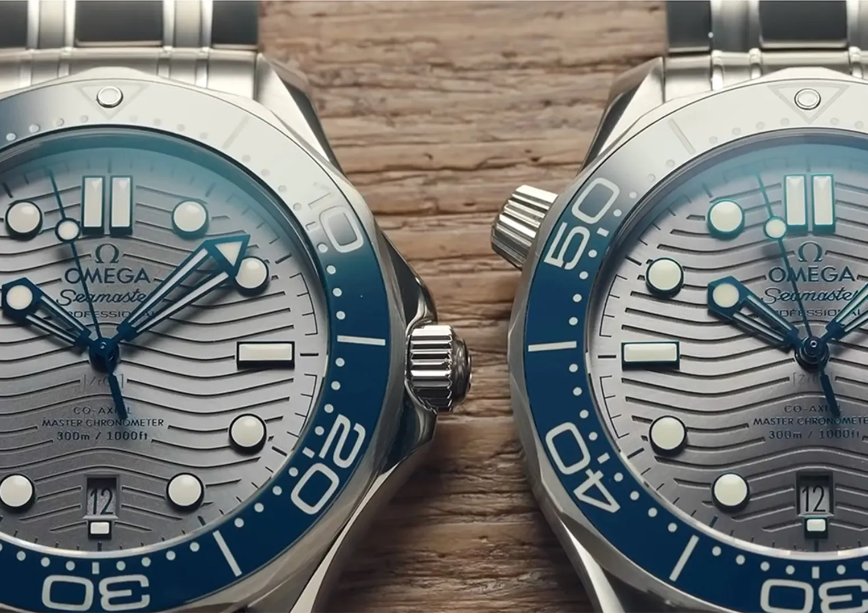




Other Forms of Counterfeiting
There are multiple forms of counterfeiting
Fake material
Knock-off store with unauthorised logo usage
Services that pretend to be backed by a big company
Fake App
High-quality Counterfeit
Website Clone
[5] https://realauthentication.com/real-or-fake-the-gucci-marmont-flap-bag/
[6] https://www.watchfinder.com/articles/feature-the-most-accurate-fake-luxury-watches-in-the-world

Slide 8

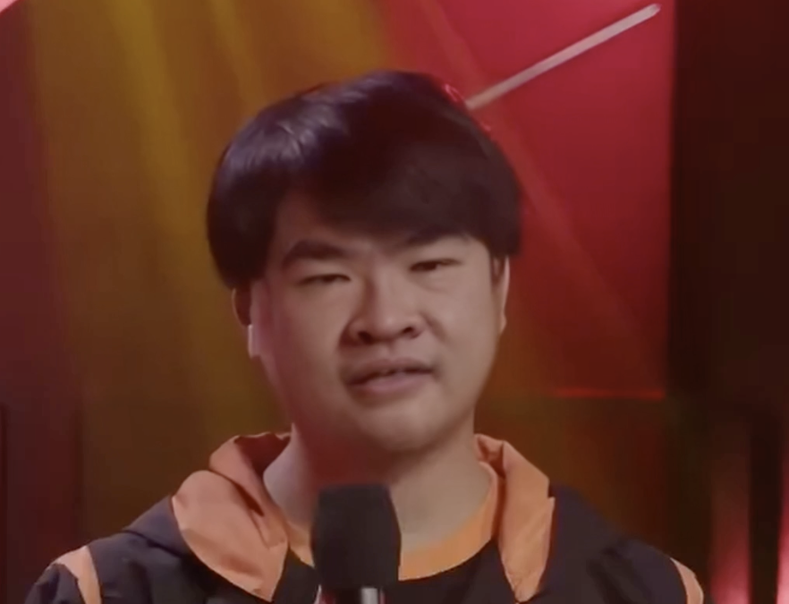
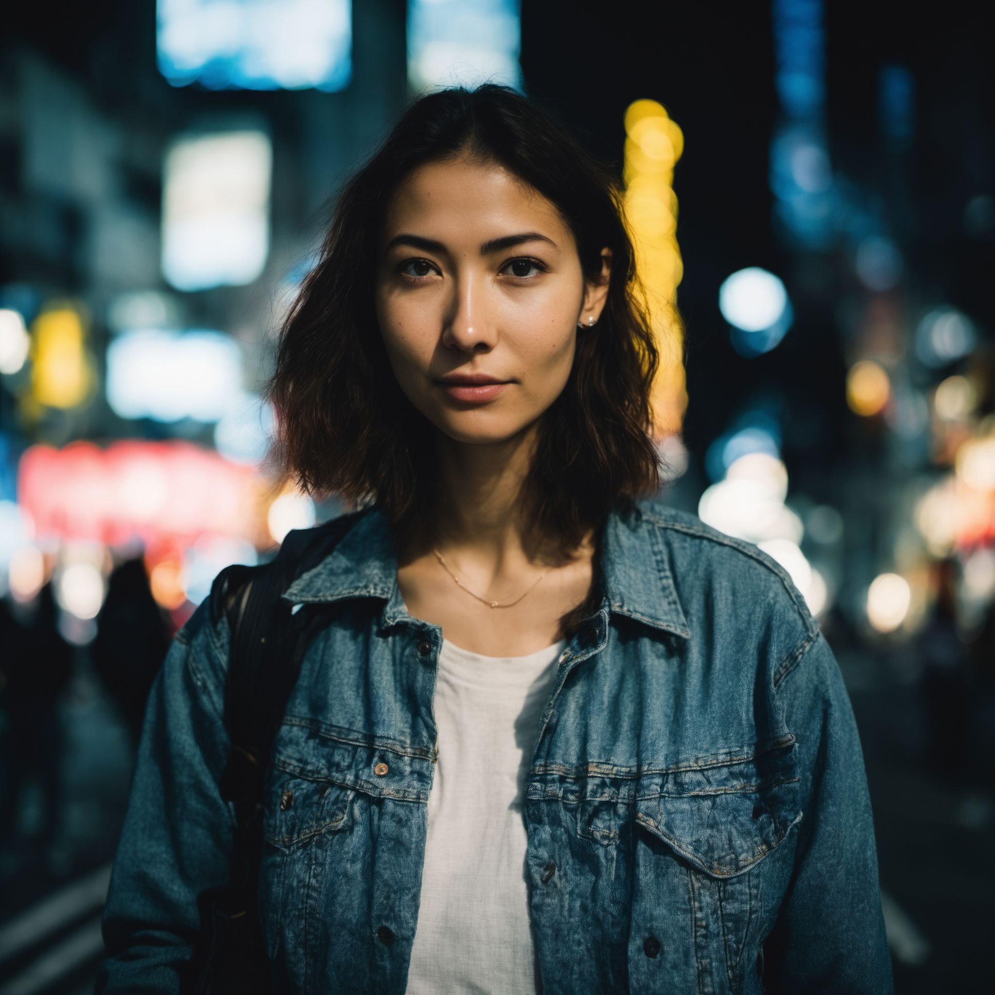
Deepfake: Counterfeiting in the Digital World
What are the criminals also doing nowadays? ➔ DeepFake
Can you distinguish which one(or more) is NOT authentic?
Slido Link:
Code:
1
2
3
Notes:
Authentic Protrait [7]
Face swap with facefusion [8]
Fully synthetic portrait with PhotoMaker [9]
[7] https://github.com/NVlabs/ffhq-dataset (22938)
[8] https://github.com/facefusion/facefusion
[9] https://github.com/TencentARC/PhotoMaker

Slide 9
Agenda
Introduction
A timeline of Deepfake
State-of-the-Art Deepfake Creation
State-of-the-Art Deepfake Defence
Our Research
Hands-on-session

Slide 10
State-of-the-art Deepfake Generation
Background
Generation ➔ Audio
Generation ➔ Image
Generation ➔ Video

Slide 11
A Brief Timeline to Deepfake and AIGC (AI Generated Content)
The evolution of deepfake has basically mirrored the evolution of computer CGI, with increasing accessibility
2026 August
Transparency obligations under Article 50 of the AI Act[16]
2026 August
Release of JPEG Trust Part 1: Core foundation [17]
2026 April
C2PA 2.4 expanded provenance support for live video, recoverable credentials and additional media workflow[15]
2024 February
Hong Kong employee transferred 20M Euros joining a video conference impersonating company personnel with a pre-recorded multi-modal video [14]
2022 August
Stable Diffusion code and weight Released [13]
2022 January
C2PA:Coalition for Content Provenance and Authenticity Announced [12]
2021
DeepTomCruise[11]
2018
Some platform start concerning and start banning face-swap
[10] C. Bregler, M. Covell, and M. Slaney, “Video Rewrite: Driving visual speech with audio,” in Proc. ACM SIGGRAPH, 1997, pp. 353–360, doi: 10.1145/258734.258880.
[11] https://journals.law.harvard.edu/jsel/2021/03/mission-impossible-the-legal-implications-of-managing-deepfake-celebrity-videos/
[12] https://c2pa.org/c2pa-releases-specification-of-worlds-first-industry-standard-for-content-provenance/
[13] https://arxiv.org/abs/2112.10752
[14] https://www.counterfraud.gov.au/case-studies/company-worker-hong-kong-pays-out-ps20m-deepfake-video-call-scam
[15] https://spec.c2pa.org/specifications/specifications/2.4/specs/C2PA_Specification.html
[16] https://digital-strategy.ec.europa.eu/en/faqs/transparency-obligations-under-article-50-ai-act
[17] https://www.iso.org/standard/91405.html
2017
Deepfake Named ➔ DeepLearning+Fake
(Hard to trace the origin but likely came from Reddit)
As early as 1997[10]

Slide 12
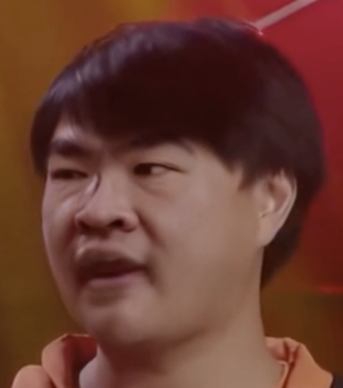
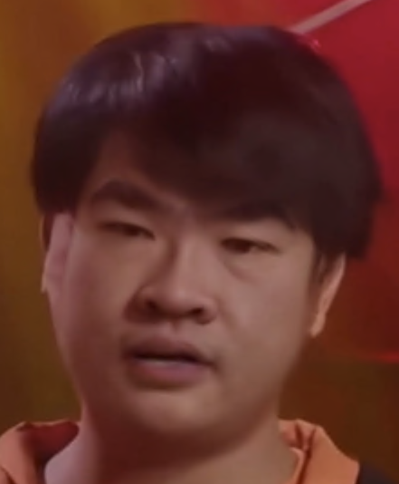
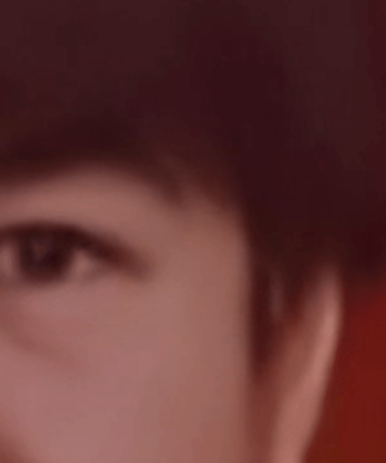

Generally, there are two main approaches…
Same materials can generate different grade of output depends on the skills and techniques
Approach 1: Low-cost method without targeted plan and advanced techniques
Approach 2: Deepfake using high compute advance techniques and plan
Simple generation workflow, obvious flaws
Minimum Computing Power Required
“Anyone” can do it for free
Can have little to no plan(s)
A generative stack, whole workflow and multimodal
Enough compute to create highly realistic outcomes
Highly technical professional with experience
A purposeful plan to collect the target victim’s data
While the free to low-cost method may generate outcomes with flaws, they still can cause damages:
  High school teacher used AI to frame principal with racist remarks in fake audio clip [18,19,20]
  Political operative paid $150 to create AI-generated to spread election misinformation to discourage voting[21,22]
  Free or low-cost AI apps requiring no technical skill are being used to create non-consensual explicit images of students, enabling bullying, humiliation and blackmail and causing serious emotional distress[23]
[18] https://www.bcps.org/system/b_c_p_s_news/2023-2024_staff_and_community_messages/april_24__2024_staff_and_community_update__message_from_superintendent_dr__myriam_rogers_regarding_pikesville_high_school_investigation
[19] https://apnews.com/article/ai-artificial-intelligence-principal-audio-maryland-baltimore-county-pikesville-853ed171369bcbb888eb54f55195cb9c
[20] https://apnews.com/article/racist-ai-recording-maryland-high-school-487ea673b0449077cb23e7970546cb9f
[21] https://www.theguardian.com/us-news/2024/feb/26/steve-kramer-admits-he-commissioned-robocall-ai-biden-new-hampshire
[22] https://docs.fcc.gov/public/attachments/FCC-24-104A1.pdf
[23] https://www.esafety.gov.au/newsroom/blogs/deepfake-damage-in-schools-how-ai-generated-abuse-is-disrupting-students-families-and-school-communities

Slide 13
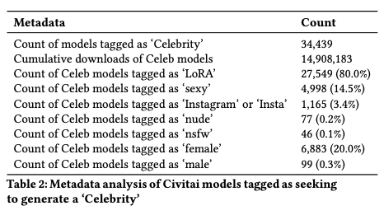
Deepfake Creation: Low/No Technical Skills Req’d
A peer-reviewed 2025 experiment showed that a first-time user, using only a laptop and browser-based services, could produce synthetic audio for free in under one hour and two deepfake videos in approximately 40 minutes [24].
An ACM FAccT study identified 34,439 publicly downloadable identity-specific image-model variants with approximately 14.9 million cumulative downloads, demonstrating the large-scale accessibility of tools can be used for deepfake creation [25].
FAccT: ACM Conference on Fairness, Accountability, and Transparency
[24] G. Murphy, D. Ching, E. Meehan, J. Twomey, A. Bolger, and C. Linehan, “An average Joe, a laptop, and a dream: Assessing the potency of homemade political deepfakes,” Applied Cognitive Psychology, vol. 39, no. 2, Art. no. e70061, 2025, doi: 10.1002/acp.70061.
[25] W. Hawkins, B. Mittelstadt, and C. Russell, “Deepfakes on demand: The rise of accessible non-consensual deepfake image generators,” in Proc. 2025 ACM Conf. Fairness, Accountability, and Transparency (FAccT ’25), Athens, Greece, 2025, pp. 1561–1573, doi: 10.1145/3715275.3732107.
Notes:
Audio:
PlayHT AI (1 hours no fee)
Video
Paid → https://sync.so/ (30 minutes)
Free → https://gooey.ai/Lipsync/ (40 minutes)
Quote: The study provides evidence that deepfake technology has become truly accessible to the average internet user. With just a few hours and no training or equipment, a first year undergraduate student was capable of generating deceptive deepfake misinformation. Participants were mostly unaware of the true purpose of the study, and even when prompted, were not more likely to identify the deepfake version of the fake story than the text or audio versions.

Slide 14
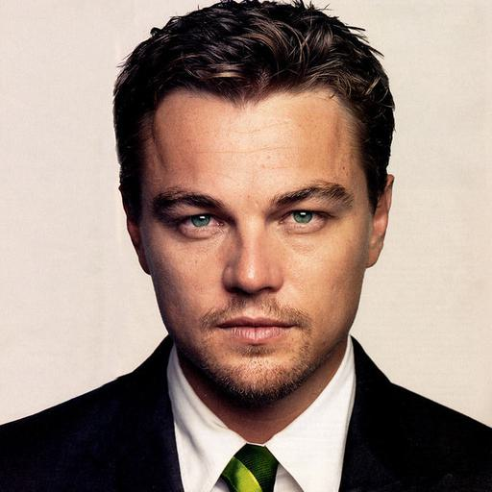
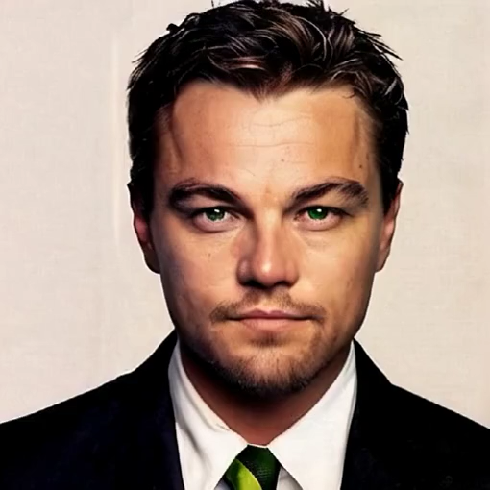

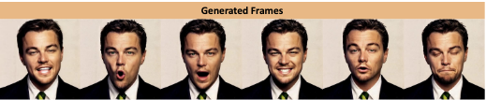
Multi-modality (i.e. image+audio+motion) Increases Realism
Image
High-realism face synthesis
Avatar modelling
Real-photo
Multi-Modal Synthetic Deepfake Material
Audio
  Speech generation
  Voice cloning
Motion
Partial Motion
Holistic Motion
[26] https://github.com/jixiaozhong/Sonic

Slide 15
Situations Where Deepfakes are Used (Non-Exhaustive)
Fraud and scams
Abuse
Payment or invoice fraud
Investment and endorsement scams
Family-emergency or kidnapping scams
Non-consensual intimate imagery
Sextortion or blackmail
Harassment
Identity and authority misuse
Evidence manipulation
Identity theft or account takeover
Police, government or employer impersonation
False emergency or workplace instructions
Fabricated recordings or documents
Witness interference or obstruction
False emergency announcements
Or even just a prank without any intention to cause issue, and the damage/impact can still be felt.
[27] eSafety Commissioner, "Deepfake trends and challenges: PoDeepfakesition statement," Australian Government, updated Aug. 4, 2026. [Online]. Available: https://www.esafety.gov.au/industry/tech-trends-and-challenges/deepfakes
[28] Australian Government, Criminal Code Amendment (Sexual Material) Act 2024, No. 78, 2024. [Online]. Available: https://www.legislation.gov.au/C2024A00078/asmade/2024-09-02/text/original/epub/OEBPS/document_1/document_1.html
[29] Australian Competition and Consumer Commission, "Impersonation scams," Scamwatch, 2023. [Online]. Available: https://www.scamwatch.gov.au/sites/www.scamwatch.gov.au/files/2023-10/Scams%20Awareness%20Week%202023_Key%20messages%20on%20impersonation%20scams.pdf
[30] U.S. Federal Trade Commission, "Scammers use fake emergencies to steal your money." [Online]. Available: https://consumer.ftc.gov/articles/scammers-use-fake-emergencies-steal-your-money

Slide 16
State-of-the-art Deepfake Generation
Background
Generation ➔ Audio
Generation ➔ Image
Generation ➔ Video

Slide 17




Faking Audio
Voice cloning is one of the common use cases of Deepfake, and they are very easy to perform:
“Some scammers use artificial intelligence (AI) to clone your loved one’s voice. With a short audio clip — maybe from content posted online— and a voice-cloning program, a scammer could call you and sound just like your family member.”[31]
“Scammers can use a few seconds of a voice recording to create AI clones. They can use these clones and call you pretending to be friends or family members in distress. This makes their emergency scenarios and appeals for help feel real.”[32]
“Cybercriminals may also use AI to create new methods of social engineering attacks, such as imitating a target’s voice based on an audio sample.”[33]
[31] https://consumer.ftc.gov/articles/scammers-use-fake-emergencies-steal-your-money
[32] https://www.scamwatch.gov.au/stop-check-protect/help-to-spot-and-avoid-scams/how-scammers-use-technology-and-ai
[33] https://www.cyber.gov.au/sites/default/files/2024-11/asd-cyber-threat-report-2024.pdf

Slide 18
Spectrum of Audio Deepfakes
Training material needed
Multiple voice clip
Short Voice Clip
Multi-Sample Fine-Tuning
Train and tuning the model for target speaker, with large speaker’s dataset
One-shot
- Generate with ONE reference example
Multiple-Shot
- Generate with MULTIPLE reference example
Zero-shot
- Generate without training
Deepfake Accuracy
Less Distinguishable
More Distinguishable
Not aiming for perfection: They don’t need to be perfect in order to make people trust
One-shot and Zero-shot approaches are becoming more and more popular​
  i.e. Easy to create deepfakes without complicated setup or advanced technical skill, or not even a lot of reference sound clip from the victims.
Goal: There is a need of better regulation and tool/framework to fight against this exponential, fast-evolving situation​
Notes:
[31] https://consumer.ftc.gov/articles/scammers-use-fake-emergencies-steal-your-money
[34] P. Peng, P.-Y. Huang, S.-W. Li, A. Mohamed, and D. Harwath, “VoiceCraft: Zero-Shot Speech Editing and Text-to-Speech in the Wild,” in Proceedings of the 62nd Annual Meeting of the Association for Computational Linguistics (Volume 1: Long Papers), Bangkok, Thailand: Association for Computational Linguistics, 2024, pp. 12442–12462. doi: 10.18653/v1/2024.acl-long.673.
[35] Y. A. Li, C. Han, V. S. Raghavan, G. Mischler, and N. Mesgarani, “StyleTTS 2: Towards Human-Level Text-to-Speech through Style Diffusion and Adversarial Training with Large Speech Language Models”.

Slide 19
State-of-the-art Deepfake Generation
Background
Generation ➔ Audio
Generation ➔ Image
Generation ➔ Video

Slide 20
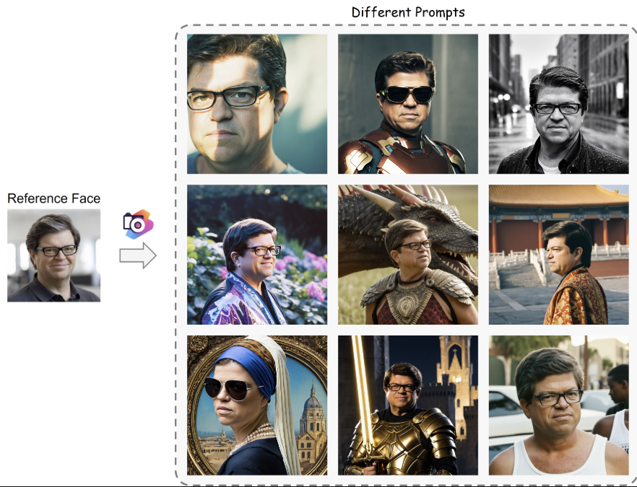
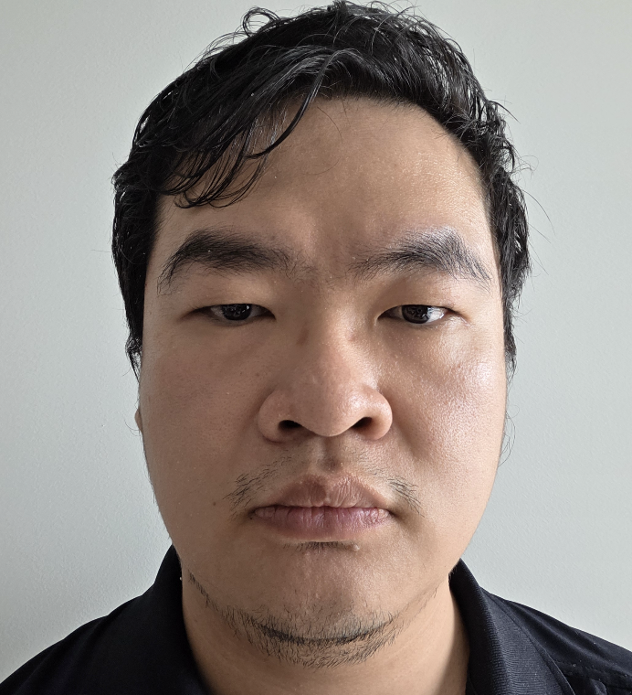
Image Deepfakes → Current Approaches
 | Face Swap | Synthetic (Entire image synthetic)
Strength | Easy to approach Only need to focus on face, other elements can be reused[36] | Generated with no to little source Flexible scene, pose, clothing style
Limitation(s) | Clear source and target are required Can be difficult to get consistent output | No Identity or details since the “person” (victim) does not exist directly
Common Use Cases | non-consensual imagery Impersonation Fraud Defamation | fake profiles fabricated scenes misinformation
Produced Output[8][9]: |  | [9]
Original Image
Face Swap
(Created with FaceFusion[8])
Victim Face
[8]https://github.com/facefusion/facefusion
[9] https://github.com/TencentARC/PhotoMaker
[36] W. Zhao, Y. Rao, W. Shi, Z. Liu, J. Zhou, and J. Lu, “DiffSwap: High-Fidelity and Controllable Face Swapping via 3D-Aware Masked Diffusion,” in 2023 IEEE/CVF Conference on Computer Vision and Pattern Recognition (CVPR), Vancouver, BC, Canada: IEEE, Jun. 2023, pp. 8568–8577. doi: 10.1109/CVPR52729.2023.00828

Slide 21
State-of-the-art Deepfake Generation
Background
Generation ➔ Audio
Generation ➔ Image
Generation ➔ Video

Slide 22
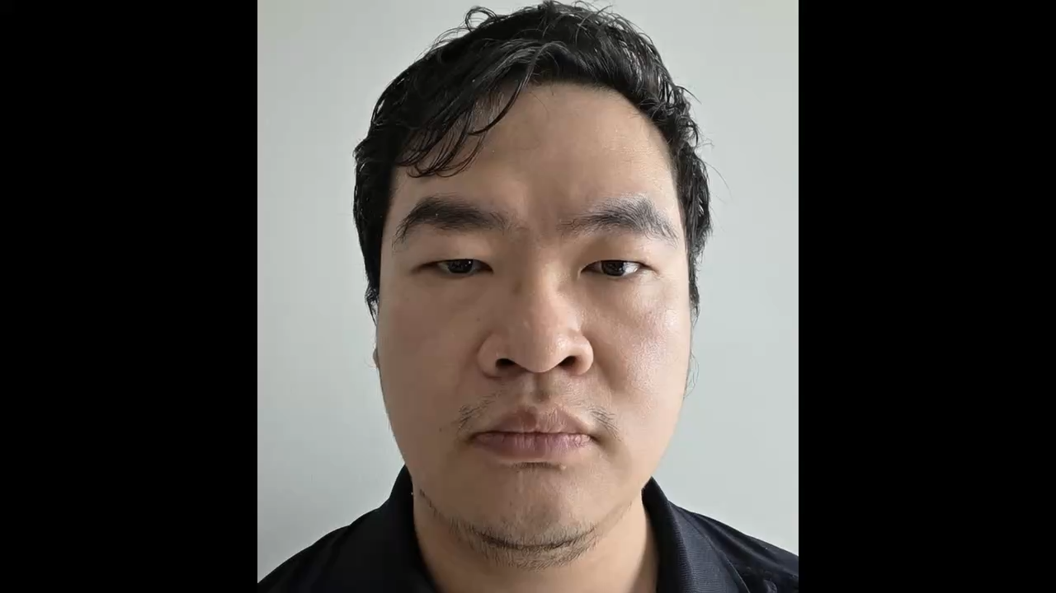
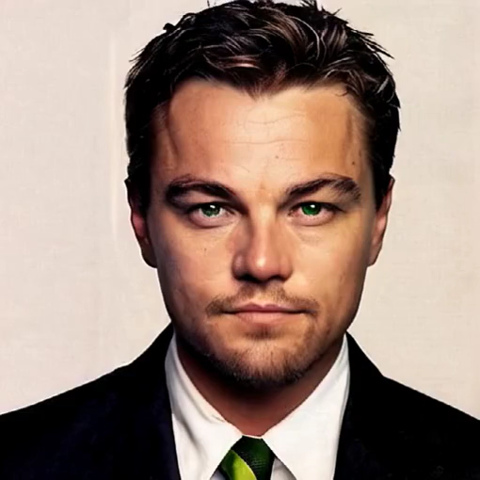
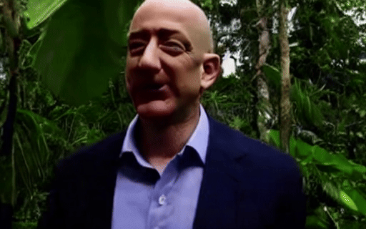
Video Deepfakes → Current Approaches
1. Lip-sync
Strengths: Fast to generate, with original scene and body remain [37].
Limitations: Emotion, head and body may not match. Side views, teeth and occlusion remain difficult.
Deepfake use: fabricated speech.
2. Talking portrait
Strengths: Speech and head motion from one portrait [38][40]
Limitations: Eyes, teeth and gaze can drift, long sequences remain difficult [38], [39], [40].
Deepfake use: Impersonation and live video-call misuse [40]
3. Embodied avatar
Strengths: Face and upper-body performance [41], [42]
Limitations: Requires more compute and data, Hands, occlusion and gesture coherence can fail [41], [42].
Deepfake use: fabricated events and scenarios audiovisual impersonation.
Some of the approaches could be executed as real-time streaming if enough computational resources are available.​
Notes:
[37] Z. Yan et al., "DF40: Toward Next-Generation Deepfake Detection," in Advances in Neural Information Processing Systems, Datasets and Benchmarks Track, vol. 37, 2024. [Online]. Available: https://proceedings.neurips.cc/paper_files/paper/2024/hash/34239f60eca7ce9bee5280aaf81362d8-Abstract-Datasets_and_Benchmarks_Track.html. [Accessed: Sep. 10, 2026].
[38] W. Zhang et al., "SadTalker: Learning Realistic 3D Motion Coefficients for Stylized Audio-Driven Single Image Talking Face Animation," in Proc. IEEE/CVF Conf. Computer Vision and Pattern Recognition (CVPR), 2023. [Online]. Available: https://openaccess.thecvf.com/content/CVPR2023/html/Zhang_SadTalker_Learning_Realistic_3D_Motion_Coefficients_for_Stylized_Audio-Driven_Single_CVPR_2023_paper.html. [Accessed: Sep. 10, 2026].
[39] X. Ji et al., "Sonic: Shifting Focus to Global Audio Perception in Portrait Animation," in Proc. IEEE/CVF Conf. Computer Vision and Pattern Recognition (CVPR), 2025. [Online]. Available: https://openaccess.thecvf.com/content/CVPR2025/html/Ji_Sonic_Shifting_Focus_to_Global_Audio_Perception_in_Portrait_Animation_CVPR_2025_paper.html. [Accessed: Sep. 10, 2026].
[40] D. Zhen et al., "Teller: Real-Time Streaming Audio-Driven Portrait Animation with Autoregressive Motion Generation," in Proc. IEEE/CVF Conf. Computer Vision and Pattern Recognition (CVPR), 2025. [Online]. Available: https://openaccess.thecvf.com/content/CVPR2025/html/Zhen_Teller_Real-Time_Streaming_Audio-Driven_Portrait_Animation_with_Autoregressive_Motion_Generation_CVPR_2025_paper.html. [Accessed: Sep. 10, 2026].
[41] E. Corona, A. Zanfir, E. G. Bazavan, N. Kolotouros, T. Alldieck, and C. Sminchisescu, "VLOGGER: Multimodal Diffusion for Embodied Avatar Synthesis," in Proc. IEEE/CVF Conf. Computer Vision and Pattern Recognition (CVPR), 2025. [Online]. Available: https://openaccess.thecvf.com/content/CVPR2025/html/Corona_VLOGGER_Multimodal_Diffusion_for_Embodied_Avatar_Synthesis_CVPR_2025_paper.html. [Accessed: Sep. 10, 2026].
[42] J. Guan et al., "AudCast: Audio-Driven Human Video Generation by Cascaded Diffusion Transformers," in Proc. IEEE/CVF Conf. Computer Vision and Pattern Recognition (CVPR), 2025. [Online]. Available: https://openaccess.thecvf.com/content/CVPR2025/html/Guan_AudCast_Audio-Driven_Human_Video_Generation_by_Cascaded_Diffusion_Transformers_CVPR_2025_paper.html. [Accessed: Sep. 10, 2026].

Slide 23
Recap Questions [Slido]
What are the most common types of image/voice/video deepfakes you have encountered? (options and free text)
What do you think we can do to stop the exacerbation of the situation? (Free text)
Slide Link:
Code:
What do you think is the main motivation of criminals creating and using deepfakes?
Sell beautiful, perfectly crafted art pieces for profit?
Earn reputation for their mastery with their material generation skill?
Find and execute the fastest and most efficient way to make profit?

Slide 24
Agenda
Introduction
A timeline of Deepfake
State-of-the-Art Deepfake Generation
State-of-the-Art Deepfake Defence
Our Research
Hands-on-session

Slide 25
State-of-the-art Deepfake Defence
Background
Defensive Source (Disruption)
Watermark, provenance and metadata (Authentication and later verification)
Detection (After Creation)
Awareness by potential victim(s)

Slide 26

Background: r-Selection and K-Selection
Many years ago, there was a popular hypothetical assumption in biology theory, the r/k selection[1]
  In this hypothesis, creatures have different selection approaches to reach their optimal population (i.e. most efficient path)
  This is same as many criminal’s approach, the most Efficient way to get the most profit
Low quality
high number
High quality
low number
Ant
Bee
Elephant
Rat
Bear
Human
However, Creatures are slow-evolving, but Deepfakes are different, they are evolving at a terrifying speed:
Fast Creation
Low-Skill Requirement
High Number
High Quality
Question: How are we going to deal with them?
[43] On r- and K-Selection https://www.journals.uchicago.edu/doi/10.1086/282697

Slide 27
Our Vision: An End-to-End Defensive Pathway
Please note that these four steps are the possible steps during the route, it is not an exhaustive list.
Knowledge
Train user about what criminal want and how they should protect them self.
Victim
User awareness
Detection
Detecting the whether the material is a deepfake material
Disrupting Distribution and Transfer
Watermark, provenance, metadata
Embedded into the material, Generated by tool
Embedding Provenance
Defensive Source
Increases the difficulty of generating deepfake with security enhanced source media
Enhancing the Source
Criminal

Slide 28
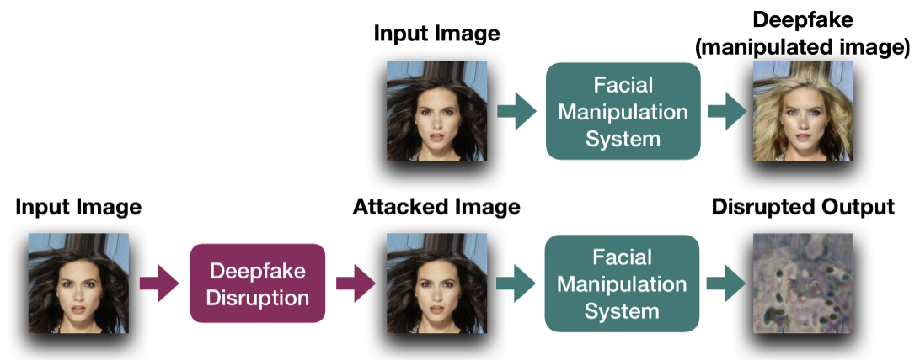
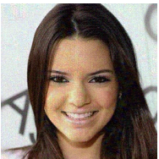
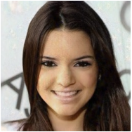
Defensive Source Enhancement
  2 current approaches to prevent the use of your photo to generate Deepfake images
Distorting Disruption
Make output Distorted [44]
Nullifying Disruption
Make output either fail, or close to the input [45]
Disrupt the output
Make AI Fail when it attempts to manipulate face
Limitations:
Depending on the technology used to create the deepfake, these preventative approaches could be bypassed by these workarounds:
Simple screen shot, AI-based purification, crop, recompression
Recompression, physical recapture
Sole reliance on these techniques is risky.
[44] N. Ruiz, S. A. Bargal, and S. Sclaroff, “Disrupting Deepfakes: Adversarial Attacks Against Conditional Image Translation Networks and Facial Manipulation Systems,” in Computer Vision – ECCV 2020 Workshops, vol. 12538, A. Bartoli and A. Fusiello, Eds., in Lecture Notes in Computer Science, vol. 12538. , Cham: Springer International Publishing, 2020, pp. 236–251. doi: 10.1007/978-3-030-66823-5_14.
[45] C.-Y. Yeh, H.-W. Chen, S.-L. Tsai, and S.-D. Wang, “Disrupting Image-Translation-Based DeepFake Algorithms with Adversarial Attacks,” in 2020 IEEE Winter Applications of Computer Vision Workshops (WACVW), Snowmass Village, CO, USA: IEEE, Mar. 2020, pp. 53–62. doi: 10.1109/WACVW50321.2020.9096939.
Notes:
[44] N. Ruiz, S. A. Bargal, and S. Sclaroff, “Disrupting Deepfakes: Adversarial Attacks Against Conditional Image Translation Networks and Facial Manipulation Systems,” in Computer Vision – ECCV 2020 Workshops, vol. 12538, A. Bartoli and A. Fusiello, Eds., in Lecture Notes in Computer Science, vol. 12538. , Cham: Springer International Publishing, 2020, pp. 236–251. doi: 10.1007/978-3-030-66823-5_14.
[45] C.-Y. Yeh, H.-W. Chen, S.-L. Tsai, and S.-D. Wang, “Disrupting Image-Translation-Based DeepFake Algorithms with Adversarial Attacks,” in 2020 IEEE Winter Applications of Computer Vision Workshops (WACVW), Snowmass Village, CO, USA: IEEE, Mar. 2020, pp. 53–62. doi: 10.1109/WACVW50321.2020.9096939.

Slide 29
Our Vision: An End-to-End Defensive Pathway
Please note that these four steps are the possible steps during the route, it is not an exhaustive list.
Knowledge
Train user about what criminal want and how they should protect them self.
Victim
User awareness
Detection
Detecting the whether the material is a deepfake material
Disrupting Distribution and Transfer
Watermark, provenance, metadata
Embedded into the material, Generated by tool
Embedding Provenance
Defensive Source
Increases the difficulty of generating deepfake with security enhanced source media
Enhancing the Source
Criminal

Slide 30
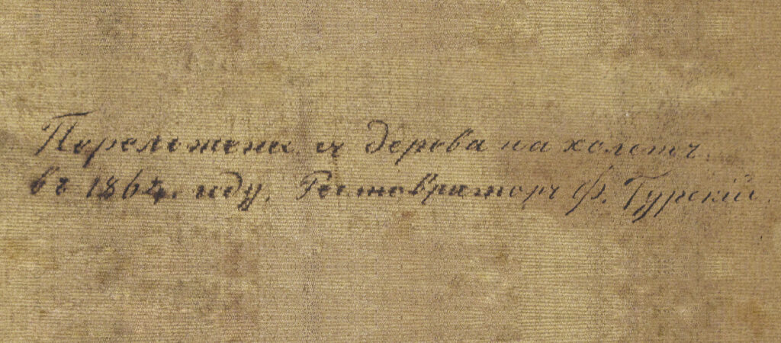
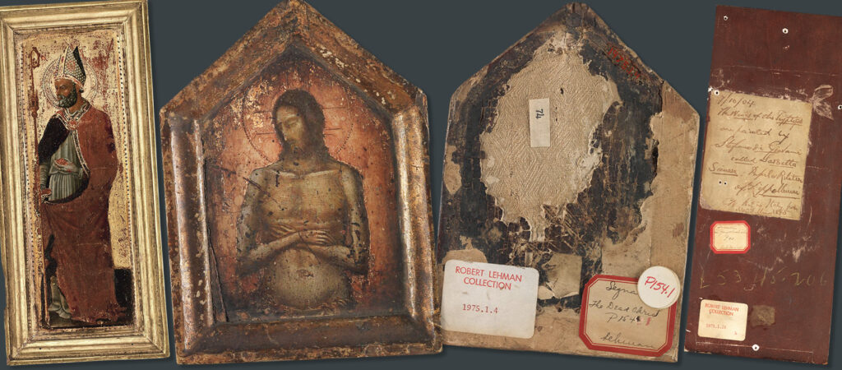
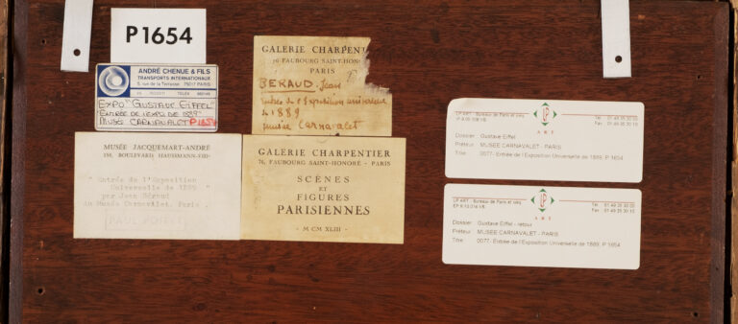
Authenticity Proof ➔ Provenance
Provenance (the origins and derivation history of data) has become more popular as a deepfake defence technique.
Here are some original usage examples of Provenance:
Handwritten note on the back of a canvas from 19th century restorer, recording transferred the paint from panel to canvas in 1864.
Two 14th century oil paintings on panel from the front (recto) and behind (verso) – the labels on the reverse list their historic cataloguing notes and museum references
An example of the various labels on the back of a painting. These labels may collect over time in sales, exhibitions and museum care.
However, these can also be faked. ☹
[46] https://fineart-restoration.co.uk/news/preserving-provenance-oil-painting-labels-notes-and-stamps/

Slide 31
Authenticity Proof via Digital Data Provenance
Digital data provenance can also be used.
Ordinary Metadata
  Like physical counterparts, unsigned EXIF and XMP can be easily tampered
Provenance
  Provenance for media file designed to contains the history(lineage).
  however, how to ensures the trustworthy of provenance is challenge
Media File.jpeg
Digital content raw data
pixels, audio or video
Metadata
Ordinary metadata with extra information
Watermark or fingerprint
  C2PA [12]
  Recently, the consortium C2PA standardised how contents provenance claims are recorded, signed and verified
[12] https://c2pa.org/c2pa-releases-specification-of-worlds-first-industry-standard-for-content-provenance/

Slide 32
Authenticity Proof: C2PA
C2PA MANIFEST
C2PA
Coalition for Content Provenance and Authenticity (C2PA)[12][47] is an open technical standard for:
Recording and verifying the provenance of digital media
defines a standard for attaching cryptographically verifiable provenance to digital media
Claim Signature
Digital signature over the claim
Claim
Hashed reference the assertions and content binding
Assertion Store
Declared statements about the asset
Hard binding
Actions and ingredients
Metadata
AI disclosure
Soft binding
And more…
Watermarks or fingerprints can act as soft bindings(cf. Clause 2.3.13 in the standard), which help locate an external C2PA Manifest and reconnect media with externally stored content credentials (e.g. C2PA manifest or provenance)
Note: Validation checks the signature and content binding, it does not establish the semantic truth of the media
[12] https://c2pa.org/c2pa-releases-specification-of-worlds-first-industry-standard-for-content-provenance/
[47] Coalition for Content Provenance and Authenticity, ‘Content Credentials: C2PA Technical Specification,’ ver. 2.4, Apr. 2026. [Online]. Available: https://spec.c2pa.org/specifications/specifications/2.4/specs/C2PA_Specification.html

Slide 33
Authenticity Proof via Digital Data Provenance
C2PA MANIFEST
Media File.jpeg
Claim Signature
Digital signature over the claim
Claim
Hashed reference the assertions and content binding
Digital content raw data
pixels, audio or video
Assertion Store
Declared statements about the asset
Metadata
Ordinary metadata with extra information
Hard binding
Actions and ingredients
Metadata
AI disclosure
Watermark or fingerprint
Soft binding
And more…
Validation can be establishing a tamper-evident association with the asset
However, it does not proof the semantic truth of the media, nor tamper proof.
[47] Coalition for Content Provenance and Authenticity, ‘Content Credentials: C2PA Technical Specification,’ ver. 2.4, Apr. 2026. [Online]. Available: https://spec.c2pa.org/specifications/specifications/2.4/specs/C2PA_Specification.html

Slide 34
Authenticity Proof ➔ JPEG Trust
Existing standards are also enhanced to reflect modern provenance challenges (i.e. JPEG Trust standard: ISO/IEC 21617-1:2026 → establishing trust in media[48][49])
  This is gradually becoming an international standard.
Core Foundation (cf. Part1 of the JPEG Trust)
Secure annotations for provenance, integrity, attribution, rights and privacy.
Law-enforcement use
Organisations and governing institutions can define context-specific Trust Profiles and generate Trust Reports,
Preserve original + annotations; verify signer/integrity; record the profile; corroborate.
Similar to the C2PA standard, missing provenance does not necessarily means/proves a fake, but a much less trustworthy content.
Current: Progress of JPEG Trust [50]:
Core ➔ Published
Profile ➔ DIS (Draft International Standard, i.e. final stage)
Media asset watermarking ➔ DIS
Reference software ➔ DIS
[48] ISO, ISO/IEC 21617-1:2026, Information technology—JPEG Trust—Part 1: Core foundation, 2nd ed., Aug. 2026. [Online]. Available: https://www.iso.org/standard/91405.html
[49] Joint Photographic Experts Group, ‘Overview of JPEG Trust,’ ISO/IEC JTC 1/SC 29/WG 1, 2026. [Online]. Available: https://jpeg.org/jpegtrust/index.html
[50] Joint Photographic Experts Group, ‘111th Meeting—Online—JPEG DNA reaches Draft International Standard stage at the 111th JPEG meeting,’ Jun. 8, 2026. [Online]. Available: https://jpeg.org/items/20260608_press.html

Slide 35
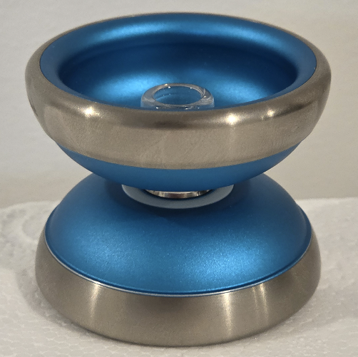
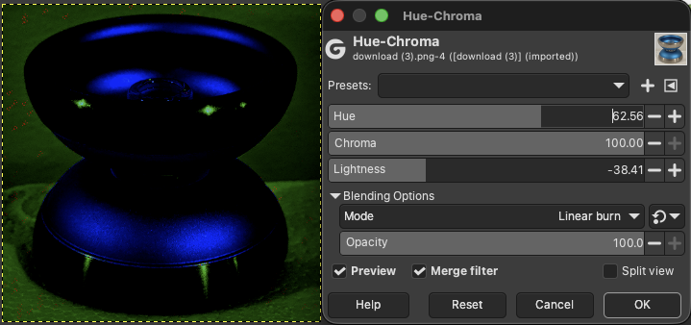
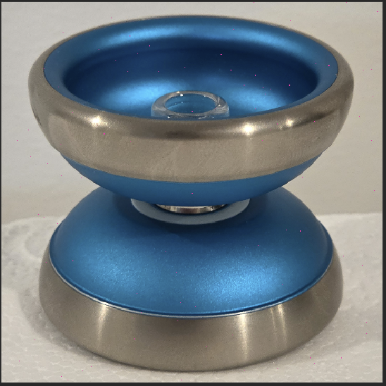
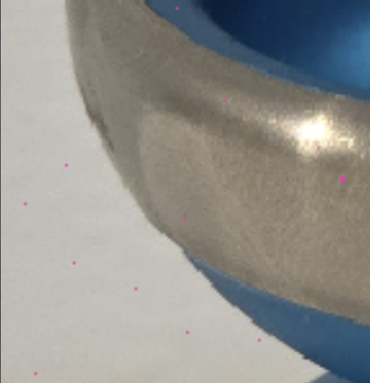
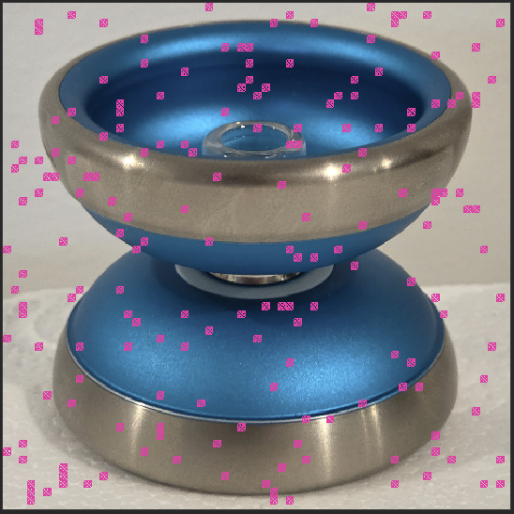
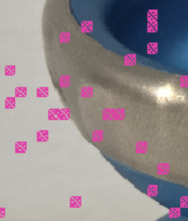
Authenticity Proof ➔ Watermarking Methods
Bit string (Payload)
Some watermarks can become visible through specific image-processing techniques
We will try this later in the hands-on session.
A sequence of binary values that encodes an identifier or other information.
A zero-bit watermark supports detection of its presence without carrying a separately decoded message.
Spatial-domain signal
Frequency-domain signal
The watermark is represented through small changes to pixels or spatial feature positions
The position of the bit varies depending on the generation method, such as secret key or special algorithms.
The watermark is represented by modifying selected coefficients after transforming the image into a frequency domain
Different frequency affect the quality of the image and the robustness of the watermark
Either way, the watermarks are usually not visible to human eyes unless with specialised tools, advance treatments, or intentionally created visible marks
Notes:
Note that spatial approaches are generally easier to break than Frequency approaches, but in real life, it largely depends on the actual implementation
https://github.com/facebookresearch/ssl_watermarking#watermarking
https://github.com/ShieldMnt/invisible-watermark#supported-algorithms

Slide 36
Our Vision: An End-to-End Defensive Pathway
Please note that these four steps are the possible steps during the route, it is not an exhaustive list.
Knowledge
Train user about what criminal want and how they should protect them self.
Victim
User awareness
Detection
Detecting the whether the material is a deepfake material
Disrupting Distribution and Transfer
Watermark, provenance, metadata
Embedded into the material, Generated by tool
Embedding Provenance
Defensive Source
Increases the difficulty of generating deepfake with security enhanced source media
Enhancing the Source
Criminal

Slide 37
Common Types of Detection Techniques
Technique | Explanation | Example
Spatial artifacts analysis
Looks for visual inconsistencies within a single image or frame.
Skin texture suddenly changes around a manipulated region.
Physical characteristics
Checks whether anatomy, lighting and natural physical behaviour make sense.
Perfect Lighting or wrong scene lighting
Physically impossible movement
Frequency and noise analysis
Examines hidden pixel patterns that cameras and generators leave behind.
lacks the camera-sensor noise (too perfect)
Processing traces
Looks for patterns left by operations such as blending or editing
A face-swap process leaves a faint blending boundary
Temporal consistency
Checks whether appearance and movement remain stable between video frames.
Detail appears and disappears across adjacent frames.
Audio-visual consistency
Checks whether what we see agrees with what we hear.
The lip movements do not match the timing or sounds of the speech(desynced)
Depends on the different generators, the detection techniques can be vary
  Unfortunately, there is no all-in-one detection technique exist.

Slide 38
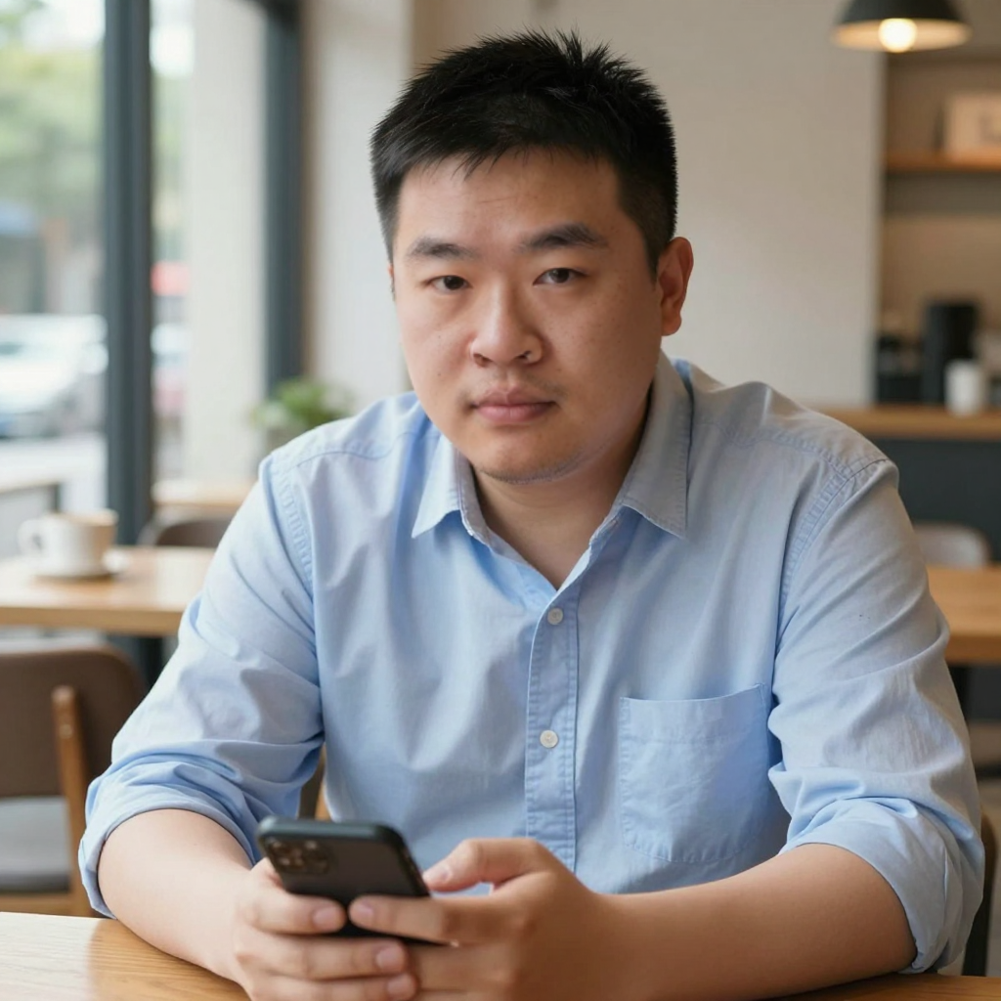
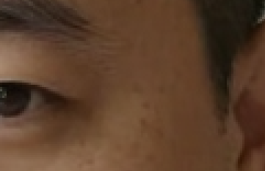
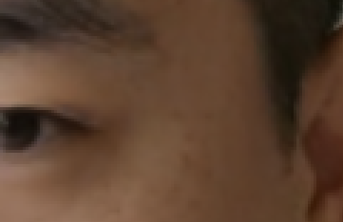
Detection ➔ Common Types of Detections
Technique | Explanation | Example
Spatial artifacts analysis
Looks for visual inconsistencies within a single image or frame.
Skin texture suddenly changes around a manipulated region.
Synthetic base image + Face swap with real photo
Generated Face
Swapped with real face
Possible signs of face swapping
Zoom into the hairline, eyes and face boundary. Look for sudden changes in skin texture, in consistent skin colour, blurred facial details and unnatural blending with the surrounding hair or ears.
We will try this later in the hands-on session.
Notes:
[63] S. Baliah, Q. Lin, S. Liao, X. Liang, and M. H. Khan, “Realistic and Efficient Face Swapping: A Unified Approach with Diffusion Models”.
[64] Z. Wang, J. Bao, W. Zhou, W. Wang, and H. Li, “AltFreezing for More General Video Face Forgery Detection,” in 2023 IEEE/CVF Conference on Computer Vision and Pattern Recognition (CVPR), Vancouver, BC, Canada: IEEE, Jun. 2023, pp. 4129–4138. doi: 10.1109/CVPR52729.2023.00402.
[65]https://csrc.nist.gov/pubs/sp/800/63/a/4/final

Slide 39
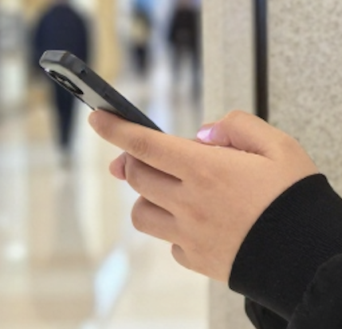
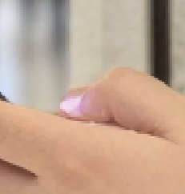
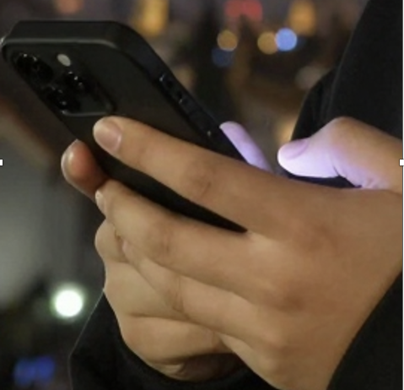
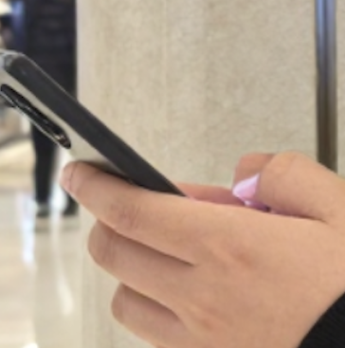
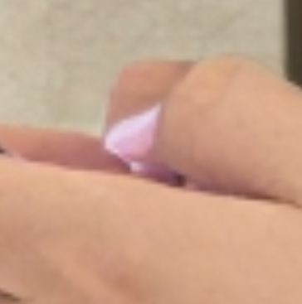
Detection ➔ Common Types of Detections
Technique | Explanation | Example
Physical characteristics
Checks whether anatomy, lighting and natural physical behaviour make sense.
Perfect Lighting or wrong scene lighting
Physically impossible movement
Correct Lighting Interpretation by AI
Incorrected lighting from the phone
The mixture of indoor and phone screen light affected the correct lighting generation
Requested to have deeper depth of field
Mis-interpreted lighting
The request from a deeper depth of field causes the AI model to misinterpret the lighting as nail polish
We will try this later in the hands-on session.

Slide 40
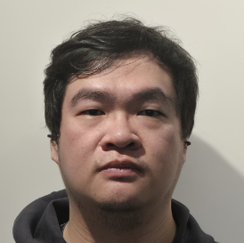
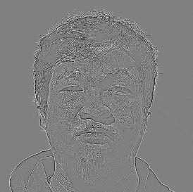
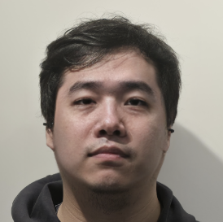
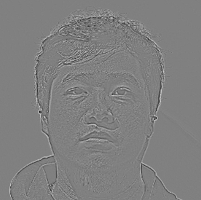
Detection ➔ Common Types of Detections
Technique | Explanation | Example
Frequency and noise analysis
Examines hidden pixel patterns that cameras and generators leave behind.
Noise and processing inconsistencies
Weak fine texture
Authentic
Face-Swapped (z-image generated people)
Apply the same high-pass filter to both images. The swapped face has weaker fine texture. In come cases, processes such as smoothing or compression can also cause this.
Face swapping and editing can introduce Inconsistencies of noise and processing pattern.
We will try this later in the hands-on session.
Notes:
To create this:
Convert the image to weighted greyscale.
Gaussian-blur it using sigma 1 pixel, a 9×9 kernel, and reflected boundaries.
Subtract the blurred image from the greyscale image: high-pass = image − blurred image.
Amplify that residual 16×, placing zero at middle grey (128), so fine detail becomes visible.

Slide 41
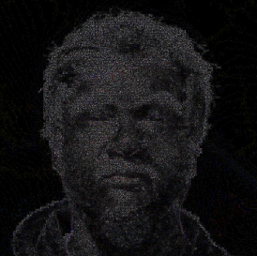
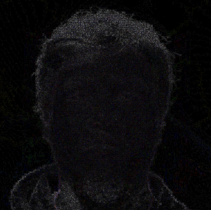
Detection ➔ Common Types of Detections
Technique | Explanation | Example
Processing traces
Looks for patterns left by operations such as blending or editing
A face-swap process leaves a faint blending boundary
Authentic
Face-Swapped (z-image generated fiction people)
Compare two portrait recompression-difference view (Error Level Analysis).
Right hand side ELA appear darker than the corresponding region, which could be a sign of face swap, as it they change less during recompression
Face swapping and editing can leave local differences in texture and compression response.
We will try this later in the hands-on session.
Notes:
Error Level Analysis (ELA)

Slide 42

Detection ➔ Common Types of Detections
Technique | Explanation | Example
Temporal consistency
Checks whether appearance and movement remain stable between video frames.
Detail appears and disappears across adjacent frames.
Real photo with synthetic movement
Follow the circled hair as the hand passes across it.
Look for an abrupt change in shape or texture between nearby frames, rather than ordinary movement of the hair.
Replay the final part of the clip to check whether the change persists.
We will try this later in the hands-on session.
Notes:
[64] Z. Wang, J. Bao, W. Zhou, W. Wang, and H. Li, “AltFreezing for More General Video Face Forgery Detection,” in 2023 IEEE/CVF Conference on Computer Vision and Pattern Recognition (CVPR), Vancouver, BC, Canada: IEEE, Jun. 2023, pp. 4129–4138. doi: 10.1109/CVPR52729.2023.00402.

Slide 43

Detection ➔ Common Types of Detections
Technique | Explanation | Example
Audio-visual consistency
Checks whether what we see agrees with what we hear.
The lip movements do not match the timing or sounds of the speech(desynced)
Real photo, real audio clip, lip-sync and head matching
There might be syncing issues between the video and audio, which sometimes result in unnatural movement.
(NB: wait for the end)
We will try this later in the hands-on session.
Notes:
https://lipsync.video/
real audio, real photo, synthetic video
[66] D. Temoshok et al., Digital Identity Guidelines: Identity Proofing and Enrollment, NIST SP 800-63A-4, Jul. 2025, sec. 3.14. [Online]. Available: https://csrc.nist.gov/pubs/sp/800/63/a/4/final
NIST discusses manipulated-media indicators in remote identity proofing. These are warning signs, not a stand-alone authenticity decision.

Slide 44
Our Vision: An End-to-End Defensive Pathway
Please note that these four steps are the possible steps during the route, it is not an exhaustive list.
Knowledge
Train user about what criminal want and how they should protect them self.
Victim
User awareness
Detection
Detecting the whether the material is a deepfake material
Disrupting Distribution and Transfer
Watermark, provenance, metadata
Embedded into the material, Generated by tool
Embedding Provenance
Defensive Source
Increases the difficulty of generating deepfake with security enhanced source media
Enhancing the Source
Criminal

Slide 45
Detection ➔ Raise Public Awareness
Victim
Besides from the technical aspects, how can we raise the public awareness? E.g.
How to make people, especially older/non-tech-savvy people, understand there is a technology can do this?
How to develop an easier way (a protocol) to let them distinguish some simple deepfake tricks?
  Especially for the “cast a wide net” style
Critical Thinking is required.
Key knowledge potential victims need to ask:
What material does the criminal want you to see or believe?
What story is the criminal trying to tell?
What actions does the criminal want you to take?
Criminal

Slide 46
Agenda
Introduction
A timeline of Deepfake
State-of-the-Art Deepfake Generation
State-of-the-Art Deepfake Defence
Our Research
Hands-on-session

Slide 47
Dr Hetong Jiang:
Our Current Research and Future Work
Our Vision
Our Research

Slide 48
Our Vision: An End-to-End Defensive Pathway
Knowledge
Train user about what criminal want and how they should protect them self.
Victim
User awareness
Detection
Detecting the whether the material is a deepfake material
Disrupting Distribution and Transfer
Research on an efficient and effective way to transfer detection technique to many potential victim from simple “cast a wide-net” style deepfake
Invent a way that can effectively do end-to-end track without breaching privacy
Watermark, provenance, metadata
Embedded into the material, Generated by tool
Embedding Provenance
Defensive Source
Increases the difficulty of generating deepfake with security enhanced source media
Unite cloud providers (e.g., if you put certain software on some cloud server, it will identify the server as C2) (JPEG Trust)
Enhancing the Source
Unite different companies to develop a standard (e.g. having a sector-wide agreement)
Criminal

Slide 49
Defence ➔ Example: Apple Reference Image
Victim
User can checks signature and revocation status. Then visually compare reference with main photo.
User awareness
Disrupting Distribution and Transfer
Apple Reference Image does not disrupt distribution and transfer
Embedding Provenance
Signed sensor data that Private Cloud Compute develops into an unalterable reference image.
Enhancing the Source
Sensor signs pixels and its metadata.
[51] Apple Security Engineering and Architecture and Camera & Photos, “Apple Reference Image: A New Approach for Verified Photography,” Sep. 15, 2026. [Online]. Available: https://security.apple.com/blog/apple-reference-image
[52] Apple, “Apple debuts iPhone 18 Pro and iPhone 18 Pro Max,” Sep. 9, 2026. [Online]. Available: https://www.apple.com/newsroom/2026/09/apple-debuts-iphone-18-pro-and-iphone-18-pro-max/
Criminal

Slide 50
Our Research
Current Research Project
Potential Research Project
Collaboration

Slide 51
Our Research ➔ Objectives
1. Improve the detection accuracy
2. Save law enforcement investigation time
3. Improve the admissibility of the evidence in courts
4. Cost-effective innovation with minimum technical skill required

Slide 52
OS Provenance ➔ What we can provide
Current Research Project
Understand the computer from inside ➔ Behaviour of application (like an x-ray scan)
Operating System Provenance
Provenance beyond general security application ➔ AI Security
AI Telemetry
Behaviour of AI ➔ Transparent AI Provenance
And more opportunities… …

Slide 53








OS Provenance ➔ how does it work
Application Level
vim, emacs, nano, nmap, msfconsole
Execute program
Sensitive file access
Other malicious behaviors
Shell Level
bash, zsh, pwsh
OS Provenance System
Note: This is also possible for Windows and Mac OS environments.
Kernel Level
Linux Kernel
Hardware Level
CPU, RAM, Hard Drive

Slide 54
OS Provenance
Fast Generating Operations
Current Problem 1:
Runtime Overhead
Current Problem 2
Volume of data
Our solution:
Negligible Runtime Overhead
Our solution:
AI Based Provenance Processing
Our Solution: OS Provenance System
Our approach is horizontally scalable

Slide 55
AI Telemetry
Computer
GPU
CPU
RAM
AI Telemetry
AI Model Weight
Hard Drive
???
OS Provenance
OS Provenance System

Slide 56
AI Telemetry
Computer
Computer
GPU
CPU
AI Telemetry
RAM
AI Model Weight
Hard Drive
???
OS Provenance
OS Provenance System

Slide 57
Current Research Project
Potential Research Project
Collaboration

Slide 58
Potential Research Projects
Combined Provenance System
OS Provenance
AI Telemetry
AI Tool Behaviour Analysis
AI Workflow Behaviour Analysis
Multiple AI Tools
Arbitrary AI Tool
Analyser
Analyser
AI Tool Workflow Behaviour Provenance
AI Tool Behaviour Provenance

Slide 59
Current Research Project
Potential Research Project
Collaboration

Slide 60
Collaboration
Potential Deepfake Material
Calibrated: Calibration uses labelled real and fake examples to adjust how a detector’s scores translate into probabilities
Uncalibrated Deepfake Detector
Calibrated Deepfake Detector
Real up-to-date Deepfake Dataset
Result (30% Confidence level)
Result (85% Confidence level)

Slide 61
Collaboration
Calibrated Deepfake Detector
Deepfake Professionals
Up-to-data Research
Real up-to-date Deepfake Dataset
Collaboration
Improve detection accuracy of the investigation
Transparent Tool Evaluation
Shorten investigation time
And More … …

Slide 62
Agenda
Introduction
A timeline of Deepfake
State-of-the-Art Deepfake Generation
State-of-the-Art Deepfake Defence
Our Research
Hands-on-session

Slide 63
Hands-on Session
Top scorer wins a prize!

Slide 64
Hands-on Session
Access one of these URLs:
- https://uqdflab.uqcloud.net
Passcode:
interpol2026
(All Lower Case)
The hands–on session consist of 10 quizzes
Please check your handout for instructions
You will have a hands-on experience in figuring out the authenticity of each piece of media
Please check the handout for detailed instructions
Prize: Please key in your nickname when you start the hands-on session.
The top scoring nickname wins a prize!
Score ordered by score, then submission time

Slide 65
Summary ➔ State-of-the-art
Is there anyway to attribute the creator of the deepfake?
  Until today, NO, and unlikely to have in the near future
Are there tools to detect whether an image is generated by deepfake?
  For specifically type of deepfake with professionals ➔ partially yes
  A single tool to detect everything ➔ No
Is there anyway to reduce the risk being impacted by the deepfake? ➔ Yes
  Transfer the knowledge of detecting simple deepfake materials to the potential victims
Can we unifying different companies and agencies to create a robust protocol for authenticity?
  This includes the tools from creation to the end consumer, can be extremely difficult
  Thus, to the best of our knowledge, the answer is NO, at least in the near future
  But some organisations are starting to do it (JPEG Trust, Apple)

Slide 66
Acknowledgements
We thank the INTERPOL for their kind invitation and arrangements:
  Dr Toshinobu Yasuhira
  Maggie Man
  Libni Garg
  Project SynthWave, Project SynthWave PLUS, and the Government of Japan
  We thank the funders of our research:
    Singapore’s HTX (Home Team Science and Technology Agency)
    Australia’s ONI (Office of National Intelligence)
  We thank our colleagues at the UQ Cyber Research Centre:
    Dr Taejun Choi
    Dr Shunyao Wang

Slide 67
Reference
[1] https://www.secretservice.gov/investigations/digitalassets
[2] https://decaturcoinandjewelry.com/product/1864-50-ct-66-confederate-civil-war-counterfeit-banknote-hoard-pmg-au-pc861/
[4] https://www.abf.gov.au/newsroom-subsite/Pages/Counterfeit-crackdown-%242-million-in-%E2%80%98cash%E2%80%99-that-didn%E2%80%99t-make-cents.aspx#
[5] https://realauthentication.com/real-or-fake-the-gucci-marmont-flap-bag/
[6] https://www.watchfinder.com/articles/feature-the-most-accurate-fake-luxury-watches-in-the-world
[7] https://github.com/NVlabs/ffhq-dataset (22938)
[8]https://github.com/facefusion/facefusion
[9]https://github.com/TencentARC/PhotoMaker
[10] C. Bregler, M. Covell, and M. Slaney, “Video Rewrite: Driving visual speech with audio,” in Proc. ACM SIGGRAPH, 1997, pp. 353–360, doi: 10.1145/258734.258880.
[11] https://journals.law.harvard.edu/jsel/2021/03/mission-impossible-the-legal-implications-of-managing-deepfake-celebrity-videos/
[12] https://c2pa.org/c2pa-releases-specification-of-worlds-first-industry-standard-for-content-provenance/
[13] https://arxiv.org/abs/2112.10752
[14] https://www.counterfraud.gov.au/case-studies/company-worker-hong-kong-pays-out-ps20m-deepfake-video-call-scam
[15] https://spec.c2pa.org/specifications/specifications/2.4/specs/C2PA_Specification.html
[16] https://digital-strategy.ec.europa.eu/en/faqs/transparency-obligations-under-article-50-ai-act
[17] https://www.iso.org/standard/91405.html
[18]https://www.bcps.org/system/b_c_p_s_news/2023-2024_staff_and_community_messages/april_24__2024_staff_and_community_update__message_from_superintendent_dr__myriam_rogers_regarding_pikesville_high_school_investigation
[19] https://apnews.com/article/ai-artificial-intelligence-principal-audio-maryland-baltimore-county-pikesville-853ed171369bcbb888eb54f55195cb9c
[20] https://apnews.com/article/racist-ai-recording-maryland-high-school-487ea673b0449077cb23e7970546cb9f
[21] https://www.theguardian.com/us-news/2024/feb/26/steve-kramer-admits-he-commissioned-robocall-ai-biden-new-hampshire
[22] https://docs.fcc.gov/public/attachments/FCC-24-104A1.pdf
[23] https://www.esafety.gov.au/newsroom/blogs/deepfake-damage-in-schools-how-ai-generated-abuse-is-disrupting-students-families-and-school-communities
[24] G. Murphy, D. Ching, E. Meehan, J. Twomey, A. Bolger, and C. Linehan, “An average Joe, a laptop, and a dream: Assessing the potency of homemade political deepfakes,” Applied Cognitive Psychology, vol. 39, no. 2, Art. no. e70061, 2025, doi: 10.1002/acp.70061.
[25] W. Hawkins, B. Mittelstadt, and C. Russell, “Deepfakes on demand: The rise of accessible non-consensual deepfake image generators,” in Proc. 2025 ACM Conf. Fairness, Accountability, and Transparency (FAccT ’25), Athens, Greece, 2025, pp. 1561–1573, doi: 10.1145/3715275.3732107.
[26] https://github.com/jixiaozhong/Sonic
[27] eSafety Commissioner, "Deepfake trends and challenges: PoDeepfakesition statement," Australian Government, updated Aug. 4, 2026. [Online]. Available: https://www.esafety.gov.au/industry/tech-trends-and-challenges/deepfakes

Slide 68
Reference
[28] Australian Government, Criminal Code Amendment (Sexual Material) Act 2024, No. 78, 2024. [Online]. Available: https://www.legislation.gov.au/C2024A00078/asmade/2024-09-02/text/original/epub/OEBPS/document_1/document_1.html
[29] Australian Competition and Consumer Commission, "Impersonation scams," Scamwatch, 2023. [Online]. Available: https://www.scamwatch.gov.au/sites/www.scamwatch.gov.au/files/2023-10/Scams%20Awareness%20Week%202023_Key%20messages%20on%20impersonation%20scams.pdf
[30] U.S. Federal Trade Commission, "Scammers use fake emergencies to steal your money." [Online]. Available: https://consumer.ftc.gov/articles/scammers-use-fake-emergencies-steal-your-money
[31] https://consumer.ftc.gov/articles/scammers-use-fake-emergencies-steal-your-money
[32] https://www.scamwatch.gov.au/stop-check-protect/help-to-spot-and-avoid-scams/how-scammers-use-technology-and-ai
[33] https://www.cyber.gov.au/sites/default/files/2024-11/asd-cyber-threat-report-2024.pdf
[34] P. Peng, P.-Y. Huang, S.-W. Li, A. Mohamed, and D. Harwath, “VoiceCraft: Zero-Shot Speech Editing and Text-to-Speech in the Wild,” in Proceedings of the 62nd Annual Meeting of the Association for Computational Linguistics (Volume 1: Long Papers), Bangkok, Thailand: Association for Computational Linguistics, 2024, pp. 12442–12462. doi: 10.18653/v1/2024.acl-long.673.
[35] Y. A. Li, C. Han, V. S. Raghavan, G. Mischler, and N. Mesgarani, “StyleTTS 2: Towards Human-Level Text-to-Speech through Style Diffusion and Adversarial Training with Large Speech Language Models”.
[36] W. Zhao, Y. Rao, W. Shi, Z. Liu, J. Zhou, and J. Lu, “DiffSwap: High-Fidelity and Controllable Face Swapping via 3D-Aware Masked Diffusion,” in 2023 IEEE/CVF Conference on Computer Vision and Pattern Recognition (CVPR), Vancouver, BC, Canada: IEEE, Jun. 2023, pp. 8568–8577. doi: 10.1109/CVPR52729.2023.00828
[37] Z. Yan et al., "DF40: Toward Next-Generation Deepfake Detection," in Advances in Neural Information Processing Systems, Datasets and Benchmarks Track, vol. 37, 2024. [Online]. Available: https://proceedings.neurips.cc/paper_files/paper/2024/hash/34239f60eca7ce9bee5280aaf81362d8-Abstract-Datasets_and_Benchmarks_Track.html. [Accessed: Sep. 10, 2026].
[38] W. Zhang et al., "SadTalker: Learning Realistic 3D Motion Coefficients for Stylized Audio-Driven Single Image Talking Face Animation," in Proc. IEEE/CVF Conf. Computer Vision and Pattern Recognition (CVPR), 2023. [Online]. Available: https://openaccess.thecvf.com/content/CVPR2023/html/Zhang_SadTalker_Learning_Realistic_3D_Motion_Coefficients_for_Stylized_Audio-Driven_Single_CVPR_2023_paper.html. [Accessed: Sep. 10, 2026].
[39] X. Ji et al., "Sonic: Shifting Focus to Global Audio Perception in Portrait Animation," in Proc. IEEE/CVF Conf. Computer Vision and Pattern Recognition (CVPR), 2025. [Online]. Available: https://openaccess.thecvf.com/content/CVPR2025/html/Ji_Sonic_Shifting_Focus_to_Global_Audio_Perception_in_Portrait_Animation_CVPR_2025_paper.html. [Accessed: Sep. 10, 2026].
[40] D. Zhen et al., "Teller: Real-Time Streaming Audio-Driven Portrait Animation with Autoregressive Motion Generation," in Proc. IEEE/CVF Conf. Computer Vision and Pattern Recognition (CVPR), 2025. [Online]. Available: https://openaccess.thecvf.com/content/CVPR2025/html/Zhen_Teller_Real-Time_Streaming_Audio-Driven_Portrait_Animation_with_Autoregressive_Motion_Generation_CVPR_2025_paper.html. [Accessed: Sep. 10, 2026].
[41] E. Corona, A. Zanfir, E. G. Bazavan, N. Kolotouros, T. Alldieck, and C. Sminchisescu, "VLOGGER: Multimodal Diffusion for Embodied Avatar Synthesis," in Proc. IEEE/CVF Conf. Computer Vision and Pattern Recognition (CVPR), 2025. [Online]. Available: https://openaccess.thecvf.com/content/CVPR2025/html/Corona_VLOGGER_Multimodal_Diffusion_for_Embodied_Avatar_Synthesis_CVPR_2025_paper.html. [Accessed: Sep. 10, 2026].
[42] J. Guan et al., "AudCast: Audio-Driven Human Video Generation by Cascaded Diffusion Transformers," in Proc. IEEE/CVF Conf. Computer Vision and Pattern Recognition (CVPR), 2025. [Online]. Available: https://openaccess.thecvf.com/content/CVPR2025/html/Guan_AudCast_Audio-Driven_Human_Video_Generation_by_Cascaded_Diffusion_Transformers_CVPR_2025_paper.html. [Accessed: Sep. 10, 2026].
[43] On r- and K-Selection https://www.journals.uchicago.edu/doi/10.1086/282697
[44] N. Ruiz, S. A. Bargal, and S. Sclaroff, “Disrupting Deepfakes: Adversarial Attacks Against Conditional Image Translation Networks and Facial Manipulation Systems,” in Computer Vision – ECCV 2020 Workshops, vol. 12538, A. Bartoli and A. Fusiello, Eds., in Lecture Notes in Computer Science, vol. 12538. , Cham: Springer International Publishing, 2020, pp. 236–251. doi: 10.1007/978-3-030-66823-5_14.
[45] C.-Y. Yeh, H.-W. Chen, S.-L. Tsai, and S.-D. Wang, “Disrupting Image-Translation-Based DeepFake Algorithms with Adversarial Attacks,” in 2020 IEEE Winter Applications of Computer Vision Workshops (WACVW), Snowmass Village, CO, USA: IEEE, Mar. 2020, pp. 53–62. doi: 10.1109/WACVW50321.2020.9096939.
[46] https://fineart-restoration.co.uk/news/preserving-provenance-oil-painting-labels-notes-and-stamps/
[47] Coalition for Content Provenance and Authenticity, ‘Content Credentials: C2PA Technical Specification,’ ver. 2.4, Apr. 2026. [Online]. Available: https://spec.c2pa.org/specifications/specifications/2.4/specs/C2PA_Specification.html
[48] ISO, ISO/IEC 21617-1:2026, Information technology—JPEG Trust—Part 1: Core foundation, 2nd ed., Aug. 2026. [Online]. Available: https://www.iso.org/standard/91405.html
[49] Joint Photographic Experts Group, ‘Overview of JPEG Trust,’ ISO/IEC JTC 1/SC 29/WG 1, 2026. [Online]. Available: https://jpeg.org/jpegtrust/index.html
[50] Joint Photographic Experts Group, ‘111th Meeting—Online—JPEG DNA reaches Draft International Standard stage at the 111th JPEG meeting,’ Jun. 8, 2026. [Online]. Available: https://jpeg.org/items/20260608_press.html
[51] Apple Security Engineering and Architecture and Camera & Photos, “Apple Reference Image: A New Approach for Verified Photography,” Sep. 15, 2026. [Online]. Available: https://security.apple.com/blog/apple-reference-image
[52] Apple, “Apple debuts iPhone 18 Pro and iPhone 18 Pro Max,” Sep. 9, 2026. [Online]. Available: https://www.apple.com/newsroom/2026/09/apple-debuts-iphone-18-pro-and-iphone-18-pro-max/

Slide 69
Reference
[53] W. Zhao, Y. Rao, W. Shi, Z. Liu, J. Zhou, and J. Lu, “DiffSwap: High-Fidelity and Controllable Face Swapping via 3D-Aware Masked Diffusion,” in 2023 IEEE/CVF Conference on Computer Vision and Pattern Recognition (CVPR), Vancouver, BC, Canada: IEEE, Jun. 2023, pp. 8568–8577. doi: 10.1109/CVPR52729.2023.00828.
[54] Y. Ma et al., “StyleTalk: One-Shot Talking Head Generation with Controllable Speaking Styles,” AAAI, vol. 37, no. 2, pp. 1896–1904, Jun. 2023, doi: 10.1609/aaai.v37i2.25280.
[55] W. Zhang et al., “SadTalker: Learning Realistic 3D Motion Coefficients for Stylized Audio-Driven Single Image Talking Face Animation,” Mar. 13, 2023, arXiv: arXiv:2211.12194. doi: 10.48550/arXiv.2211.12194.
[56] E. Corona, A. Zanfir, E. G. Bazavan, N. Kolotouros, T. Alldieck, and C. Sminchisescu, “VLOGGER: Multimodal Diffusion for Embodied Avatar Synthesis”.
[57] J. Guan et al., “AudCast: Audio-Driven Human Video Generation by Cascaded Diffusion Transformers”.
[58] G. Pei et al., “Deepfake Generation and Detection: A Benchmark and Survey,” Mar. 09, 2026, arXiv: arXiv:2403.17881. doi: 10.48550/arXiv.2403.17881.
[59]Z. Liu et al., “Fine-Grained Face Swapping via Regional GAN Inversion”.
[60] J. Deng et al., “A Survey of Defenses Against AI-Generated Visual Media: Detection,Disruption, and Authentication,” Oct. 06, 2025, arXiv: arXiv:2407.10575. doi: 10.48550/arXiv.2407.10575.
[61] W. Hawkins, B. Mittelstadt, and C. Russell, “Deepfakes on Demand: The rise of accessible non-consensual deepfake image generators,” in Proceedings of the 2025 ACM Conference on Fairness, Accountability, and Transparency, Athens Greece: ACM, Jun. 2025, pp. 1602–1614. doi: 10.1145/3715275.3732107.
[62] R. Umbach, N. Henry, G. Beard, and C. Berryessa, “Non-Consensual Synthetic Intimate Imagery: Prevalence, Attitudes, and Knowledge in 10 Countries,” in Proceedings of the CHI Conference on Human Factors in Computing Systems, May 2024, pp. 1–20. doi: 10.1145/3613904.3642382.
[63] S. Baliah, Q. Lin, S. Liao, X. Liang, and M. H. Khan, “Realistic and Efficient Face Swapping: A Unified Approach with Diffusion Models”.
[64] Z. Wang, J. Bao, W. Zhou, W. Wang, and H. Li, “AltFreezing for More General Video Face Forgery Detection,” in 2023 IEEE/CVF Conference on Computer Vision and Pattern Recognition (CVPR), Vancouver, BC, Canada: IEEE, Jun. 2023, pp. 4129–4138. doi: 10.1109/CVPR52729.2023.00402.
[65]https://csrc.nist.gov/pubs/sp/800/63/a/4/final
[66] D. Temoshok et al., Digital Identity Guidelines: Identity Proofing and Enrollment, NIST SP 800-63A-4, Jul. 2025, sec. 3.14. [Online]. Available: https://csrc.nist.gov/pubs/sp/800/63/a/4/final

Slide 70
Thank you
Prof Ryan Ko | Dr Hetong Jiang
UQ Cyber Research Centre
ryan.ko@uq.edu.au
hetong.jiang@uq.edu.au

