Slide 1
ARv2 Architecture/Design Thoughts
John Hetrick
Neutron Scattering Division
Oak Ridge National Laboratory

Slide 2
Some Thoughts
Separate Concerns:
  Workflow System
  Monitor System
Limit database access behind an abstraction layer & class
  Class should be an abstraction for what is being persisted so it can be interacted with as an object hiding the persistence details
I think in layers starting with the “application” layer. How objects in that layer talk to other objects would be handled in lower layers.
  Solve the problem at the higher layer first

Slide 3
Some of Many Things I Don’t Know
Monitoring
  does the information come in experiment centric, instrument centric, or both?
  Is the status presentation by experiment first?
  Experiment information that is in other places, e.g. plot and meta data, pulled on demand or pulled and put into the database (PostgreSQL)?
Workflow
  Are the logged transactions per experiment (file)?

Slide 4
Monitor System Thoughts
Monitor System
  Could use Observer Pattern (MVC) for monitoring front-end
  Interfaces to status suppliers could use an adaptor so internal processing can use consistent information format
    In this way adapters could be added/removed with little impact to internal processing

Slide 5
Workflow System Thoughts
Separate the workflow from the workflow engine
  I think this is being done now and Joes work
  Stateless
  Need to find the appropriate patter
Are the logged transactions per experiment (file)?

Slide 6
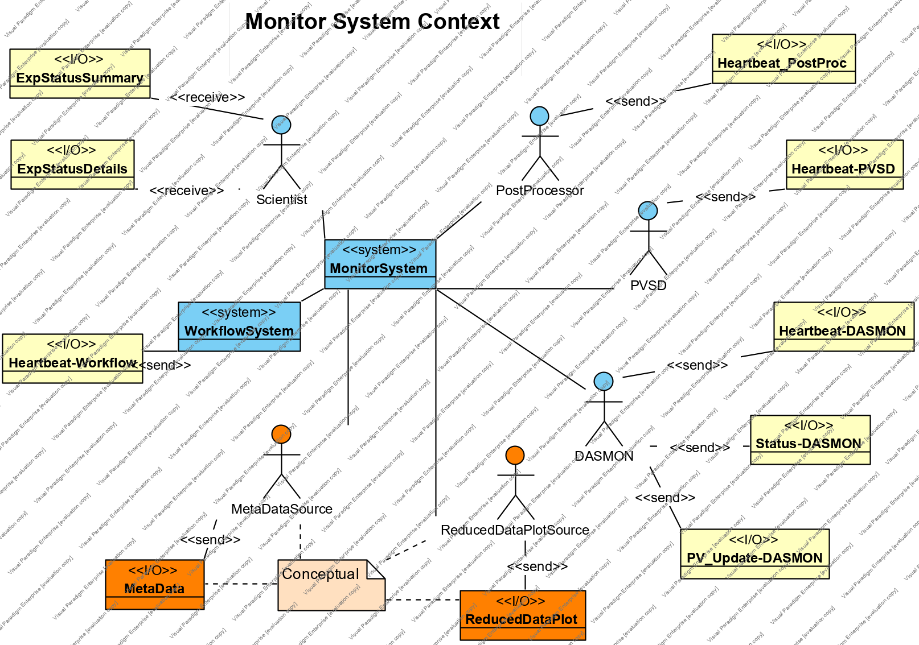
Monitor Context

Slide 7
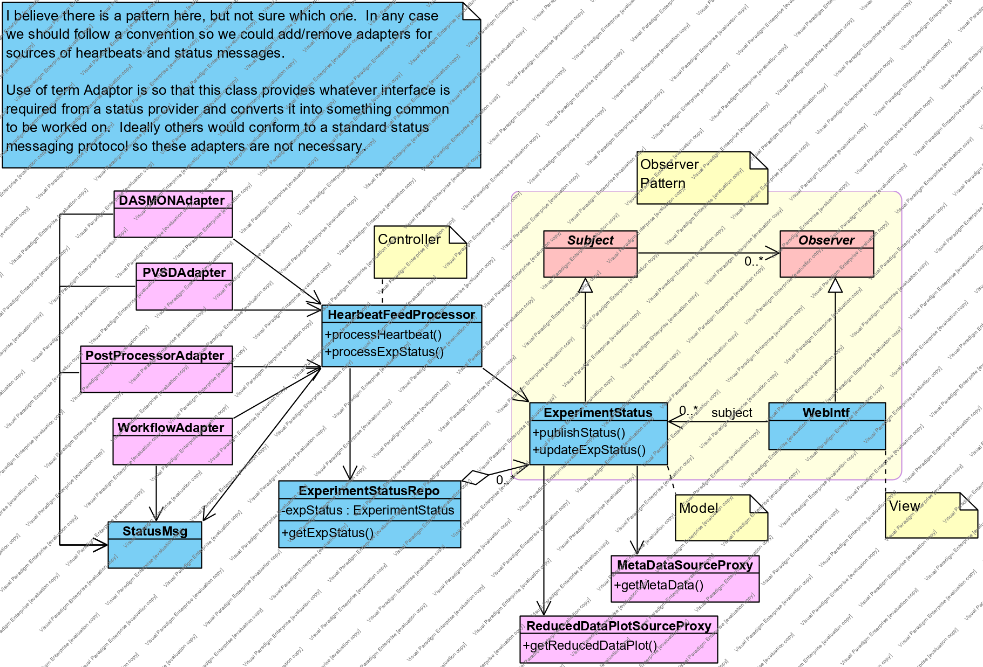
Monitor White Box

Slide 8
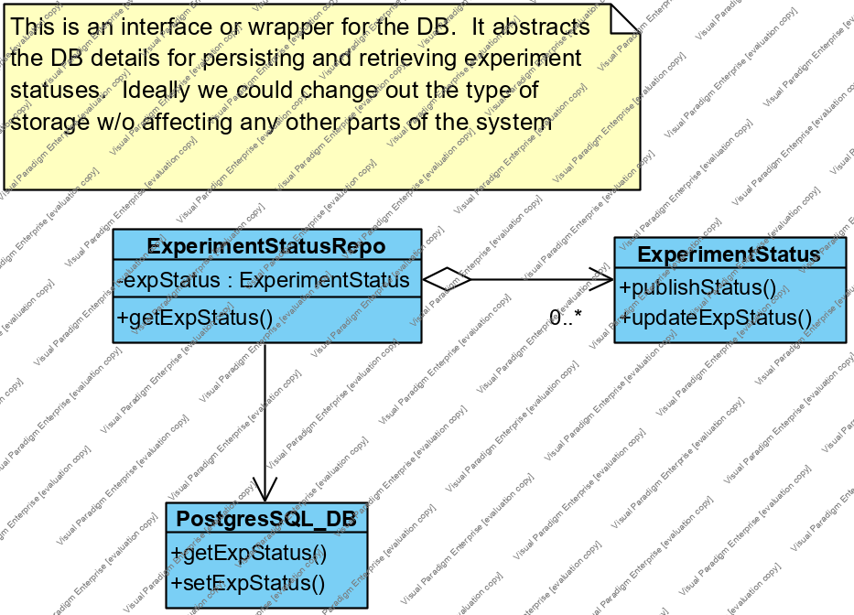
Monitor Persistence

Slide 9
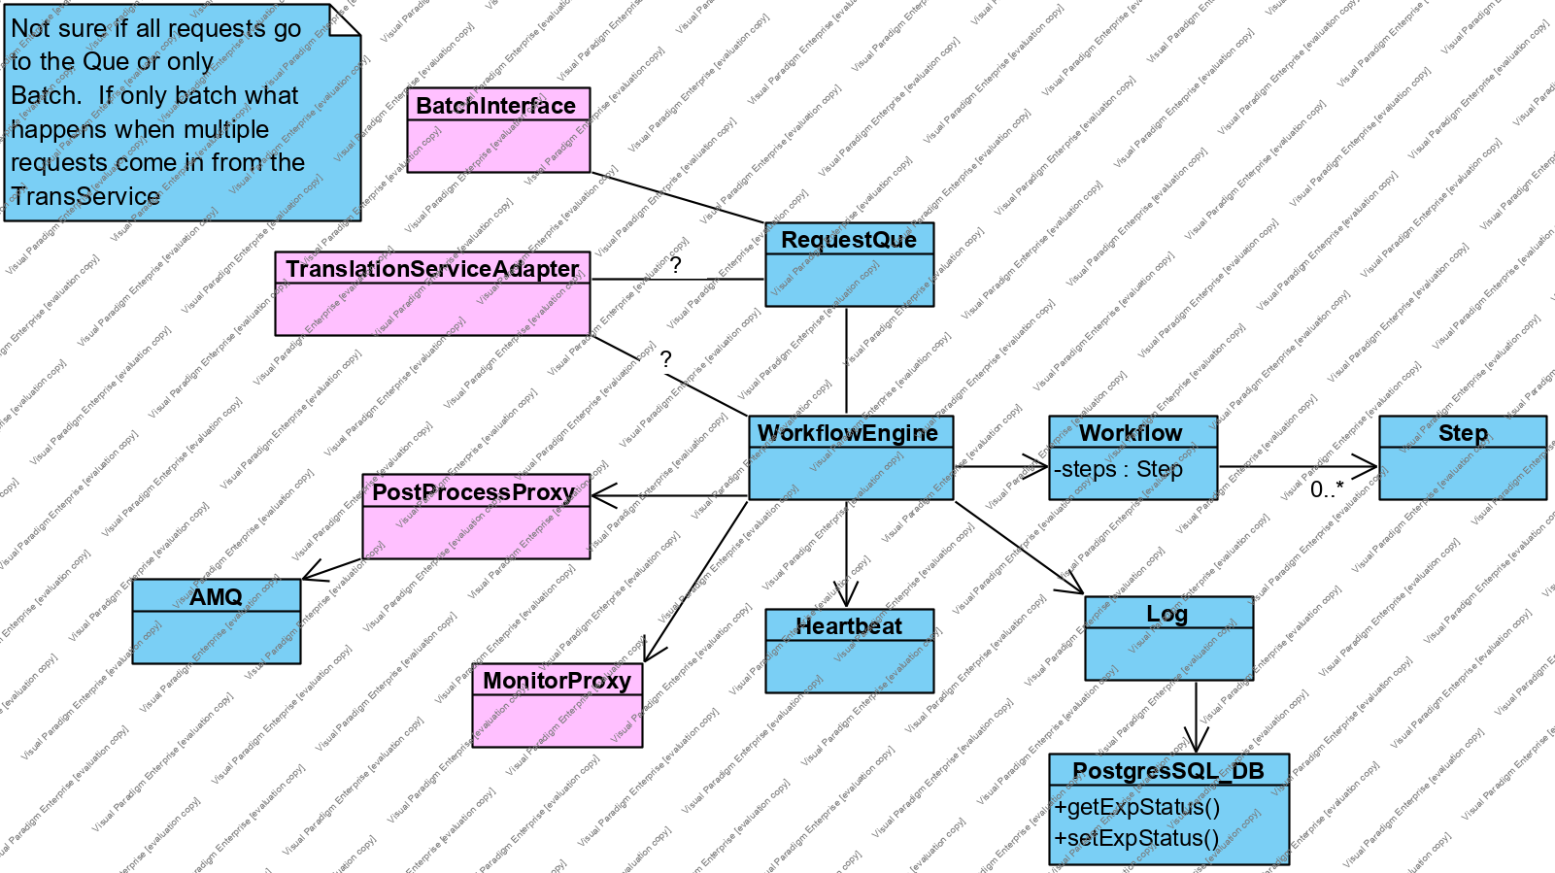
Workflow White Box

Slide 10
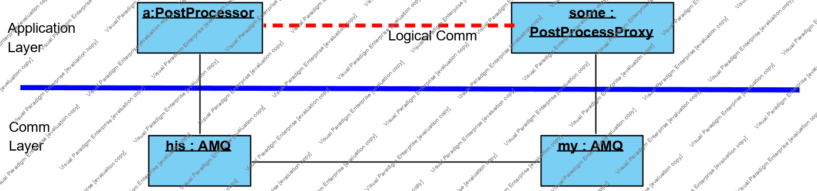
Communication with AMQ

