Slide 1
Intelligent Park Tracker & Vehicle Detection
Internal Guide:- Mr. Krunal Panchal (Asst. Professor)
Prepared By:-
Het Shah - 150320107544
Hardik Patel - 150320107533
Branch:- Computer Engineering

Slide 2
Sr. No | Topic | Slide No.
1 | Introduction to System | 3
2 | Requirement Analysis | 7
3 | System Design | 8
4 | Data Dictionary | 13
5 | Future Enhancement | 15
6 | Conclusion | 16
7 | References | 17

Slide 3
Introduction

Slide 4
Introduction to System :-
Our project will detect an object(vehicle) and it will extract data from the recognized object using Computer Vision and after that object will be checked if it is placed according to blueprint or not. By expanding this, A vehicle will come to the premises and it will be checked if owner is the member of the premises or not, if he is member then his vehicle will be parked to its member area and non-member will park his vehicle in the visitor’s parking, if it is improper then a alert will be generated in the system.

Slide 5
Objective of the new system :-
The objective of this system is to prevent haphazard parking in residential or business premises, by using different procedures and functions. Security concerns and trespassing problems will be solved using this system.Notifying and sending alerts to the authority for the improper parking

Slide 6
Problem Definition:-
In many premises, there are many problems related to parking resulted due to tactless management. Bifurcation of members and visitors will help for better parking management. Vehicles can be tracked based on the records of our the database. Trespassing can be controlled.

Slide 7
Requirement Analysis
2.1) Feasibility study
Residential buildings, business complex, government building etc.
2.2) Requirement of System
Good Camera Resolution
Python Latest Version
2.3) Tools and Technology used
Python
OpenCV
Numpy
MySQL
Machine Learning
2.4) Project Estimation
Can be perennial and will be used in all types of premises

Slide 8
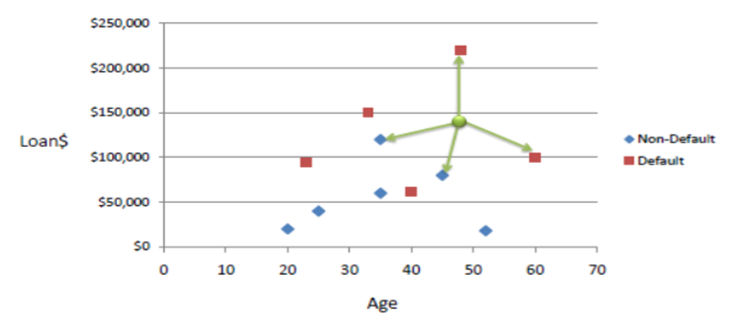
About KNN Algorithm
K nearest neighbors is a simple algorithm that stores all available cases and classifies new cases based on a similarity measure (e.g., distance functions). KNN has been used in statistical estimation and pattern recognition already in the beginning of 1970’s as a non-parametric technique.
A case is classified by a majority vote of its neighbors, with the case being assigned to the class most common amongst its K nearest neighbors measured by a distance function. If K = 1, then the case is simply assigned to the class of its nearest neighbour

Slide 9
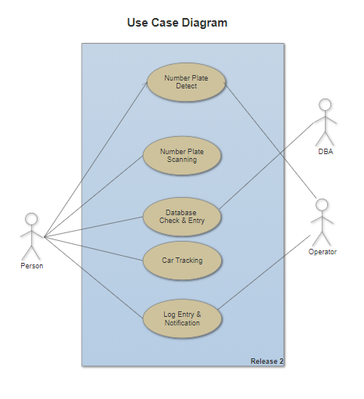
System Design

Slide 10
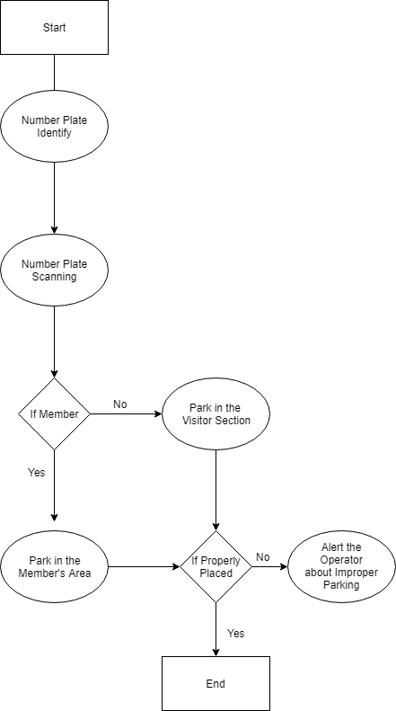
Activity
Diagram

Slide 11
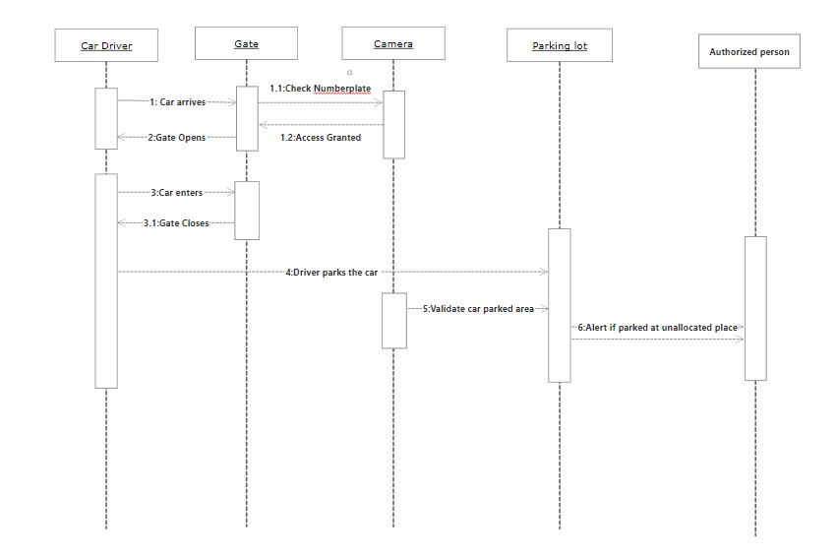
Sequence Diagram

Slide 12
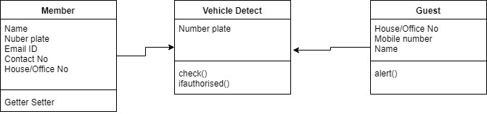
Class Diagram

Slide 13
Data Dictionary
Field Name | Data Type(Size) | Constraint | Description
Login ID | Int(10) | Primary Key | User Id of the user (Auto Incremented)
First Name | Varchar(50) | Not null | Name of the User
Last Name | Varchar(50) | Not null | Surname of the User
Email ID | Varchar(100) | Unique Key | Email ID of the User
Contact No | Varchar(15) | Not null | Phone No of the User
Password | Varchar(50) | Not null | Password of the User
Member’s Registration

Slide 14
Field Name | Datatype(Size) | Constraint | Description
Login ID | Int(10) | Primary Key | Login ID of the User
Email ID | Varchar(100) | Not null | Email ID of the User
Password | Varchar(50) | Not null | Password of the User
Login Table

Slide 15
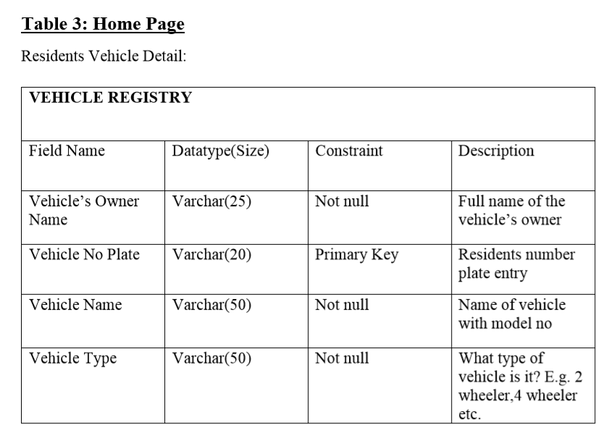

Slide 16
5) Further Enhancement
Can work in any weather condition.
Improved Camera Quality
Can track multiple cars at a time
Fully Automated System
Face Detection can be included.

Slide 17
Conclusion
In the conclusion we can say that, with the help of our system there will be well organized parking management and there will be no conflicts about parking in a residential and business premises. Haphazard parking problem will be solved afterwards using this system by keeping track of vehicles.

Slide 18
Reference
https://patents.google.com/patent/US8374910
https://patents.google.com/patent/KR20130097868A/
Quora
https://www.quora.com/What-is-the-car-parking-management-system
Internal Faculties
Youtube https://www.youtube.com/watch?v=hbL_FTEZSyY&list=PLQVvvaa0QuDffXBfcH9ZJuvctJV3OtB8A
Harrison Kinsley Tutorial

