Slide 1
Netflix ML Project Analysis
Linear Regression Results and Exploratory Data Analysis

Slide 2
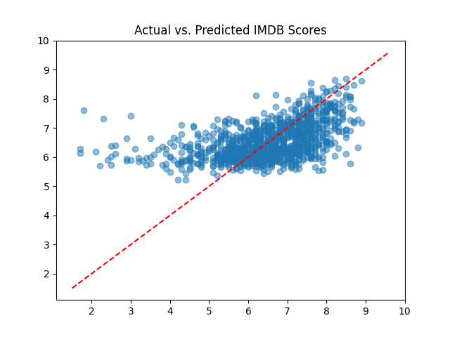
Actual vs Predicted IMDB Scores

Slide 3
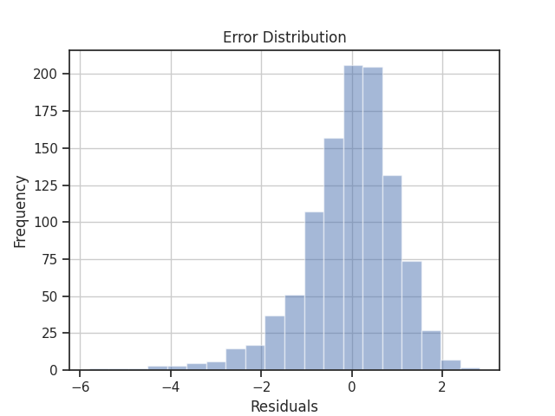
Error Distribution

Slide 4
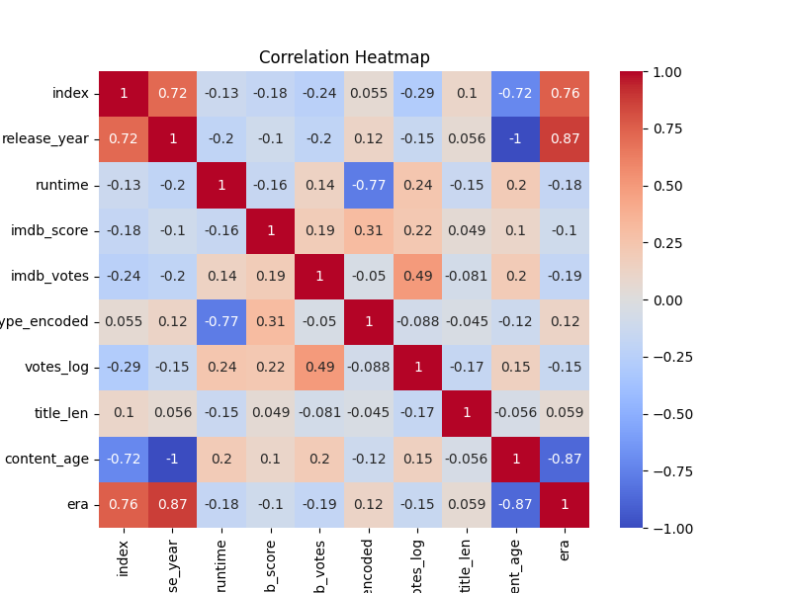
Correlation Heatmap

Slide 5
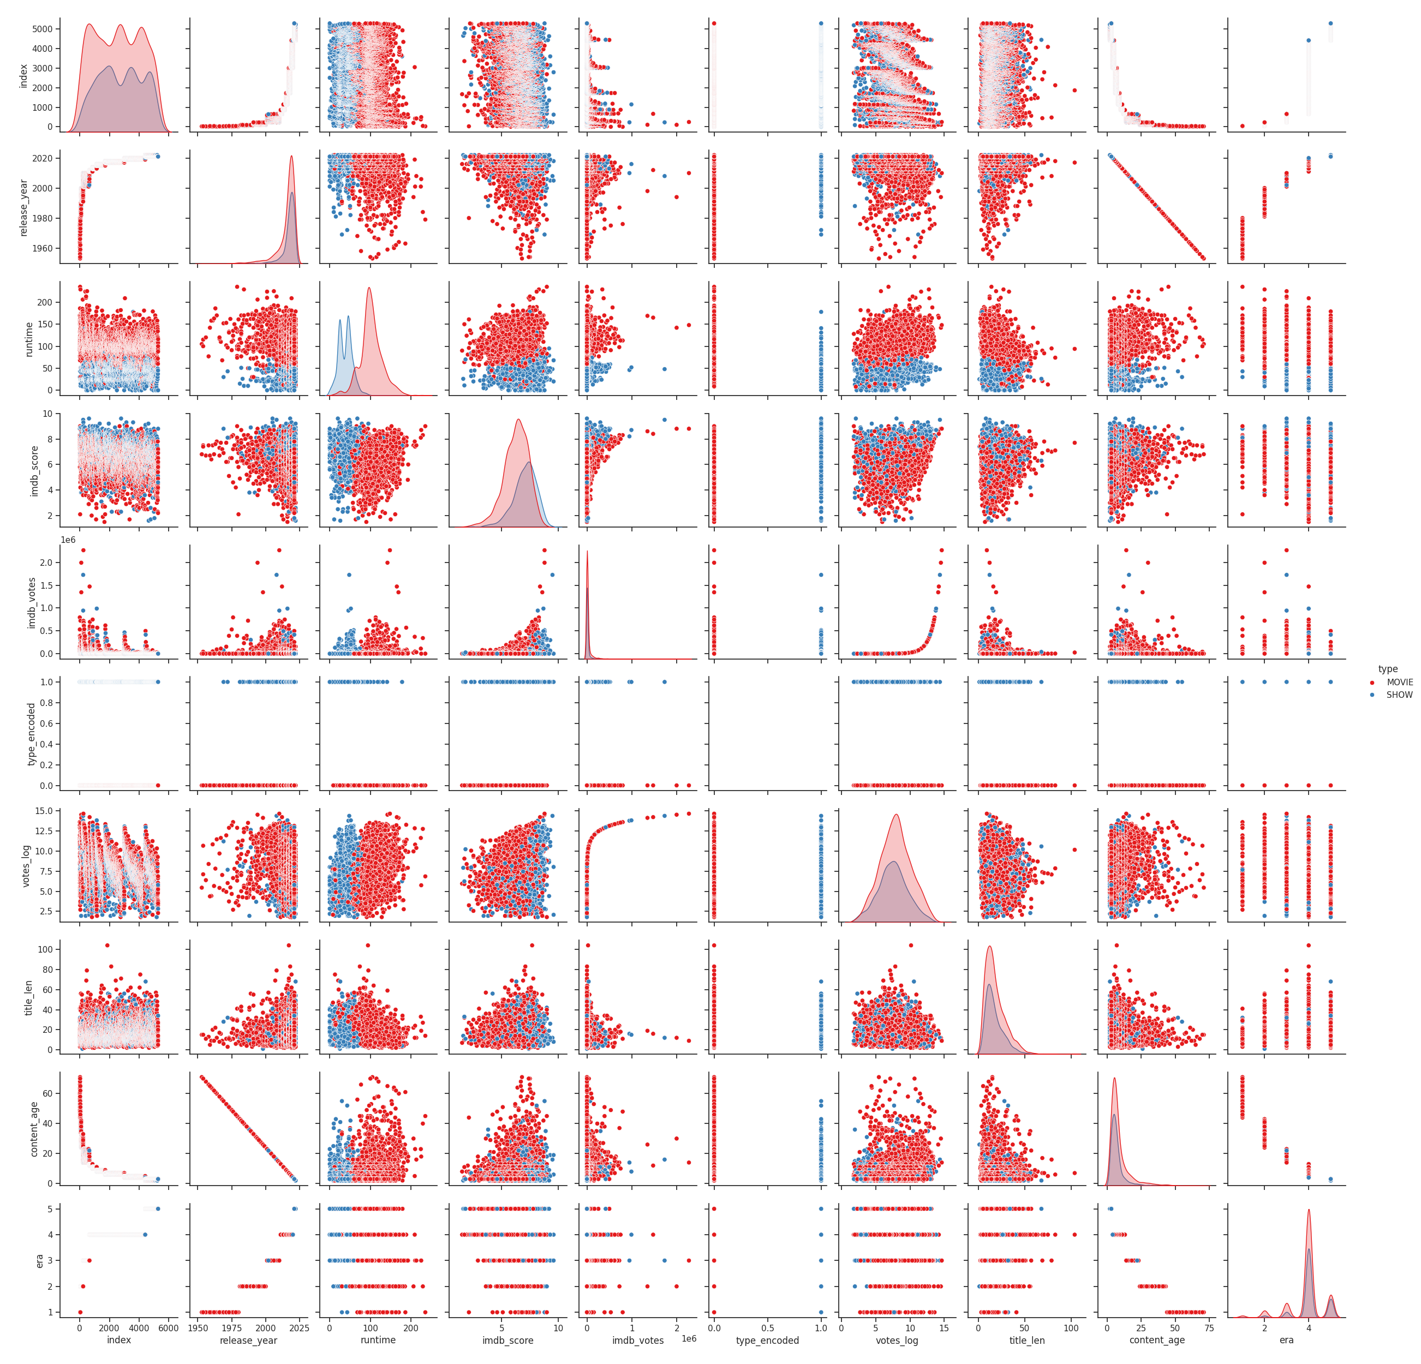
Pairplot of Features based on Content Type

