Slide 1

CompliTracker
Ensuring Accuracy, Empowering Compliance.

Slide 2

Meet The Team
Sayam Pelrecha
Hetu Chauhan
Pragalv Bhattarai
Terrell Davis
Raymond Quan

Slide 3
Problem
Hospitals face frequent form rejections due to incorrect or missing information.
Rejected forms delay insurance claims, impacting hospital revenue and efficiency.
Manual error-checking is time-consuming and prone to mistakes.

Slide 4


What is CompliTracker
Automated Form Validation : Upload completed PDF forms , and our system will analyze them
Error Detection : Identify potential rejections and highlight incorrect fields
Actionable Insights: Provide specific Help and display errors before submission

Slide 5
Key Features
Machine Learning Based Validation - AI determines acceptance Probability
Automated Error Detection: Finds Missing or Inaccurate Fields
Database Integration - Checks Against Hospital And Patient Records
User - Friendly Dashboard - Displays Flagged Forms And Necessary Corrections
Improved Claim Approval Rates : Reduced Rejected Claims And Increases Reimbursements For Hospitals

Slide 6
How it Works
Upload Forms: - Hospitals upload completed forms into our system
AI Powered Analysis: - Our ML model evaluates each form for potential errors
Database Validation: - Our Software will Query hospital and patient databases for missing or incorrect information.
Error Identification: Highlights incorrect Fields and Suggests Necessary Corrections
Resubmission Ready : Ensures Forms are corrected before submission to insurance providers

Slide 7
Technology Stack
Frontend - HTML, Javascript, Tailwind, NodeJS
Scripting Language - Python
Machine Learning - Random Forest Classifier, sklearn, numpy
Additional - Chatgpt API

Slide 8
Benefit For Hospitals
Higher Claim Approval Rates - Ensures Accurate Submissions
Faster Processing - Reduces Manual Effort And Submission Delays
Increase Revenue - Minimizes Losses From Rejected Claims
Seamless Integration - Works with JSON Files and Current Hospital Databases

Slide 9
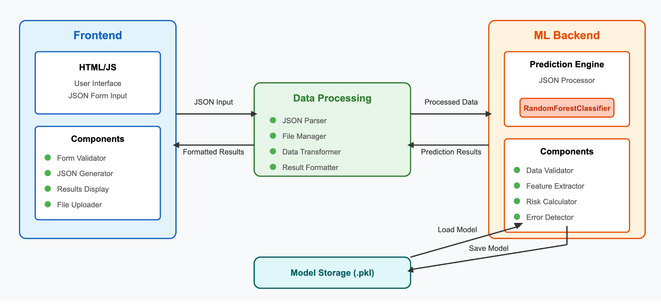
Architecture

Slide 10
Key Stats of Sterilization
consent form
Rejection rate
of SCF
10% to 30%
85%
Respondents 12%
Loss in
Globe fee
mismatching
of info
Across 36 the states rejection rate for
Sterilization consent form is between 10%- 30%
Ex: incorrect dates or time on the SCF
that a rejected SCF resulted in the loss of the entire obstetrical global payment for the provider and the facility

Slide 11


Target
Customer
Medical Billing Departments
Healthcare Providers
Patients
Healthcare Providers
Patients
CompliTrack will allow
Healthcare providers to catch mistakes due to patient errors before it is to late saving them both time and money.
Patients will be more well informed about sterilization consent forms that they are signing.

Slide 12
Business Model and Future plans
Business through
integration
Additional features
Future integration of the platform inside healthcare providers electronic health record (EHR) system
With a premium version also regular web browser version for patients/other use
Interactive training modules
Reinforcing best practices across consent discussion
Enhance models that are customizable

Slide 13
Demo Time
Live Demo Showcasing Form Upload, Error Detection , And Correction Process
Walkthrough Of Dashboard Functionalities

Slide 14
Conclusion/ Next Steps
Impact : Reducing Claim Rejection Through AI - Driven Accuracy
Future Plans : Expanding Database Coverage , Improving AI Accuracy , And Integrating with more hospital Systems
Join Us : Get in Touch to Collaborate Or Pilot CompliTrack At Your Hospital.

Slide 15
Final Thoughts

Slide 16
Citations
Russell, C. B., Evans, M. L., Qasba, N., Frankel, A., & Arora, K. S. (2020, December). Medicaid sterilization consent forms: Variation in rejection and payment consequences. American journal of obstetrics and gynecology. https://pmc.ncbi.nlm.nih.gov/articles/PMC7704718/

