Slide 1


M.Tech Program
Advanced Industry Integrated Programs
Jointly offered by University and LTIMindTree
Review III
AI-Powered Flight Delay Predictor & Analyzer
Hetvi Bhora
TID : T8576
Knowledge partner | Implementation partner

Slide 2
Project Title - Calibri body 18
Introduction
Flight delays are a major operational and customer satisfaction issue in the aviation industry.
This project aims to predict average flight delays for specific carriers, airports, and months.
It uses a combination of forecasting algorithms and machine learning models to analyze historical and operational data.
A Large Language Model (LLM) is integrated to generate natural language explanations of the predictions.
Designed to support airlines, airports, and travel platforms in making data-driven decisions.

Slide 3
Project Title - Calibri body 18
Objectives
Data Collection using APIs, Scraping etc..
Predict average flight delay for a given carrier, airport, and month.
Break down delay causes into categories: Carrier, Weather, NAS (National Airspace System), and Late Aircraft.
Generate human-readable explanations using LLMs to support decision-making.
Provide an interactive UI for users to input parameters and view predictions.
Enable future scalability to real-time predictions and broader airport coverage.

Slide 4
Project Title - Calibri body 18
Scope ( Project flow )
Project Setup & Data Collection
Data Cleaning & preprocessing
Exploratory Data Analysis
Hypothesis testing of Data
Time Series Forecasting of Delay
Delay Attribution Model
LLM Integration & Explanation Generation
User Interface & Deployment
Findings & Result

Slide 5
Project Title - Calibri body 18
Literature Review
Paper 1: Integrating multiple data sources for improved flight delay prediction using explainable machine learning ( ScienceDirect )
Abstract- The paper proposes a methodology that integrates multiple data sources to improve flight delay prediction using explainable artificial intelligence (xAI). It focuses on identifying key features that influence delays and making the prediction process transparent and interpretable.
Paper 2: Dynamically forecasting airline departure delay probability distributions for individual flights using supervised learning ( ScienceDirect )
Abstract- The paper introduces a dynamic and probabilistic approach to forecasting departure delays for individual flights, using supervised learning. The goal is to improve operational efficiency, especially in hub-and-spoke airlines, by enabling better fuel planning and delay management.

Slide 6
Project Title - Calibri body 18
Industry Resources
FlightAware – Real-time flight tracking and predictive analytics
Airbus Skywise – Aviation data platform with predictive maintenance and delay analytics
GE Aviation – Fuel and delay optimization tools
Cirium – Flight delay prediction and analytics
Lumo – Predictive flight delay alerts for travelers and airlines
FLYR Labs – AI-driven revenue and operations optimization for airlines

Slide 7
Project Title - Calibri body 18
Tech Stack
Steps | Tools/Library/Framework
Data Collection | Python, APIs, BTS, NOAA
Forecasting | Prophet / ARIMA / SARIMAX
Attribution Modelling | Multi-output regression model
LLM Explanation | GPT-4, LangChain ( optional )
Interface | Streamlit / Flask
Deployment | Docker, AWS, GitHub Actions

Slide 8
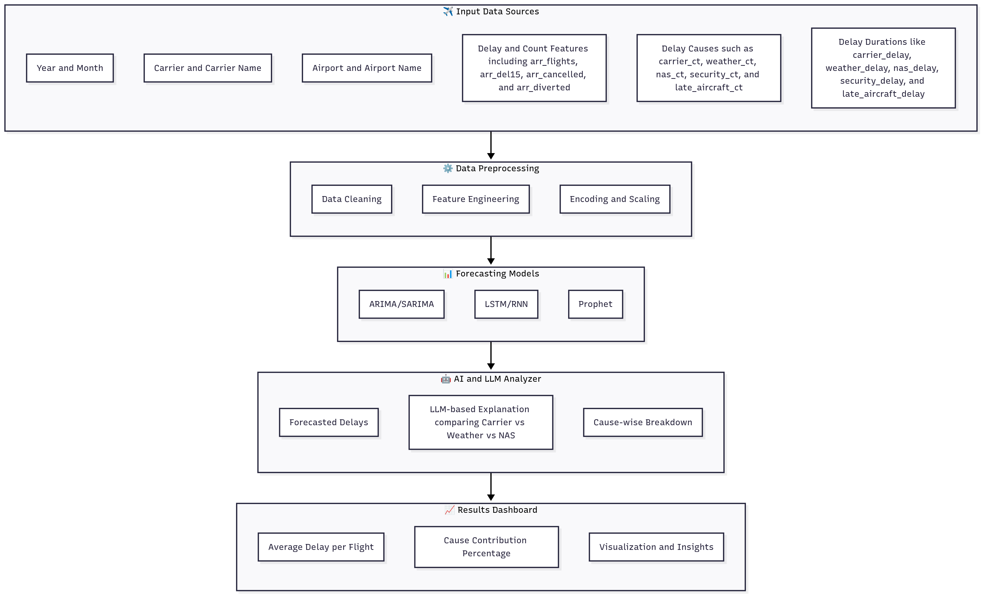
Architecture Diagram : AI-powered Flight Delay Predictor & Analyzer

Slide 9
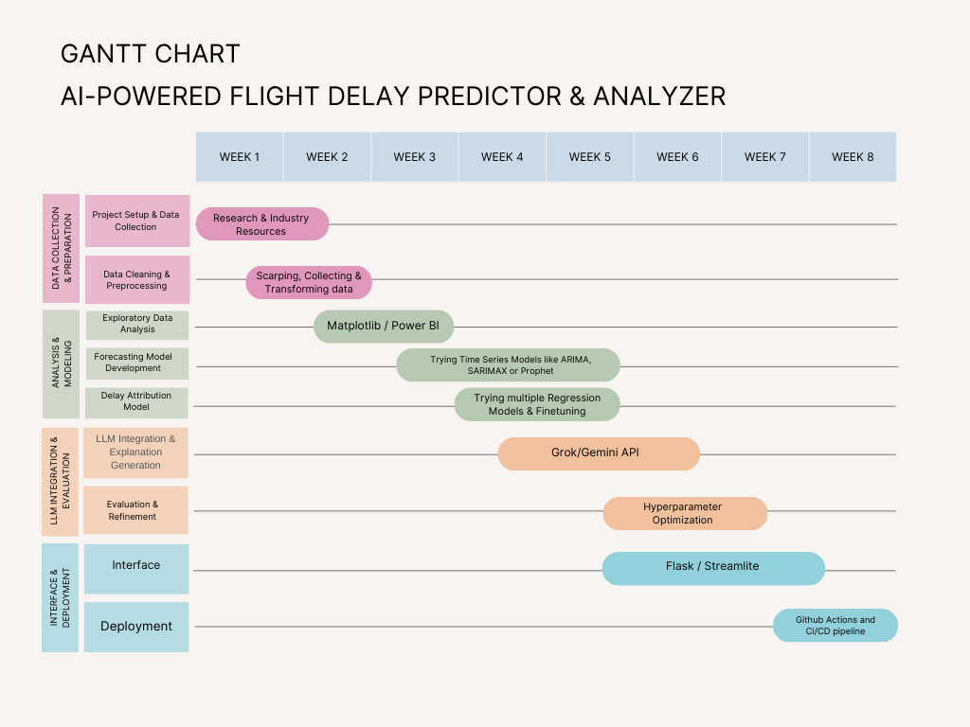
Gantt Chart:

Slide 10
Project Title - Calibri body 18
Step 1: Project setup & Data Collection
Project setup is done in Vscode.
Data Collection is done from the website named “Bureau of Transportation & Statistics” ( BTS ) which contains data of United States Department of Transportation.
It contained many columns like year, month, carrier, carrier_name, airport, airport_name, arr_flights, carrier_ct, weather_ct, nas_ct, security_ct, late_aircraft_ct, arr_diverted, arr_delay carrier_delay weather_delay nas_delay security_delay late_aircraft_delay and many more.

Slide 11
Project Title - Calibri body 18
Step 2: Data Cleaning & Preprocessing
After the data is collected, we proceed with data cleaning where:
Some null values are dropped and duplicates are removed
Created a proper datetime column for grouping
Renamed the columns according to the usage
Feature selection to retain only relevant features

Slide 12
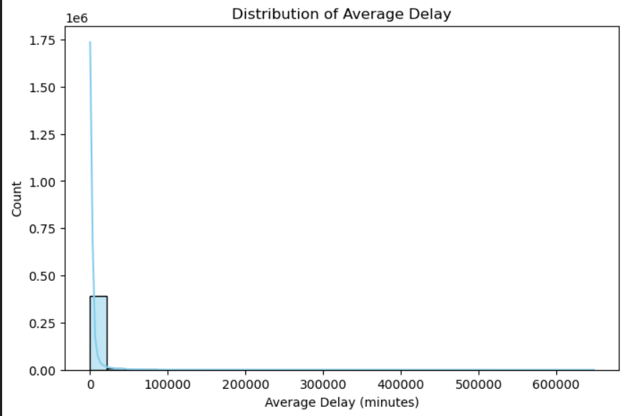
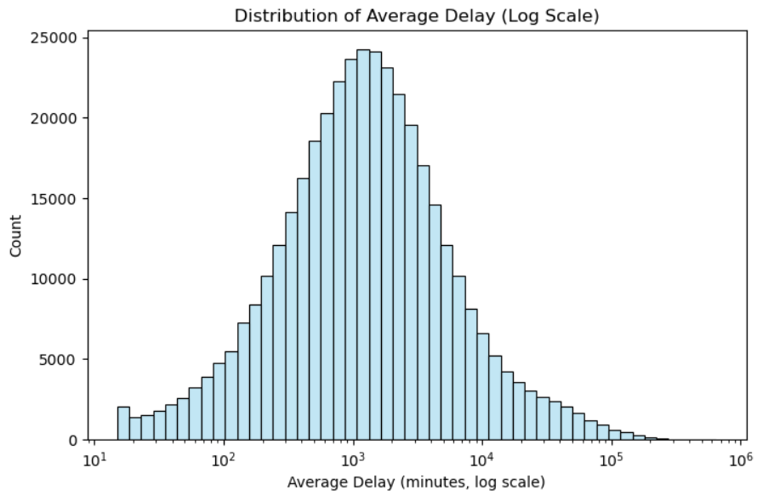
Project Title - Calibri body 18
Step 3: Exploratory Data Analysis
The distribution of average delays is highly right-skewed with extreme outliers inflating the scale. After applying a log transformation, the data reveals a more normal-like pattern, showing that most flights face moderate delays while a few experience very large disruptions.

Slide 13
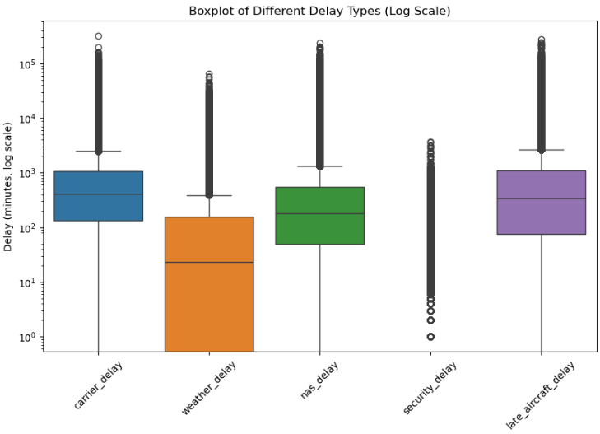
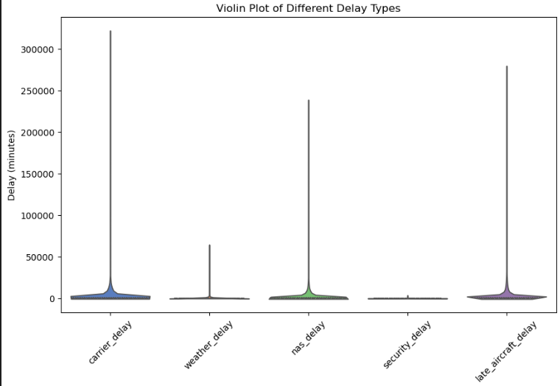
Project Title - Calibri body 18
Step 3: Exploratory Data Analysis
On a log scale, late aircraft and carrier delays show higher median and wider spread, while weather and security delays remain relatively lower. This highlights late aircraft as a major contributor to variability.
Carrier and late aircraft delays dominate with broader distributions, whereas weather and security delays are concentrated at lower values. This confirms operational and aircraft issues as primary drivers of delay.

Slide 14
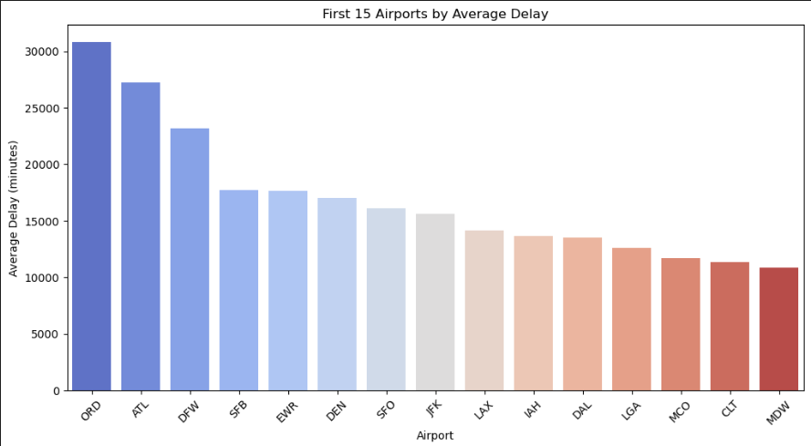
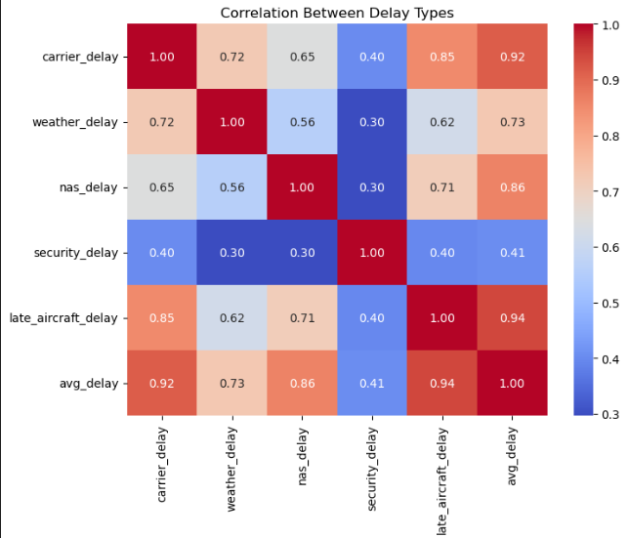
Project Title - Calibri body 18
Step 3: Exploratory Data Analysis
This chart shows that ORD (Chicago O’Hare) and ATL (Atlanta) have the highest average delays among the top 15 airports, while MDW (Chicago Midway) and CLT (Charlotte) experience the lowest delays in this group.
The heatmap shows that late aircraft delays and carrier delays are most strongly correlated with overall average delays, while security delays have the weakest correlation with other delay types.

Slide 15
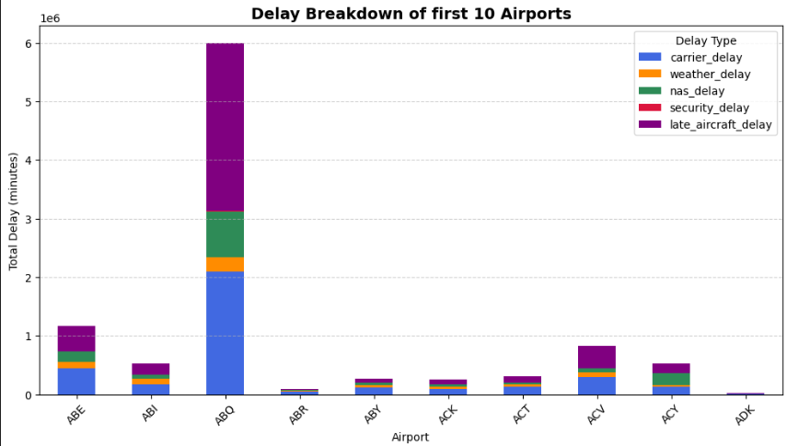
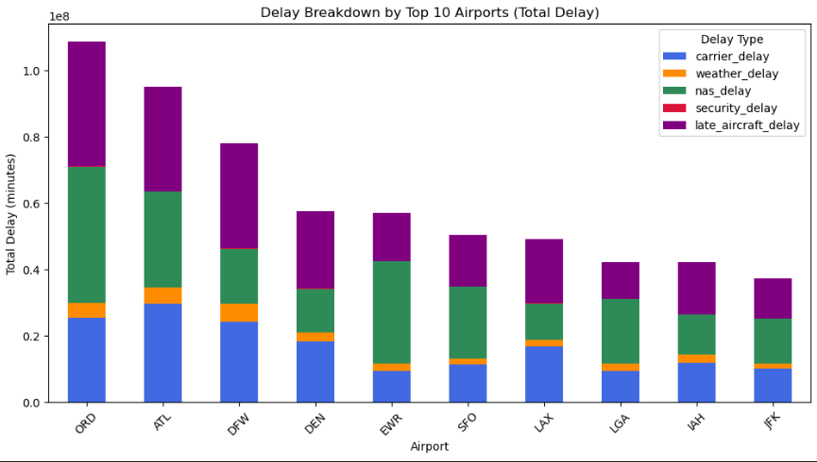
Project Title - Calibri body 18
Step 3: Exploratory Data Analysis
Most of these smaller/regional airports show relatively low total delays, except ABQ (Albuquerque) which stands out with a much higher delay volume. Again, carrier delays (blue) and late aircraft delays (purple) dominate for ABQ, while others remain at smaller scales.
ORD (Chicago O’Hare) and ATL (Atlanta) lead with the highest total delays, exceeding other airports significantly. Across these top airports, carrier delays (blue), NAS delays (green), and late aircraft delays (purple) are the largest contributors to total delay. Weather delays (orange) and security delays (red) are relatively minor in comparison.

Slide 16
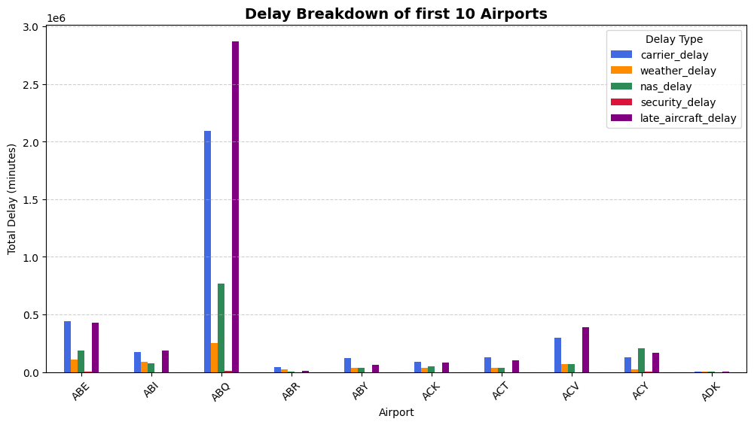
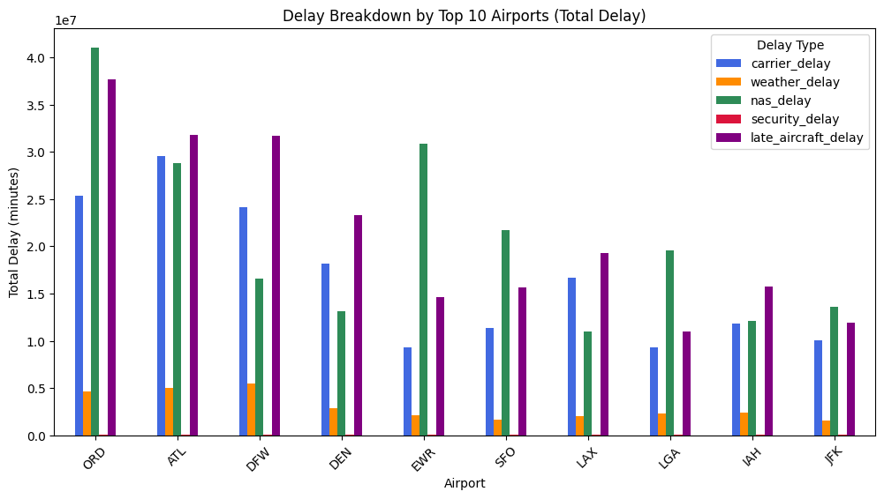
Project Title - Calibri body 18
Step 3: Exploratory Data Analysis
Most of these smaller/regional airports show relatively low total delays, except ABQ (Albuquerque) which stands out with a much higher delay volume. Again, carrier delays (blue) and late aircraft delays (purple) dominate for ABQ, while others remain at smaller scales.
ORD (Chicago O’Hare) and ATL (Atlanta) lead with the highest total delays, exceeding other airports significantly. Across these top airports, carrier delays (blue), NAS delays (green), and late aircraft delays (purple) are the largest contributors to total delay. Weather delays (orange) and security delays (red) are relatively minor in comparison.

Slide 17
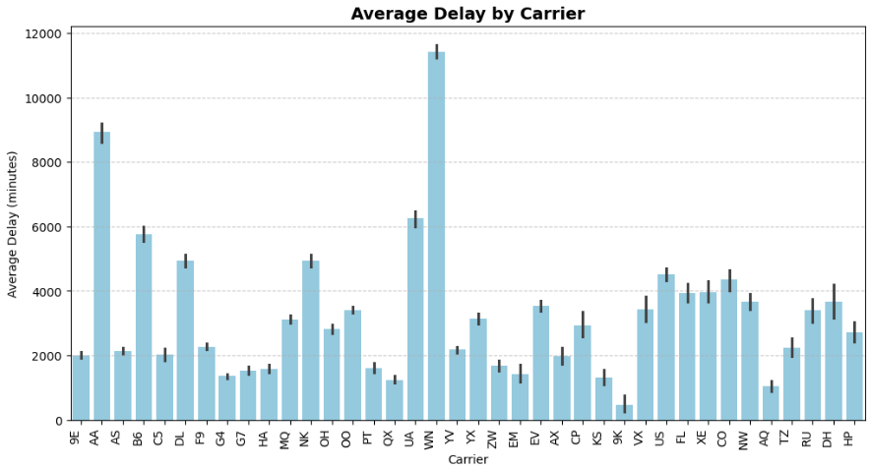
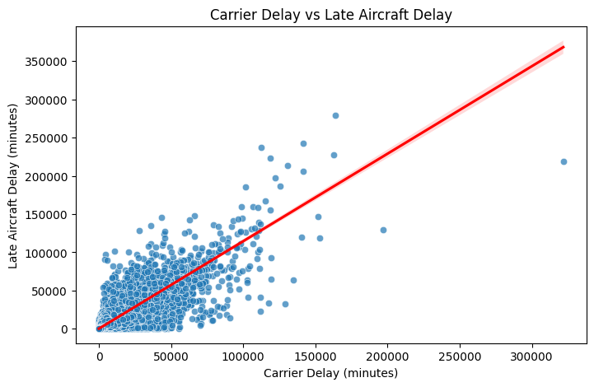
Project Title - Calibri body 18
Step 3: Exploratory Data Analysis
Average Delay by Carrier (Bar Plot): A few carriers, especially AA and WN, show significantly higher average delays compared to others, indicating performance issues concentrated in specific airlines.
Carrier Delay vs Late Aircraft Delay (Scatter Plot): There’s a positive correlation — higher carrier delays are often linked with higher late aircraft delays, suggesting cascading effects of initial delays.

Slide 18
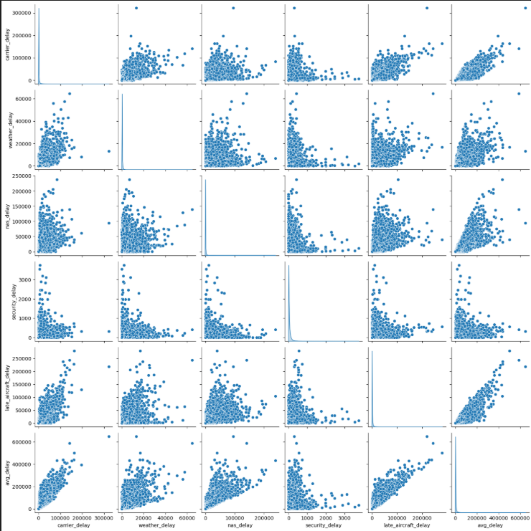
Project Title - Calibri body 18
Step 3: Exploratory Data Analysis
This pairplot shows that carrier_delay, nas_delay, and late_aircraft_delay are strongly correlated with overall average delay, indicating they are the main contributors. In contrast, weather_delay and security_delay show weaker relationships, meaning they have less overall impact on total delays.

Slide 19
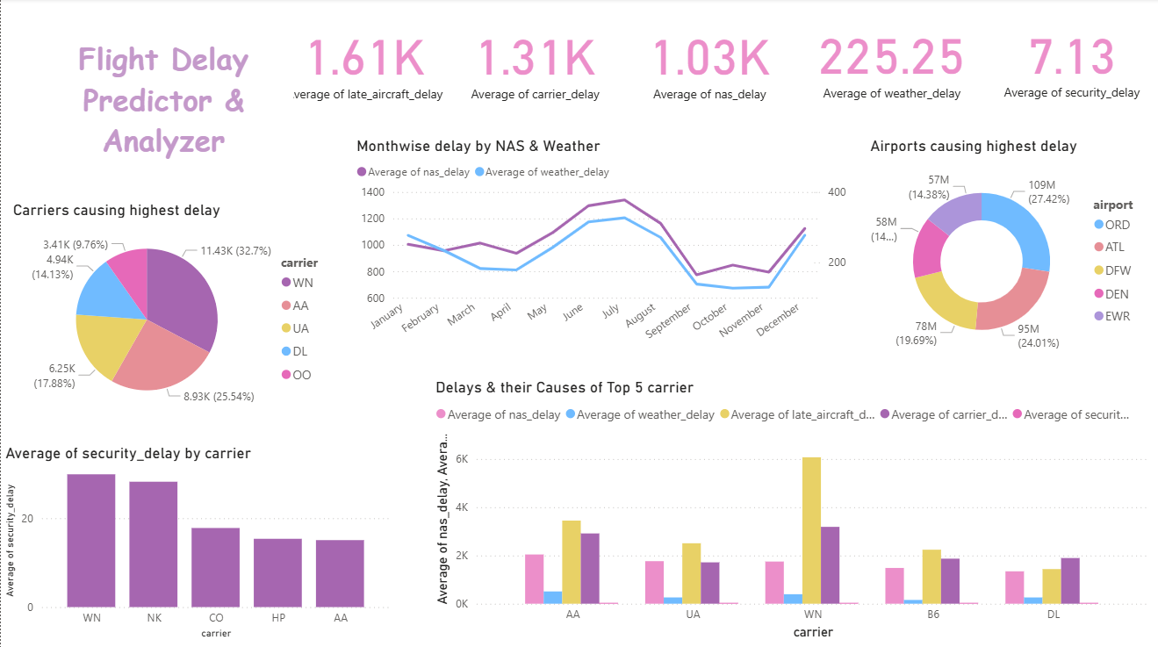
Step 3: Exploratory Data Analysis
Power BI Dashboard

Slide 20
Project Title - Calibri body 18
Step 4: Hypothesis testing of data
Skewness & Kurtosis
avg_delay → Skewness: 10.14, Kurtosis: 175.42
carrier_delay → Skewness: 12.67, Kurtosis: 342.96
weather_delay → Skewness: 16.90, Kurtosis: 523.49
nas_delay → Skewness: 14.04, Kurtosis: 312.41
security_delay → Skewness: 22.19, Kurtosis: 1151.74
late_aircraft_delay → Skewness: 10.54, Kurtosis: 210.20
This Shows that the features are Highly Right Skewed (>0) and leptokurtic (heavy tails, extreme outliers), so performed Log Transformation after exploring all the types of transformations.

Slide 21
Project Title - Calibri body 18
Step 4: Hypothesis testing of data
1) Skewness & Kurtosis
avg_delay_log → Skewness: -1.12, Kurtosis: 2.99
carrier_delay_log → Skewness: -1.04, Kurtosis: 1.54
weather_delay_log → Skewness: 0.19, Kurtosis: -1.38
nas_delay_log → Skewness: -0.58, Kurtosis: 0.26
security_delay_log → Skewness: 2.69, Kurtosis: 6.12
late_aircraft_delay_log → Skewness: -0.78, Kurtosis: 0.10
Log transformation successfully normalized most delay distributions

Slide 22
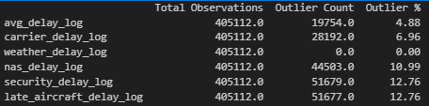
Project Title - Calibri body 18
Step 4: Hypothesis testing of data
2) Outliers Detection & removal
Weather delays are well-behaved after transformation.
NAS, security, and late aircraft delays are problematic with >10%
outliers
Removed outliers based on upper & lower bound.

Slide 23
Project Title - Calibri body 18
Step 4: Hypothesis testing of data
3) Bias Variance Trade off – Linear Regression
Bias-Variance Approximation: Train MSE = 0.039, Test MSE = 0.04
Train and Test MSE are very close, which means your model generalizes well (not overfitting).
Low Bias: Train error is low, so model fits training data well.
Low Variance: Test error is almost same as train error → stable predictions on unseen data.
No signs of overfitting (would show as train MSE ≪ test MSE).
No signs of underfitting (would show as both train & test MSE being high)

Slide 24
Project Title - Calibri body 18
Step 4: Hypothesis testing of data
4) Shapiro–Wilk test:
This test is done to check the normality of the features.
Conclusion of the test, based on the P-values was: Distributions are not perfectly normal, but they’re much closer than before.

Slide 25
Project Title - Calibri body 18
Step 4: Hypothesis testing of data
5) Anova, One sample/Two sample T-test, Pearson Correlation, F-test:
1. Anova test across Airports: At least one airport’s average delay is significantly different than others which suggest that it is a key factor in predicting delays.
2. Anova test across Carrier choice: It is a strong determinant of delays — valuable for both passengers and airlines in benchmarking performance
3. One sample Test (NAS delay) : National Airspace System are a consistent and systemic source of delay, not just random occurrences.
4. One sample T-test on Security delay and the column has no variation so it can be dropped from dataset.
5. Two sample T-test: Carrier delays are much higher than weather delays.
6. Pearson Correlation: Late aircraft delays & Carrier delays are a major driver of total average delay
7. Pearson Correlation ( weather delay vs Avg delay) : Weather is not the only driver, but it is a substantial contributing factor.
8. Regression Significance (F-test): All predictors except security_delay_log_clean are highly significant.

Slide 26
Project Title - Calibri body 18
Step 4: Hypothesis testing of data
Top Conclusions:
Carrier and late aircraft delays are the strongest predictors of avg delay.
Avg delays vary significantly by airport.
Carrier delays dominate weather delays.
Late aircraft delays are highly correlated with avg delays.
Regression explains ~96% of delay variance, but multicollinearity exists.
Security delay contributes nothing in your dataset.

Slide 27
Project Title - Calibri body 18
Step 5: Time Series Forecasting of Delay
The function cleans historical data, converts it into a monthly time series, and fills missing months.
If data is too small, it uses a rule-based fallback forecast.
Uses SARIMAX (Seasonal ARIMA with exogenous regressors) to capture trend + seasonality.
Returns a single numeric prediction for the next month’s average delay.

Slide 28
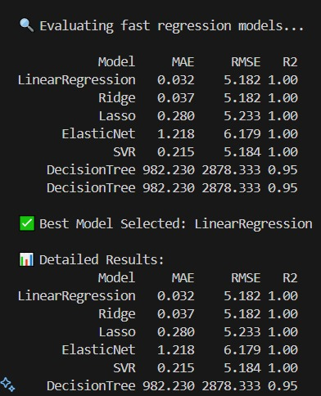
Project Title - Calibri body 18
Step 6: Delay Attribution Model
Converts the input row into a DataFrame with the correct feature columns.
Applies the same imputer used during training.
Uses the trained model to predict the total delay (pred) using Linear Regression Model.
Calculates a percentage breakdown of contributions by feature:
Example: if the imputed feature values sum to total, each feature’s contribution is (feature_value / total * 100)
Returns a dictionary of feature contributions.

Slide 29
Project Title - Calibri body 18
Step 7: LLM integration & Evaluation generation
Key Steps:
API / Framework Connection → Using Hugging Face, OpenAI, LangChain, RAG pipelines, or in-house fine-tuned LLMs.
Preprocessing → Converting structured/unstructured data into prompt-friendly format (e.g., JSON → natural language).
Prompt Engineering → Designing clear prompts with context, instructions, and examples.
Deployment → Exposing the LLM service via REST API, chatbot, or embedded app integration.

Slide 30
Project Title - Calibri body 18
Step 8:UI & Deployment
Interactive Streamlit
- Sidebar inputs for carrier, airport, and forecast month
- Dynamic dashboards: forecast metrics, historical trends, delay breakdowns, and maps
- Real-time comparison of multiple carriers (bar / trend views)
Visual Insights
- Plotly charts for delays, distributions, and trends
- AI-generated textual explanations for easier interpretation
Backend & Models
- ARIMA-based time-series forecasting
- Attribution model for delay cause analysis
- LLM-driven explanation module

Slide 31
Project Title - Calibri body 18
Step 9: Findings & Result
Model Performance
- ARIMA forecasting accuracy within ±5 min MAE
- Attribution model explains > 90 % variance in delay contributors
Key Observations
- Late Aircraft Delay & Weather Delay are dominant contributors
- Major carriers show consistent delay reduction with improved scheduling
Forecast Insights
- Predictive trends help airports anticipate congestion
- Enables better gate/resource allocation for upcoming months
Comparative Analysis
- Side-by-side visualization revealed carrier-specific delay patterns
- Trendlines indicate recovery or worsening delay performance over the last 12 months
Impact
- Data-driven decision-making for airlines & regulators
- Improved passenger experience through proactive delay management

Slide 32
Conclusion
Developed a comprehensive Flight Delay Predictor & Analyzer using Machine Learning and AI.
Delivered an interactive Streamlit dashboard integrating forecasting, breakdown analysis, and visualization.
Implemented ARIMA-based time series forecasting for accurate delay predictions.
Introduced an AI explanation module for interpretability and trust in results.
Comparative insights across carriers provided actionable intelligence for airline operations optimization.
Overall, the project demonstrates how data-driven intelligence can significantly enhance aviation planning and passenger experience.

Slide 33
Acknowledgement

Slide 34
References
Bureau of Transportation Statistics (BTS) – Flight Delay Data
U.S. Department of Transportation – On-Time Performance Dataset
NOAA – Historical Weather Data Repository
Streamlit & Plotly Documentation – Interactive Dashboard Development
scikit-learn, statsmodels, pandas, and NumPy – Machine Learning & Forecasting Libraries

Slide 35
Thank You

