Slide 1
Food Delivery Time Estimation
Team Name – Tragic Bytes
Team members –
Hetvi Vikani
Bhumi Radadiya
Yash Ranpariya

Slide 2
Problem Understanding
Need accurate delivery time prediction
  Dynamic traffic & urban environment
  Static rule-based systems are inaccurate
  Machine Learning provides adaptive solution

Slide 3
Project Objective
Predict delivery time (minutes)
  Use order, partner & location features
  Minimize MAE & RMSE
  Deploy real-time prediction system

Slide 4
Dataset Overview
Delivery Partner Age & Rating
  Restaurant Latitude & Longitude
  Delivery Latitude & Longitude
  Type of Order & Vehicle
  Target: Delivery Time (minutes)

Slide 5
Project Architecture
Data Collection (Dataset.csv)
  Data Preprocessing & Feature Engineering
  Model Training (train.py)
  Model Saving (best_model.pkl)
  Deployment using Streamlit (app.py)

Slide 6
Data Preprocessing
Handled missing values
  Encoded categorical variables
  Feature scaling applied
  Train-Test split performed

Slide 7
Feature Engineering
Distance calculated using Haversine formula
  Encoded vehicle & order types
  Distance identified as strongest predictor

Slide 8
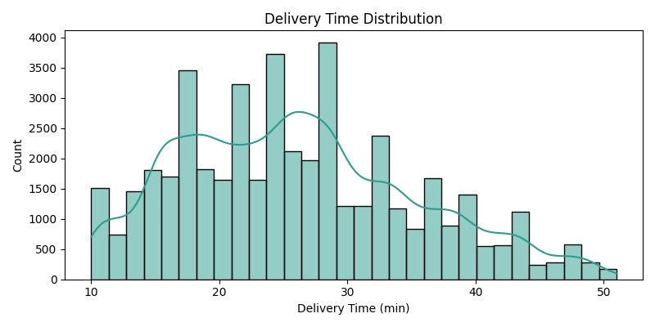
Delivery Time Distribution

Slide 9
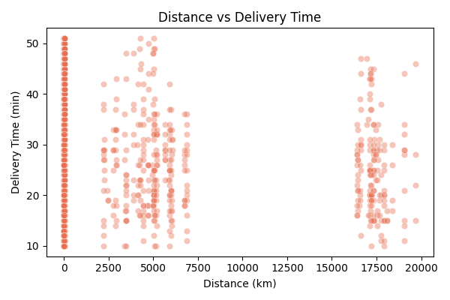
Distance vs Delivery Time

Slide 10
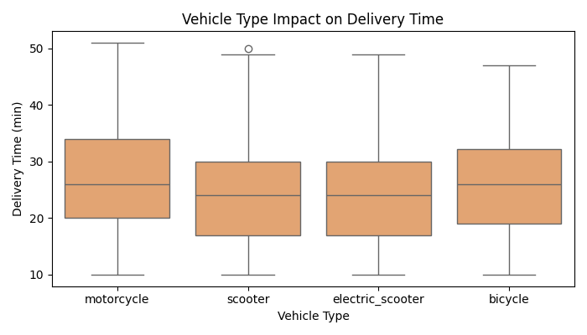
Vehicle Type Impact

Slide 11
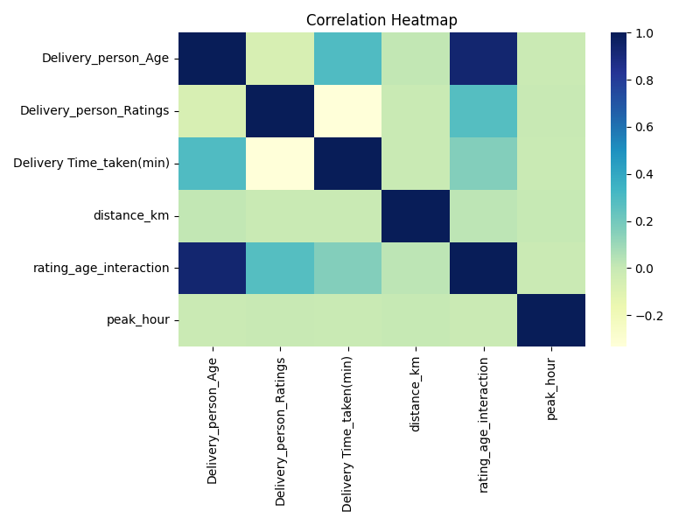
Correlation Heatmap

Slide 12
Model Training & Comparison
Linear Regression
  Decision Tree Regressor
  Random Forest Regressor
  Gradient Boosting Regressor
  Compared using MAE & RMSE

Slide 13
Best Model - Gradient Boosting Regressor
Achieved lowest RMSE & MAE
  Boosting improves weak learners sequentially
  Handles non-linearity effectively
  Provides high prediction accuracy
  Model saved as best_model.pkl

Slide 14
Evaluation Metrics
MAE (Mean Absolute Error)
  RMSE (Root Mean Squared Error)
  Gradient Boosting achieved best performance

Slide 15
Deployment - Streamlit Application
User inputs delivery details
  Distance calculated dynamically (utils.py)
  Model loads best_model.pkl (Gradient Boosting)
  Predicted delivery time displayed instantly

Slide 16
Business Impact
Improved customer satisfaction
  Accurate ETA prediction
  Better resource planning
  Operational efficiency

Slide 17
Scalability & Future Enhancements
Cloud deployment ready
  Traffic & Weather API integration
  Periodic model retraining
  Advanced boosting & ensemble techniques

