Slide 1
IBM University Engagement Project Submission
“Exploring the Power of Agentic AI with IBM Granite”
Challenge 13 – AI-Powered Cotton & Groundnut Market Linkage Platform
Domain: Economic Development | Focus: Gujarat Agriculture

Slide 2

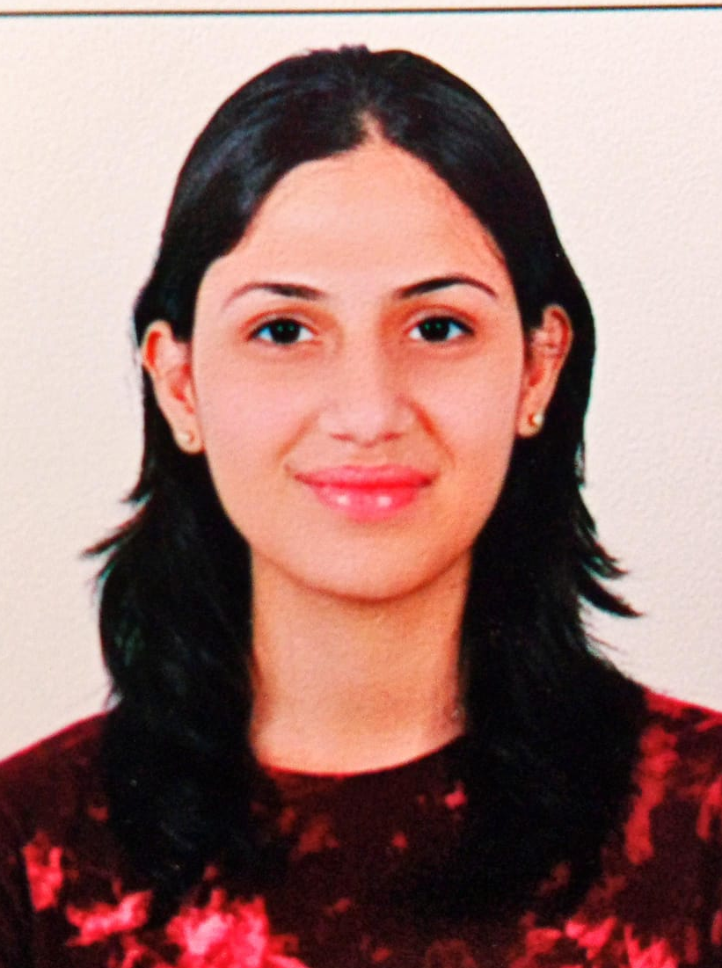
Project Title – KisanSetu: AI-Powered Cotton & Groundnut Market Linkage Platform
Domain of Project – Economic Development / Agriculture
Student Name | Recent Passport Photo | Email ID | Mobile number [WhatsApp]
Team KisanSetu Greshi Doshi Hetvi Bhatt Grishma Gajera Nikki Bhoot |  | greshidoshi779@gmail.com greshidoshi.co24d1@scet.ac.in hetvibhatt1977@gmail.com hetvibhatt.co24d1@scet.ac.in | 9925194820 7383836069

Slide 3
Problem Statement – Challenge 13
The Challenge
Gujarat is a leading producer of cotton and groundnut, but farmers often face price exploitation by middlemen, limited access to real-time mandi prices, and weak bargaining power in direct market linkages.
The Objective
Build an Agentic AI platform that provides real-time price intelligence, directly connects farmers with buyers, and supports informed selling, storage, quality and income decisions.
Suggested AI Agents
• Mandi Price Forecasting Agent
• Direct Buyer–Farmer Matching Agent
• Storage & Selling Timing Advisor Agent
• Quality Grading Assistance Agent
• Farmer Income Dashboard Agent

Slide 4
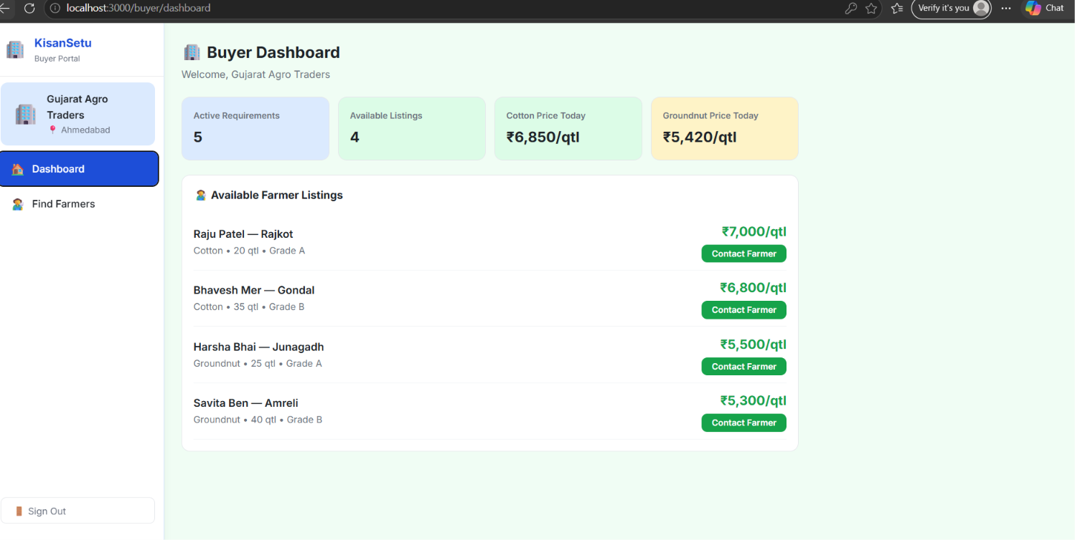
Proposed Solution – KisanSetu
KisanSetu is a multi-agent AI market linkage platform for Gujarat’s cotton and groundnut farmers.
It combines price intelligence, buyer matching, storage/selling advice, quality support and income visibility.
1. Price Intelligence
2. Direct Matching
Uses mandi data to show current prices, trends and forecast signals.
Matches farmer listings with buyers using crop, quantity, grade and price.
3. Selling + Storage
4. Quality + Income
Advises whether to sell now or store based on price direction and context.
Supports quality grading and converts sales into simple income insights.
Working demo: farmer dashboard

Slide 5
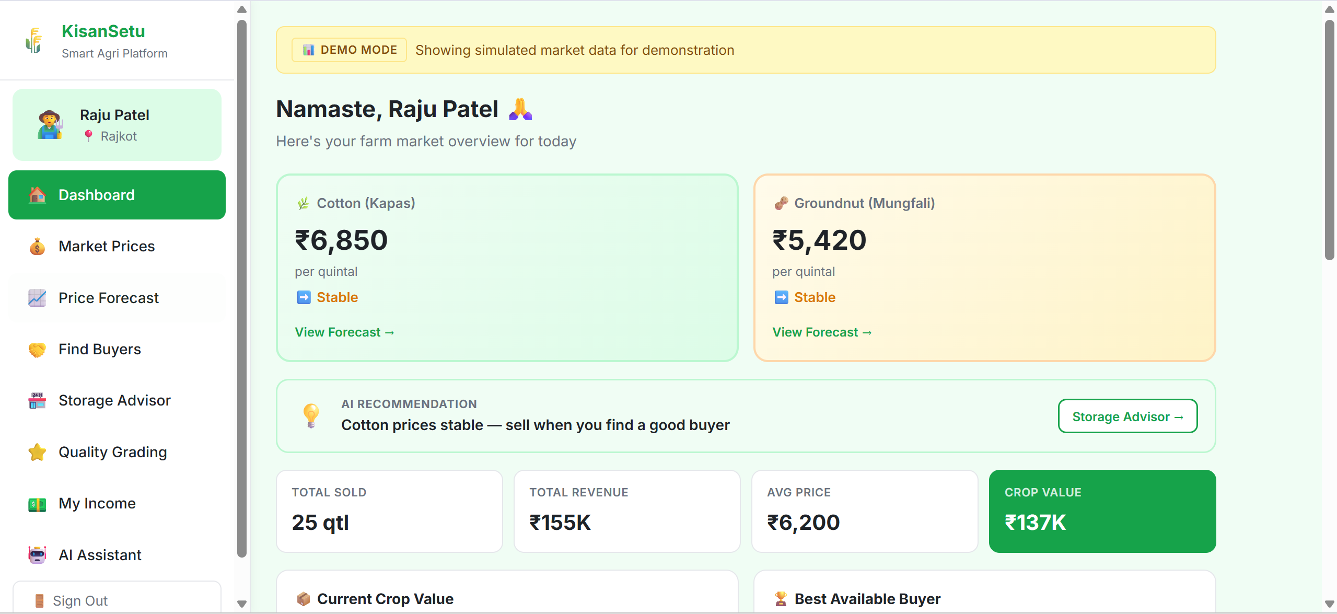
Proposed Solution – KisanSetu

Slide 6
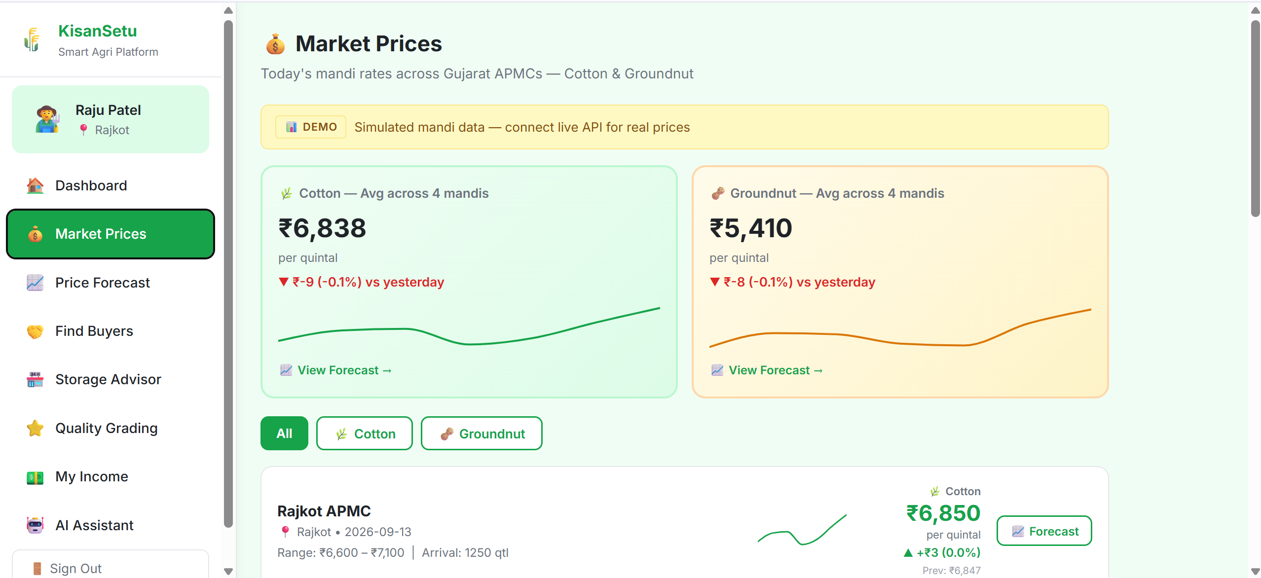
Proposed Solution – KisanSetu

Slide 7
Technology Used
IBM BOB
IBM Granite LLM
Used as the development / project environment for building and demonstrating the solution.
Provides natural-language understanding, reasoning and agent responses.
IBM Cloud
LangFlow
Provides cloud infrastructure for deployment, scalability and integration.
Visual orchestration of the multi-agent workflow and connected components.
RAG + Market Data
React Frontend
Retrieves current / trusted market information before generating useful recommendations.
Farmer and buyer portals provide dashboards, listings, prices and AI-assisted decisions.

Slide 8
Role of Agentic AI in the Solution
Agentic AI enables KisanSetu to act as a goal-driven decision system rather than a simple chatbot. The agents can choose the relevant task, use available market/listing information, reason over the context, and return an actionable recommendation.
Autonomous Task Routing
Context Awareness
Tool + Data Use
Selects the right specialist agent for the farmer/buyer request.
Uses crop, quantity, grade, location and price context.
Retrieves market/listing data before making a recommendation.
Multi-Agent Collaboration
Actionable Decisions
Continuous Support
Forecasting, matching, storage and quality agents work together.
Suggests where/when/how to sell, not only market information.
Keeps the farmer informed through dashboards and AI assistance.

Slide 9
Novelty and Uniqueness
KisanSetu combines Agentic AI, market intelligence and direct market linkage into one farmer-focused platform.
• Multi-Agent Intelligence – specialist agents collaborate instead of relying on one generic chatbot.
• Real-Time Price Intelligence – brings mandi prices and trend signals into the farmer decision process.
• Direct Buyer–Farmer Matching – matches quantity, crop, grade and price requirements to reduce middlemen dependence.
• Selling + Storage Intelligence – supports the decision of selling now versus storing for a better opportunity.
• Quality-Aware Recommendations – quality/grade becomes part of price and buyer matching.
• Income Visibility – converts crop quantity and sale price into understandable revenue and crop-value insights.
• Action-Oriented AI – the system explains what the farmer can do next, not only what the market looks like.

Slide 10
GitHub Link
Public GitHub Repository
GitHub URL: https://github.com/hetvibhatt19/kisansetu-agri-platform
Repository should contain:
• README.md with project overview and setup steps
• Source code for frontend / backend / agent workflow
• app.json (as required by the submission template)
• Problem statement PDF
• Final project presentation PPTX
• Any required configuration / supporting files

Slide 11
Future Scope
• Live Mandi API Integration – replace simulated data with verified real-time APMC/market feeds.
• Advanced Price Forecasting – improve forecasts using historical prices, arrivals, weather and market signals.
• WhatsApp / Voice Assistant – allow farmers to ask questions in Gujarati and other Indian languages.
• Image-Based Quality Grading – estimate crop quality/grade from uploaded cotton or groundnut images.
• Digital Negotiation Support – give buyers and farmers AI-assisted price and quantity negotiation suggestions.
• Logistics & Payments – add transport coordination, digital agreements and payment tracking.
• Personalized Farmer Memory – remember crop inventory, preferred markets and previous selling decisions with consent.
• Scalable IBM Cloud Deployment – move from demo mode to production-grade multi-user deployment.

Slide 12
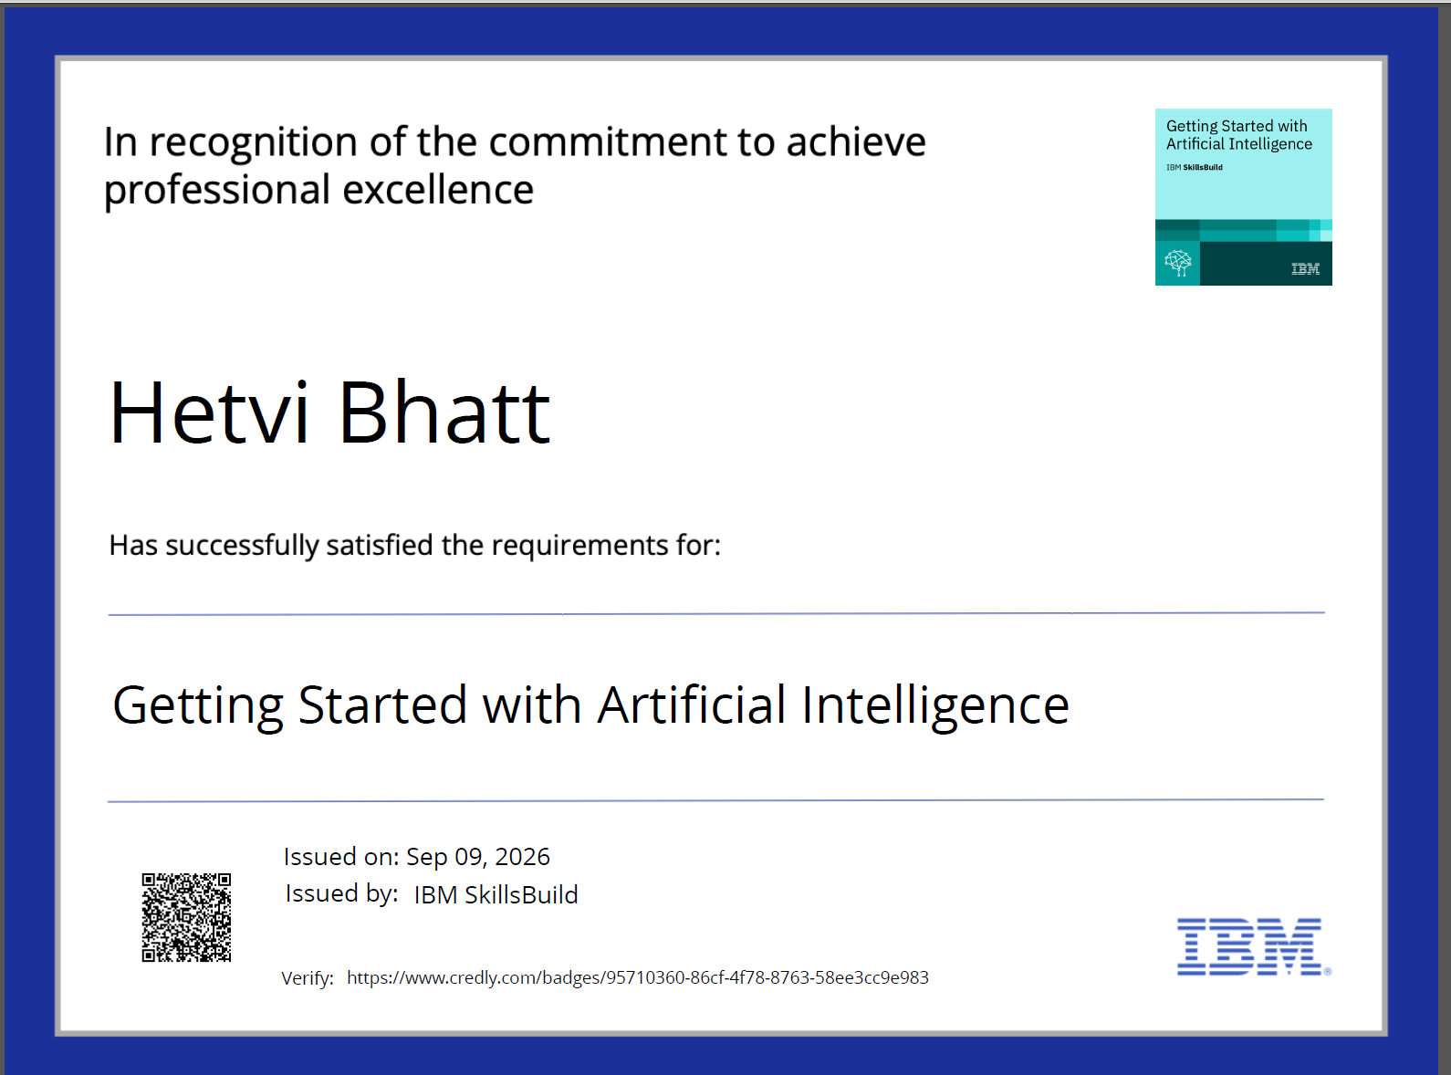
Certificates Earned
Credly Certificate

Slide 13
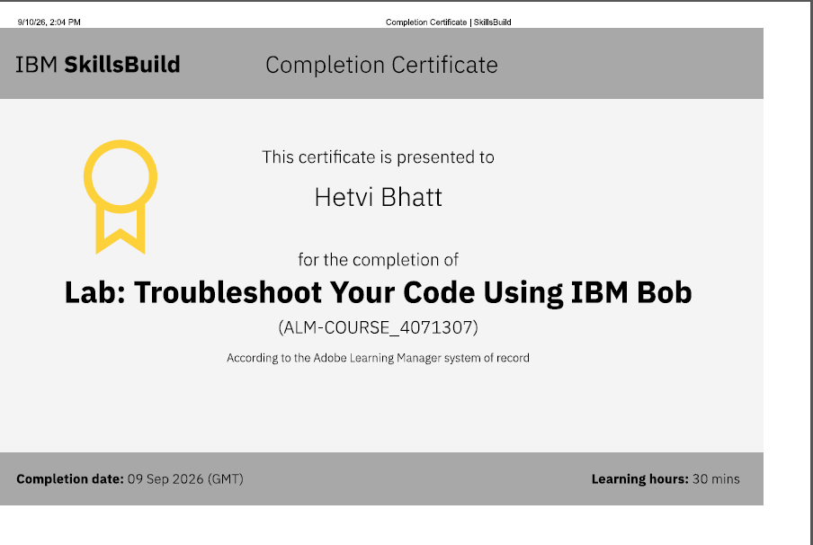
Certificates Earned – IBM BOB
IBM BOB Certificate

Slide 14


