Slide 1
MLZilla - Loan Risk Analysis Team Alpha

Slide 2
TABLE OF CONTENTS
01
02
Problem Statement
Data Analysis and Insights
03
04
Data Cleaning and Pre-Processing
Model Creation
05
Business Implication

Slide 3
Problem Statement
Our works primary goal is to predict and minimize the bank financial risk. The suggested approach also focuses on providing detailed data analysis on the patterns of persons who are defaulters (Charged Off). The success of the business model depends on the prediction and management of risks. There is a likelihood that a customer won't be able to make a needed payment, resulting in a loss for the bank or financial institution who gave the loan. Therefore, there is a need for a reliable system to tackle this.
Project link: Loan Risk Analysis
Tableau Report Link: Report

Slide 4
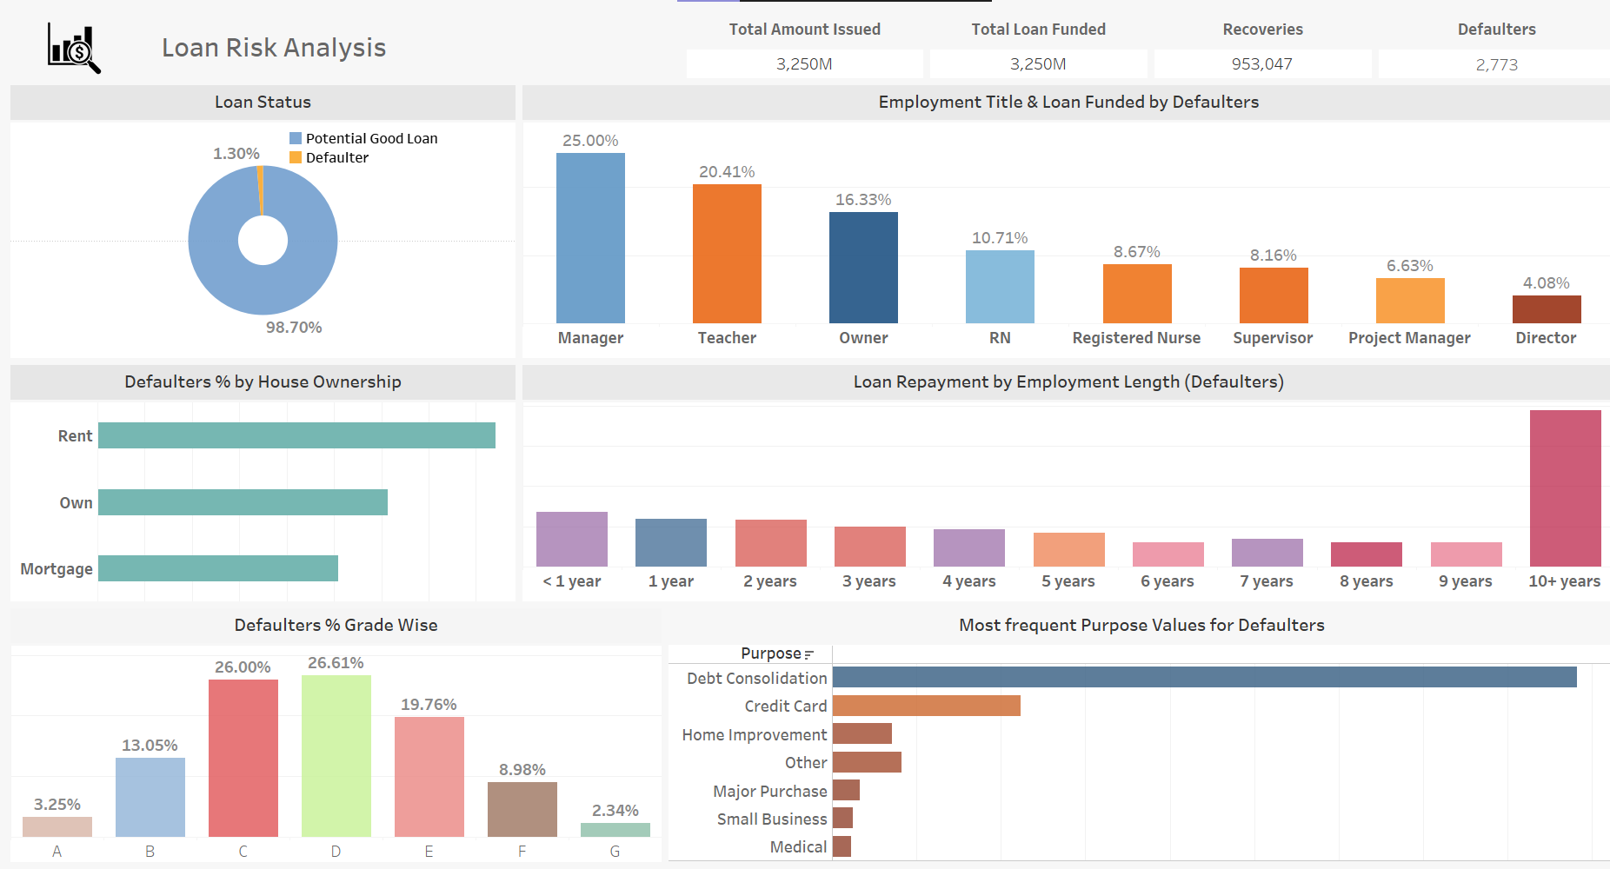
Insights and Analysis

Slide 5
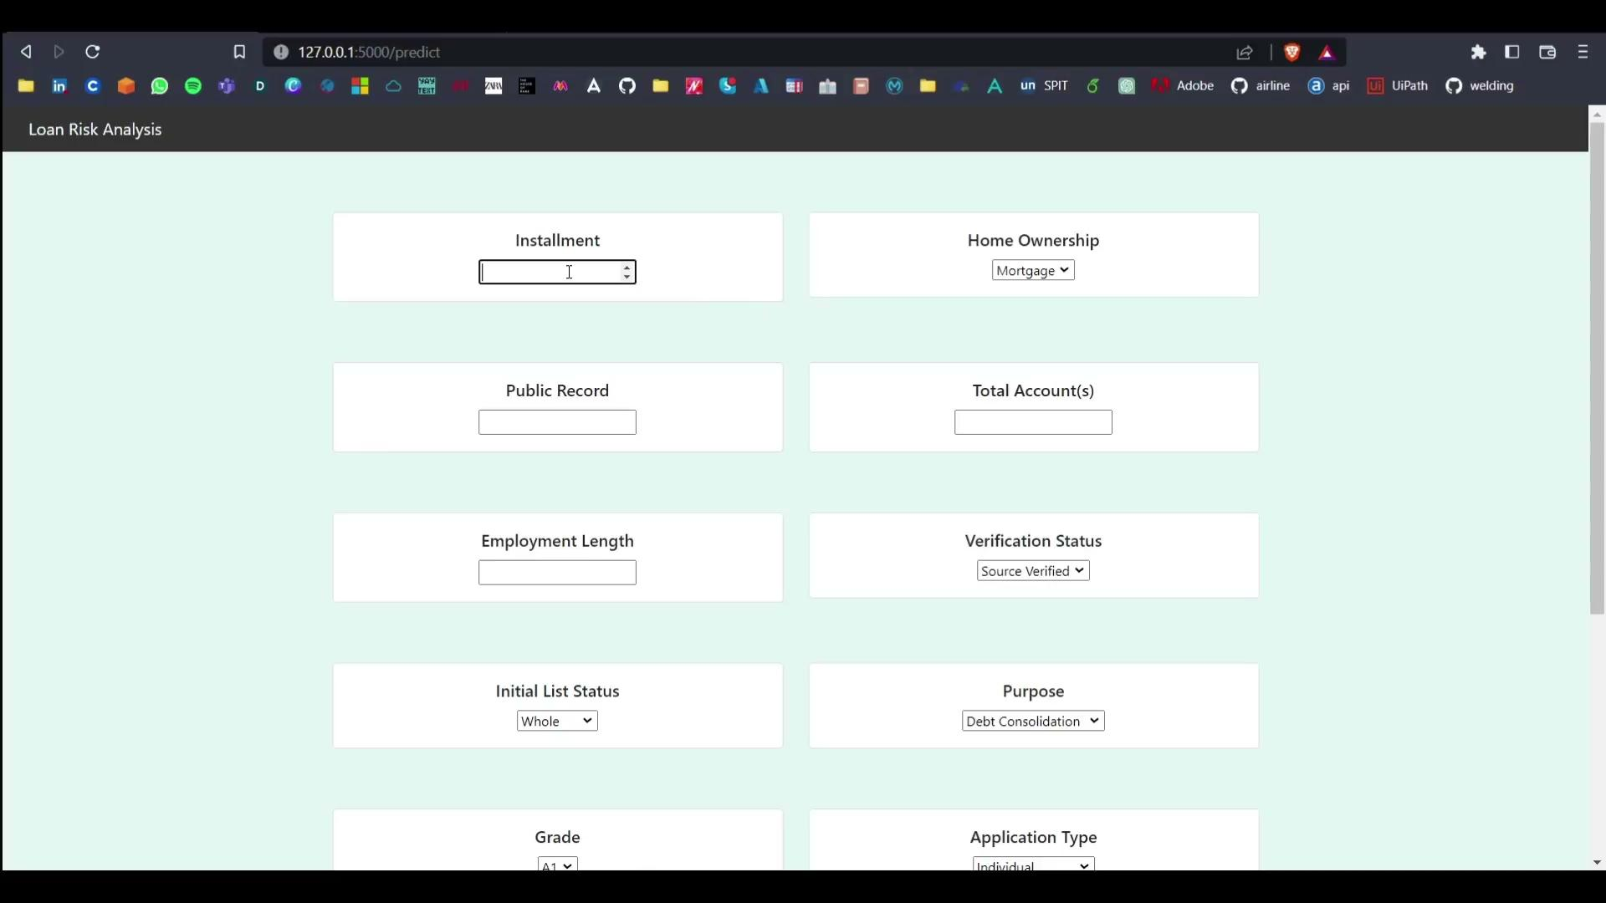

Slide 6
Data Cleaning and Pre-Processing
The following columns was dropped:
'Id', 'member_id', 'mths_since_last_major_derog', 'annual_inc_joint', 'dti_joint', 'emp_title', 'issue_d', 'last_credit_pull_d', 'last_pymnt_d', and 'next_pymnt_d'
Reasons:
Missing data
Categorical features with unique values
Data with not much insights

Slide 7
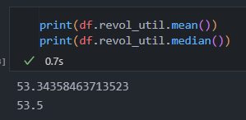
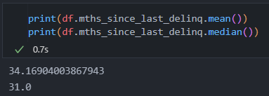
Data Manipulation:
Extracted digits from 'term' column and converted it to int
Extracted experience years from 'emp_length' column and converted it to int
Label Encoder:
Convert the categorical features to numerical features
Handled Null Values:
Replaced Nan with mean

Slide 8
Univariate Feature Selection:
Chi-Square and ANOVA
Features with good scores were considered
Correlation:
'Grade' was dropped because it was highly correlated with 'sub_grade' and 'sub_grade' basically represents the 'grade' but more detailed
One more reason to keep 'sub_grade' is that it has more categories and the score was higher for 'sub_grade' than 'grade'
'int_rate' was dropped because it was highly correlated with 'sub_grade'
‘title’ was dropped because it was highly correlated with purpose

Slide 9



Minority duplication + SMOTE oversampling
Highly imbalanced data which may lead to bias. We need to fix it!
Effective output, meaningful synthetic data using KNN
Efficient usage of dataset and effective handling of minority population

Slide 10
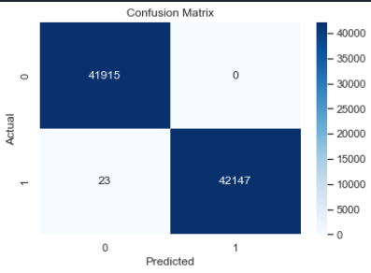
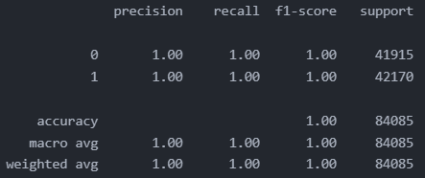
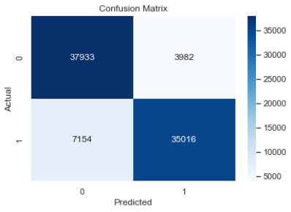
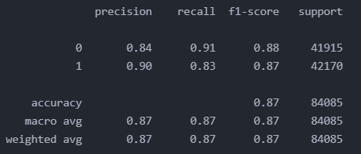
Model Creation
Random Forest Classifier:
XGBoost Classifier:

Slide 11
Our Analysis
The model predicted few of the ‘Current’ labels as Defaulters.
There can be two POV:
23 could be potential number of defaulters who won’t be able to repay the loan. Thus a good note to prevent loss by not giving them the loan.
There could be a minor precision error in the model but it won’t affect much since it predicted only 23 labels as defaulters which is not even 0.1% of the dataset.

Slide 12
Thank-You

