Slide 1
Detection of Image Pixelation And Correction
Image pixelation is the phenomenon of visual distortion where individual pixels become visible, causing a loss of image clarity and detail. This typically occurs due to low image resolution or excessive compression, resulting in a blocky, blurred appearance that reduces the quality and interpretability of the image.
Image pixelation can occur due to compression of images in an attempt to reduce the size of the image.
Its removal can improve the resolution and clarity of medical images, aiding in better diagnosis and analysis. Ensures critical details are visible, enhancing patient care. It can also be used for various other applications like removal of pixelation from security camera footage, satellite imagery quality enhancement etc.

Slide 2
Patch Based Pixelation Removal
We have proposed a method of creating patches of the input image to remove pixelation. This has been done as we noticed that Pixelation removal models tend to perform better on smaller images.
It has also been noted that overlap of these patches during model training can help the model extract better features, providing higher Peak Signal To Noise Ratio (PSNR).
The ESPCN model used here has been tuned to work with smaller images, with lesser number of filters and filter size.

Slide 3
Features Offered
Patch Based Processing
Efficiently divides an image into multiple smaller patches. This allows for local enhancement of image quality compared to traditional methods that process the entire image.
ESPCN Model Optimized for patch processing
An Efficient Sub-Pixel Convolution Neural Network tuned for patch processing to upscale and remove the pixelation of the input image.
Efficient Storage And Deployment
The pixelation removal model is under 200kb which makes it easy to deploy the model on various devices.

Slide 4
Process flow
Images from Div2K were divided into patches of size 10x10. The patches are then fed into MobileNetV2 to classify whether that area of the image is pixelated or not. If it is pixelated, that patch will be sent to the model for enhancement.
The stride value for patching was set to 5 to ensure overlapping patches which can help in capturing more spatial information from the pixelated image.
The patches are then fed into a custom ESPCN model. The model was tuned to work with smaller image patches with lesser number of convolutional layers and smaller filters to prevent a drastic reduction in image dimensions. Single pixel attention was incorporated into the model to dynamically adjust the importance of each pixel.
Finally,

Slide 5
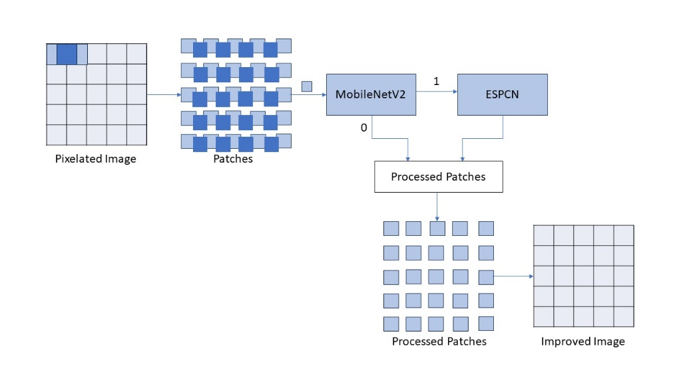
Architecture Diagram
As discussed earlier, the sample image will be passed into a classifier model which will check whether the image is pixelated or not. If the image is pixelated, the image will go to the ESPCN model which will improve the model quality.

Slide 6
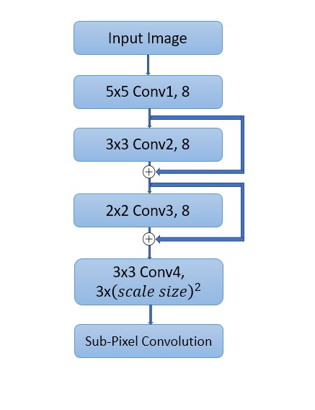
Tuned ESPCN Architecture
The model has 3 convolutional layers for feature extraction, all with 16 filters. The first convolutional layer has a 5x5 window size, the next convolutional layer has a 3x3 window size and the last layer has a 2x2 window size.
The model also uses Residual Connections to better handle the dimension reduction of the pixelated input image patch.
This is then passed through a single pixel attention block to help the model focus on important local pixel information. Finally, it’s output is passed into a sub-pixel convolution layer and the model gives an enhanced patch which is then reassembled.

Slide 7
Technologies used
Data and Preprocessing:
DIV2K Dataset: Utilized for high-quality image super-resolution tasks.
Image Resizing and Patching: Resized images and divided them into 10x10 patches with a stride of 5 to create overlapping patches for enhanced feature extraction.
Machine Learning and Deep Learning Frameworks:
TensorFlow / PyTorch: Employed for building and training the ESPCN model.
ESPCN (Efficient Sub-Pixel Convolutional Neural Network): Used for super-resolution to improve image quality.

Slide 8
Libraries And Tools:
NumPy and Pandas: Utilized for data manipulation and handling.
OpenCV: Used for image processing tasks, such as resizing and patching.
Matplotlib / Seaborn: Employed for visualizing results.
Model Training/Evaluation:
Keras: A high-level neural networks API used for training the ESPCN model.
Evaluation Metrics: PSNR (Peak Signal-to-Noise Ratio) for assessing image quality. All the models were trained on Intel server.

Slide 9
Team members and contribution: A descent number of pixelation removal models have been tried out by all the members, however considering the ESPCN model used here, the contributions is as follows: E Jayanth : Created the preprocessing functions and the base ESPCN model. Joel Alex : Fine tuned the model by incorporating Single-Pixel Attention to the base model. Rutwik Kumar : Incorporated the concept of patching and reconstruction of images to achieve higher PSNR. Noel Tony : Created the pixelation detection classifier and combined it with the pixelation removal model.

Slide 10
Conclusion
We began our project by developing a pixelation detection and classification model to aid the image pixelation removal model. Throughout our experimentation, we compared multiple pixelation removal models, noting that traditional models typically use scale sizes of 2x or 4x for degradation. Among the models tested, the ESPCN model stood out by achieving the highest PSNR of 17. This model was trained on 6x degraded images, revealing that it performed optimally on images in the YUV format.
To further enhance performance, we incorporated a Single Pixel Attention mechanism, which significantly improved the PSNR to 26. Additionally, we theorized that the model could more effectively restore smaller images, leading us to create patches for the final step. This patch-based approach leveraged the model's strengths, resulting in improved restoration of high-quality images giving a final PSNR of 32 successfully concluding the project.

