Slide 1

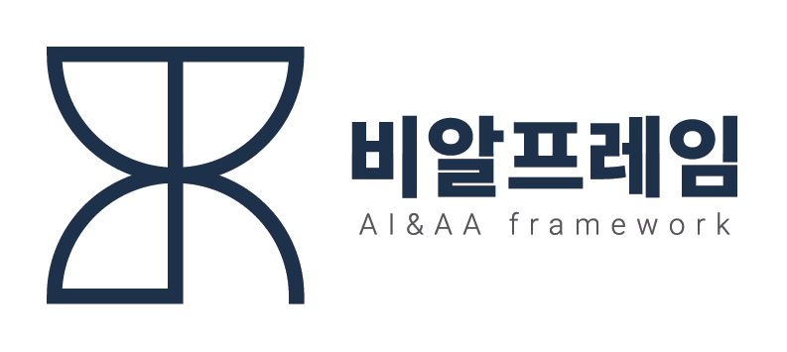
머신러닝(인공지능)
머신러닝(인공지능) Agenda
2021.06.10~06.11 (2 Day)
㈜비알프레임 강희재

Slide 2
학습목표
학습 Flow
1일차
2일차
AI Trend
Azure AI Platform
Vision AI recipes
MLOps(Azure ML)
1.AI Trend(MS AI 활용)
2.Azure AI Platform
3.Azure Cognitive Service
- Custom Vision 학습 Model 활용
4.Python DL Basic
Ml basic
Pytorch
1.Pytorch
2.Microsoft vision recipes
3.Azure ML Service
- MLOps
- AutoML 등
4.평가
1~3.자체
4.MS Learn
1.MS Learn
2.Github
3.자체 & MS Learn

Slide 3
2 Day
Tool 활용
1.VS Code
2.Docker
Pytorch
1.MS Learn Pytorch
2.참고 사이트
Azure ML 서비스
1.AutoML
2.Deploy 서비스
Vision Receipt
1.MS Vision Receipt

Slide 4
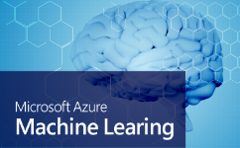

Website
http://www.brframe.com/
Contact Point
E-mail
admin@brframe.com
Copyright © 2021 BRFrame - All rights reserved

