Slide 1
Accelerated
Desktop
Control
--
acdeco
Petri Heinilä
0035087

Slide 2
IDEA
To use desktop computer by smart-phone with hand movements
Without touchscreen display

Slide 3
Why not use touchscreen display ?
Display uses big fraction of smart-phone power
  Aggressive power saving => need to open/unlock phone continuously
Need to watch smart-phone screen
  By nature control signal messages are trivial and does not really need touch-screen manipulation

Slide 4
Audience
Plain desktop user with smart-phone – short distance remote control
User with multi-media computer – medium distance remote control

Slide 5
Used devices
Desktop computer
  Linux workstation – X11
    With bluetooth capability
Android smart-phone
  Samsung Galaxy S2
    With bluetooth and accelerometer capabilities

Slide 6
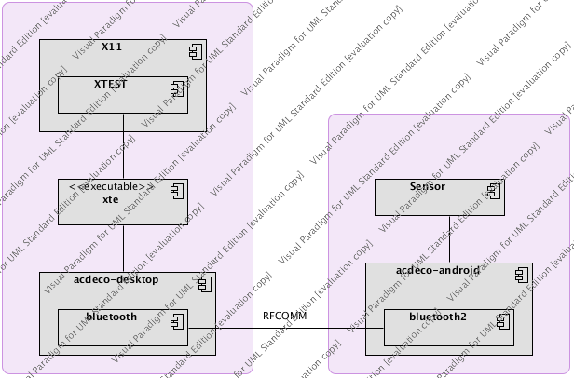
Implementation Parts

Slide 7
Implementation “Challenges”
Linux desktop
  Python 2.7 because PyBluez is dead and Python 3.3 does not support bluetooth discovery
  12h debugging for: /etc/bluetooth/main.conf: DisablePlugins = pnat, to get RFCOMM to work
Android 4.1.2
  SIGSEGV on bluetooth socket close() => no proper disconnection management
  Keep-alive application activity when screen is closed by android ?

Slide 8
Demo
Running right now :)

